Slide 1
amazon
Brazil
SQL Data Analysis
Amazon Brazil – Operations & Strategy Intelligence
About Amazon Brazil
Amazon Brazil (amazon.com.br) launched in 2012 and rapidly grew into Latin America's largest e-commerce platform. Operating across 26 states and the Federal District, it serves millions of customers with a vast marketplace of third-party sellers, its own logistics network, and a wide product catalogue spanning electronics, books, fashion, and more. The platform's scale generates enormous transactional data — making SQL-driven analytics essential for every major business decision.
Presented by
Shubham Paitwar
Confidential – Internal Use Only

Slide 2

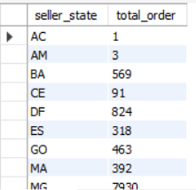
Q1
Total Orders Fulfilled by Each Seller State
Business Context
Amazon Brazil's logistics team is planning its next round of regional fulfillment center investments. Before committing budget, they need to know which states are generating the most order volume on the seller side — so infrastructure goes where the actual demand is.
Amazon Brazil SQL Analysis • Q1 of 14 • Shubham Paitwar

Slide 3
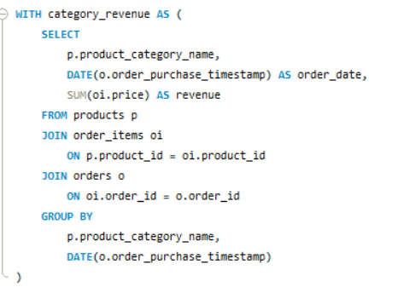
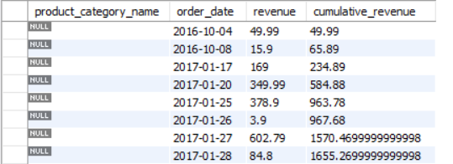
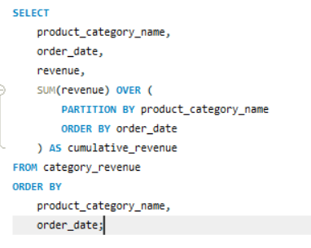
Q2
Cumulative Revenue per Product Category Over Time
Business Context
The growth team wants to see how revenue builds up within each category across the order timeline. This running total helps spot which categories hit their revenue targets early versus which pick up toward the end — useful for planning flash sales and push notifications.
Amazon Brazil SQL Analysis • Q2 of 14 • Shubham Paitwar

Slide 4
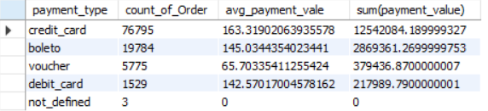
Q3
Most Popular Payment Method & Average Order Value
Business Context
The finance and partnerships team is renegotiating contracts with payment providers. They need to know which payment method — credit card, boleto, voucher, or debit card — dominates the platform, and whether high-value orders cluster around a specific payment type.
Amazon Brazil SQL Analysis • Q3 of 14 • Shubham Paitwar

Slide 5
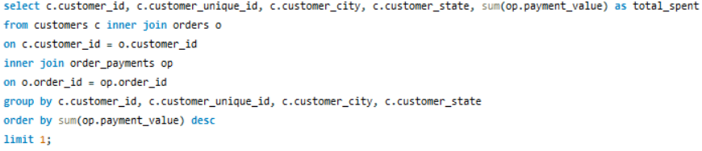
Q4
Customer with Highest Total Spend
Business Context
The CRM team is launching Amazon Brazil's first premium loyalty tier. The first step is identifying the single highest-spending customer on the platform — both to personally onboard them into the program and to understand what a top-tier customer profile looks like.
Amazon Brazil SQL Analysis • Q4 of 14 • Shubham Paitwar

Slide 6
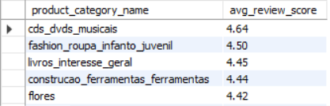
Q5
Average Review Score per Product Category
Business Context
The customer experience team tracks satisfaction at the category level. A low average review score often signals a fulfillment issue, a product quality problem, or a mismatch between listing and actual product. This helps prioritize which categories need intervention first.
Amazon Brazil SQL Analysis • Q5 of 14 • Shubham Paitwar

Slide 7

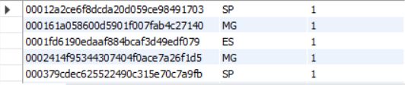
Q6
Total Orders per Customer Broken Down by State
Business Context
The regional marketing team is planning state-level campaigns in Brazil. They want to know how order frequency varies by customer location — so they can target low-frequency states with acquisition offers and reward high-frequency states with loyalty perks.
Amazon Brazil SQL Analysis • Q6 of 14 • Shubham Paitwar

Slide 8
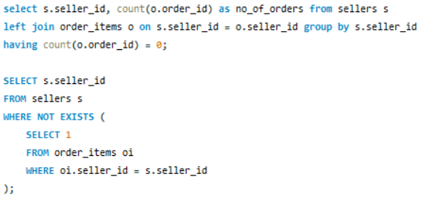
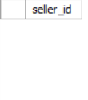
Q7
Sellers Registered But Never Fulfilled an Order
Business Context
📊
The seller growth team runs quarterly re-engagement campaigns targeting dormant sellers. To build that list, they need every seller account that exists in the system but has zero fulfilled orders — accounts that need a nudge or review for removal.
Amazon Brazil SQL Analysis • Q7 of 14 • Shubham Paitwar

Slide 9
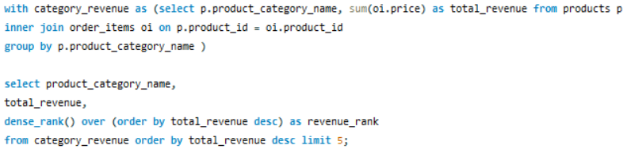
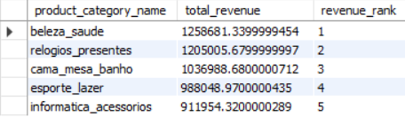
Q8
Top 5 Product Categories by Total Revenue
Business Context
Before every major sales event — Black Friday Brazil, Dia das Mães, Cyber Monday — the merchandising team decides which categories get homepage real estate and promotional budget. Total revenue by category is the primary input for that decision.
Amazon Brazil SQL Analysis • Q8 of 14 • Shubham Paitwar

Slide 10
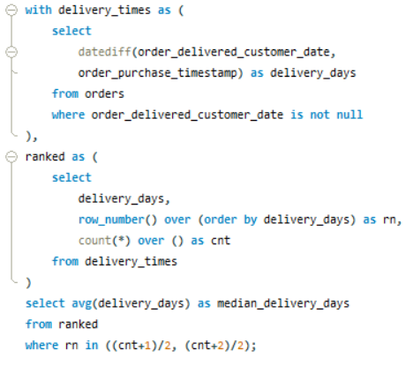

Q9
Median Delivery Time (Days) from Order to Delivery
Business Context
The logistics director wants to know the true middle ground of how long customers wait. The median is preferred over the average because a handful of extremely delayed orders (due to remote locations in Brazil's interior) would skew the average upward.
Amazon Brazil SQL Analysis • Q9 of 14 • Shubham Paitwar

Slide 11
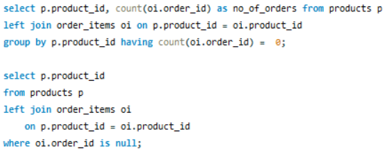
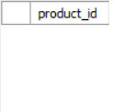
Q10
Products That Have Never Been Ordered
Business Context
The catalogue operations team does a quarterly clean-up of dead listings. Products that have never received a single order waste search index space, confuse customers, and inflate category browse pages. This query gives the exact list to review, reprice, or remove.
Amazon Brazil SQL Analysis • Q10 of 14 • Shubham Paitwar

Slide 12
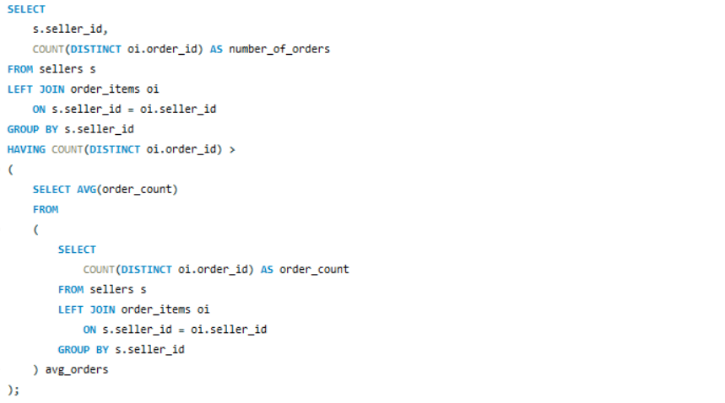
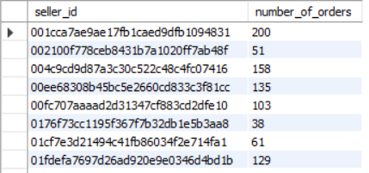
Q11
Sellers with Above-Average Order Fulfillment
Business Context
The seller success team is building an invite list for Amazon Brazil's 'Top Seller' badge program. Only sellers who perform above the platform average qualify. This query identifies exactly who clears that bar and gives a baseline for above-average performance.
Amazon Brazil SQL Analysis • Q11 of 14 • Shubham Paitwar

Slide 13
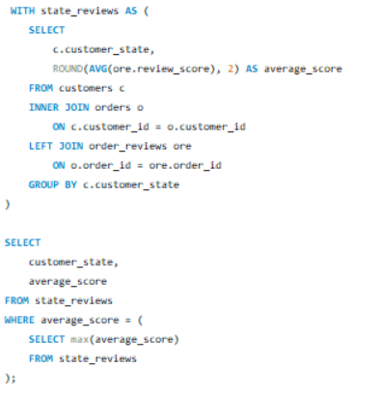

Q12
States with Highest Avg Customer Review Score
Business Context
Last-mile delivery experience varies across Brazil — deliveries to São Paulo and Rio are generally faster than to states in the North and Northeast. This query helps the CX team correlate delivery destination with satisfaction to push logistics partners to improve.
Amazon Brazil SQL Analysis • Q12 of 14 • Shubham Paitwar

Slide 14
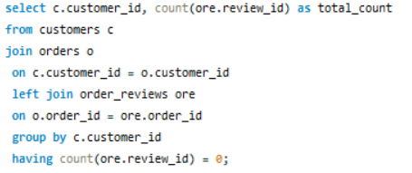
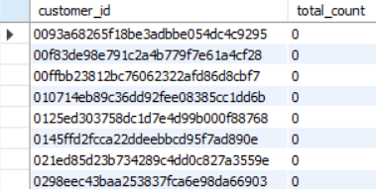
Q13
Customers Who Ordered But Never Left a Review
Business Context
The post-purchase engagement team wants to grow the volume of reviews on the platform — more reviews mean better product discoverability and buyer trust. They need customers who buy regularly but never review, to target with reminder emails and in-app nudges.
Amazon Brazil SQL Analysis • Q13 of 14 • Shubham Paitwar

Slide 15
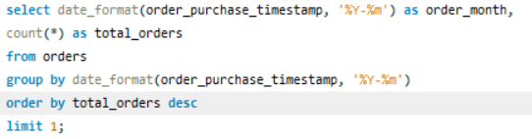

Q14
Month with the Highest Number of Orders Placed
Business Context
The demand forecasting team needs to know Amazon Brazil's peak order month historically. This drives decisions about warehouse capacity, temporary delivery staff, and when to start marketing campaigns for the next peak season.
Amazon Brazil SQL Analysis • Q14 of 14 • Shubham Paitwar

Slide 16
Summary & Key Takeaways
🏪 Seller & Fulfilment
💰 Revenue & Growth
⭐ Customer & Experience
Q1 – Seller states drive investment decisions
Q7 – Dormant sellers flagged for re-engagement
Q11 – Above-avg sellers invited to Top Seller badge
Q9 – Median delivery time benchmarked
Q2 – Cumulative revenue trends by category
Q3 – Payment method share & avg order value
Q4 – Top spender identified for loyalty onboarding
Q8 – Top 5 categories for promo budget
Q5 – Avg review score flags quality issues
Q6 – Order frequency mapped by state
Q12 – CX satisfaction by delivery state
Q13 – Non-reviewing buyers targeted for nudges
Q14 – Peak month guides capacity planning
Q10 – Zero-order products cleaned from catalogue
14 SQL Queries · 6 Business Teams · 1 Platform — Turning Data into Decisions

