Slide 1

POWER BI & EXCEL ANALYTICS PORTFOLIO
EV Charging Infrastructure
Analytics
Performance, utilization, customer behavior & ROI analysis across 18 Bengaluru districts — built for Tata Power on Excel Power Pivot & Power BI.
Shubham Paitwar | Data Analyst

Slide 2
PORTFOLIO HIGHLIGHT
Four Interactive
Power BI Dashboards
Each page is fully interactive — sliced live by district, station and income tier — covering usage, station operations, customer behavior and financial ROI.
01
02
03
04
Business & Usage Overview
Station Utilization & Efficiency
Customer & Demand Behavior
Financial Performance & ROI

Slide 3
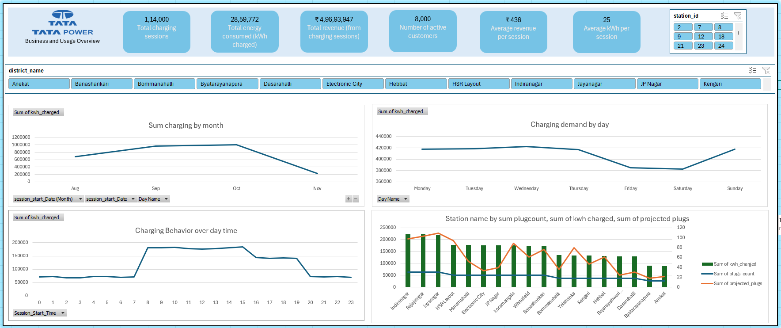
DASHBOARD 01
Business & Usage Overview
● 1.14L sessions tracked ● Demand peaks Aug–Oct ● Clear daily & hourly usage rhythm
EV CHARGING INFRASTRUCTURE ANALYTICS · TATA POWER
01 / 16

Slide 4
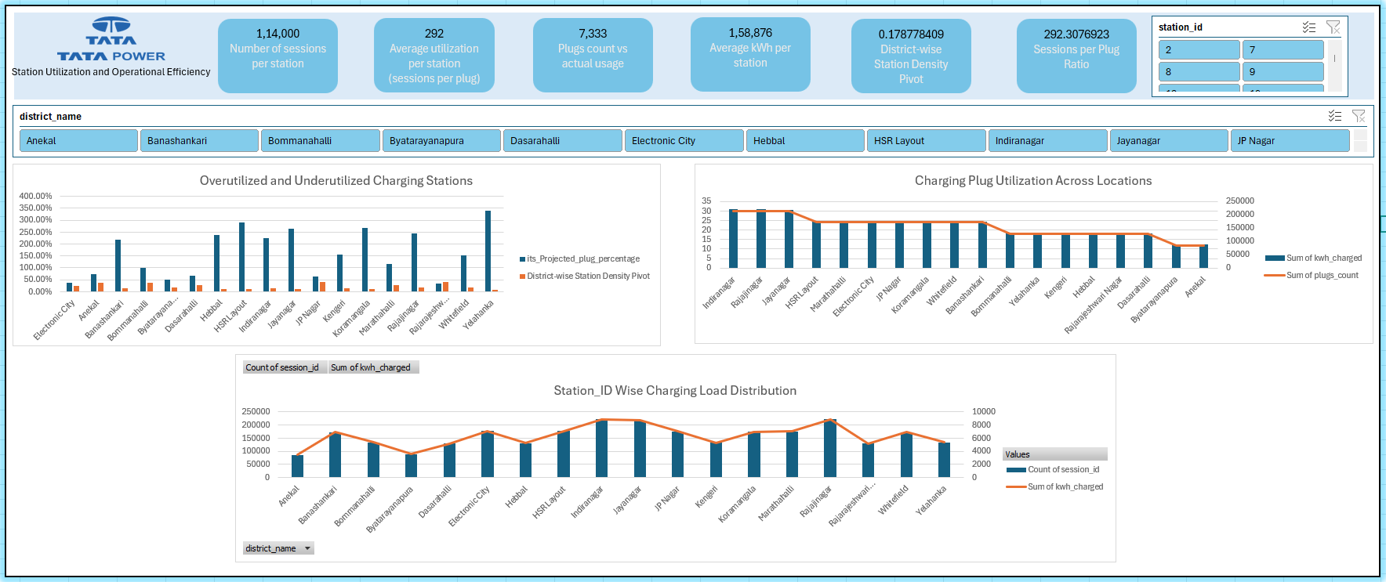
DASHBOARD 02
Station Utilization & Operational Efficiency
● Overutilized vs underutilized stations ● Plug utilization by location ● Load distribution across districts
EV CHARGING INFRASTRUCTURE ANALYTICS · TATA POWER
02 / 16

Slide 5
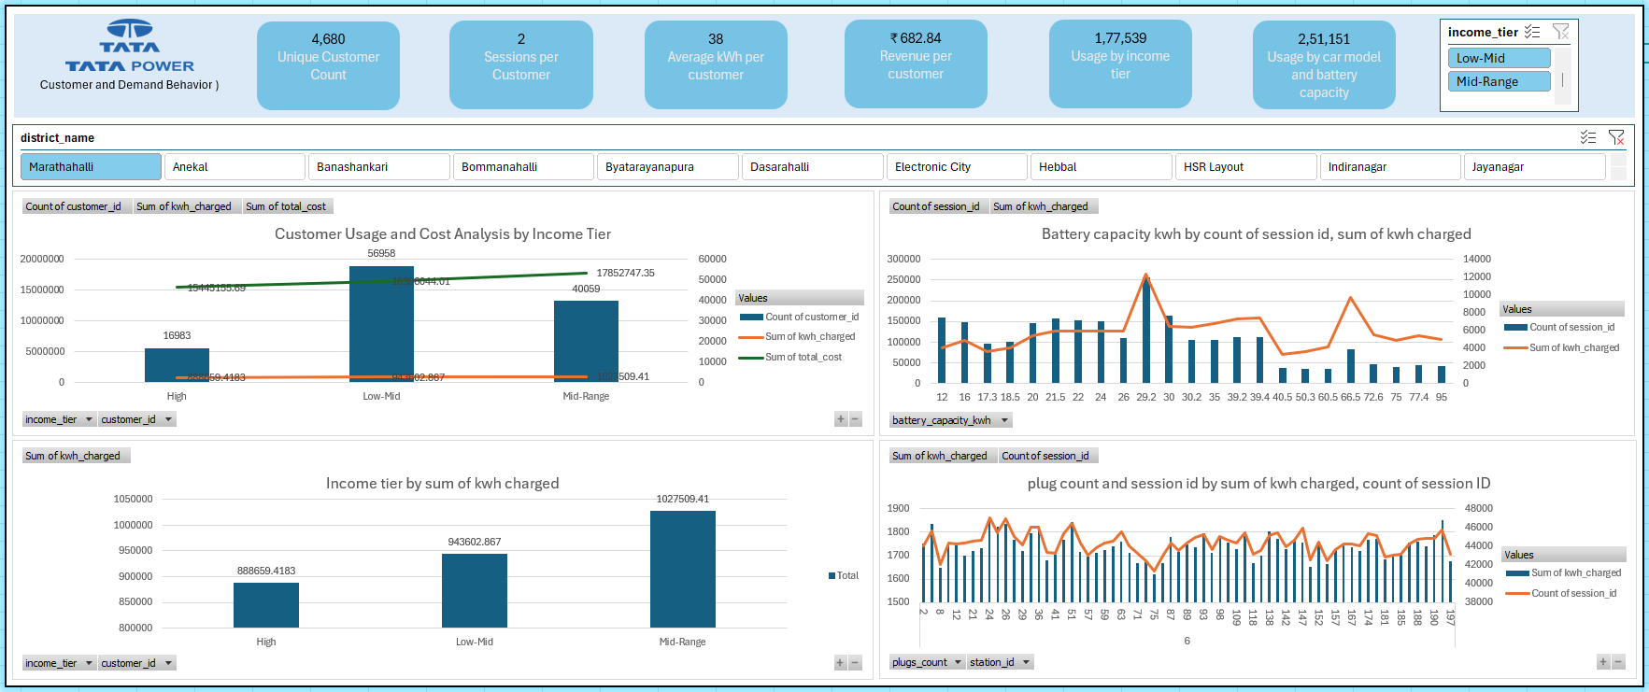
DASHBOARD 03
Customer & Demand Behavior
● Usage & cost by income tier ● Battery capacity behavior ● Session-level engagement patterns
EV CHARGING INFRASTRUCTURE ANALYTICS · TATA POWER
03 / 16

Slide 6
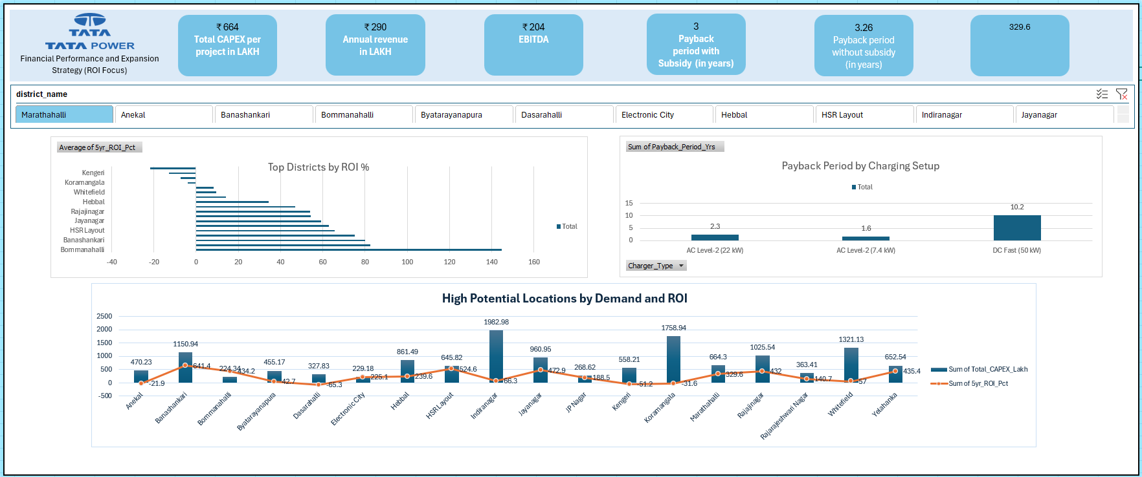
DASHBOARD 04
Financial Performance & Expansion (ROI Focus)
● ROI % by district ● Payback period by charger type ● High-potential expansion sites
EV CHARGING INFRASTRUCTURE ANALYTICS · TATA POWER
04 / 16

Slide 7
PROJECT OVERVIEW
Objective & Business Problem
OBJECTIVE
BUSINESS PROBLEM
Analyze the performance, profitability, operational efficiency, and expansion potential of Tata Power's EV charging infrastructure across Bengaluru districts.
Tata Power wants to understand:
How EV charging demand is growing
Whether existing stations can handle future demand
Which stations are over- or under-utilized
Customer charging behavior patterns
Which districts provide the highest ROI
Best locations for future expansion
Monitor EV charging demand
Analyze charging station utilization
Evaluate financial profitability
Identify high-demand locations
Support infrastructure expansion decisions
Improve operational efficiency
EV CHARGING INFRASTRUCTURE ANALYTICS · TATA POWER
05 / 16

Slide 8
METHODOLOGY
Dataset & Analytical Approach
DATA SOURCES
PROCESS
Charging Sessions
Session ID, kWh charged, revenue, duration
1
Collect
Imported 5 linked tables covering sessions, stations, customers, EVs and finances.
Station Details
Station ID, district, plug count
2
Clean
Customer Details
Customer ID, income tier
Removed duplicates, handled missing values, standardized columns & types.
EV Details
EV model, battery capacity
3
Transform
Built Month/Quarter/Year, time-of-day bands, income tiers & battery ranges.
Financial Data
CAPEX, ROI, EBITDA
4
Model
Related tables via Session ID, Station ID, Customer ID & District for KPI-ready analysis.
EV CHARGING INFRASTRUCTURE ANALYTICS · TATA POWER
06 / 16

Slide 9
AT A GLANCE
Headline KPIs Across the Network
1,14,000
28,59,772
₹4.97 Cr
8,000
Total charging sessions
Total kWh charged
Total revenue
Active customers
₹436
25 kWh
145%
329.6%
Avg. revenue / session
Avg. energy / session
Top district ROI (Bommanahalli)
Best 5-yr ROI potential
Sourced from Excel Power Pivot measures and mirrored across all four Power BI dashboard pages.
EV CHARGING INFRASTRUCTURE ANALYTICS · TATA POWER
07 / 16

Slide 10
INSIGHT 01
How Is Charging Demand Evolving?
KEY FINDINGS
Demand climbs steadily from Aug to Oct, then drops sharply in Nov — a seasonal or data-window effect worth tracking.
Weekday usage (Mon–Wed) consistently outpaces weekends.
Hourly data shows two clear peaks: mid-morning (8–15h) and a smaller evening band, aligning with commuter charging.
EV CHARGING INFRASTRUCTURE ANALYTICS · TATA POWER
08 / 16

Slide 11
INSIGHT 02
Which Stations Need Capacity Action?
OVERUTILIZED — EXPAND CAPACITY
UNDERUTILIZED — OPTIMIZE FIRST
Yelahanka, HSR Layout, Koramangala, Jayanagar & Rajajinagar
show projected demand far exceeding station density — the clearest candidates for new infrastructure investment.
Anekal & Byatarayanapura
have station density higher than projected demand — infrastructure is sufficient; focus on driving usage before adding plugs.
RECOMMENDATION
Prioritize new capacity in high-utilization districts while increasing customer engagement in underutilized ones before further expansion spend.
Load distribution: Indiranagar, Rajajinagar & Jayanagar carry the heaviest session load; Anekal carries the least and is not a capacity priority.
EV CHARGING INFRASTRUCTURE ANALYTICS · TATA POWER
09 / 16

Slide 12
INSIGHT 03
Which Customers Drive Usage & Revenue?
KEY INSIGHTS
Mid-Range income tier drives the highest kWh and revenue — the strongest overall utilization segment.
Low-Mid tier has the most customers, contributing the second-highest energy & revenue.
High income tier has fewer, lighter users — lowest consumption of the three groups.
The 29.2 kWh and 66.5 kWh battery segments account for the highest charging activity, marking the dominant EV models on the network.
EV CHARGING INFRASTRUCTURE ANALYTICS · TATA POWER
10 / 16

Slide 13
INSIGHT 04
Which Districts Deliver the Best ROI?
TOP OPPORTUNITIES
Banashankari
5-yr ROI 641% on ₹1,150.9L CAPEX — top expansion priority.
Jayanagar
5-yr ROI 473% backed by strong demand (₹961L CAPEX).
Yelahanka
5-yr ROI 435% with solid station capability.
Payback
AC Level-2 (7.4kW) pays back fastest at 1.6 yrs; DC Fast (50kW) slowest at 10.2 yrs.
EV CHARGING INFRASTRUCTURE ANALYTICS · TATA POWER
11 / 16

Slide 14
WRAP-UP
Conclusion
This project analyzed EV charging infrastructure performance across 18 districts — evaluating demand, station utilization, customer behavior, and financial returns to guide Tata Power's expansion strategy.
DEMAND
CAPACITY GAPS
EV charging demand is rising steadily, with heavy energy use across major districts.
Yelahanka, Rajajinagar, Jayanagar, HSR Layout & Koramangala show signs of capacity strain.
UNDERUSED SITES
BEST CUSTOMERS
Anekal & Byatarayanapura have spare capacity — optimize usage before expanding.
Mid-Range income customers are the most valuable segment by usage and revenue.
DOMINANT EVS
BEST ROI
29.2 kWh and 66.5 kWh battery classes drive the highest charging activity.
Bommanahalli, Banashankari, Jayanagar & Yelahanka deliver the strongest financial returns.
EV CHARGING INFRASTRUCTURE ANALYTICS · TATA POWER
12 / 16

Slide 15
FINAL RECOMMENDATION
A Balanced, ROI-Driven Expansion Strategy
Tata Power should expand infrastructure in high-demand, high-ROI districts while improving utilization in underperforming locations — combining demand forecasting, operational optimization, and ROI-driven investment.
Expand
Optimize
Forecast
Sustain
Prioritize Banashankari, Jayanagar & Yelahanka for new station rollouts.
Drive engagement in Anekal & Byatarayanapura before adding capacity.
Use demand trends to time infrastructure investment ahead of strain points.
Balance CAPEX against payback period to protect long-term profitability.
EV CHARGING INFRASTRUCTURE ANALYTICS · TATA POWER
13 / 16

Slide 16
Thank You
EV Charging Infrastructure Analytics — Tata Power
Shubham Paitwar
Data Analyst · Excel Power Pivot & Power BI
EV CHARGING INFRASTRUCTURE ANALYTICS · TATA POWER
14 / 16

