Slide 1

Movie Recommendation System using Machine Learning (Collaborative Filtering)
(Permanently Affiliated to University of Mumbai)

Slide 2
(Permanently Affiliated to University of Mumbai)
Group No. : 6
Project Guide : Prof. Abhay Patil
Student Details :
Name | Roll No.
Miit Chauhan | 605
Sameer Kirwale | 615
Shubham Patel | 627
Viral Patel | 628

Slide 3
Index
Abstract
Problem Statement
Objectives
Technology
Filtering Approach
Flow Diagram
Survey of Existing System
System Requirements
References

Slide 4
Abstract
Now-a-days the amount of movies has increased to become more congested, making it difficult for users to find a movie through existing technologies.
Users need a system that can suggest movies to them based on their preference, and the best technology out there to make this possible is Movie Recommendation System using Collaborative approach.
There are various researchers paying attention to increase the accuracy of existing collaborative filtering methods. So, to further improve the accuracy of the system we are using Cosine Similarity algorithm.

Slide 5
Problem Statement
To recommend movies to users with great accuracy than purely content based recommendations, therefore we are using collaborative approach in our system.
To use an algorithm that can predict movies for users with higher accuracy, so we are using Cosine Similarity algorithm.
It is important to compute the connection between different clients and their ratings, which allows other users to explore more content with reliable results.

Slide 6
Objectives
The proposed system, is an ML-based approach to filtering or predicting the users film preferences based on their movie content and behaviour.
Our system aims at gathering the most up-to-date database of movies, which can be used to train the model and achieve greater accuracy.
Our system aims to be an advanced collaborative filtration mechanism that predicts the possible movie choices of the concerned user and their preference towards a specific genre.

Slide 7
Technology
Numpy, pandas, matplotlib for pre-processing and analysing data
scikit-learn for training models
Flask for backend
Cosine Similarity Formula :
cos ( x, y ) = [ x . y ] / [ || x || * || y || ] , where
x . y = dot product of vectors x and y
|| x || and || y || = length of vectors x and y
|| x || * || y || = cross product of vectors x and y

Slide 8
Filtering Approach
TF-IDF Scores (TfidfVectorizer)
Similarity Matrix using Cosine Similarity
Input: Target Movie Title
Find index of target movie in the Similarity Matrix
Sort based on Similarity Scores
Manipulate required Dataframes
Create a dataframe of movies similar to target movie
Recommend Top 5 movies similar to target movie

Slide 9
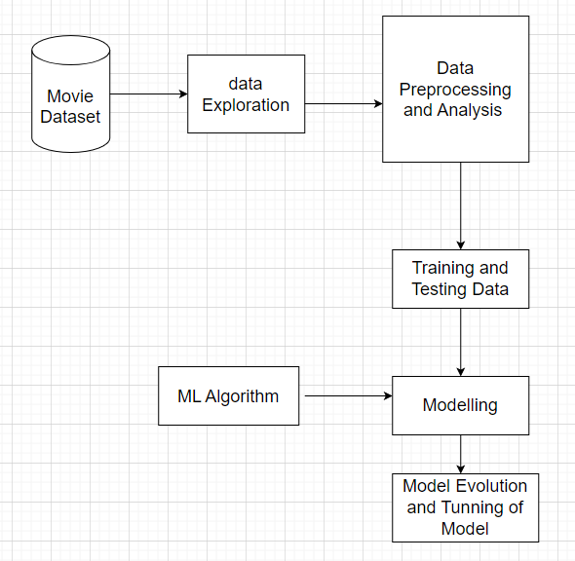
Flow Diagram

Slide 10
Survey of Existing Systems
Paper Name | Author | Approach | Key Findings | Drawbacks
"Movie Recommendation using Collaborative Filtering with Improved Similarity Measure" | R. Padmavathi and Dr. K. Duraiswamy | Collaborative Filtering with Improved Similarity Measure | Proposed similarity measure improves the accuracy of the recommendation system | Limited ability to handle cold start problem
"A Survey of Collaborative Filtering Techniques for Movie Recommendation System" | K. Nandhini, R. Geetha Ramani and P. Thambidurai | Collaborative Filtering, Content-Based Filtering and Hybrid Systems | Hybrid systems show better performance compared to individual techniques | Hybrid systems can be complex to implement and maintain
"A Movie Recommendation System using Item-Based Collaborative Filtering" | Z. Lu and J. Wu | Item-Based Collaborative Filtering | Item-based collaborative filtering provides better performance compared to user-based filtering | Limited ability to handle cold start problem

Slide 11
Survey of Existing Systems
Paper Name | Author | Approach | Key Findings | Drawbacks
"A Hybrid Collaborative Filtering and Demographic-based Approach to Movie Recommendation" | B. Li, C. Li and Y. Li | Collaborative Filtering and Demographic-based Filtering | Demographic-based filtering can complement collaborative filtering for better performance | Demographic-based filtering may not work well for diverse user groups
"Improving the Accuracy of Movie Recommendation by Incorporating Implicit Feedback" | L. Hu and Y. Koren | Collaborative Filtering with Implicit Feedback | Incorporating implicit feedback improves the accuracy of the recommendation system | Implicit feedback may not be available or reliable for all users
"An Improved Hybrid Recommendation Algorithm based on Collaborative Filtering" | W. Wang and X. Chen | Collaborative Filtering and Content-Based Filtering | Hybrid system with improved similarity measure and feature selection improves the accuracy of the recommendation system | Hybrid systems can be complex to implement and maintain

Slide 12
System Requirements
Software Requirements :
Windows, MacOS, Android, iOS ( Operating Systems )
Chrome, Microsoft Edge, Safari, Mozilla Firefox
Hardware Requirements :
Laptop, Smartphone, PC, Tablet
Stable internet connection with minimum 1 Mbps speed

Slide 13
References
Zhang, S., Yao, L., Sun, A., & Tay, Y. (2019). Deep learning based recommender system: A survey and new perspectives. ACM Computing Surveys (CSUR), 52(1), 1-38.
Wang, Y., Liu, J., Wu, C., & Huang, S. (2020). A hybrid recommendation model based on deep learning and user behaviour. IEEE Access, 8, 61528-61539.
Zou, Y., Wang, X., Chen, G., & Wang, X. (2019). Multi-objective deep reinforcement learning for movie recommendation. IEEE Access, 7, 72389-72397.
Cheng, X., Zhu, Y., & Jin, X. (2019). Movie recommendation based on deep matrix factorization with implicit feedback. Neurocomputing, 338, 102-113.

Slide 14
Thank You

