Slide 1
Coursera Capstone
IBM Applied Data Science Capstone
Car Accident Severity
By: Shubham Das
August 2020

Slide 2
Business Problem
Traffic accidents are extremely common and in a metropolis city we’ve heard about the accident on daily basis
Objective: To overcome or to minimize this problem traffic accident predictor model is created that would be easily accessible by anyone
Business question: If a new users want to cross through the red zone i.e. where frequently road/car accidents happen, what would you recommend to him to reach the destination safely?

Slide 3
Data
Data required
Latitude and Longitude coordinates
Red zone area
Number of incidents occurs per day,etc
Sources of data
From local authorities
Users experience
Reported data from local police station, etc

Slide 4
Methodology
Analyze the data
Perform data cleaning and feature selection
By using Supervised Learning
Model Training
Model Evaluation
After training the Model perform testing bu using test data sets
Observe the error margin and it is minimun then we can use this model else modify the model to get the error minimum

Slide 5
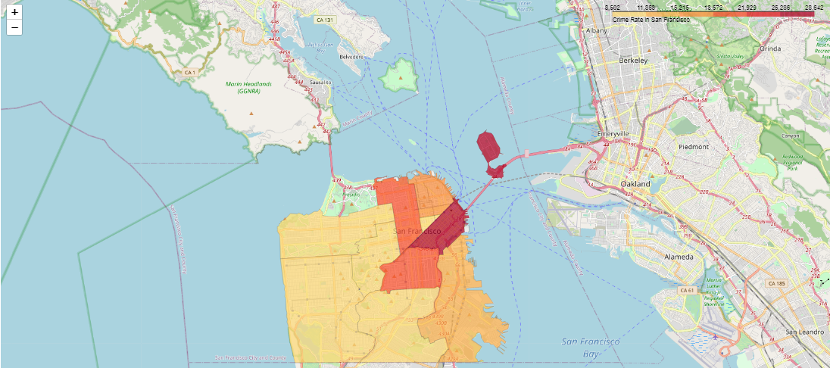
Results
By the help of this model:
Allow users to input an origin and find the best driving route that connects the two
Allow user to pick the date/time they plan to make the trip and identify areas along the route that are particularly accident-prone within that time window
Know about weather condition

Slide 6
Discussion
Most of these incidents occur in a meteropolis city during the pick hours
For easy visualization we marked the place where most of these incidents occurs as in red color
Try to divert the routes during pick hours
Also pick the date/time they plan to make the trip and identify areas along the route that are particularly accident-prone within that time window

Slide 7
Recommendations
Avoid to pass through the zed zone area specially during pick hours
Follow the traffic rules while driving
Do not drink and drive
Know about weather condition while going out
Try to maintain the speed as per instructed by authorities

Slide 8
Conclusions
Answer to business question: New users can drive through the red zone area but with a some special carefully and follow the guidelines
Findings of this project will definitely help to minimize the car accidents without blocking any traffic or road

Slide 9
THANK YOU

