Slide 1
Project Metrics
Function Point Analysis

Slide 2
Function point metric was proposed by Albrecht [1983].
it can be used to easily estimate the size of a software product directly from the problem specification.
size of a software product is directly dependent on the number of different functions or features it supports.
A software product supporting many features would certainly be of larger size than a product with less number of features.
Each function when invoked reads some input data and transforms it to the corresponding outputdata.

Slide 3
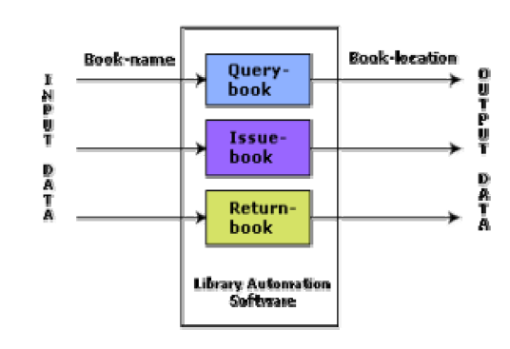
Example

Slide 4
For example, the issue book feature of a Library Automation Software takes the name of the book as input and displays its location and the number of copies available.
Thus, a computation of the number of input and the output data values to a system gives some indication of the number of functions supported by the system. Albrecht postulated that in addition to the number of basic functions that a software performs, the size is also dependent on the number of files and the number of interfaces.
function point metric computes the size of a software product (in units of functions points or FPs)

Slide 5
The size of a product in function points (FP) can be expressed as the weighted sum of these five problem characteristics. The weights associated with the five characteristics were proposed empirically and validated by the observations over many projects.
UFP = (Number of inputs)*4 + (Number of outputs)*5 +(Number of inquiries)*4 + (Number of files)*10 +(Number of interfaces)*10

Slide 6
Number of inputs:
Each data item input by the user is counted.
Data inputs should be distinguished from user inquiries.
Inquiries are user commands such as print-account-balance. Inquiries are counted separately. It must be noted that individual data items input by the user are not considered in the calculation of the number of inputs, but a group of related inputs are considered as a single input.
For example, while entering the data concerning an employee to an employee pay roll software; the data items name, age, gender, address, phone number, etc. are together considered as a single input. All these data items can be considered to be related, since they pertain to a single employee.

Slide 7
Number of outputs:
The outputs considered refer to reports printed, screen outputs, error messages produced, etc.
While outputting the number of outputs the individual data items within a report are not considered, but a set of related data items is counted as one input.

Slide 8
Number of inquiries:
Number of inquiries is the number of distinct interactive queries which can be made by the users.
These inquiries are the user commands which require specific action by the system.
Number of files:
Each logical file is counted. A logical file means groups of logically related data. Thus, logical files can be data structures or physical files.
Number of interfaces:
Here the interfaces considered are the interfaces used to exchange information with other systems. Examples of such interfaces are data files on tapes, disks, communication links with other systems etc.

Slide 9
Now, technical complexity factor (TCF) is computed
TCF refines the UFP measure by considering fourteen other factors such as high transaction rates, throughput, and response time requirements, etc.
Each of these 14 factors is assigned from 0 (not present or no influence) to 6 (strong influence).
The resulting numbers are
summed, yielding the total degree of influence (DI).
Now, TCF is computed as
(0.65+0.01*DI).
As DI can vary from 0 to 70, TCF can vary from 0.65 to 1.35.
Finally, FP=UFP*TCF.

Slide 10
FP example
STOCK CONTROL SYSTEM - estimating the time needed to develop application
Let's imagine a company which sells goods on the phone - if agents call the customers, customers call the agents, and so on - business operates successfully, but there comes a time for putting the whole in order. There occurs a need for developing a system able to control the whole stock, from orders to payments.Our thing is to estimate how complex such system can be and - after that - try to predict how long it would take to develop it.

Slide 11
Solution
At first, functionality - what exactly the system should be able to do. Basically, it should be able to take care about three parts - customers, stock, and transactions. Then, let us group functions into five categories:
External Inputs - customer, order, stock, and payment details. There are four things we need to consider.
External Outputs - customer, order, and stock details, and credit rating. Once again, there are four things to consider.
External Inquiries - the system is requested for three things, which are customer, order, and stock details.
External Interface Files - there's no EIFs to consider.
Internal Logical Files - finally, the four elements belong to the last group. Customer, and good files, and customer, and good transaction files.

Slide 12
That's all about selecting the components. Unfortunately, it's the most difficult aspect of FPA because of lack of specified rules determining how to distinguish functions. to accomplish the function points analysis.
Let's predict every function's complexity is low, so the values can be presented in a table:
4*3+4*4+3*3+4*7=65 [Function Points]
Let us omit additional technical complexity factors, so the only thing left to do is to check how long it takes to produce 65 function points. Some sources prove that one function point is an equivalent of eight hours of work in C++ language. Then, the last thing is:
65*8=520 [hours]
The answer? The estimate for developing the application would take about 520 hours of work.
Category | Multiplier | Weight
EI | 4 | 3
EO | 4 | 4
EQ | 3 | 3
ILF | 4 | 7

