Slide 1
Lux/Light Sensor
Simarjeet S. Brar

Slide 2
Proposal
TSL2561 functionality will be to collect data from the sensor the brightness of light in the atmosphere/room and set the brightness of device/room to more comfortable level and also infrared light will detect the presence of someone in the dark to turn on the light.

Slide 3
Budget
Raspberry pi 3 b+ | $131.64
Adafruit Lux/Light Sensor [TSL2561] | $22.58
Ethernet cable Others | $16.50
Overall Total | $154.22

Slide 4
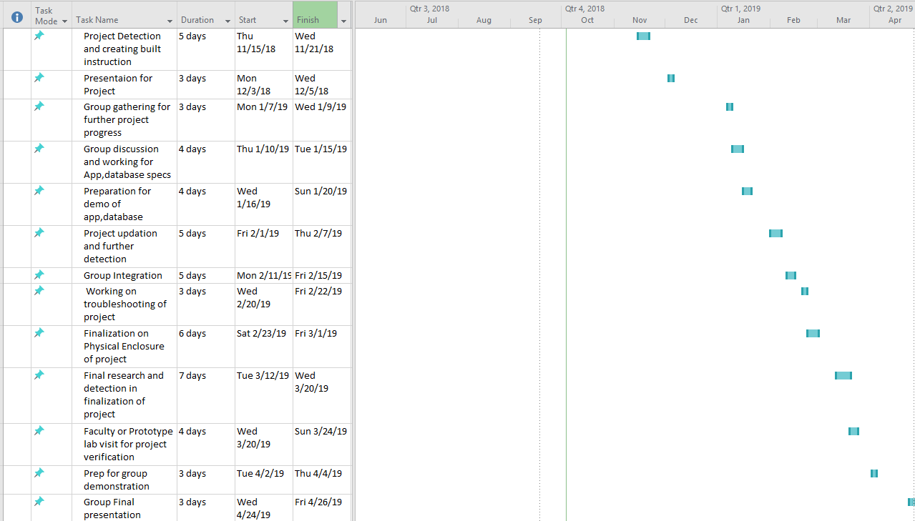

Slide 5
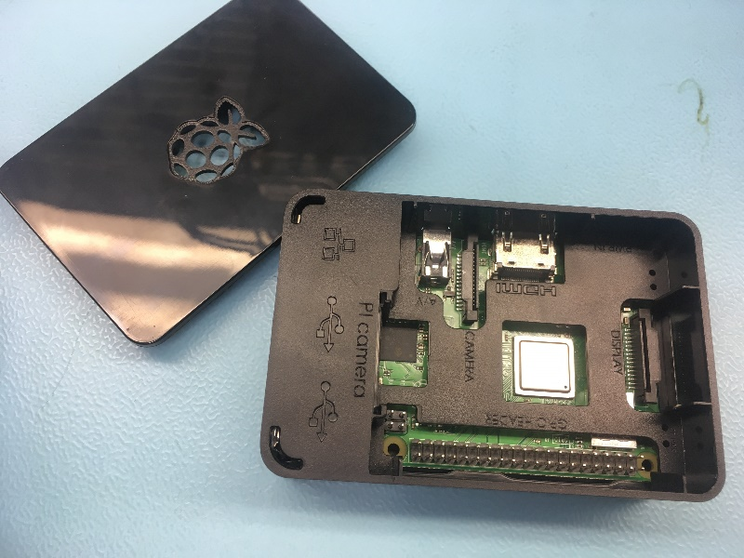
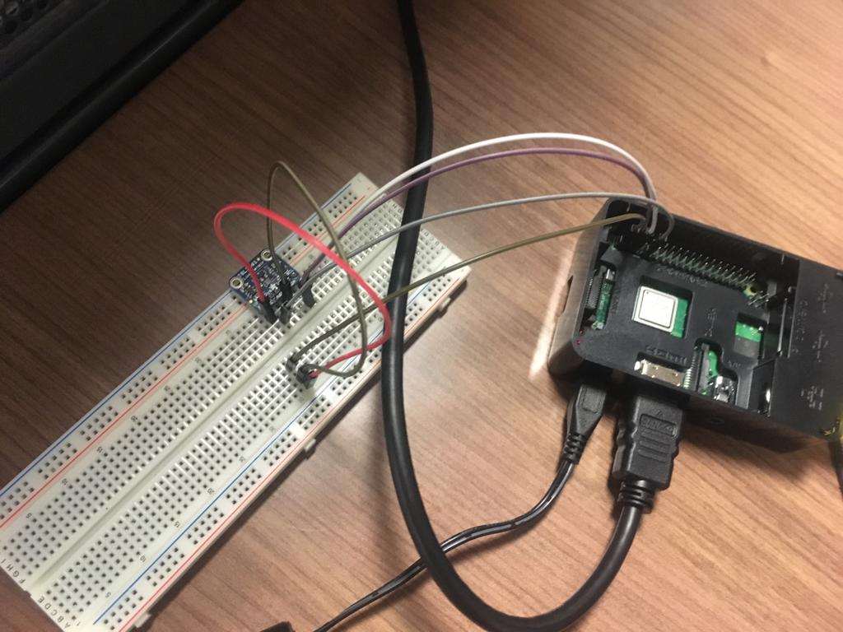
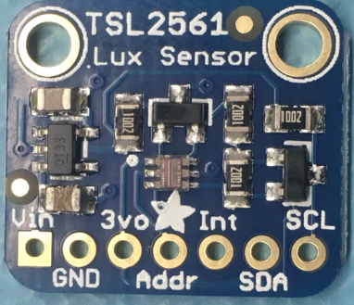
Testing circuit

Slide 6
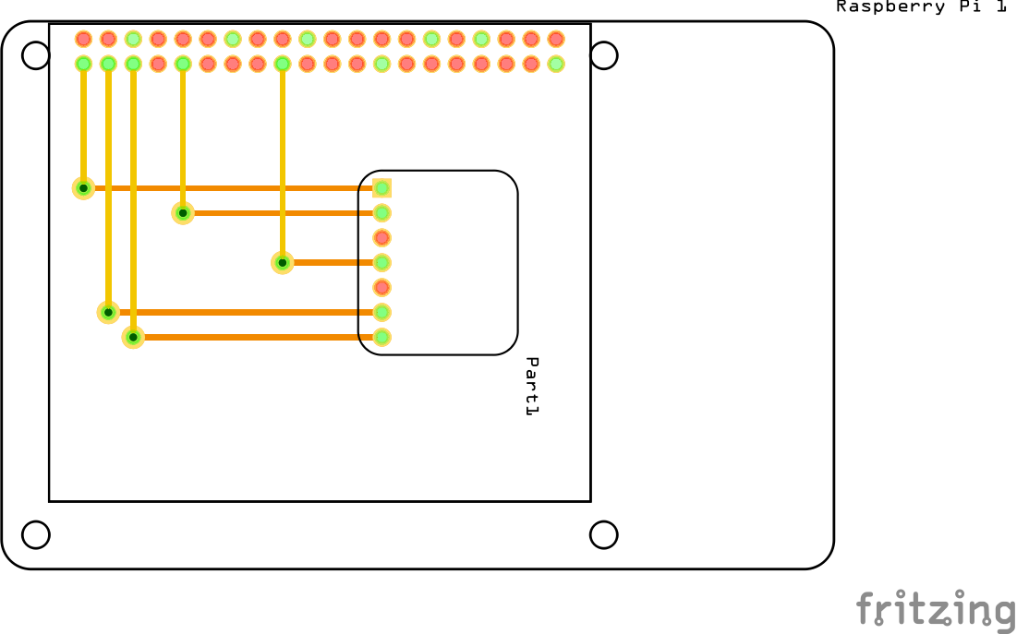
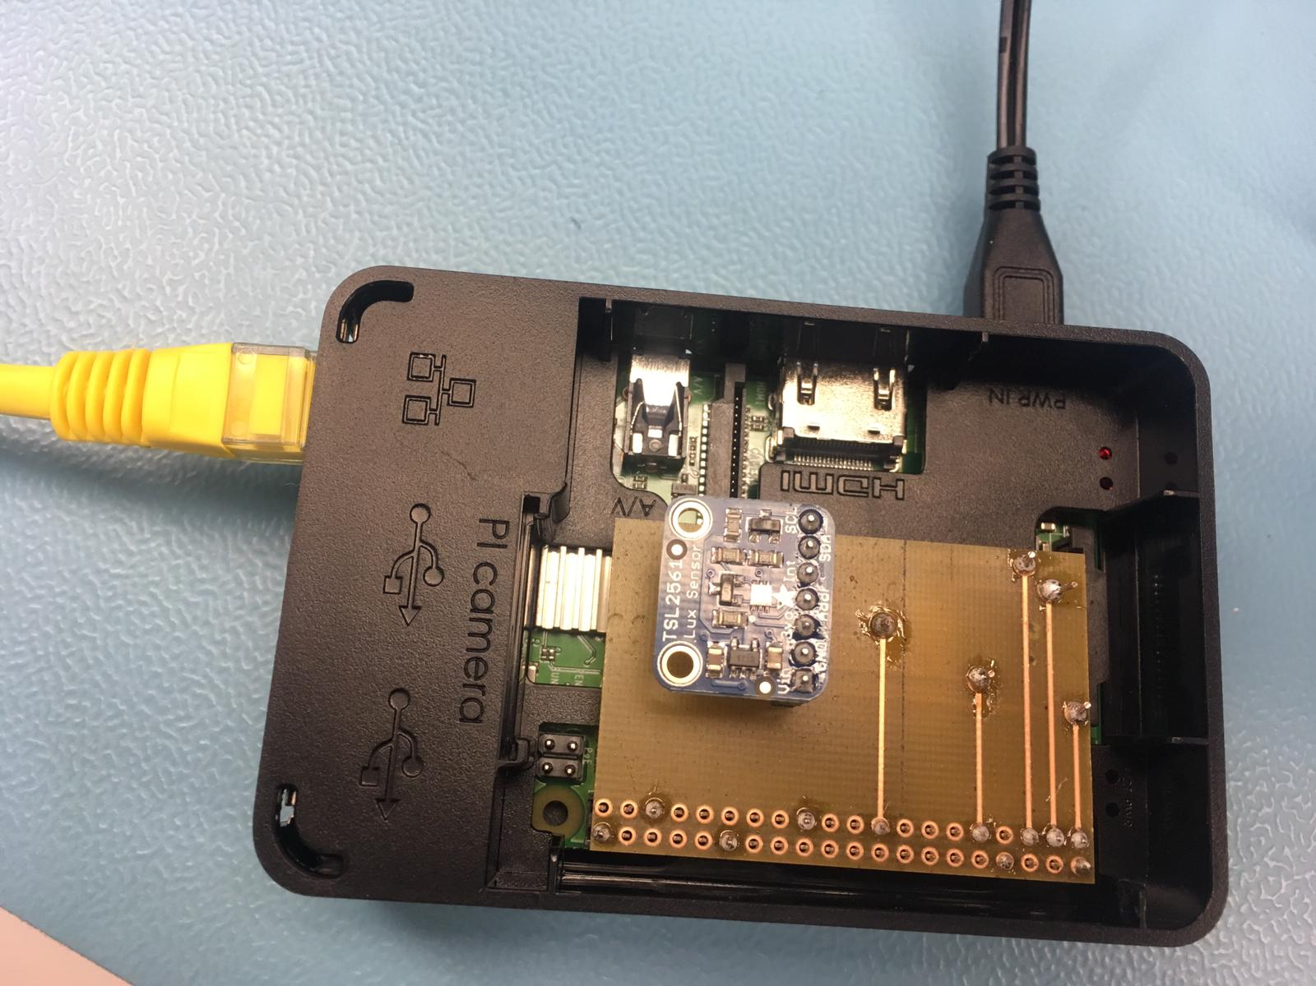
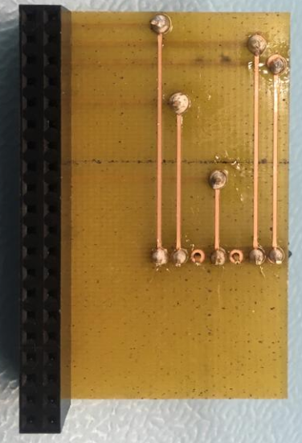
Designing PCB and Get it to work

Slide 7
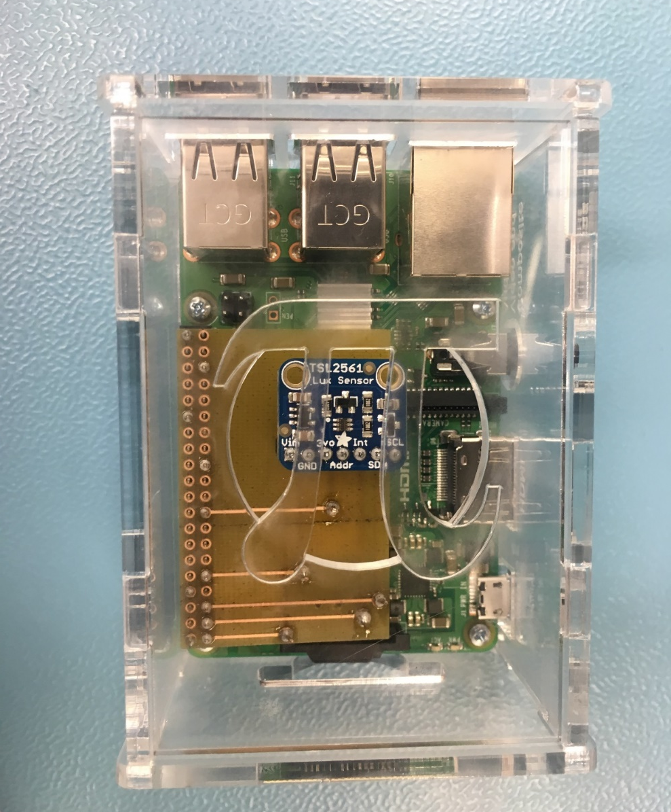
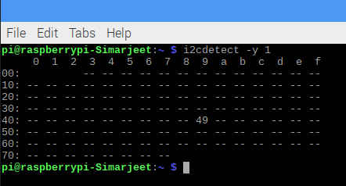
Testing address with PCB and Enclosure

Slide 8
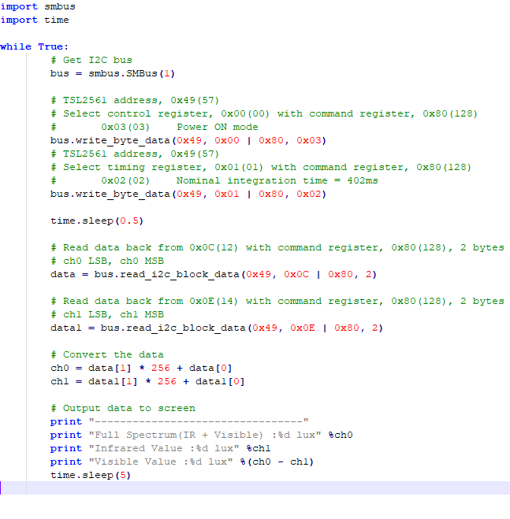
Python Script

Slide 9
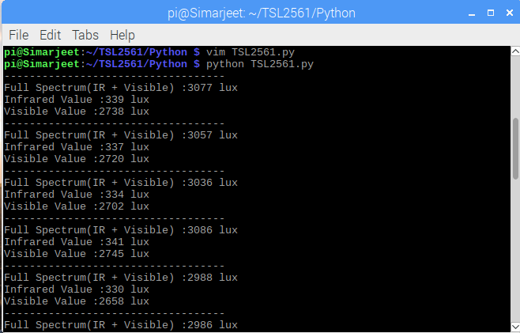
Reading Data From Sensor

Slide 10
Knowledge from other courses
TECH 101 and Tech 150 - Working with electronic circuit and connections
ESOL 120 and ESOL 220 - Technical Writing Skills for writing reports
TECH 153 - introduction with raspberry pi and how it works
CENG209 and CENG 252 - Micro assembly language how to get data from device
CENG 200 - writing/understanding python scripts

Slide 11
Thanks!

