Slide 1


WEB SCRAPING TO GAIN COMPANY INSIGHTS

Slide 2
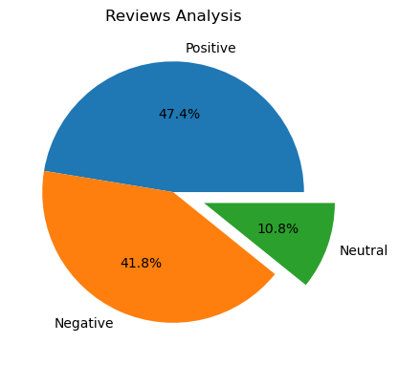
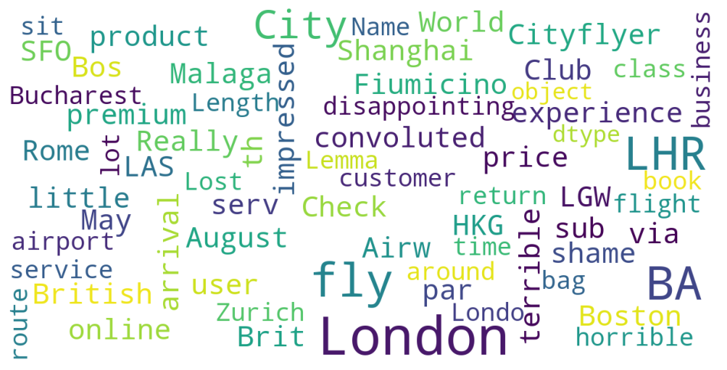
INSIGHTS FROM CUSTOMER REVIEWS
From cleaning 1000 reviews given by the customers, we obtained
Positive 474
Negative 418
Neutral 108
Word cloud of keywords used in reviews

