Slide 1

AUTOMATED
VISVESVARAYA TECHNOLOGICAL UNIVERSITY
BHEEMANNA KHANDRE INSTITUTE OF TECHNOLOGY
DEPARTMENT OF ELECTONICS&COMMUNICATION ENGINEERING
BHALKI-585 328
Waste Segregation
Guided by : Prof. Savitri K .
: Sanjeev Gogga
:B Mamma
Presented by :Batch 7
Shubham(3RB22EC070)
Varun(3RB22EC088)
Vijay (3RB22EC091)

Slide 2

Table Of Contents
Introduction
Overview
Understanding the problems
Project objective
Our Solution Project
The Basic Design
Working Cycle of Segregation System
Challenges and Limitations
Advantages
Challenges and Limitations
Conclusion and Future Scope

Slide 3
Introduction
• Waste management is a significant environmental challenge.
• Improper segregation leads to reduced recycling and environmental harm.
• Automatic Waste Segregation aims to simplify and improve waste management.

Slide 4





Overview
1 Definition: Waste Sorting separates waste into different categories
2 .Swachh Bharat Mission (2014):
Promoted separation of Dry and Wet waste.
3 Implementation:
Compact bins: Blue for Dry waste, Green for Wet waste and yellow for metal.
4 Impact:
Encouraged responsible disposal in public spaces.
Simplified segregation for the government.
wet

Slide 5
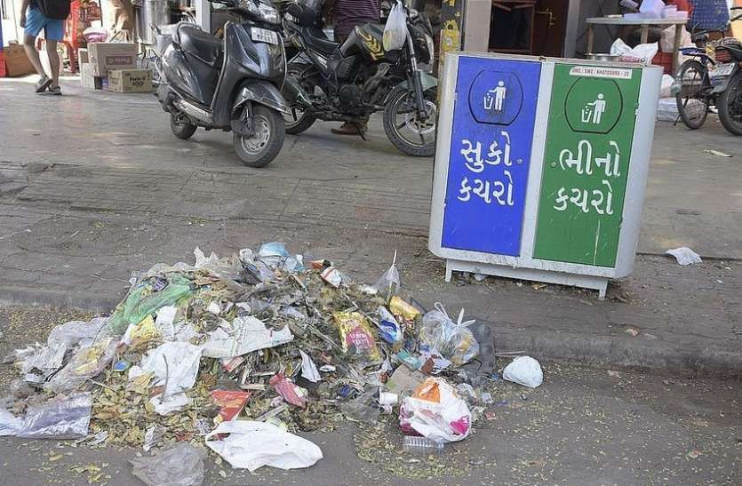
Understanding the problems
Lack of public awareness
Lack of Waste Management Knowledge among social workers
No monitoring of Garbage system and Dustbins
Negligible usage of technological advancements
Sad truth : Laziness of acknowledgment of Dry & Wet waste in public

Slide 6
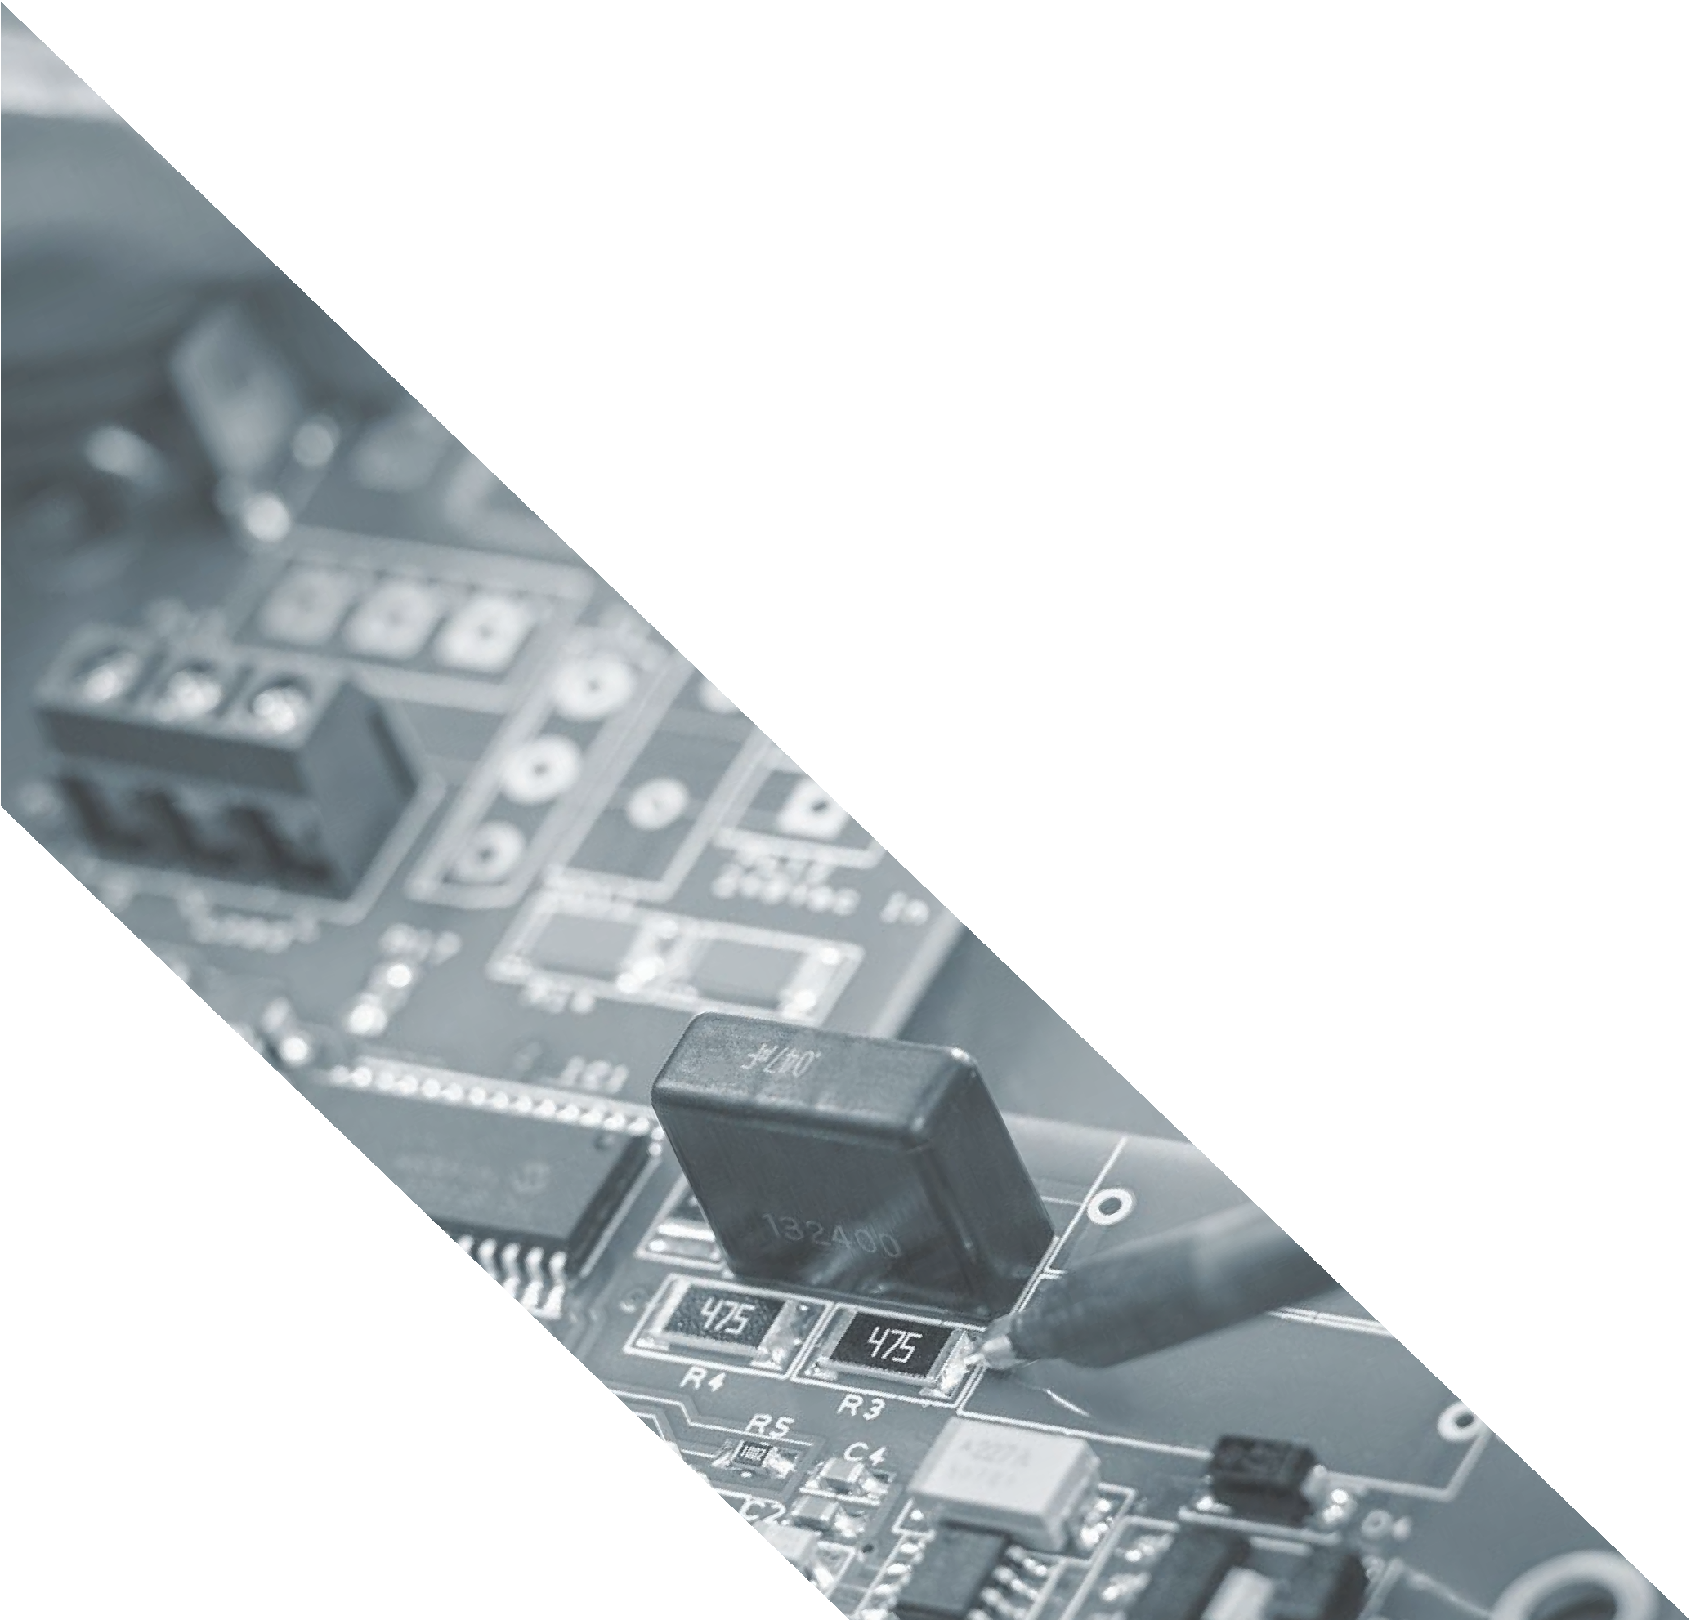
Project objective
To create such a SMART BIN that can automatically segregate metallic,Dry & Wet waste in different compartments without any human efforts and monitoring of quantity/quality filled in those dustbins

Slide 7
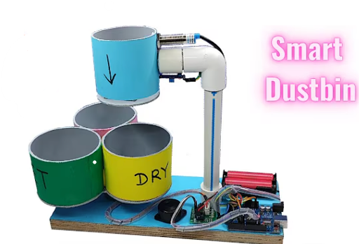
Our Solution
SmartBin designed using Arduino and
Sensors IOT based systems for smart operating by itself
Creating an affordable compact design for cooperative as well as public usage.

Slide 8
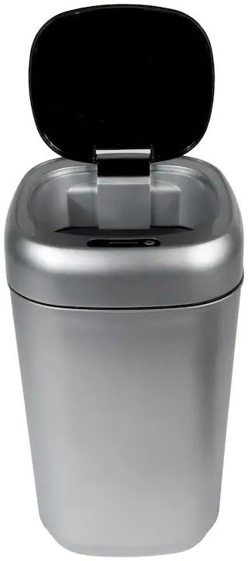
The Basic Design
Consisting 3 Major smart systems in one design
Waste Detection:
  IR Sensors identify and categorize waste (metallic, wet, or dry).
Automated Sorting:
  Servo Motors move waste to the correct compartment.
3. Sorting:
Rotation Mechanism: Rotates to bring the appropriate bin under the waste chute.

Slide 9




Working Cycle of Segregation System
STEP 1
Drop the Waste: Waste is dropped into the pipe.
04
STEP 4
The whole process is Autonomous and Continuous
01
03
STEP 2
Depending upon the Threshold set , the I r & moisture sensor or metal senser classifies it as metal Dry or Wet
STEP 3
As soon step 2 is done Servo Motor runs to either direction depending upon the type of waste and the waste goes in the appropriate compartment.
02

Slide 10
Advantages
• Promotes environmental sustainability.
• Reduces manual effort in waste segregation.
• Enhances efficiency in recycling processes.

Slide 11
Challenges and Limitations
  • Sensors may struggle with certain waste types.
  • Initial setup cost can be high.
  • System needs maintenance for consistent performance.

Slide 12
Conclusion and Future Scope
Conclusion:
The SMART BIN efficiently segregates metallic, dry, and wet waste with minimal human intervention, promoting sustainable waste management.
Future Scope:
Enhanced Sensors: Improve detection accuracy.
Cost Efficiency: Develop affordable components.
IoT Integration: Enable real-time monitoring.
Energy Efficiency: Reduce power consumption.

Slide 13

Thank you

