Slide 1
ASSIGNMENT - 1
You have to create a simple job, you have to install apache httpd server and have to install index.html page on apache, using jenkins. and website should be up after running job.
AUTHOR
SHUBHAM TAPKIR

Slide 2
Prerequisite
First step : - install java open jdk 11 on machine
amazon-linux-extras install java-openjdk11 -y
Second step : - install apache tomcat version 9.0
wget https://dlcdn.apache.org/tomcat/tomcat-9/v9.0.82/bin/apache-tomcat-9.0.82.zip
unzip apache-tomcat-9.0.82.zip
chmod +R 777 apache-tomcat-9.0.82
Third step : - install jenkins (war file) : -
wget https://get.jenkins.io/war-stable/2.414.3/jenkins.war

Slide 3
Some steps we have to do to get jenkins admin panel
Put jenkins.war in /apache-tomcat-9.0.82/webapps
Start the apache server : -
Go to /apache-tomcat-9.0.82/bin
Run command ./startup.sh
Hit public_url_of_instance:8080/jenkins for open jenkins admin panel
Now will u connect to jenkins admin panel

Slide 4
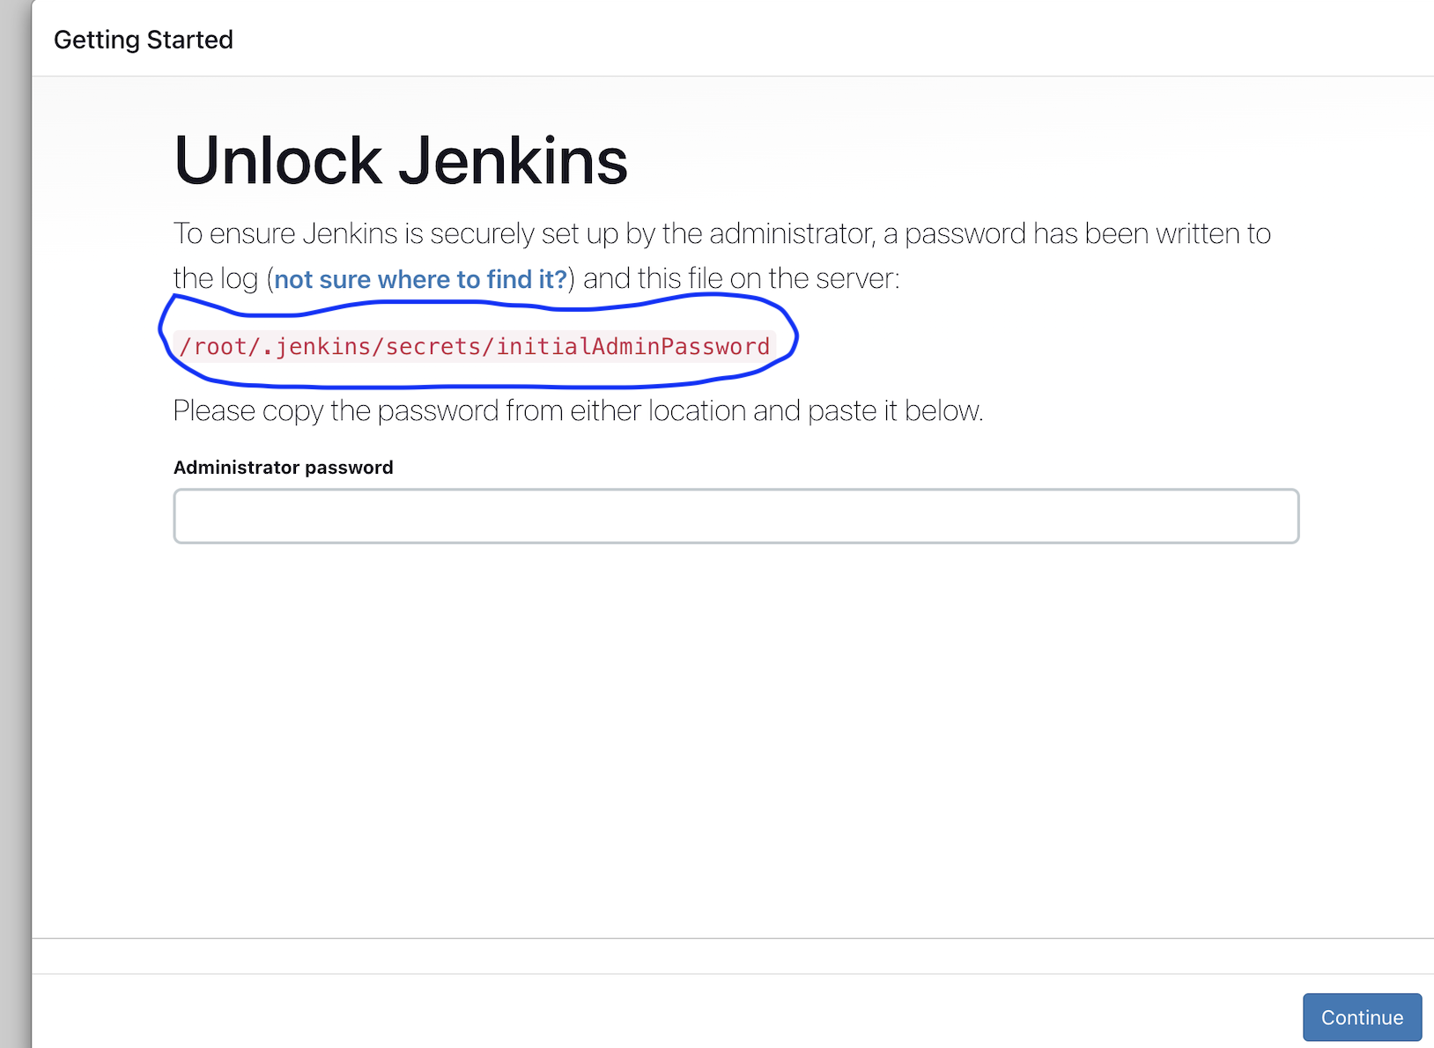
To get password, simply run command and pest password in textbox
cat /root/.jenkins/secrets/initialAdminPassword

Slide 5
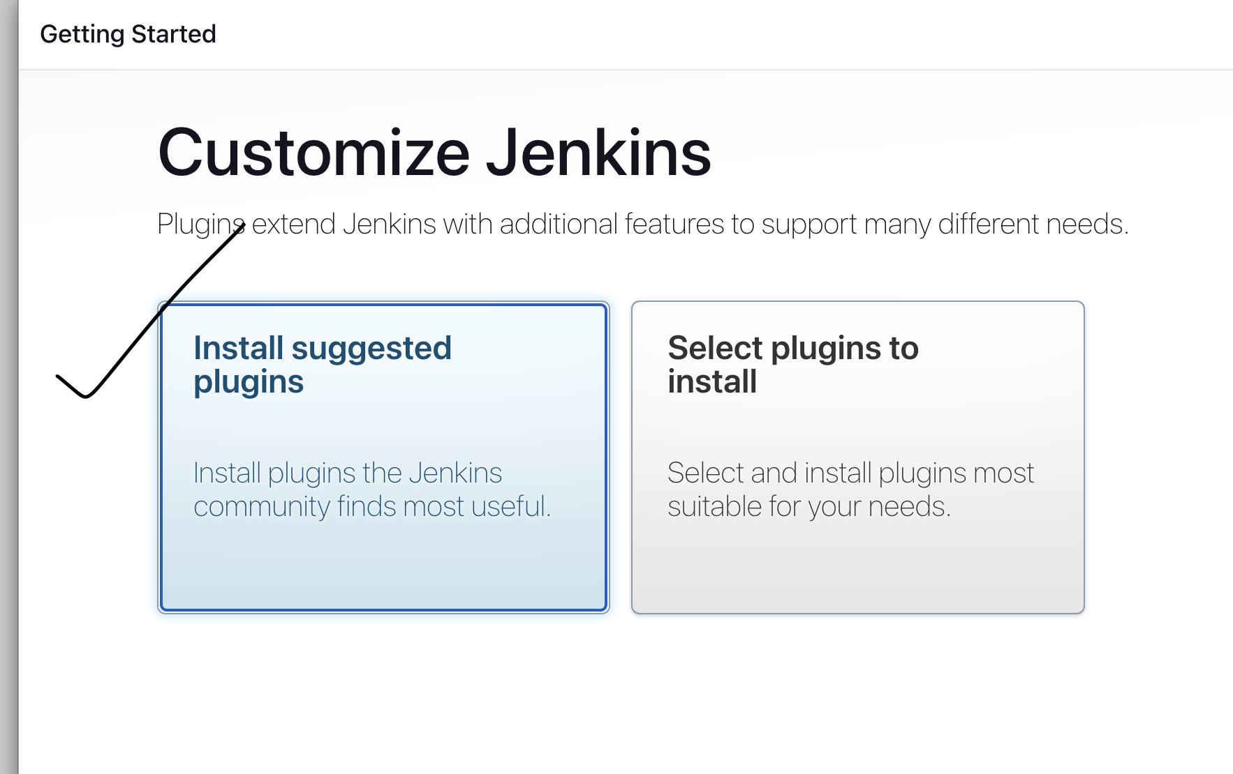
Click on install suggested plugins

Slide 6
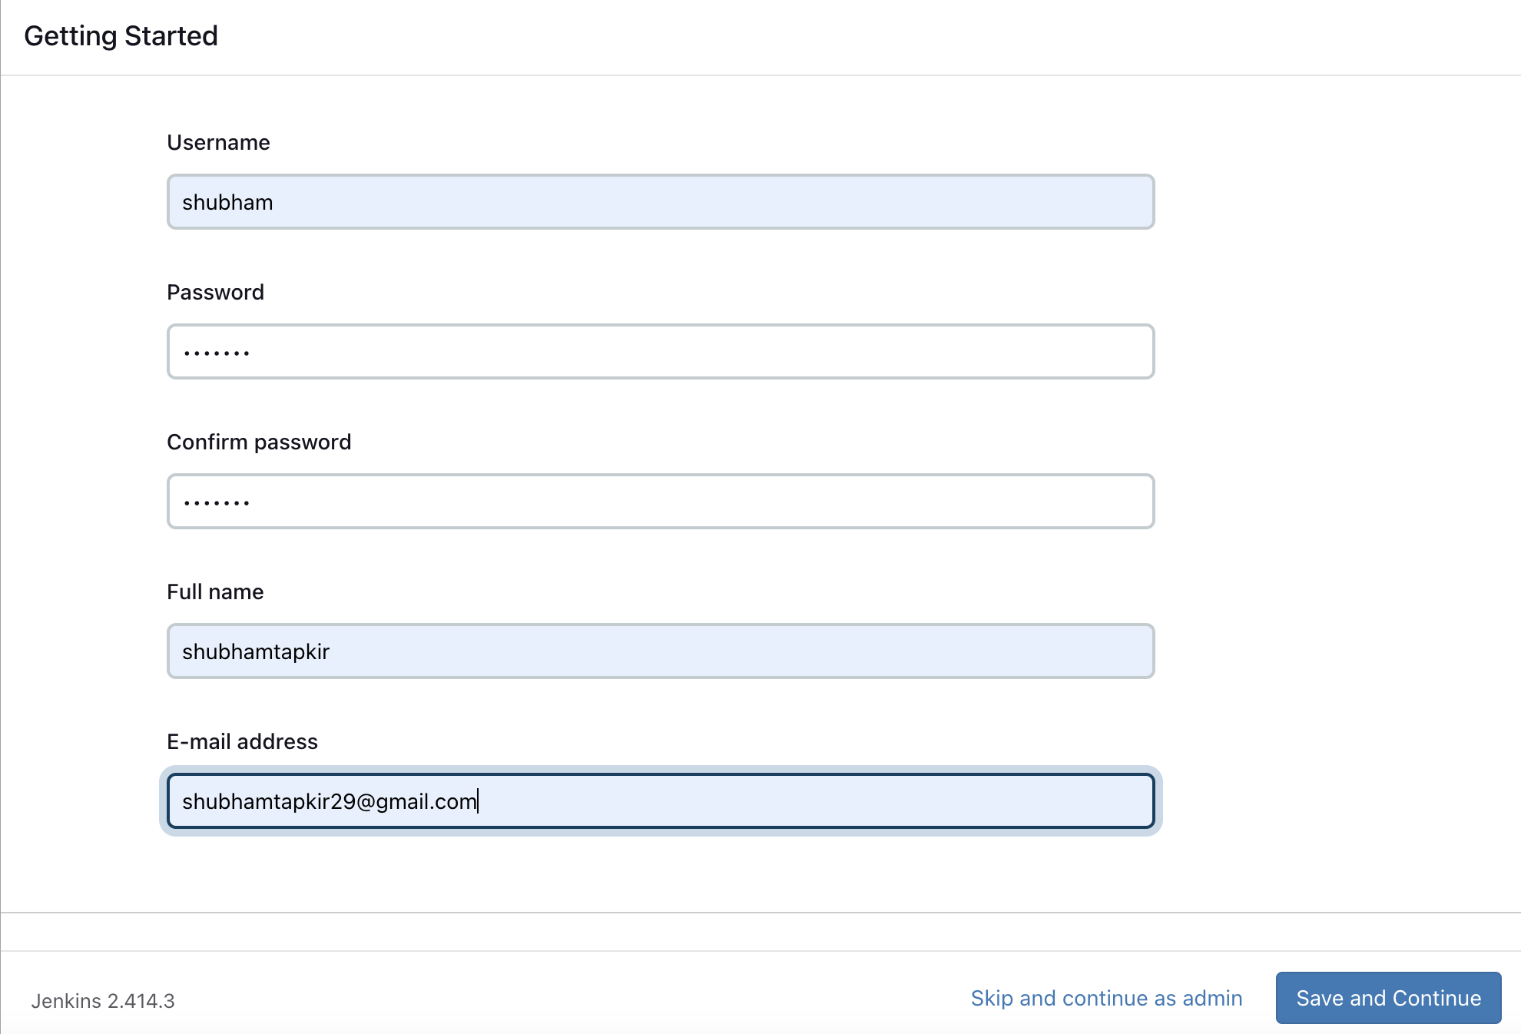
Fill the info and click on save and continue

Slide 7
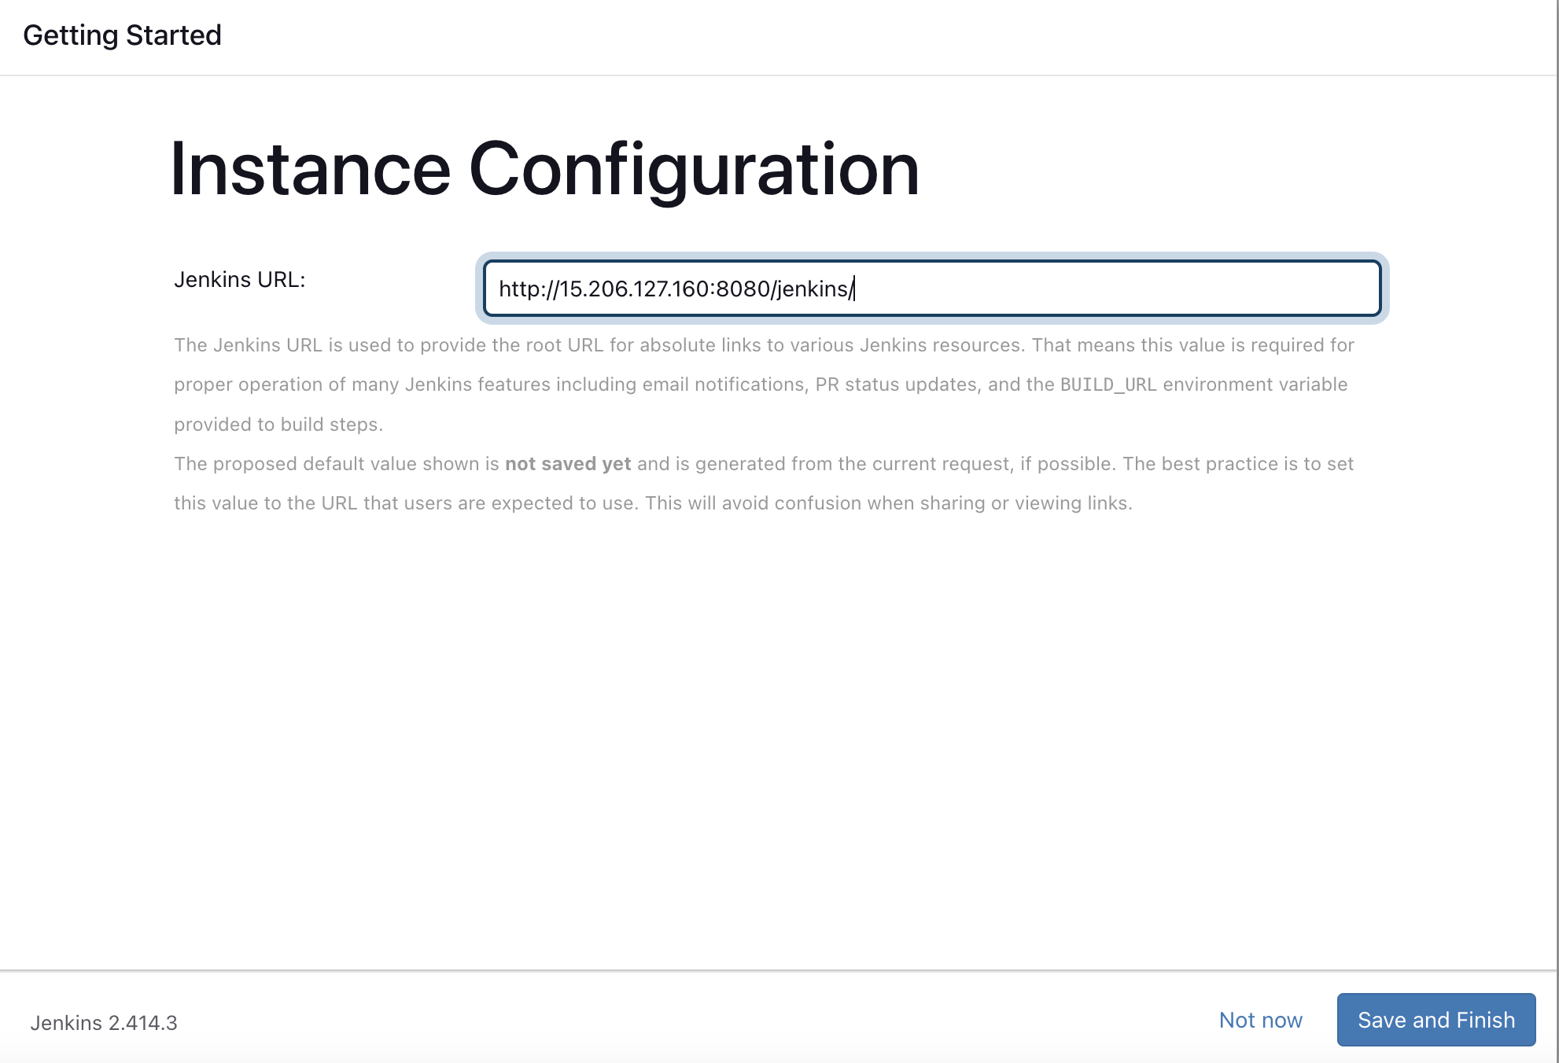
Fill the info and click on save and continue

Slide 8
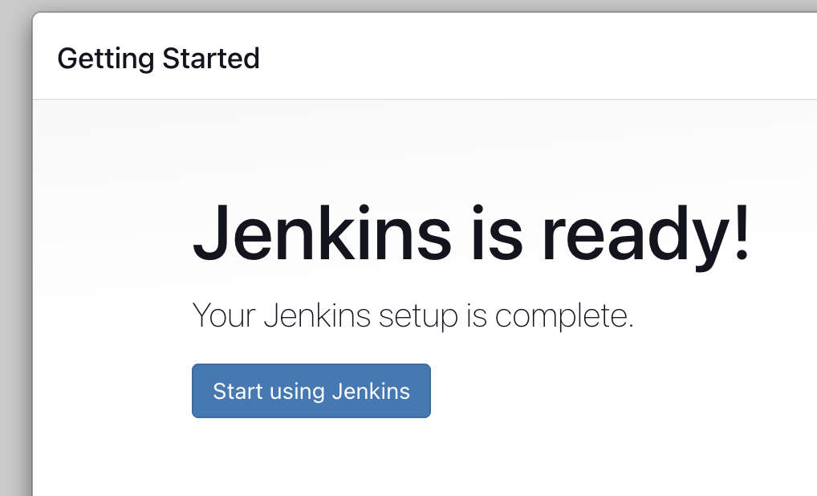

Slide 9
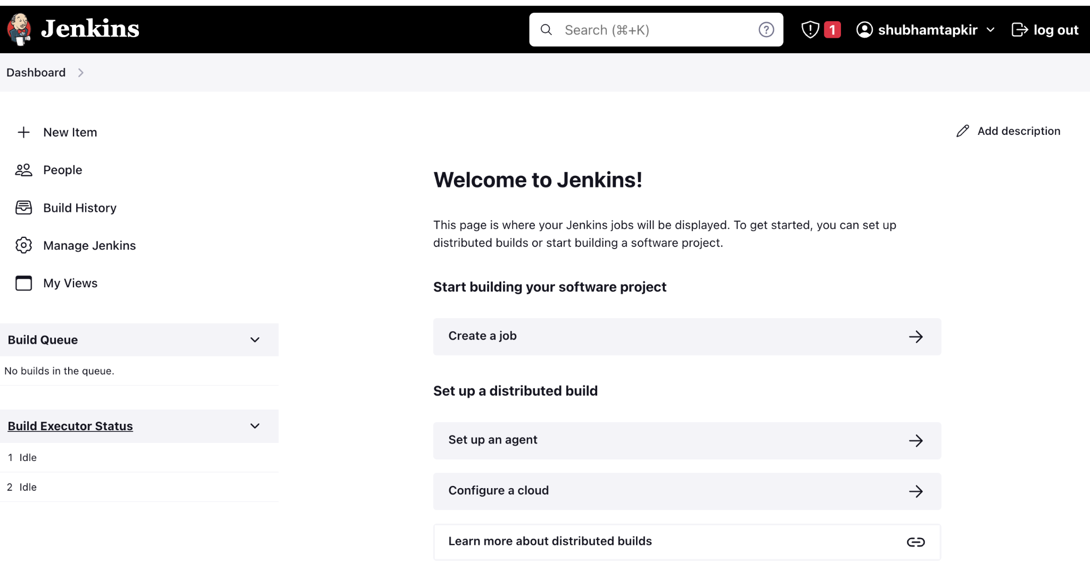
Click on new item

Slide 10
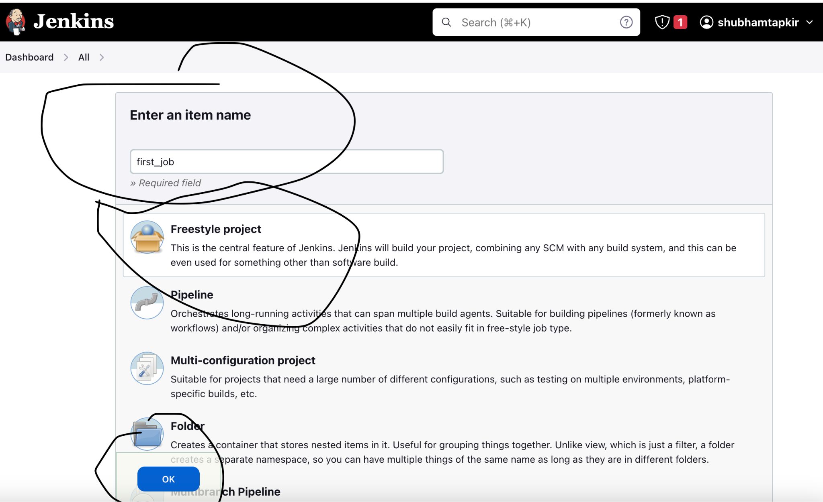
Fill required fill
Click on freestyle project
Click on ok

Slide 11
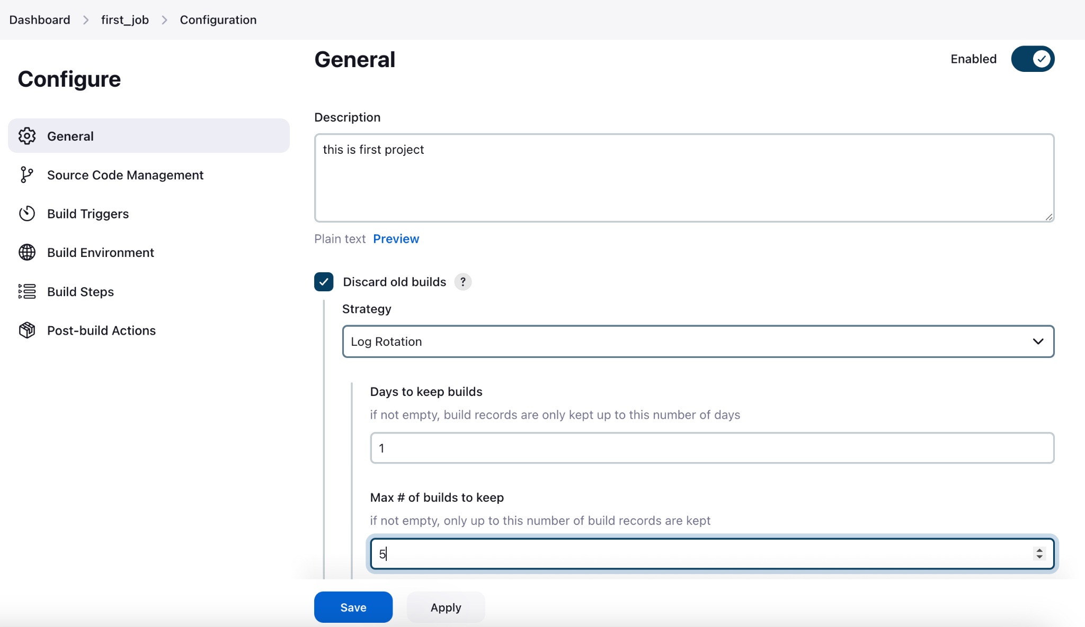
Fill details

Slide 12
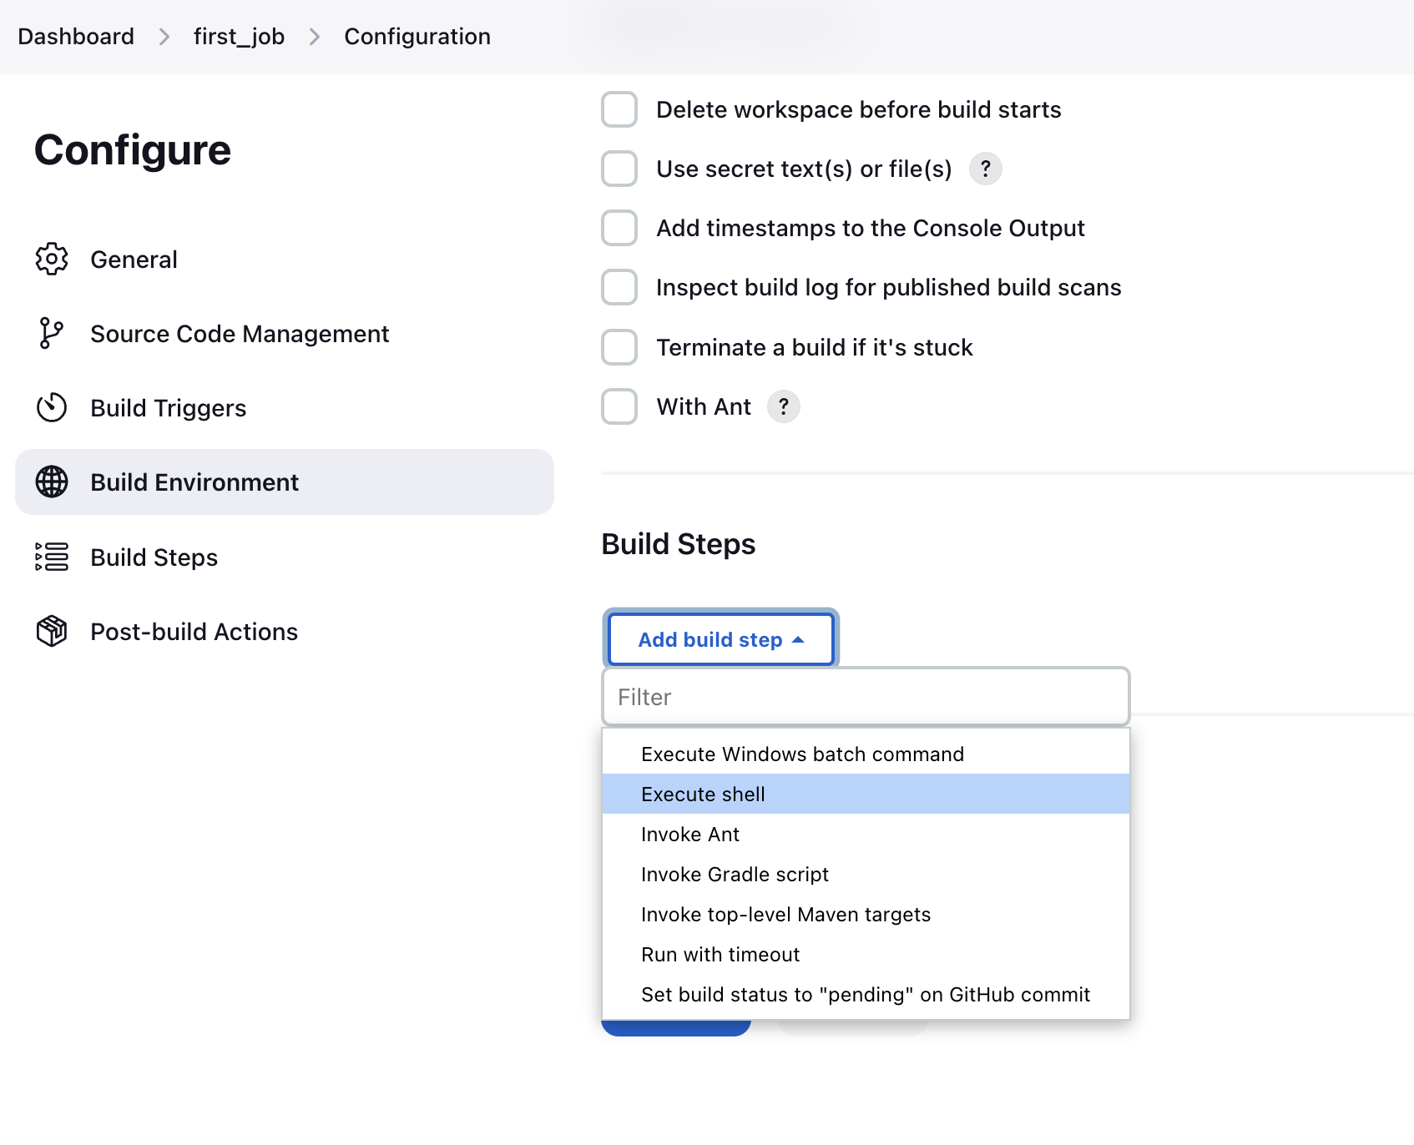

Slide 13
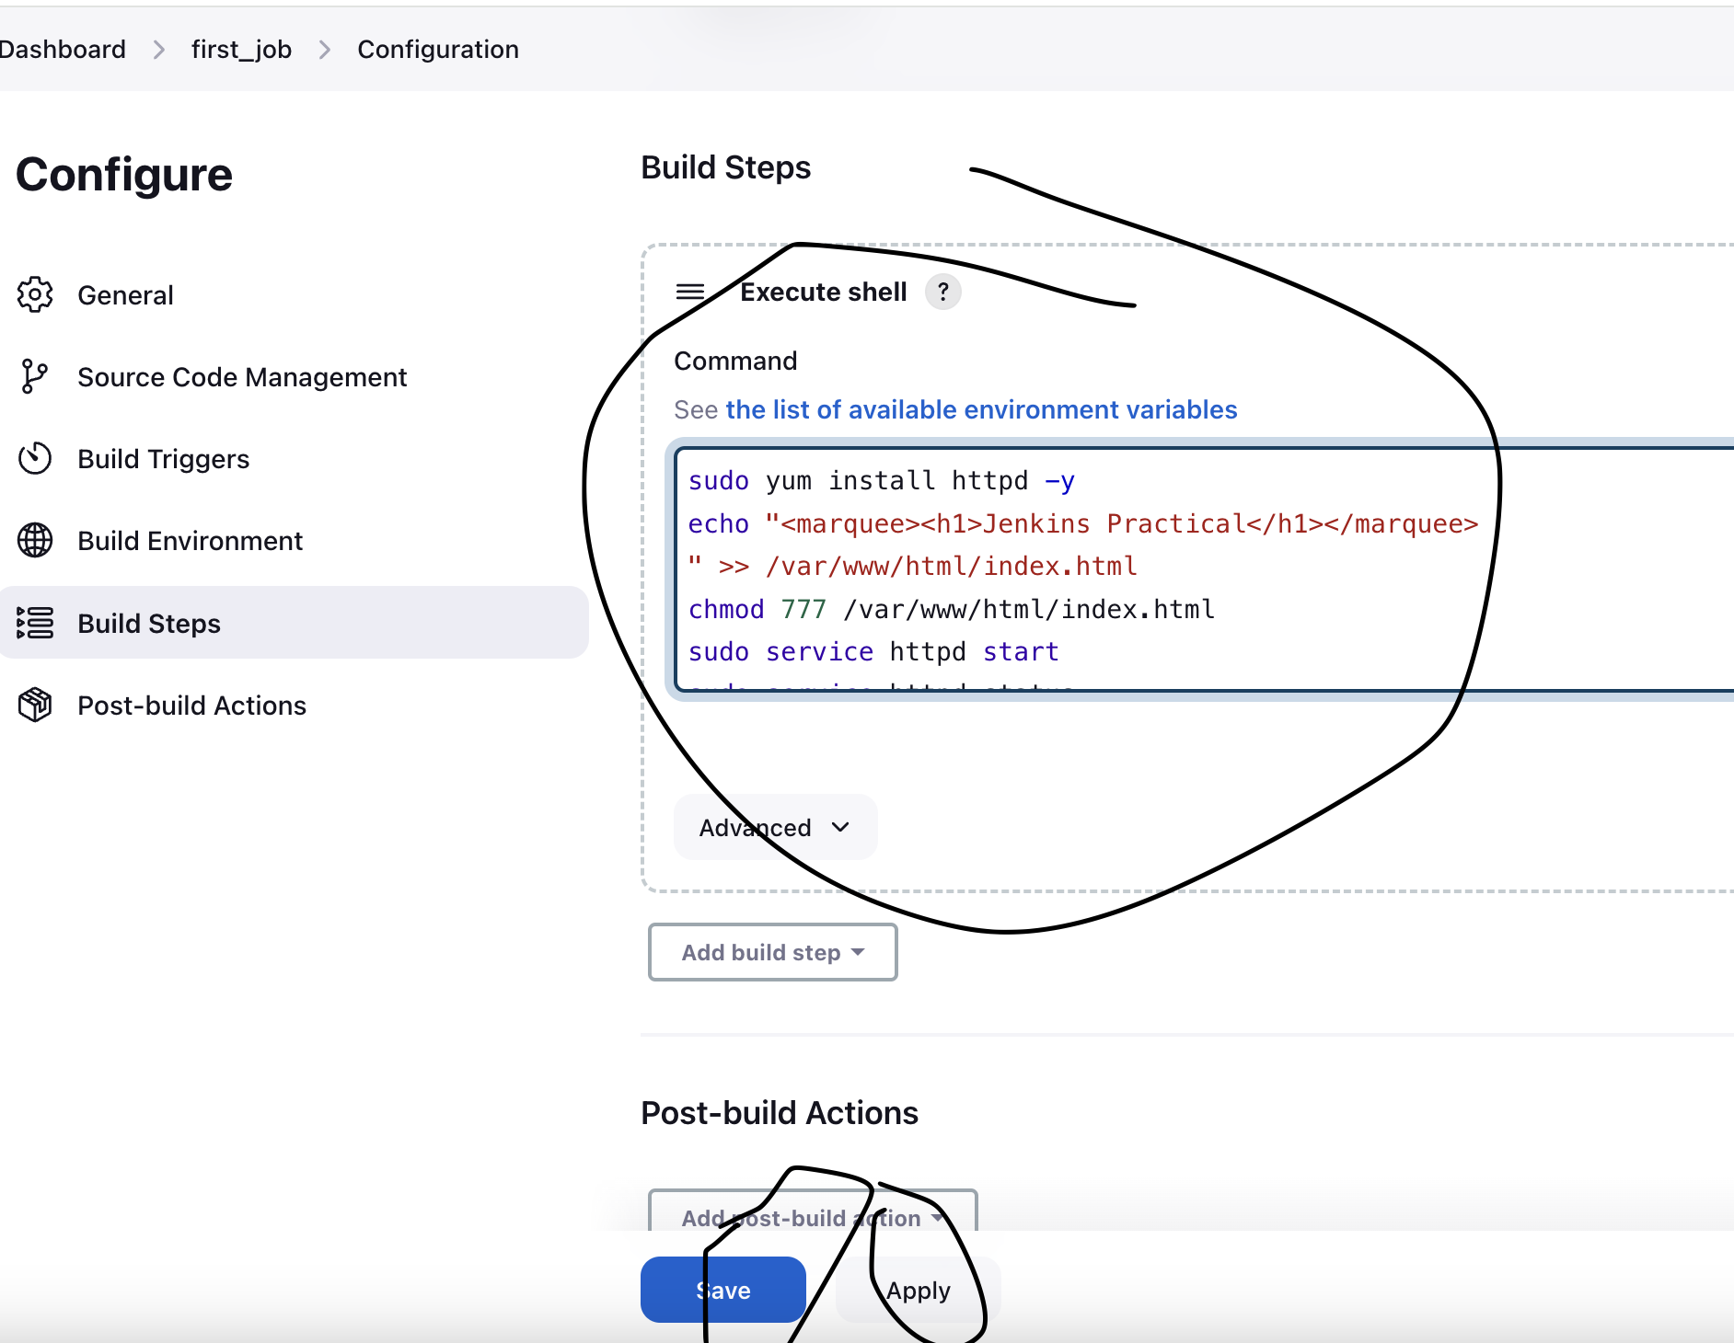

Slide 14
sudo yum install httpd -y
echo "<marquee><h1>Jenkins
Practical</h1></marquee>
" >> /var/www/html/index.html
chmod 777 /var/www/html/index.html
sudo service httpd start
sudo service httpd status

Slide 15
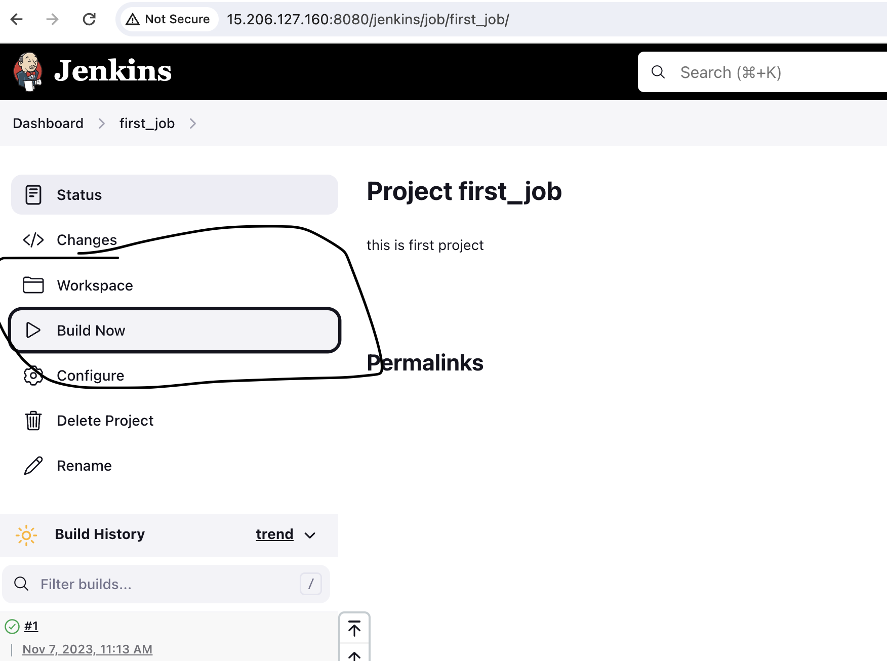

Slide 16
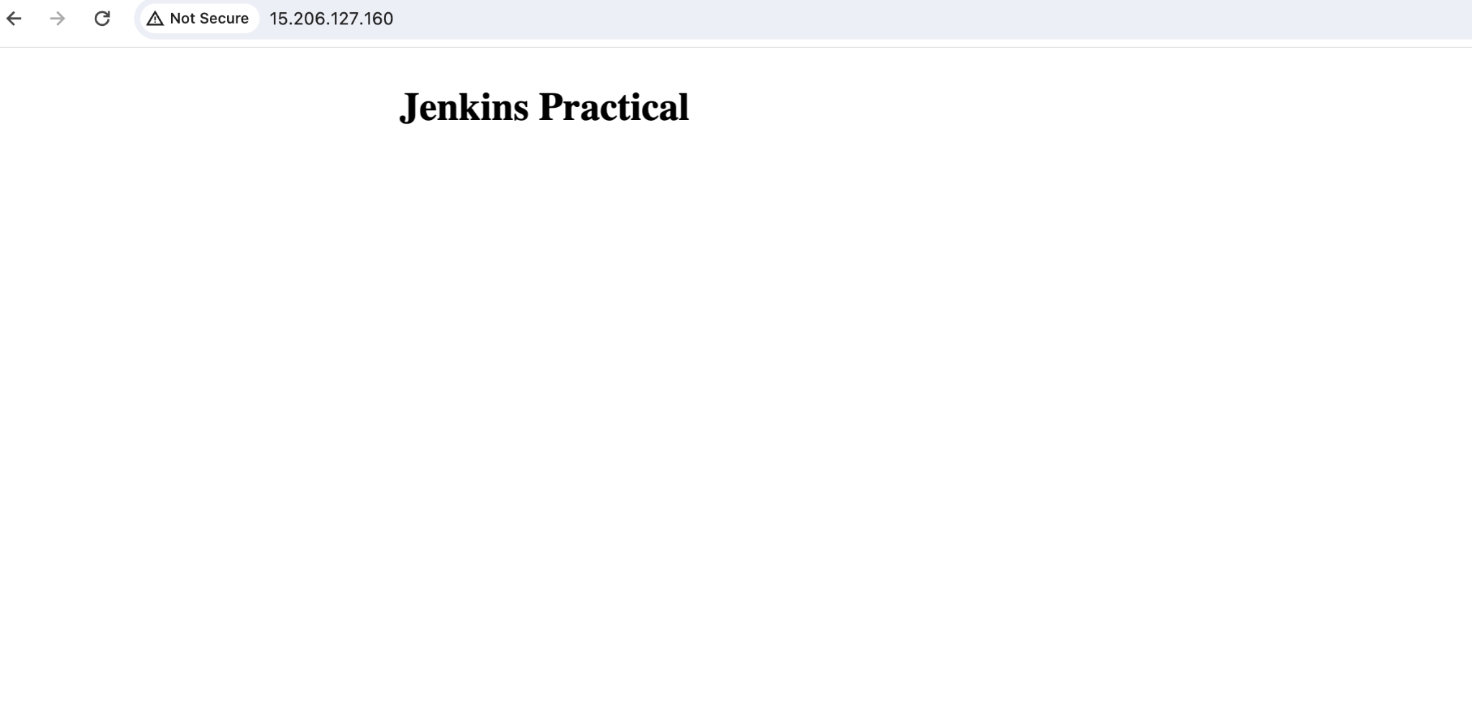
Hit the public url

