Slide 1
HRMS Department Modules
Human Resource Management System
All Modules Organized by Department
Generated: July 07, 2026

Slide 2
Departments
01. Core & Authentication 02. Admin Dashboard 03. Employee Dashboard 04. HR Administration 05. Leave & Attendance 06. Asset Management 07. Recruitment (ATS) 08. Onboarding & Offboarding 09. Payroll 10. Performance Management 11. Expense Management 12. Help Desk 13. Document Management 14. Employee Self-Service 15. Analytics & Reports

Slide 3
Core & Authentication
Login, sessions, and access control

Slide 4
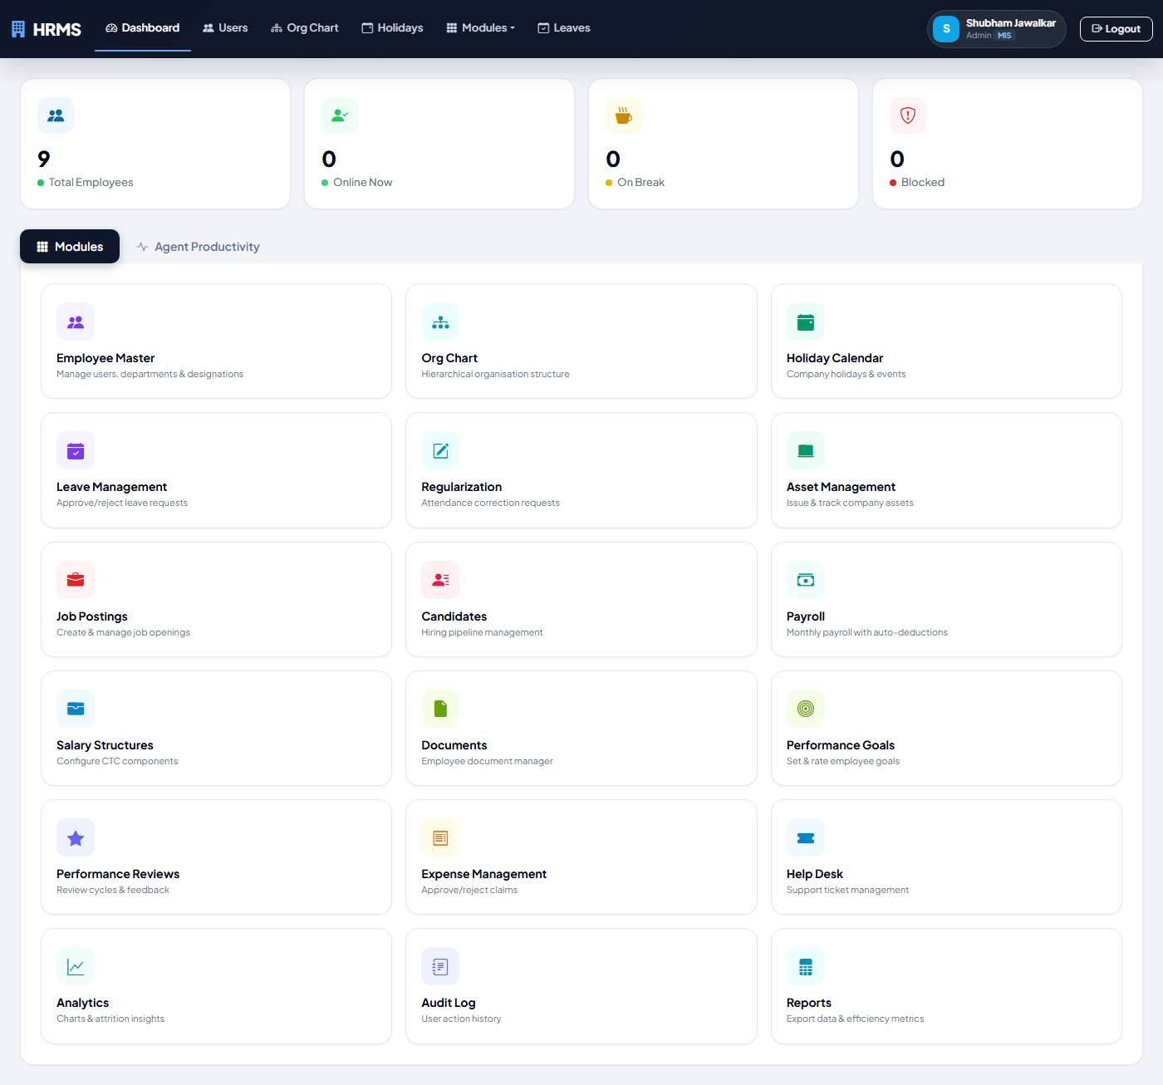
Login Page
Employee login with credentials table showing all users and their passwords (pass123).

Slide 5
Admin Dashboard
Real-time monitoring, module grid, agent productivity

Slide 6

Admin Dashboard
Real-time break monitoring dashboard with employee metrics, online status, and active breaks.

Slide 7
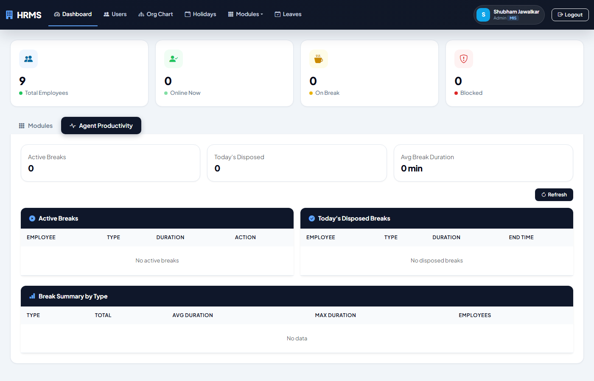
Admin Dashboard Agent Productivity
Live monitoring, dispose breaks, break summary tables with 5s auto-refresh.

Slide 8
Employee Dashboard
Self-service home with module cards, breaks, activity

Slide 9
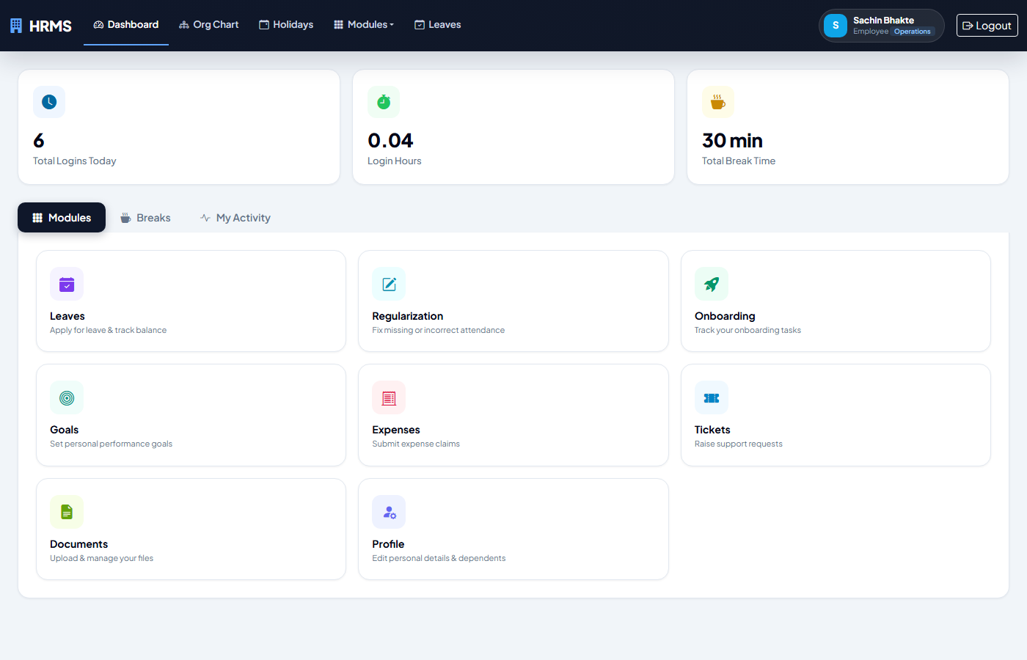
User Dashboard Modules
Module cards grid: Leaves, Regularization, Goals, Expenses, Tickets, Documents, Profile.

Slide 10
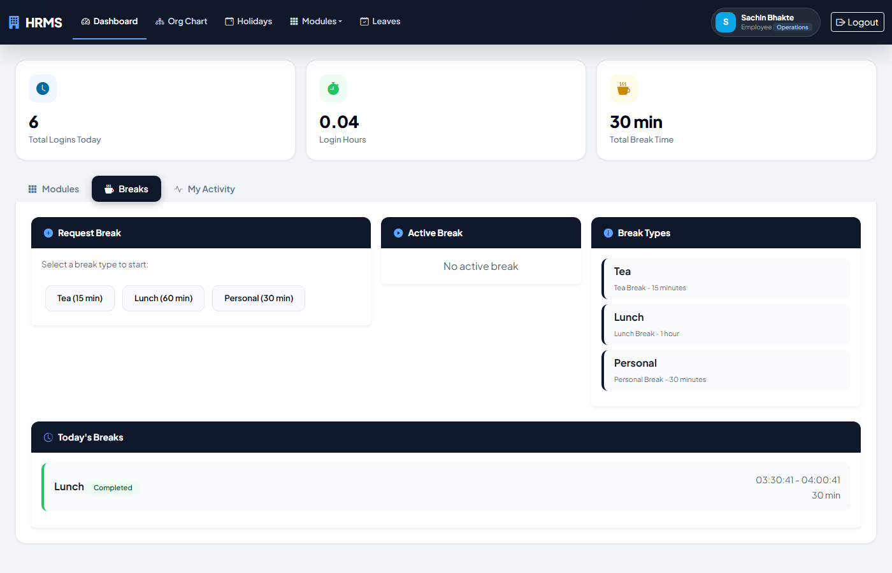
User Dashboard Breaks
Start/end breaks, active break timer, today break history.

Slide 11
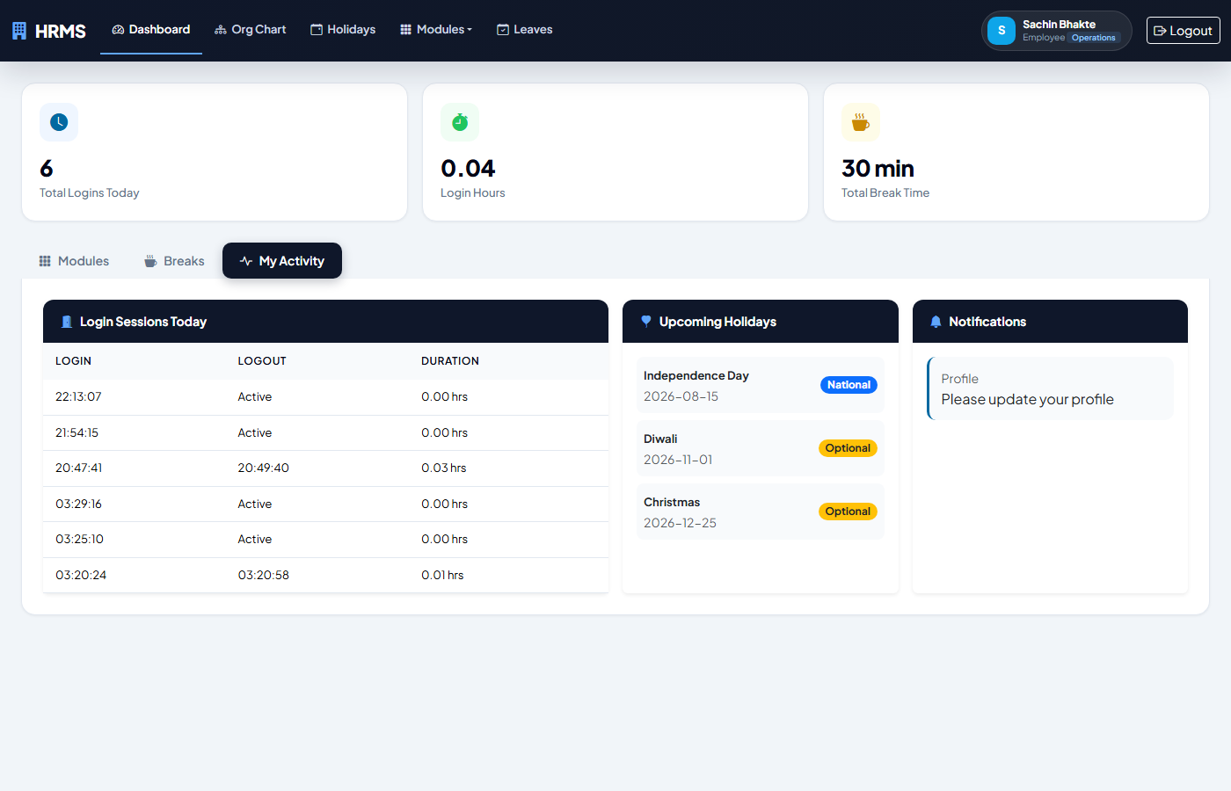
User Dashboard My Activity
Login sessions, upcoming holidays, notifications panel.

Slide 12
HR Administration
Employee master, org structure, holidays, import, audit

Slide 13
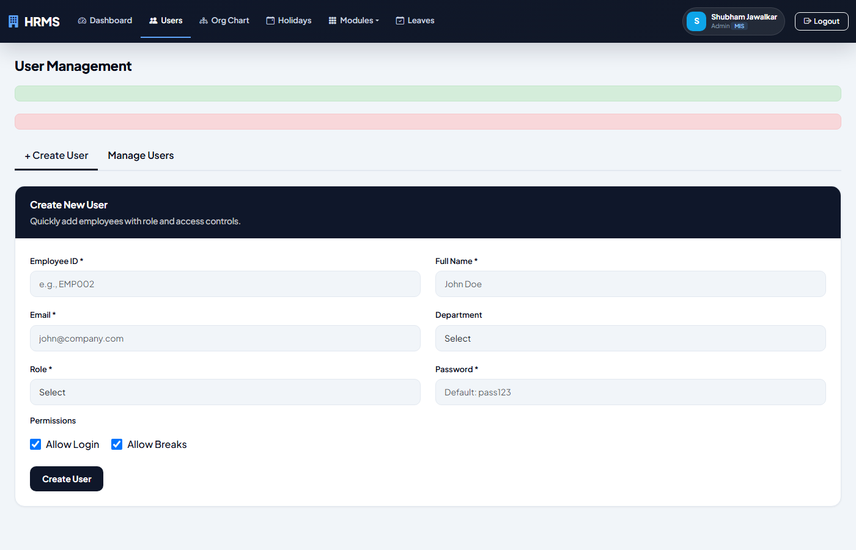
Employee Master
User management with department, designation, phone, DOB, DOJ, address, emergency contacts.

Slide 14
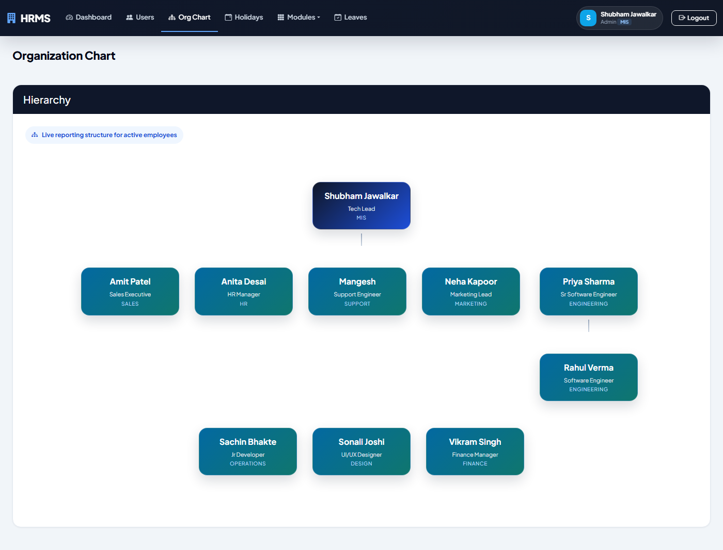
Organisation Chart
Hierarchical org tree built from manager_emp_id relationships.

Slide 15
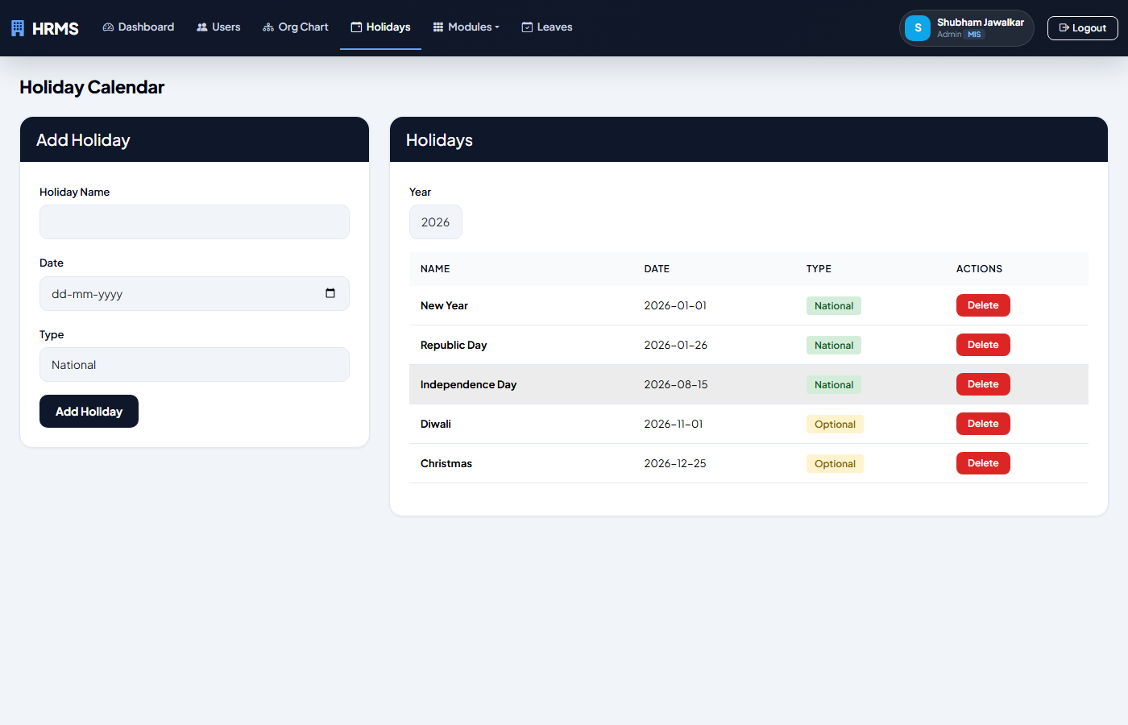
Holiday Calendar
CRUD for company holidays with National/Optional types.

Slide 16
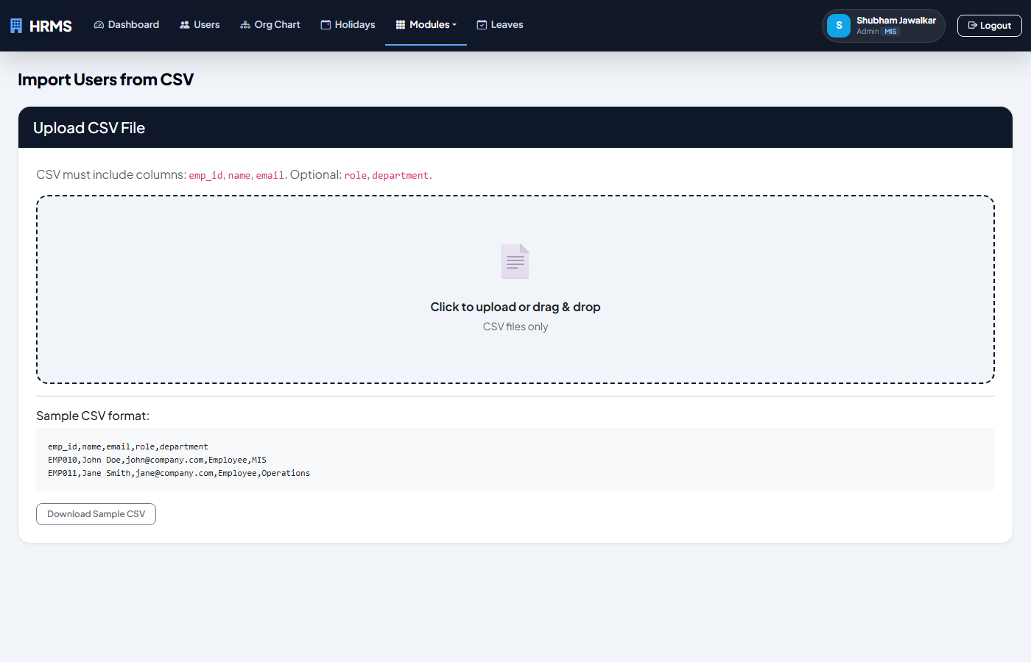
CSV Import Wizard
Drag-and-drop employee import with sample CSV download.

Slide 17
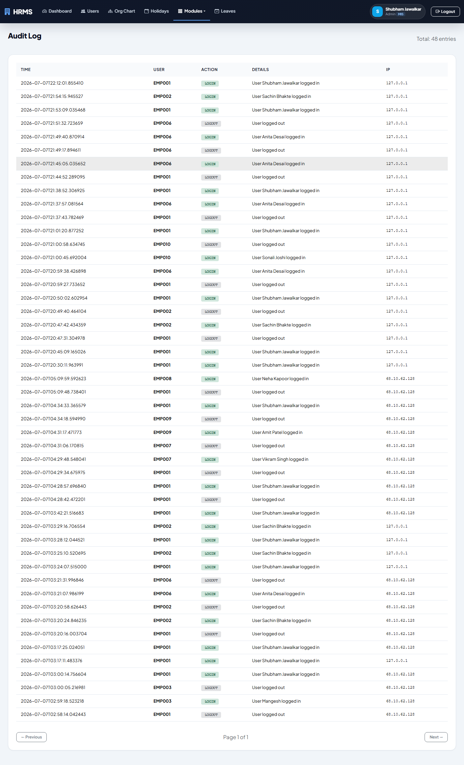
Audit Log
Track all user actions with pagination (LOGIN, LEAVE_APPLY, USER_CREATE, etc.).

Slide 18
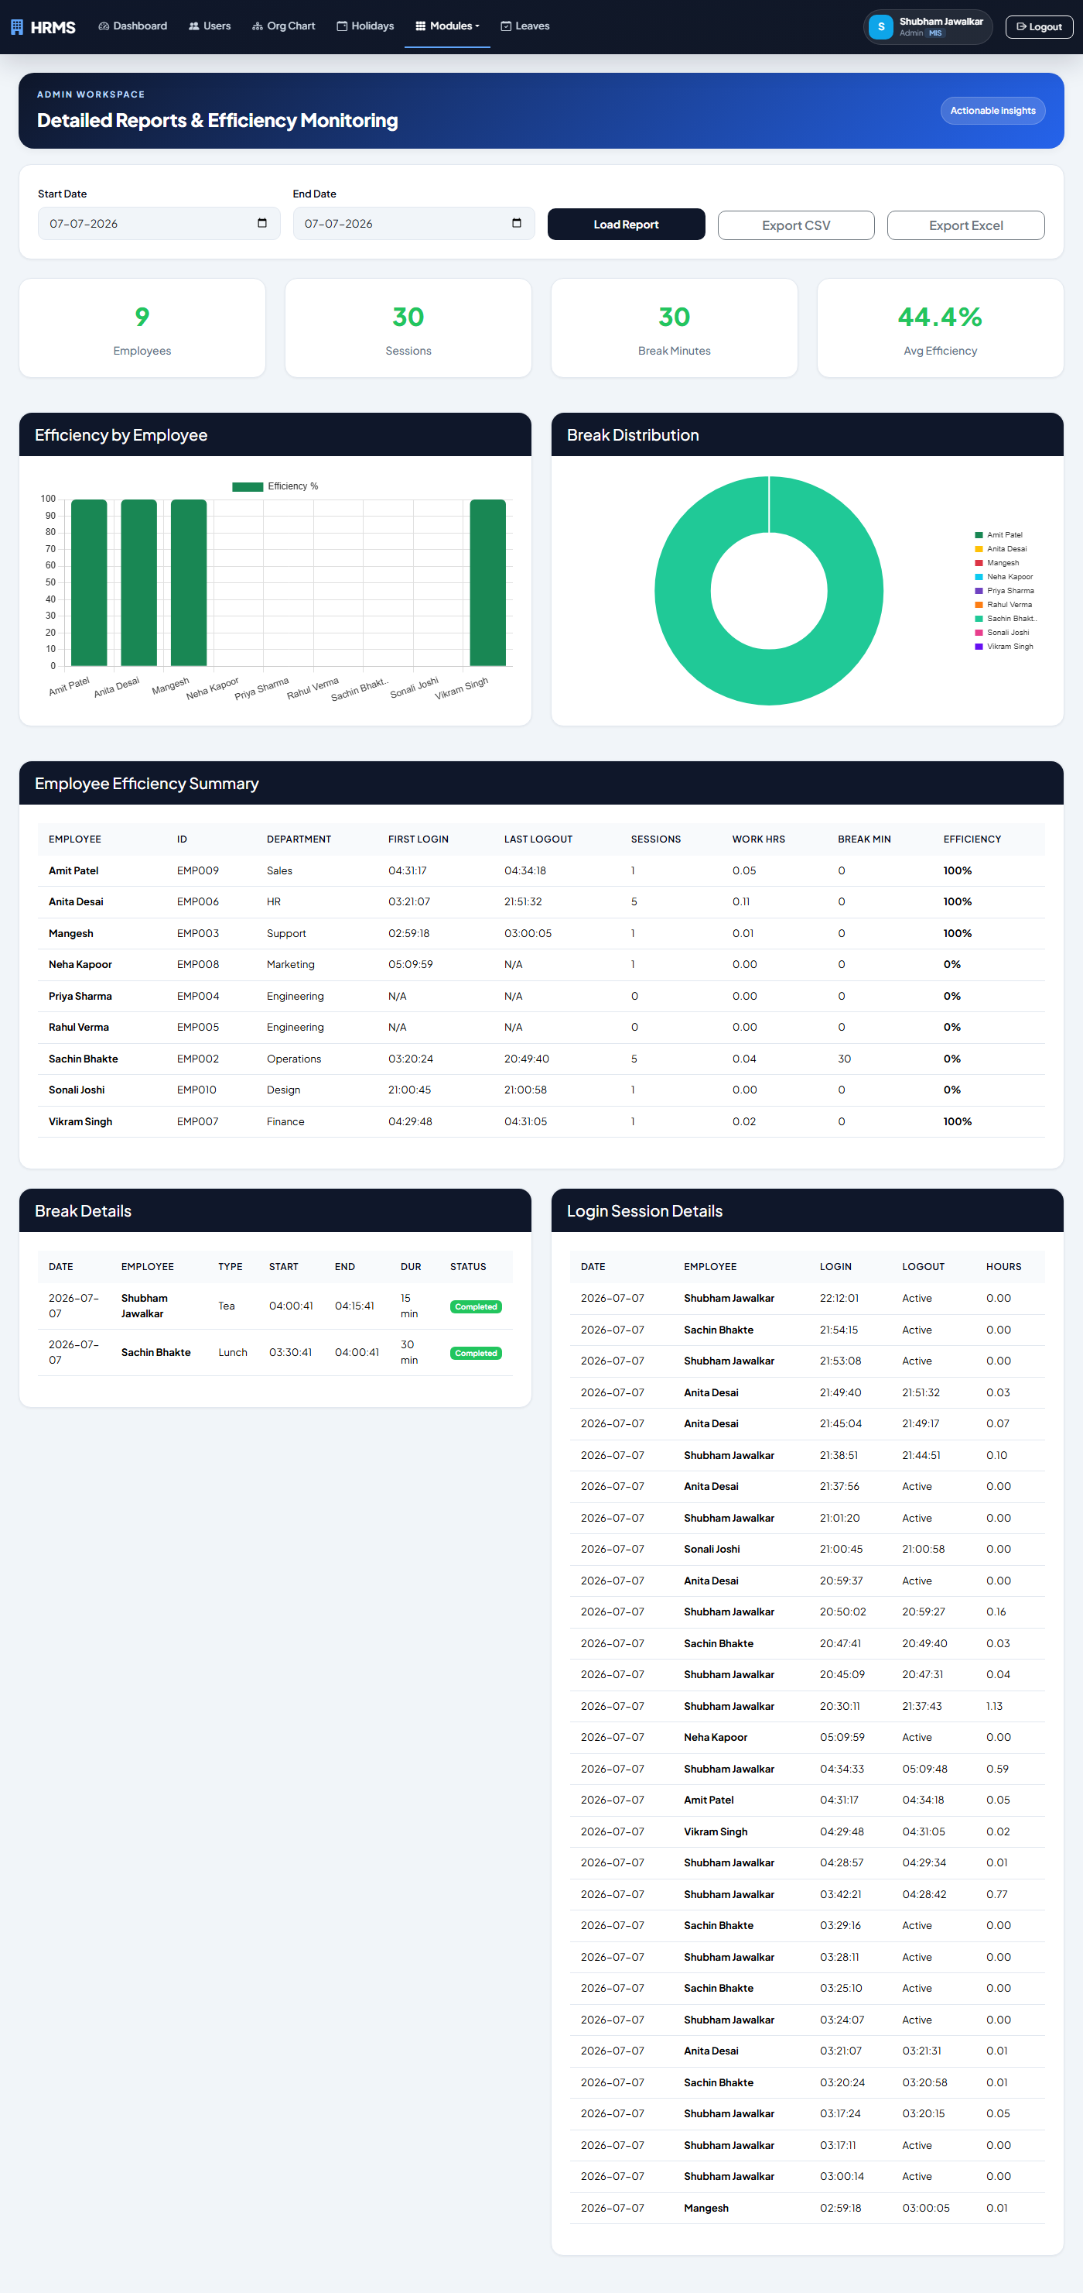
Reports & Export
Date-range reports with CSV/Excel export and employee efficiency metrics.

Slide 19
Leave & Attendance
Leave applications, balance tracking, regularization

Slide 20
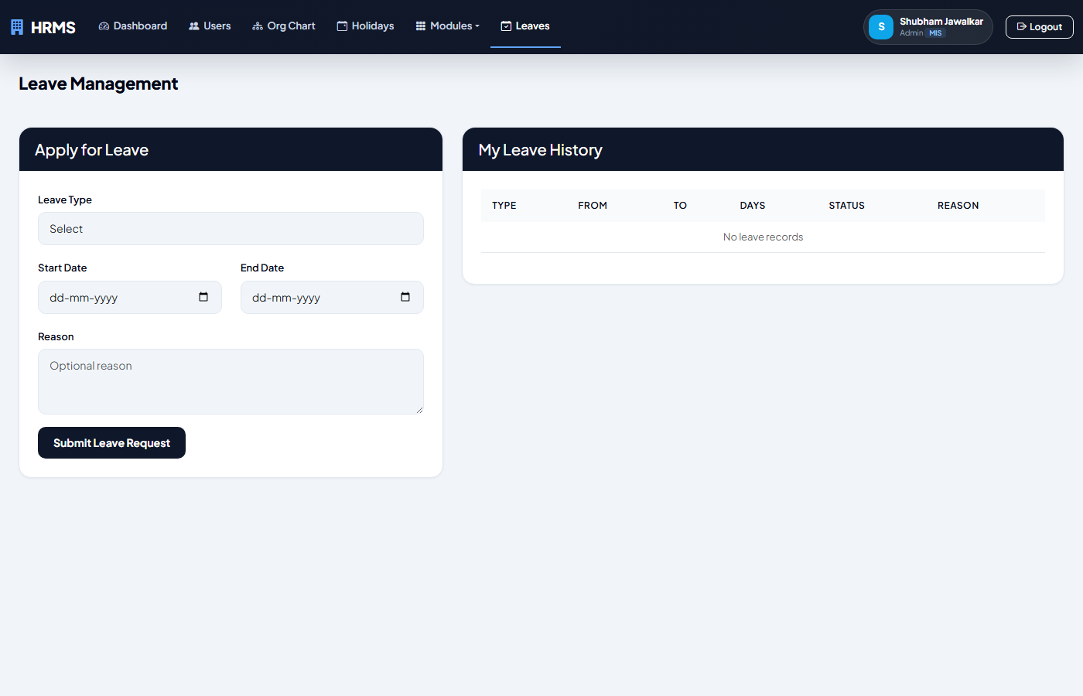
Leave Management (Employee)
Apply for leave, view balance, track approval status with real-time notifications.

Slide 21
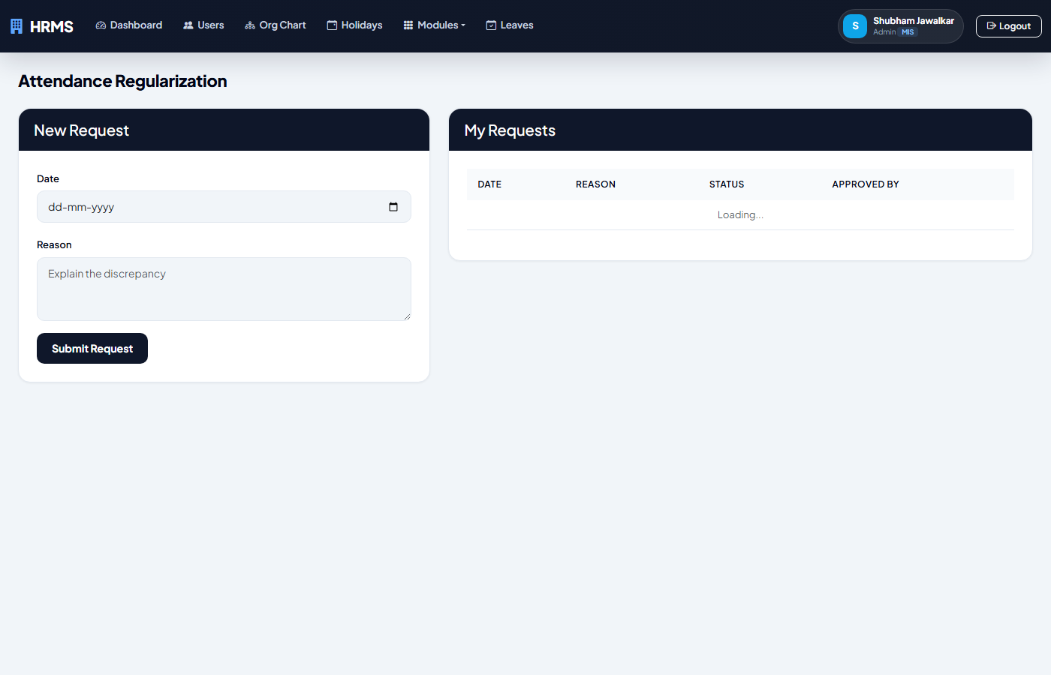
Regularization (Employee)
Submit attendance regularization requests for missing or incorrect logs.

Slide 22
Asset Management
Issue, track, and return company assets

Slide 23
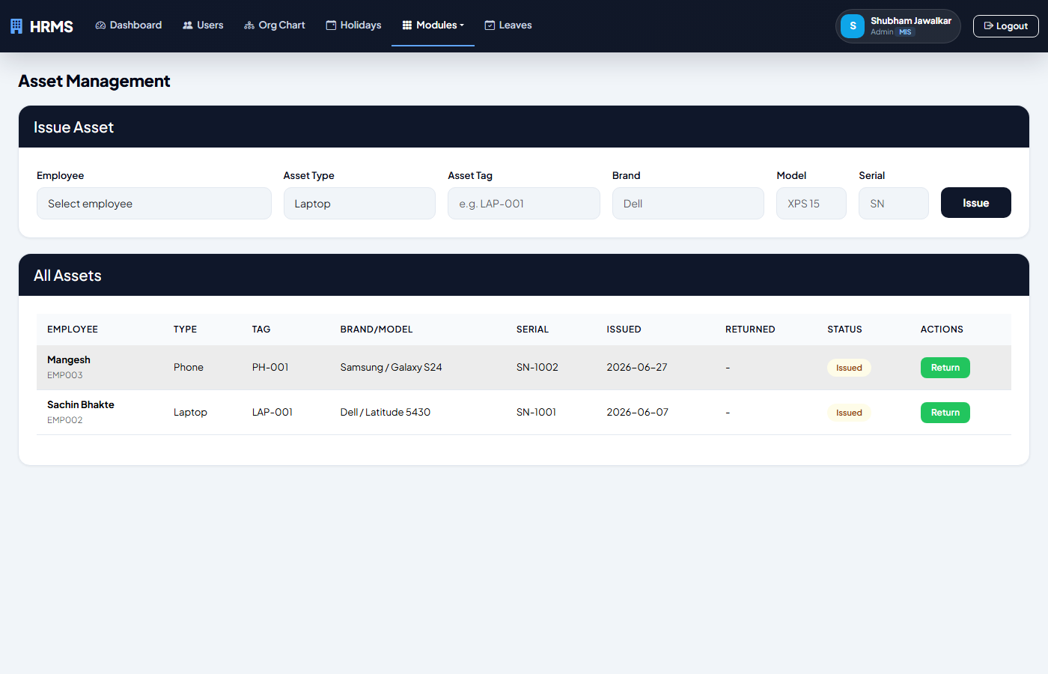
Asset Management
Issue, track, and return company assets (laptops, monitors, phones).

Slide 24
Recruitment (ATS)
Jobs, candidates, hiring pipeline

Slide 25
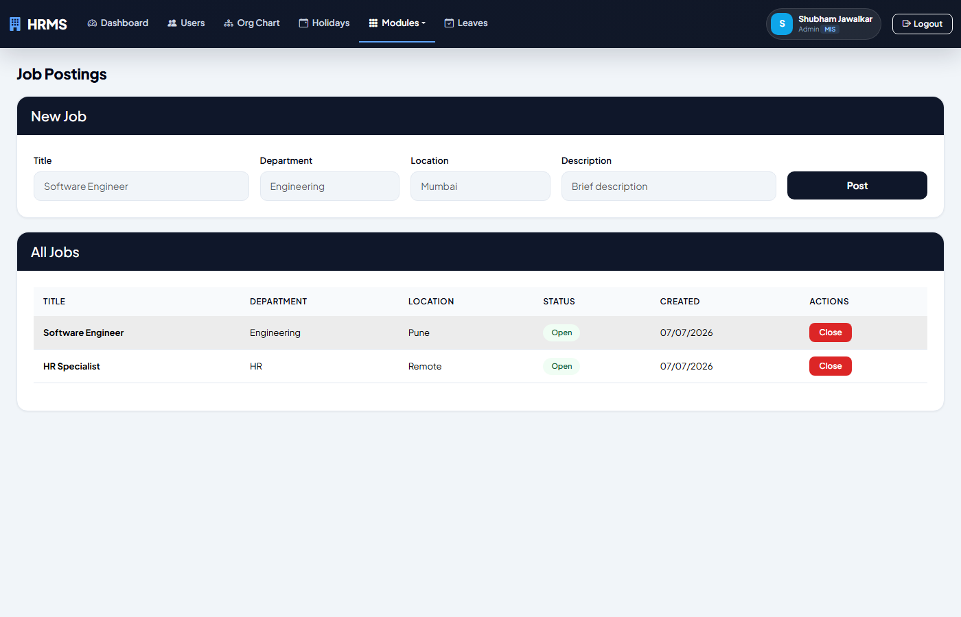
Job Postings
Create and manage job openings with department, location, and status.

Slide 26
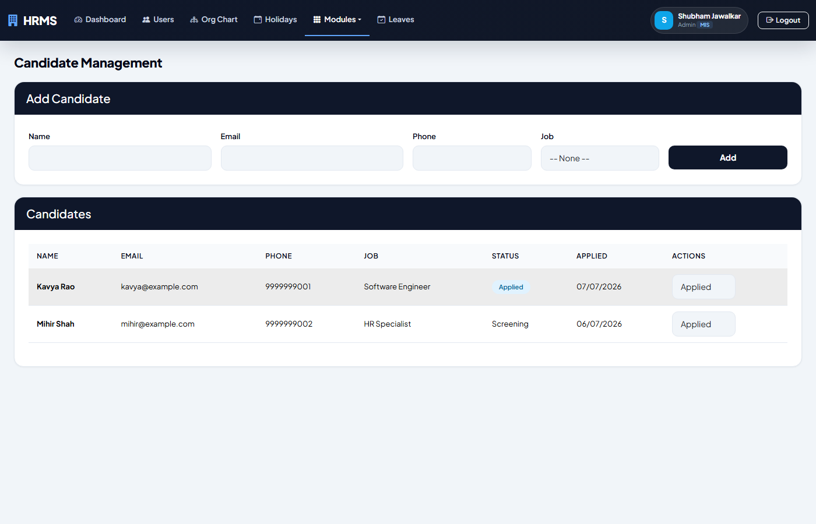
Candidate Management
Track candidates through hiring pipeline: Applied Screened Interviewed Offered Hired.

Slide 27
Onboarding & Offboarding
New-hire tasks and exit process

Slide 28
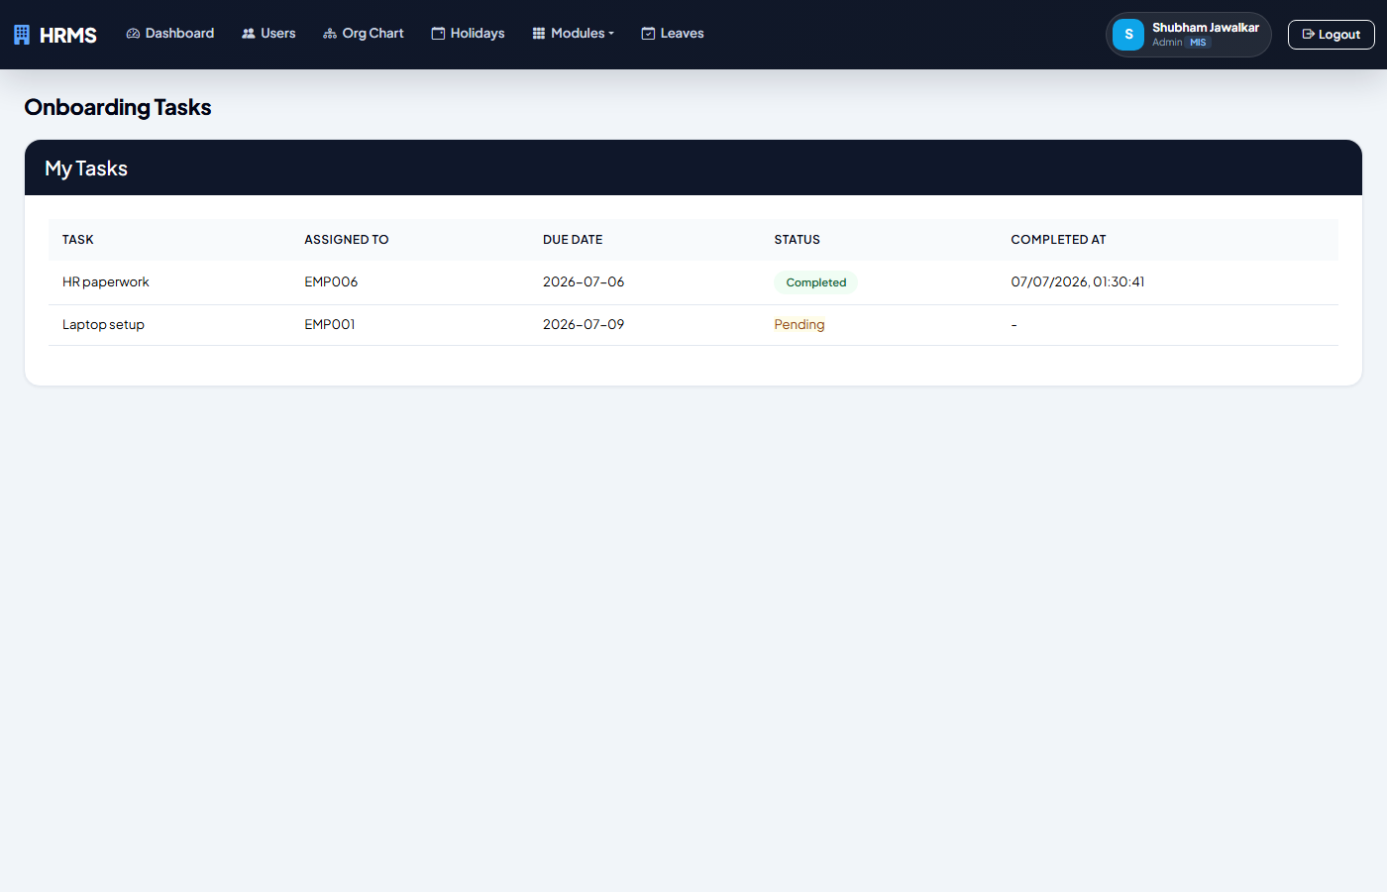
Onboarding (Employee)
View assigned onboarding tasks with status tracking.

Slide 29
Payroll
Salary structures, payroll runs, deductions (PF/ESI/PT)

Slide 30
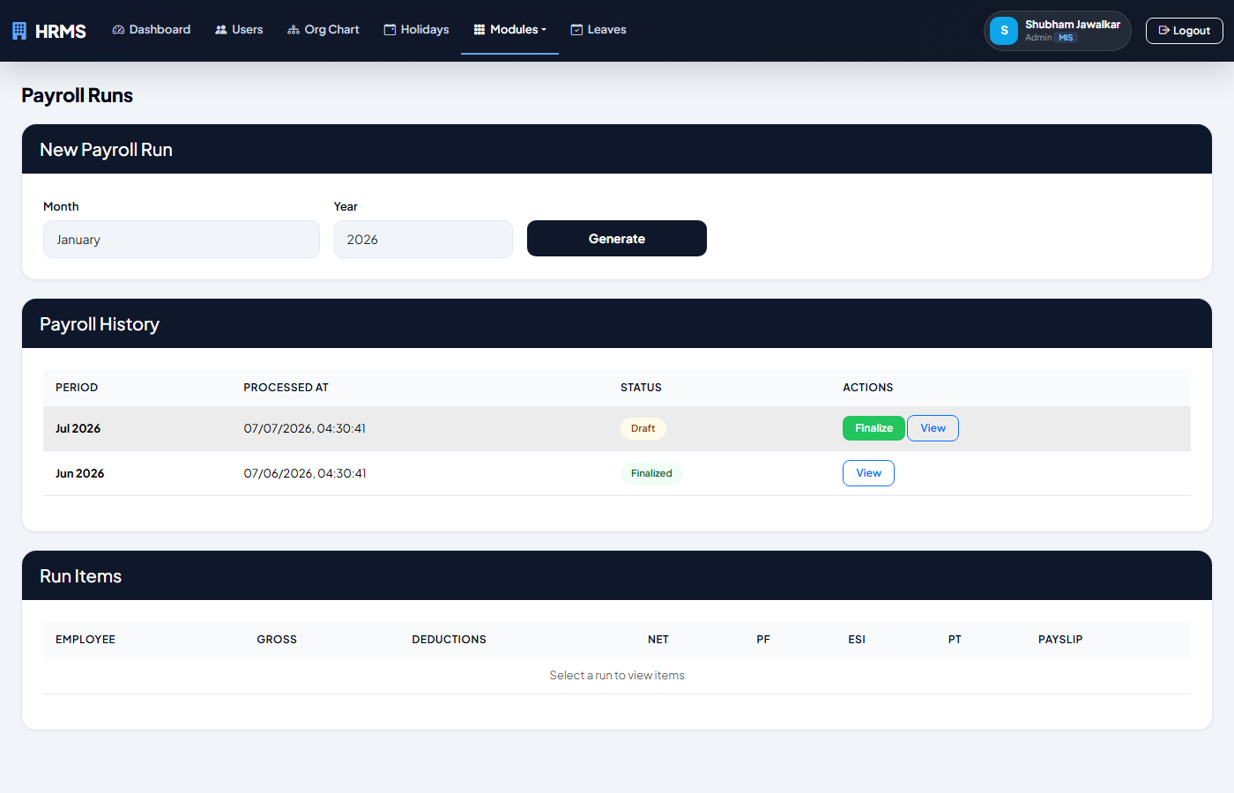
Payroll Runs
Monthly payroll generation with auto-calculated PF, ESI, PT deductions.

Slide 31
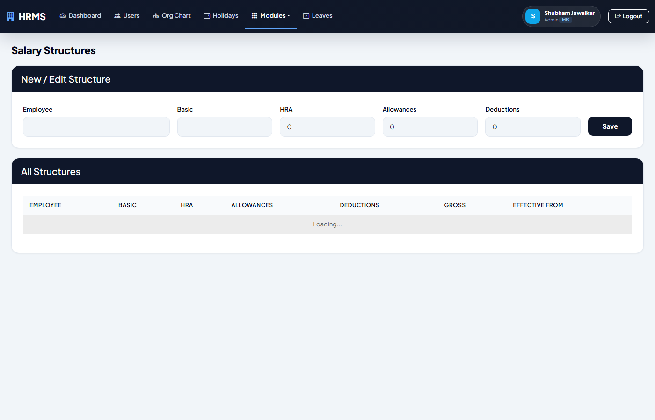
Salary Structures
Configure employee salary components: Basic, HRA, Allowances, Deductions.

Slide 32
Performance Management
Goals, reviews, ratings, 360 feedback

Slide 33
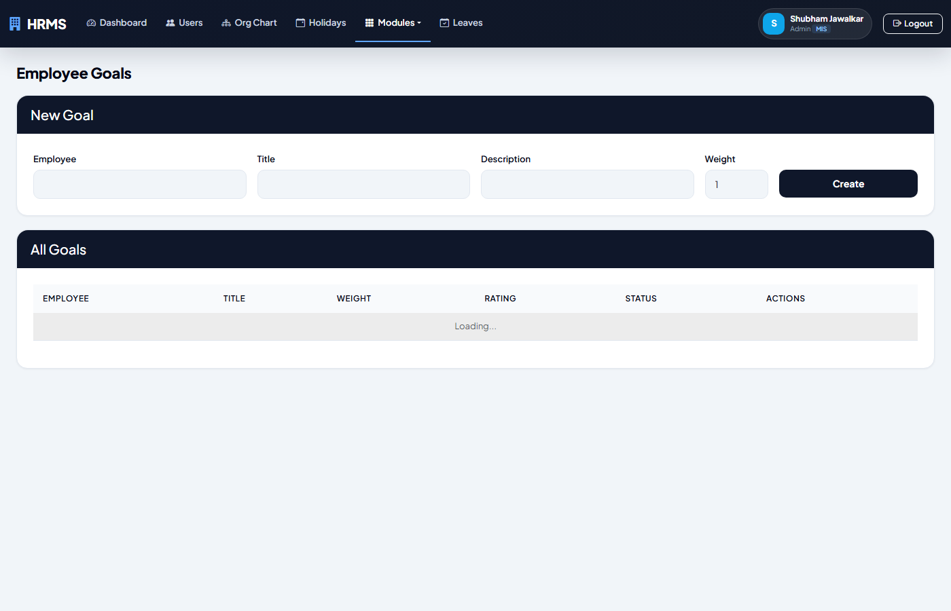
Performance Goals (Admin)
Set and rate employee goals/KRAs with weight and 1-5 star ratings.

Slide 34
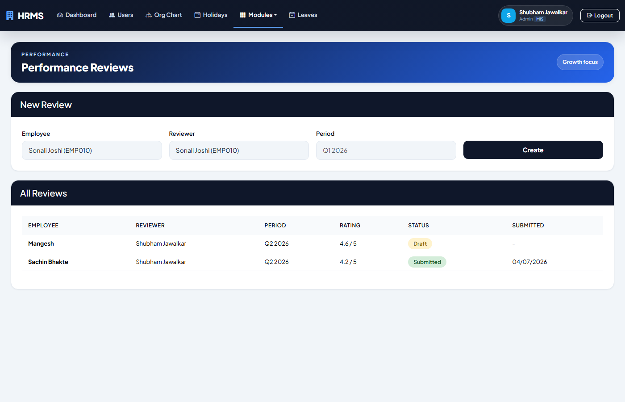
Performance Reviews (Admin)
Create review cycles, assign reviewers, track submitted ratings.

Slide 35
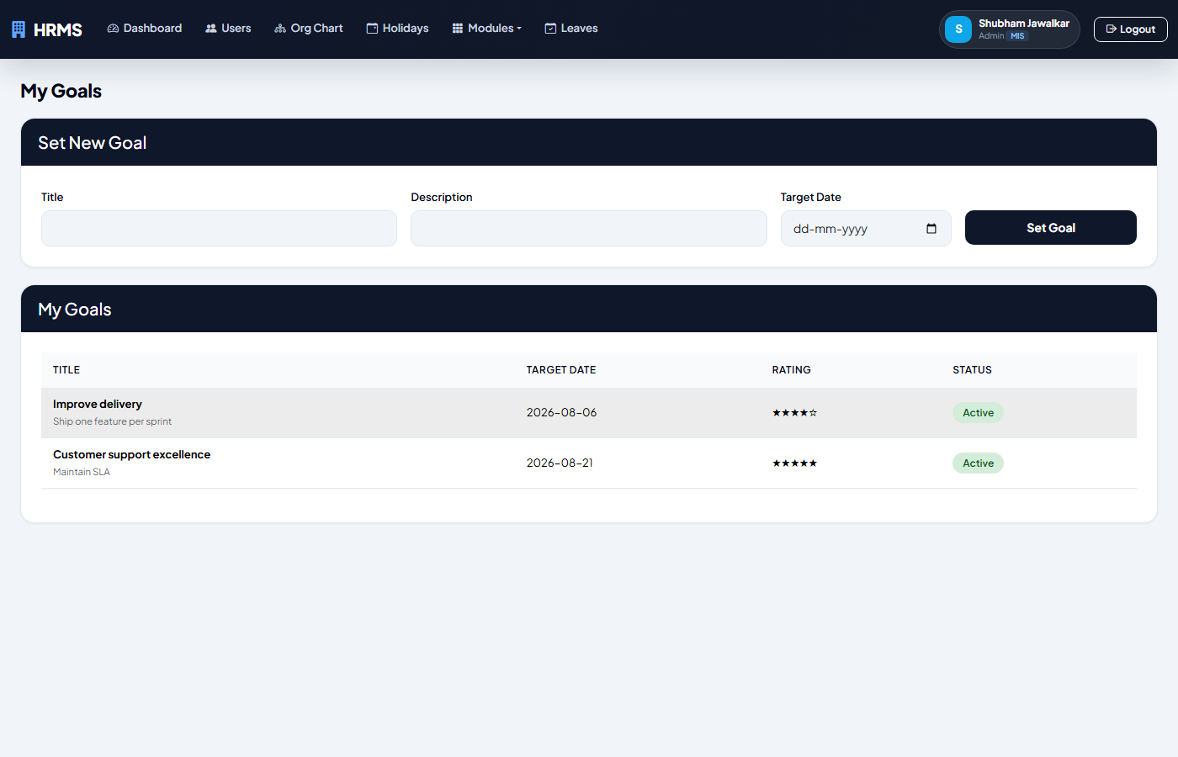
My Goals (Employee)
Set personal goals and view managerial ratings.

Slide 36
Expense Management
Claims, approvals, reimbursements

Slide 37
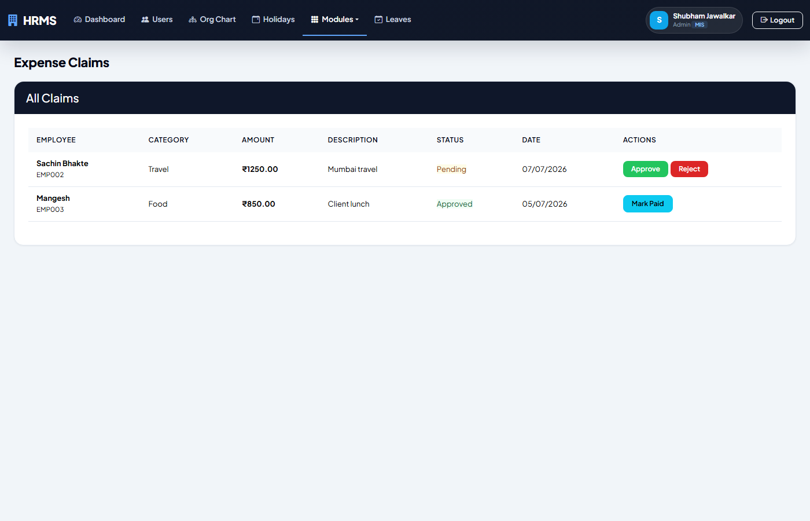
Expense Management (Admin)
Approve/reject employee expense claims with Paid workflow.

Slide 38
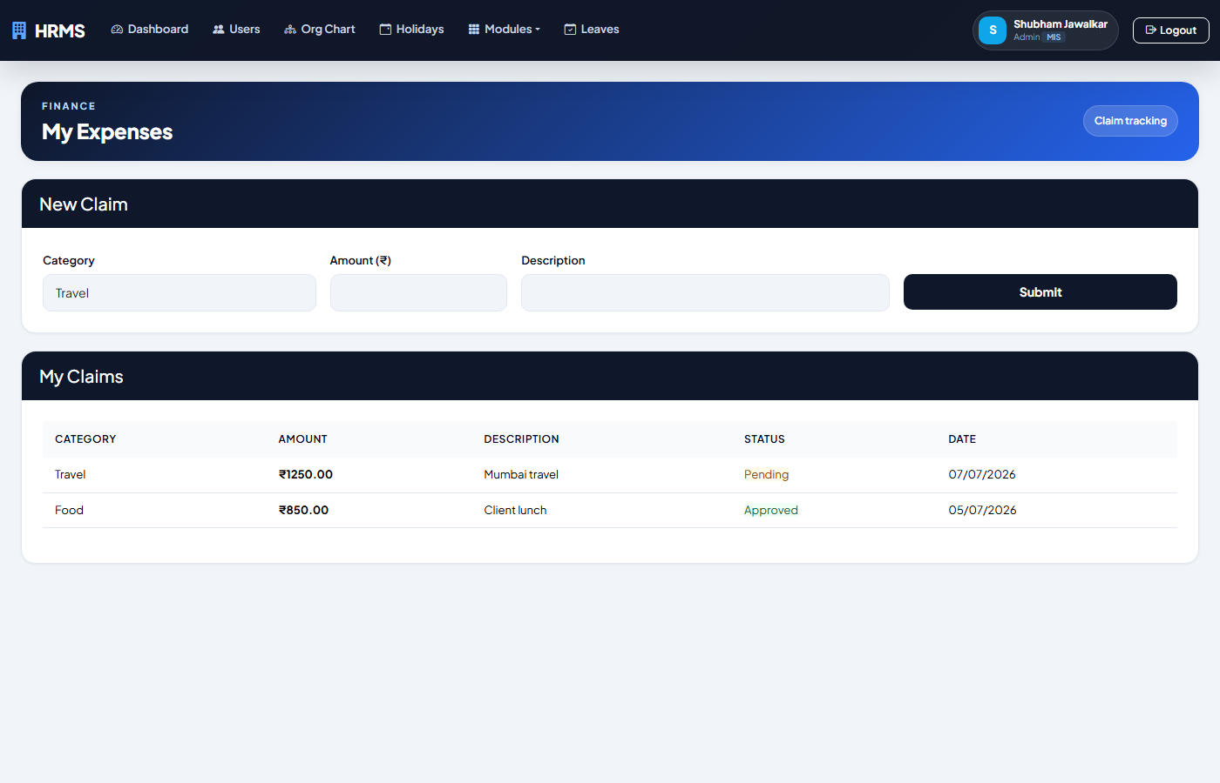
My Expenses (Employee)
Submit expense claims with category and amount.

Slide 39
Help Desk
Tickets, comments, assignments

Slide 40
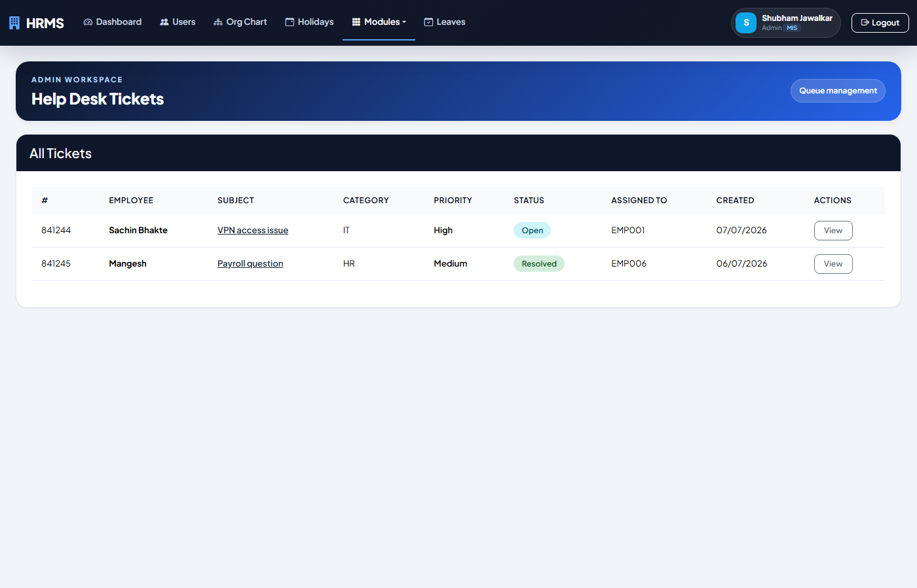
Help Desk (Admin)
Manage support tickets with comments, priority, status tracking, and assignment.

Slide 41
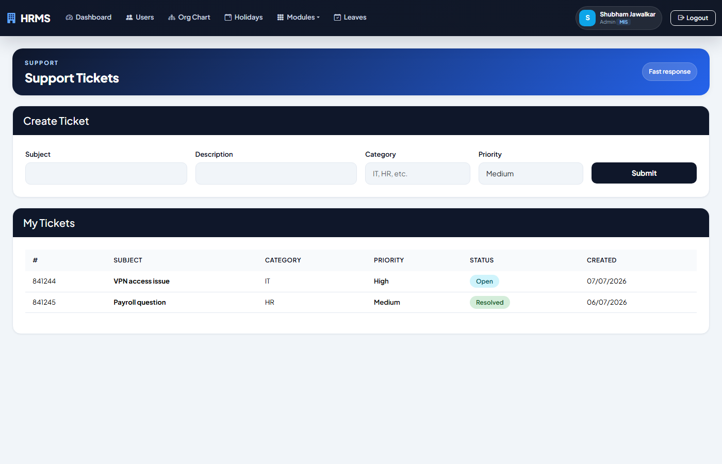
My Tickets (Employee)
Create and track support tickets.

Slide 42
Document Management
Upload, download, manage employee documents

Slide 43
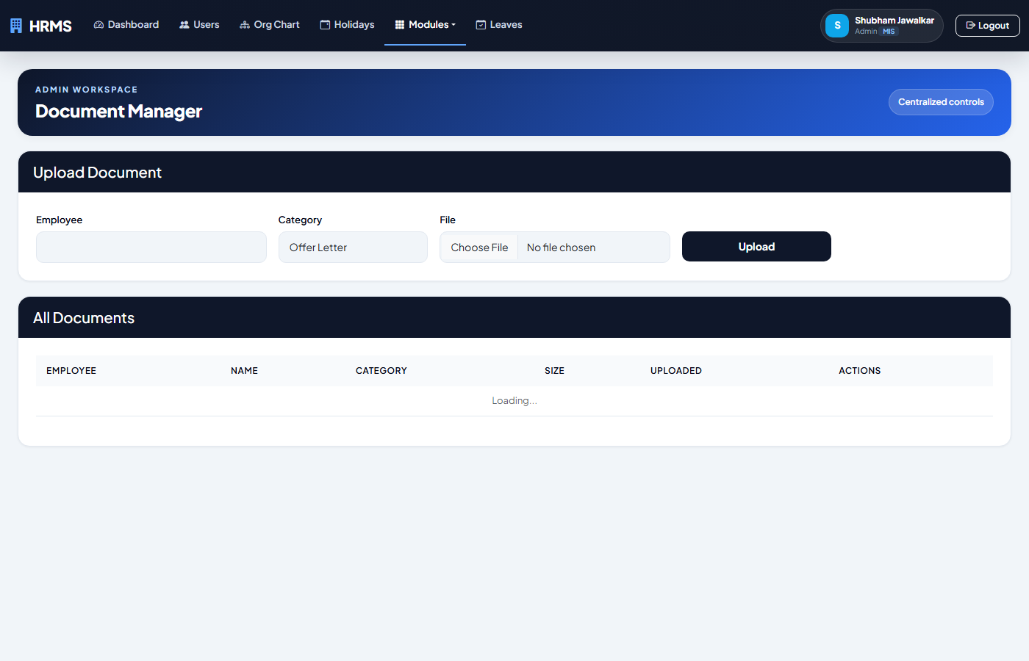
Document Manager (Admin)
Upload, download, and manage employee documents with categories.

Slide 44
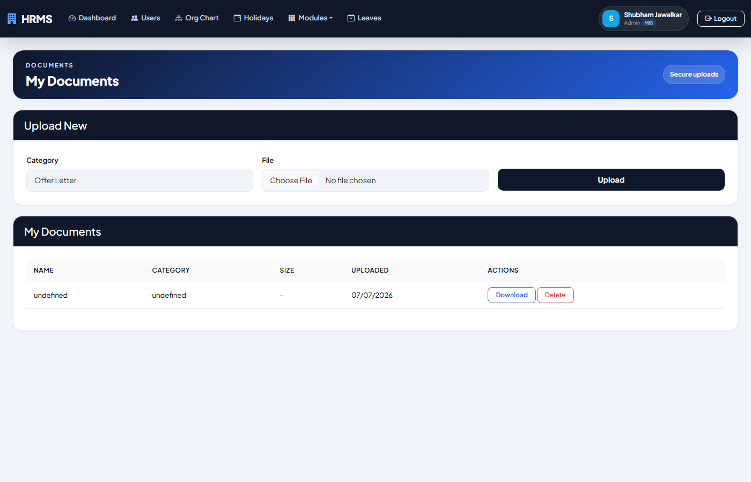
My Documents (Employee)
Upload and manage personal documents.

Slide 45
Employee Self-Service
Profile, dependents, emergency contacts

Slide 46
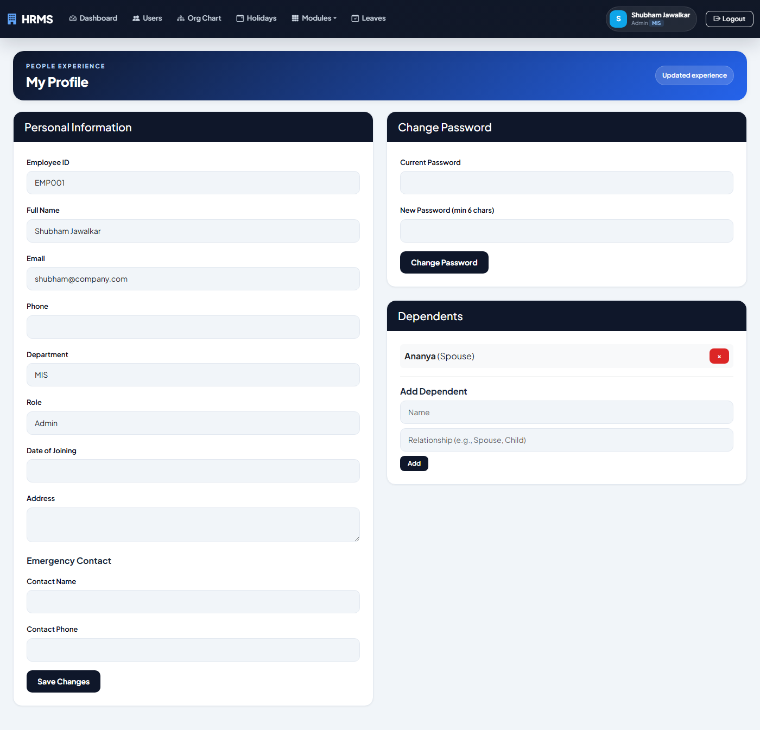
Employee Profile
View/edit personal details, emergency contacts, and dependents.

Slide 47
Analytics & Reports
Charts, attrition risk, data export

Slide 48
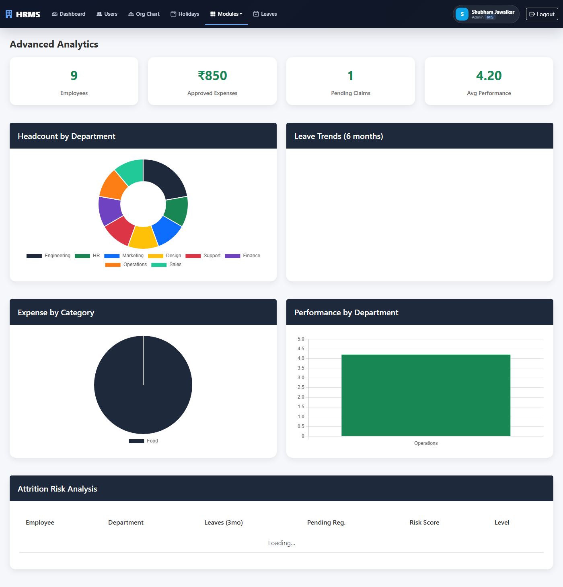
Advanced Analytics
Dashboard with 4 Chart.js charts: headcount, leave trends, expenses, performance + attrition risk.

Slide 49
Thank You
HRMS Complete HR Solution
Generated 2026-07-07 22:13

