Slide 1

IILM University, Greater Noida
School of Computer Science and Engineering
Internship Evaluation Report
Java Full Stack Developer
Virtual Internship
Shubham Kumar
Roll No. 2410031595 · B.Tech CSE · Batch 2026–27

Slide 2
Contents
What This Report Covers
4.1
Internship Overview
4.6
Technologies & Tools Used
4.2
Organization Profile
4.7
System Architecture
4.3
Problem Statement
4.8
Methodology
4.4
Project Objectives
4.9
Expected Outcomes
4.5
Scope of the Project
4.10
Certificate of Completion
Java Full Stack Developer Virtual Internship
2 / 13

Slide 3
4.1 · Introduction
An Industry-Aligned
Virtual Internship
An 8-week virtual internship organised under the National Internship Portal, Ministry of Education, delivered in partnership with AICTE and EduSkills Academy — focused on building practical, industry-relevant skills in full stack Java development across both front-end and back-end technologies.
Duration
8 weeks
Period
August – October 2026
Result
Certificate of Virtual Internship — Grade P (Pass)
Java Full Stack Developer Virtual Internship
3 / 13

Slide 4
4.2 · Organization Profile
Who Delivered the Program
AICTE
National Internship Portal
EduSkills Academy
All India Council for Technical Education, Ministry of Education — program authority via the National Internship Portal.
The Government platform connecting students to structured, verified virtual internship programs.
“Nation Building Through Skills” — designs and delivers the industry-aligned Java full stack curriculum.
Java Full Stack Developer Virtual Internship
4 / 13

Slide 5
4.3 · Problem Statement
Bridging Theory and Practice
Many engineering graduates carry strong theoretical knowledge but limited hands-on experience building complete, end-to-end web applications.
The internship addressed this gap through guided development of a full stack application — spanning front-end interfaces, back-end logic, and database integration.
The goal: close the distance between classroom learning and industry-ready development skills, using Java-based tools and frameworks throughout.
Java Full Stack Developer Virtual Internship
5 / 13

Slide 6
4.4 · Project Objectives
What the Internship Set Out to Achieve
Gain practical, hands-on experience developing full stack web applications using Java-based technologies.
Apply front-end fundamentals — HTML, CSS, JavaScript — alongside back-end development in Java.
Design, connect, and query relational databases as part of a complete application stack.
Build and deploy a working full stack project following industry-standard practices.
Develop problem-solving and debugging skills relevant to real-world software engineering roles.
Java Full Stack Developer Virtual Internship
6 / 13

Slide 7
4.5 · Scope of the Project
In Scope & Out of Scope
In scope
Out of scope
Client-side interface, server-side logic, and persistent data storage
Deployment to live production systems
Structured 8-week curriculum with modules, assignments, and assessments
Access to any organisation's proprietary codebase
Guided sample projects provided under the internship
Java Full Stack Developer Virtual Internship
7 / 13

Slide 8
4.6 · Technologies & Tools Used
The Full Stack Toolkit
Java
Core language for back-end application development
HTML · CSS · JavaScript
Responsive front-end user interfaces
Spring / Spring Boot
Back-end REST APIs and business logic
SQL (Relational DB)
Data modelling, storage, and querying
IDE & Version Control
Writing, testing, and managing project code
Java Full Stack Developer Virtual Internship
8 / 13

Slide 9
4.7 · System Architecture
Three-Tier Full Stack Design
01
Presentation Layer
HTML, CSS, JavaScript — user interface
02
Application Layer
Java, Spring / Spring Boot — business logic & REST APIs
03
Data Layer
Relational database (SQL) — persistent storage
Layers communicate through well-defined REST API endpoints, following the client–server model.
Java Full Stack Developer Virtual Internship
9 / 13

Slide 10
4.8 · Methodology
How the Project Was Built
Completed structured learning modules on front-end basics, Java fundamentals, and full stack concepts.
Designed the front-end interface using HTML, CSS, and JavaScript.
Developed back-end services and REST APIs using Java and Spring Boot.
Designed the database schema and integrated it with the back-end application.
Tested and debugged the application across front-end, back-end, and database layers.
Submitted assignments via the National Internship Portal for evaluation and certification.
Java Full Stack Developer Virtual Internship
10 / 13

Slide 11
4.9 · Expected Outcomes
Skills & Results Achieved
Full Stack Fluency
API Development
Working understanding of Java development across front-end, back-end, and database layers.
Hands-on experience with the Spring / Spring Boot framework and REST API design.
Debugging Discipline
Certification
Improved problem-solving skills applicable to real-world software projects.
Certificate of Virtual Internship (Grade P) jointly issued by AICTE and EduSkills Academy.
Java Full Stack Developer Virtual Internship
11 / 13

Slide 12
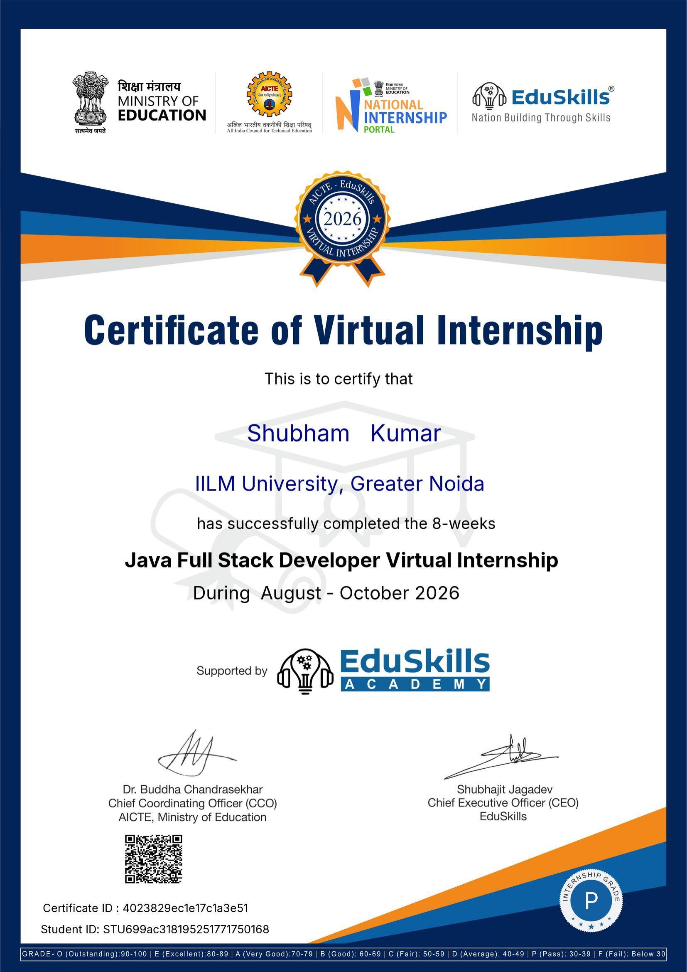
4.10 · Certificate of Completion
Certificate of Virtual Internship
Java Full Stack Developer Virtual Internship
12 / 13

Slide 13
Thank You
Java Full Stack Developer Virtual Internship — Questions & Discussion
Shubham Kumar · 2410031595 · IILM University, Greater Noida

