Slide 1
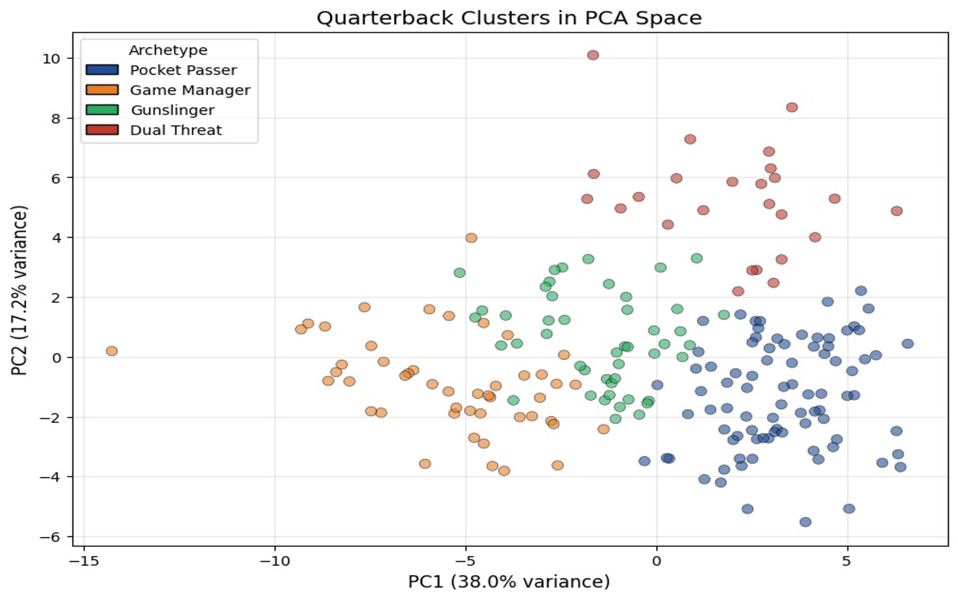
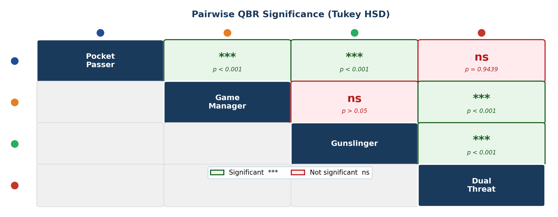

Identifying NFL Quarterback Archetypes via K-Means Clustering
Shubhan Tamhane | Undergraduate Data Science Student | University of Connecticut | Spring 2026
ABSTRACT
RESULTS — QB CLUSTERS IN PCA SPACE
STATISTICAL VALIDATION
Conventional QB metrics like passer rating collapse multidimensional playing styles into a single value. This study asks: Can K-means clustering identify distinct, interpretable archetypes from NFL performance?
10 / 10 metrics statistically significant
by one-way ANOVA (all p < 0.001)
Silhouette score at k=4: 0.208 | Elbow + silhouette both confirmed k=4 | Tukey HSD run on all 10 metrics
DATA
TUKEY HSD POST-HOC RESULTS (QBR)
204
2019–24
≥100/20
QB-Seasons
NFL Seasons
Pass/Rush Att.
Source: Pro Football Reference. Merged passing & rushing season stats; mid-season trades handled via totals rows. Missing QBR imputed with mean; longest rush with median.
METHODS
1
Feature Engineering 43 passing + rushing metrics; non-numeric identifiers dropped.
PC1 (38.0% variance) separates high-volume passers from limited starters. PC2 (17.2% variance) isolates rushing-dominant players. Dual Threat QBs form a visually distinct cluster at high PC2 values.
2
Standardization Z-score scaling via StandardScaler to equalize feature magnitudes.
💡 Key Finding
3
PCA Applied for visualization & dimensionality reduction (~90% variance at 10 PCs).
CLUSTER MEANS (KEY METRICS)
Pocket Passers and Dual Threats show no significant difference in QBR (p = 0.9439), despite radically different playing styles, elite efficiency is achievable through passing volume or rushing dominance equally.
4
K-Means Clustering k-means++ init; k=2–10 evaluated via elbow + silhouette. k=4 selected.
Archetype | Pass Yds | TD (pass) | INT | QBR | Rush Yds | Rush TD
🔵 Pocket Passer | 4,102 | 28.3 | 10.5 | 61.8 | 172 | 1.5
🟠 Game Manager | 1,475 | 8.1 | 5.7 | 43.4 | 139 | 0.9
🟢 Gunslinger | 2,903 | 15.1 | 10.8 | 46.4 | 237 | 1.2
🔴 Dual Threat | 3,430 | 23.8 | 9.8 | 63.0 | 720 | 5.8
5
Validation One-way ANOVA + Tukey HSD post-hoc tests across all key metrics.
ARCHETYPE DISTRIBUTION
CONCLUSIONS
✓ All 10 ANOVA tests significant (p < 0.001) — clusters are statistically real.
✓ Pocket Passers and Dual Threats have similar QBR, efficiency achieved via different styles.
⚠ Archetypes exist on a continuum; moderate boundary overlap is expected.
EXAMPLE PLAYERS PER ARCHETYPE
→ Future work: within-career style evolution; Next gen stats
Pocket Passer: Patrick Mahomes (KC), Dak Prescott (DAL), Joe Burrow (CIN), Tom Brady (NE)
Game Manager: Mac Jones (NE), Devlin Hodges (PIT) , Early Jalen Hurts (2020, PHI)
CODE AND REPRODUCIBILITY
CODE & REPRODUCIBILITY
Gunslinger: Justin Herbert (LAC), Taylor Heinicke (WAS) , Sam Howell (WAS) , Josh Johnson (DEN)
GitHub Repository
github.com/ShubhanTamhane1/ nfl-qb-archetypes
Scan for source code, notebook, and data pipeline.
Dual Threat: Lamar Jackson (BAL) , Kyler Murray (ARI) , Josh Allen (BUF) , Jalen Hurts (PHI)
References: Celebi et al. (2013) Expert Syst. Appl. 40:200–210 • Lutz (2012) J. Quant. Anal. Sports 8 • Quealy & Carter (2013) NYT • Data: Pro Football Reference (pfr.com)

