Slide 1
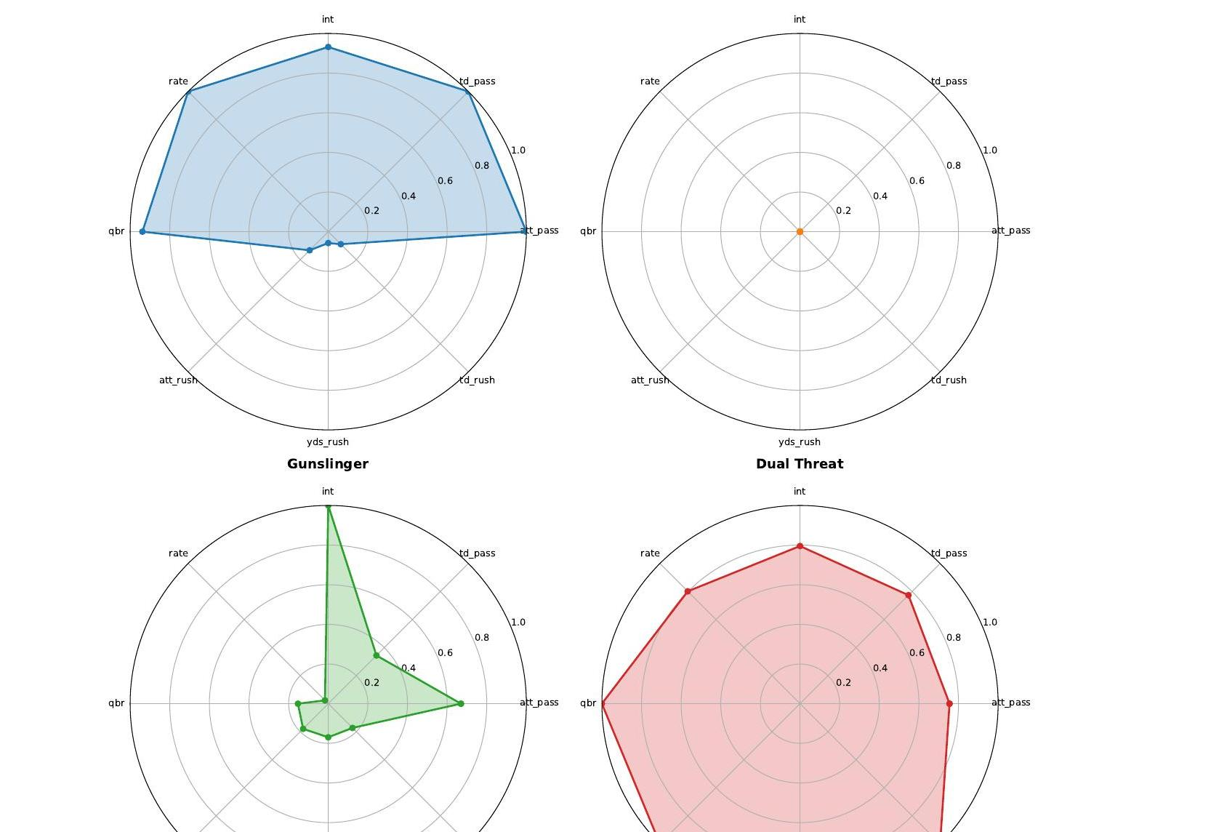
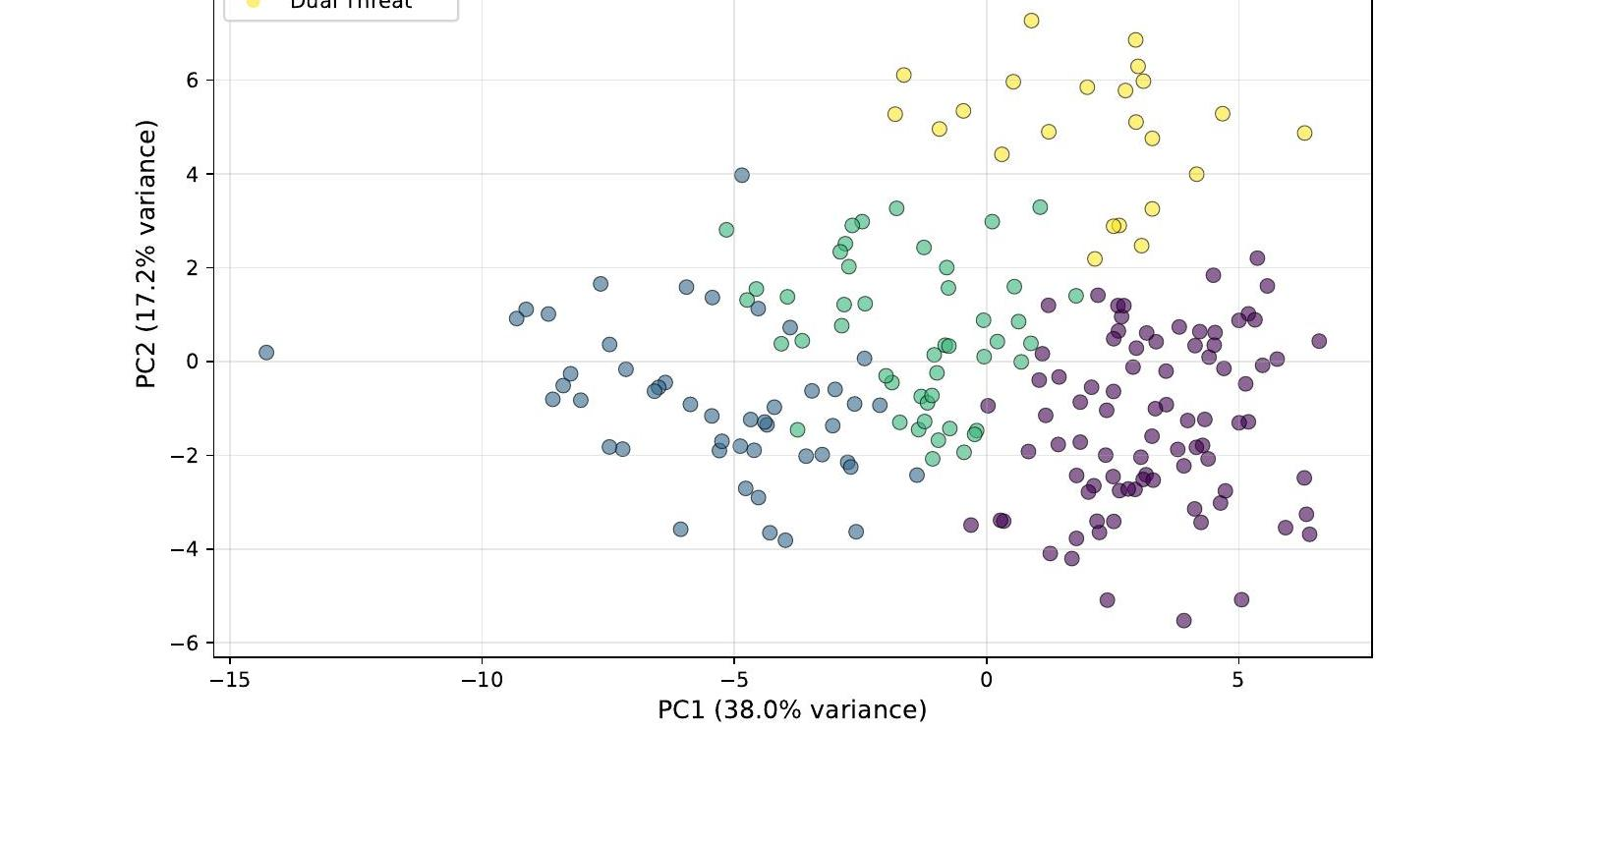
Identifying NFL Quarterback Archetypes via K-Means Clustering
UCONN
DATA SCIENCE
Shubhan Tamhane | Undergraduate Data Science Student | University of Connecticut | Spring 2026
INTRODUCTION
RESULTS — ARCHETYPE RADAR PROFILES
RESULTS — QB CLUSTERS IN PCA SPACE
Conventional QB metrics like passer rating collapse multidimensional playing styles into a single value. This study asks: Can K-means clustering identify distinct, interpretable archetypes from NFL performance data — without imposing labels a priori?
DATA
204
2019–24
≥100/20
QB-Seasons
NFL Seasons
Pass/Rush Att.
Pro Football Reference. Merged passing & rushing stats; mid-season trades via totals rows. QBR imputed with mean; longest rush with median.
PC1 (38.0%) separates high-volume QBs. PC2 (17.2%) isolates rushing-dominant players. Dual Threat QBs form a visually distinct cluster at high PC2.
Normalized profiles (0–1) across 8 key metrics. Dual Threat QBs dominate rushing dimensions; Game Managers cluster near zero.
STATISTICAL VALIDATION
METHODS
10 / 10 metrics significant by one-way ANOVA (all p < 0.001)
1
Feature Engineering 43 passing + rushing metrics; non-numeric identifiers dropped.
CLUSTER MEANS (KEY METRICS)
2
Standardization Z-score scaling (StandardScaler) to equalize magnitudes.
Archetype | Pass Yds | TD | INT | QBR | Rush Yds | n
🔵 Pocket Passer | 4,102 | 28.3 | 10.5 | 61.8 | 172 | 85
🟠 Game Manager | 1,475 | 8.1 | 5.7 | 43.4 | 139 | 48
🟢 Gunslinger | 2,903 | 15.1 | 10.8 | 46.4 | 237 | 47
🔴 Dual Threat | 3,430 | 23.8 | 9.8 | 63.0 | 720 | 25
Silhouette k=4: 0.208 | Elbow + silhouette confirmed k=4 | Tukey HSD run on all metrics
3
PCA Dimensionality reduction; ~90% variance at 10 PCs.
TUKEY HSD POST-HOC (QBR)
4
K-Means Clustering k-means++ init; k=2–10 via elbow + silhouette score. k=4 chosen.
Comparison | p-value | Sig.
Pocket Passer vs. Game Manager | < 0.001 | ***
Pocket Passer vs. Gunslinger | < 0.001 | ***
Pocket Passer vs. Dual Threat | 0.9439 | ns
Game Manager vs. Dual Threat | < 0.001 | ***
Gunslinger vs. Dual Threat | < 0.001 | ***
5
Validation One-way ANOVA + Tukey HSD post-hoc on all key metrics.
CONCLUSIONS
EXAMPLE PLAYERS PER ARCHETYPE
✓ All 10 ANOVA tests significant (p < 0.001) — clusters are statistically real.
Pocket Passer: Patrick Mahomes, Dak Prescott, Joe Burrow, Tom Brady, Aaron Rodgers
✓ High-performing QBs across archetypes share efficiency but differ in volume & mobility.
Game Manager: Mac Jones, Devlin Hodges, Early Jalen Hurts (2020)
ARCHETYPE DISTRIBUTION
⚠ Archetypes exist on a continuum; moderate overlap is expected (silhouette = 0.208).
Gunslinger: Justin Herbert, Taylor Heinicke, Sam Howell, Josh Johnson
→ Future work: within-career evolution; GMMs for soft cluster membership.
Dual Threat: Lamar Jackson, Kyler Murray, Josh Allen, Jalen Hurts
Refs: Celebi et al. (2013) • Lutz (2012) • Quealy & Carter (2013) NYT • Data: Pro Football Reference

