Slide 1
PROJECT PRESENTATION
ADVENTURE WORKS
Sales Analysis & Dashboard Project
End-to-End Data Analytics using
Excel • SQL • Power BI • Tableau
Data Preparation • Analysis • DAX • Dashboards • Business Insights
MICROSOFT EXCEL
POWER BI
SQL
TABLEAU
GOUP 2
Adventure Works | Project Presentation |
1

Slide 2
PROJECT OVERVIEW
Excel + Power BI
Adventure Works Sales Analytics • Excel • SQL • Power BI • Tableau
Adventure Works Cycles is a fictional multinational bicycle manufacturer and seller. This project transforms raw sales data into business insights across products, customers, regions and time, using Excel, SQL, Power BI and Tableau.
DATA PREPARATION
SQL ANALYSIS
VISUALIZATION
POWER QUERY
Append and merge sales/product/customer data; clean fields and create relationships.
13 business questions solved with queries, joins, dates and aggregations.
Excel, Tableau and Power BI dashboards with KPIs, charts and slicers.
Data cleaning, append/merge, transformations and calculated fields.
PROJECT WORKFLOW
Raw Data
→
Data Prep
→
Model
→
Calculations
→
Dashboard
→
Insights
DATA MODEL : Fact_Sales → DimCustomer | DimProduct | DimDate | DimSalesTerritory
Adventure Works | Project Presentation |
2

Slide 3
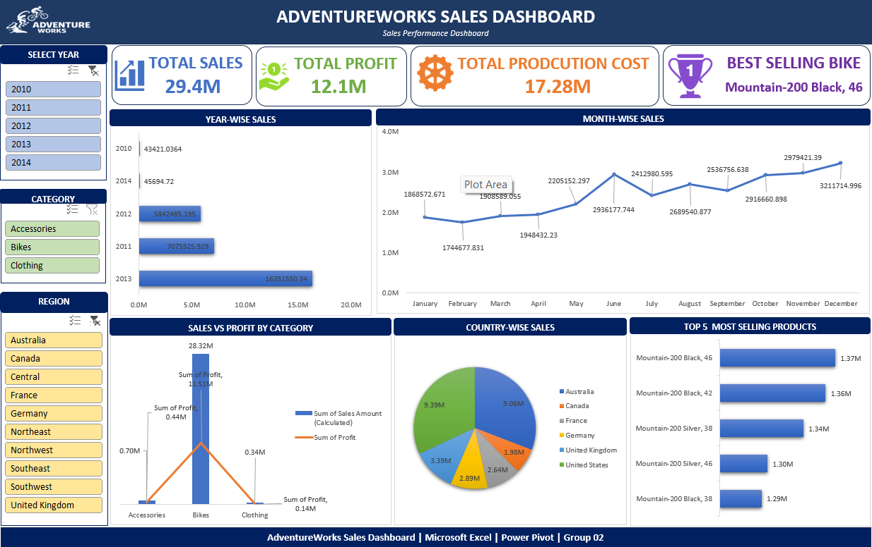
EXCEL DASHBOARD
Microsoft Excel | Pivot Tables | Charts | Slicers
EXCEL DASHBOARD SCREENSHOT
Pivot Tables
Year-wise, month-wise, quarter-wise and region analysis.
KPI Cards
Total Sales, Total Profit, Total Orders, Avg Order and Profit Margin.
Interactive Slicers
Year, Region and Category filters for focused analysis.
Charts
Bar, line, pie and combination charts for performance comparison.
Excel Work Completed
Data cleaning • calculated fields • pivot analysis • dashboard formatting
Adventure Works | Project Presentation |
3

Slide 4
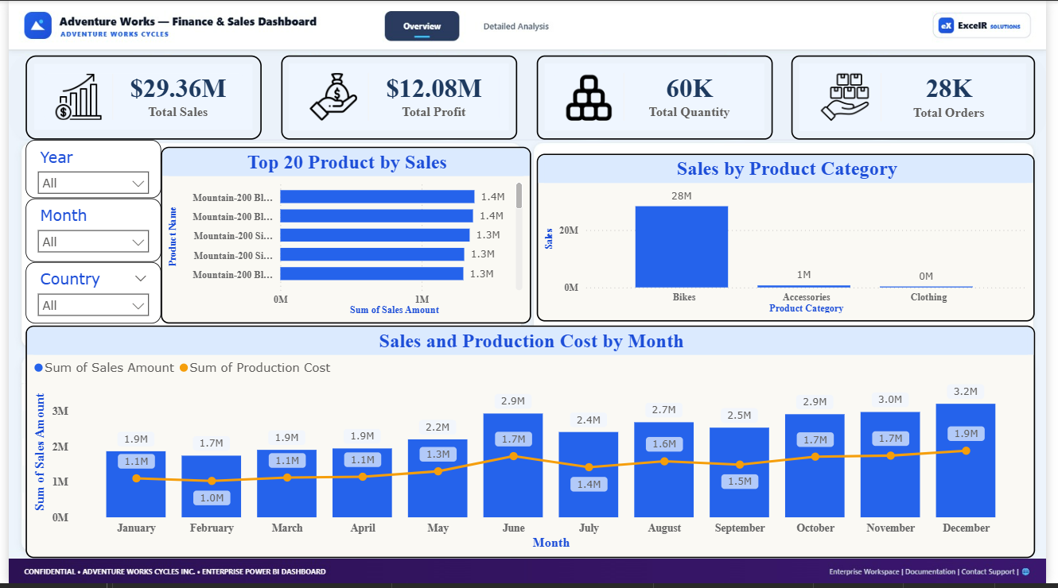
POWER BI DASHBOARD
Overview | Executive KPIs | Sales Trends | Category Analysis
PAGE 1 - FINANCE & SALES OVERVIEW
Executive KPIs
Monitors $29.36M Total Sales, $12.08M Total Profit, 60K Units, and 28K Total Orders.
Top Products & Categories
Bikes drive $28M revenue; Mountain-200 series leads top 20 selling products.
Sales vs Cost Trajectory
Monthly combo tracking revenue vs cost, peaking in Dec at $3.2M sales ($1.9M cost).
Interactive Slicers
Dynamic multi-level filtering by Year, Month, and Country across all overview visuals.
Power BI Overview Work Completed
Data Modeling • DAX Calculations • Monthly Trends & Slicers
Adventure Works | Project Presentation |
4

Slide 5
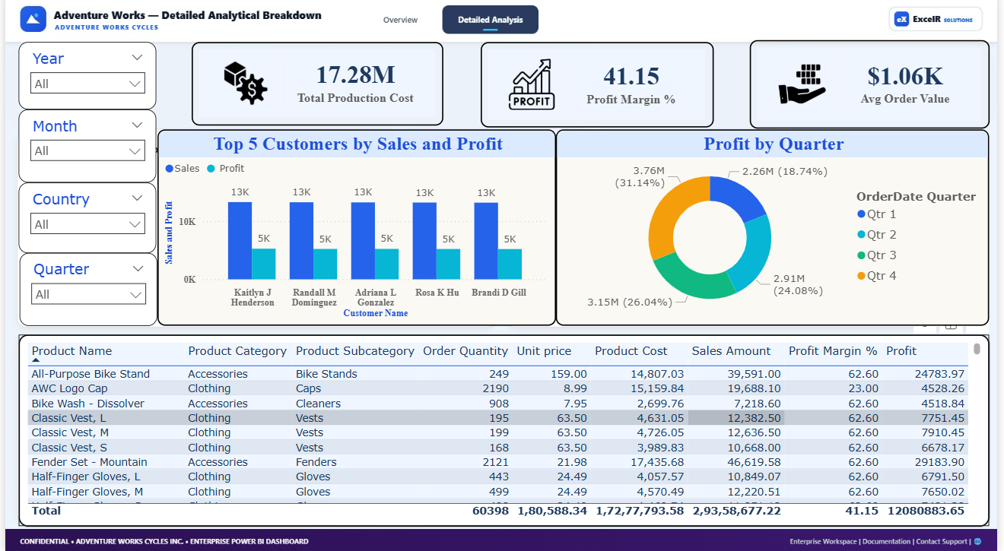
POWER BI DASHBOARD
Detailed Analysis | Production Cost | Margin % | Customer Breakdown
PAGE 2 - DETAILED ANALYTICAL BREAKDOWN
Cost & Margin Metrics
Tracks $17.28M Production Cost, 41.15% Profit Margin, and $1.06K Avg Order Value.
Top 5 Customers Analysis
Identifies high-value customers (Kaitlyn Henderson, Randall Dominguez) by sales & profit.
Quarterly Profit Distribution
Quarterly donut breakdown showing Q4 leading with $3.76M (31.14%) profit contribution.
Granular Product Matrix
Detailed matrix table breaking down product details, order quantity, cost, margin, and profit.
Power BI Detailed Analysis Completed
Customer Level Analytics • Profit Share by Quarter • Matrix Table
Adventure Works | Project Presentation |
5

Slide 6
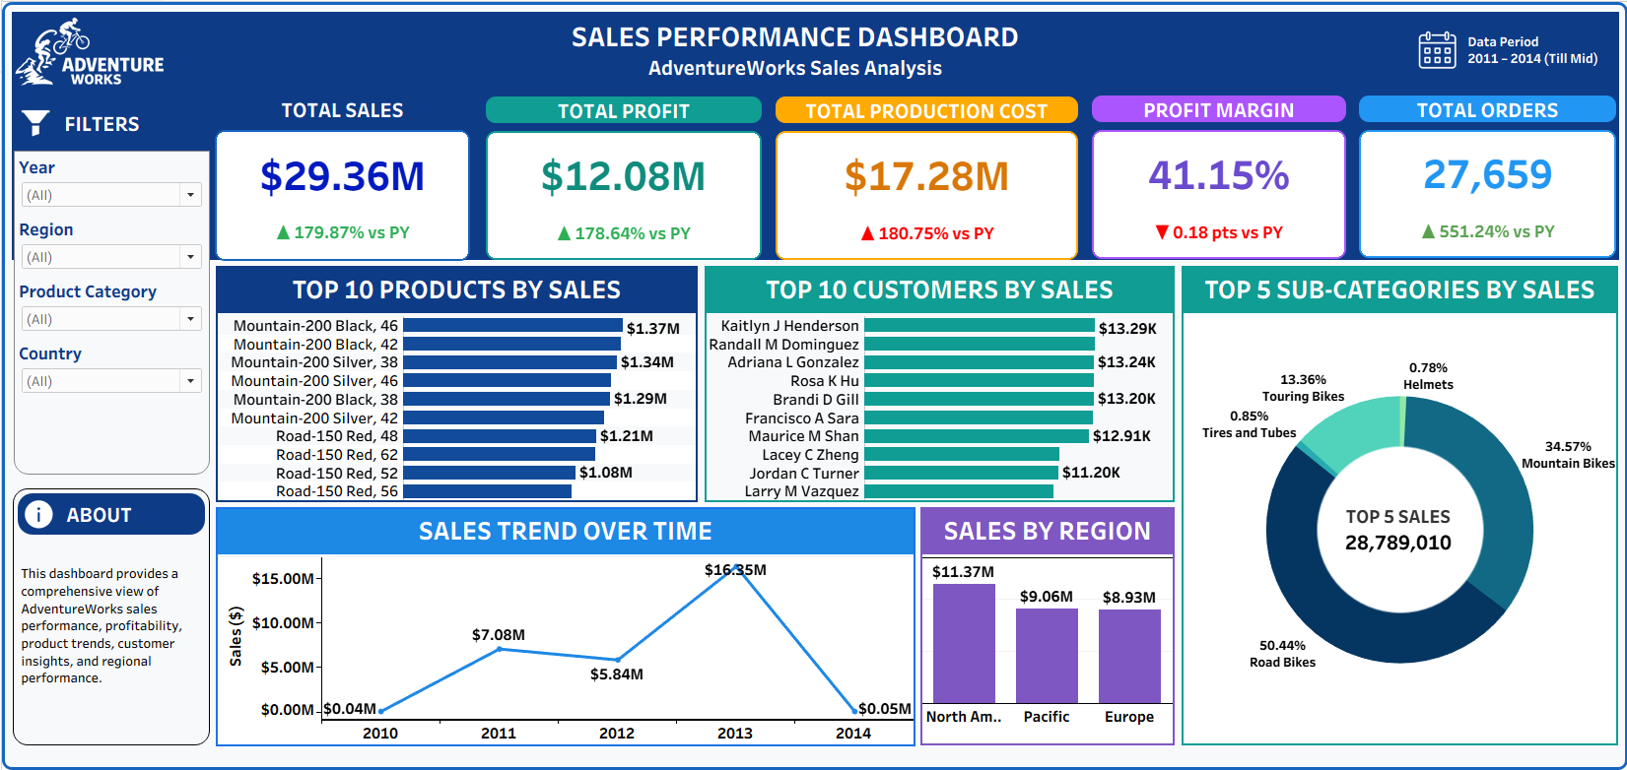
TABLEAU DASHBOARD
Tableau | Calculated Fields • Filters • Interactive Visualizations
TABLEAU DASHBOARD SCREENSHOT
DATA CONNECTION & PREPARATION
Connected and prepared AdventureWorks datasets using Tableau for analysis and visualization.
DATA MODELING
Created relationships between sales, customer, product, date and sales territory data for analysis.
CALCULATED FIELDS & KPIs
Created calculated fields for Sales, Profit, Production Cost, Profit Margin and other key metrics.
Interactive Dashboard
Interactive filters and visualizations for Year, Region, Product Category, Customer and Sales analysis.
Tableau Work Completed
Data Preparation • Calculated Fields • KPI Analysis • Interactive Visual Storytelling
Adventure Works | Project Presentation |
6

Slide 7
SQL QUERIES - Q0 TO Q6
MySQL Transformations & KPIs
Q0 - Union of Both Sales Tables
CREATE TABLE Fact_Sales AS
SELECT * FROM FactInternetSales
UNION ALL SELECT * FROM Fact_Internet_Sales_New;
Q1 - Lookup Product Name
SELECT f.*, p.EnglishProductName FROM Fact_Sales f
LEFT JOIN DimProduct p ON f.ProductKey = p.ProductKey;
Q2 - Lookup Customer Name & Unit Price
SELECT f.*, CONCAT(c.FirstName, ' ', c.LastName) AS CustomerFullName, p.ListPrice
FROM Fact_Sales f LEFT JOIN DimProduct p ON f.ProductKey = p.ProductKey
LEFT JOIN DimCustomer c ON f.CustomerKey = c.CustomerKey;
Q3 - Date Columns from OrderDateKey
YEAR(...) AS Year, MONTH(...) AS MonthNo, MONTHNAME(...) AS MonthName,
CONCAT('Q', QUARTER(...)) AS Quarter, DATE_FORMAT(..., '%Y-%b') AS YearMonth,
CASE WHEN MONTH>=4 THEN MONTH-3 ELSE MONTH+9 END AS FinancialMonth
Q4 - Sales Amount
SELECT (UnitPrice * OrderQuantity * (1 - UnitPriceDiscountPct)) AS SalesAmount
FROM Fact_Sales;
Q5 - Production Cost & Q6 - Profit
SELECT (ProductStandardCost * OrderQuantity) AS ProductionCost FROM Fact_Sales;
SELECT (SalesAmount - ProductionCost) AS Profit FROM Fact_Sales;
AdventureWorks Cycles | Sales Analysis |

Slide 8
SQL QUERIES - Q7 TO Q13
MySQL Transformations & KPIs
Q7 - Monthly Sales (Pivot)
SELECT YEAR(...) AS Year, MONTHNAME(...) AS Month,
ROUND(SUM(UnitPrice*Qty*(1-Disc))/1000,2) || ' K' AS TotalSales
FROM Fact_Sales GROUP BY Year, Month ORDER BY Year, Month;
Q8 - Year-wise Sales (Bar Chart)
SELECT YEAR(STR_TO_DATE(OrderDateKey, '%Y%m%d')) AS Year,
ROUND(SUM(UnitPrice*OrderQuantity*(1-UnitPriceDiscountPct))/1000,2) || ' K' AS TotalSales
FROM Fact_Sales GROUP BY Year ORDER BY Year;
Q9 - Month-wise Sales (Line Chart)
SELECT Year, MonthNo, MonthName, ROUND(SUM(SalesAmount)/1000,2) || ' K' AS TotalSales
FROM Fact_Sales GROUP BY Year, MonthNo, MonthName ORDER BY Year, MonthNo;
Q10 - Quarter-wise Sales (Pie Chart)
SELECT CONCAT('Q', QUARTER(STR_TO_DATE(OrderDateKey, '%Y%m%d'))) AS Quarter,
ROUND(SUM(UnitPrice*OrderQty*(1-Disc))/1000,2) || ' K' AS TotalSales
FROM Fact_Sales GROUP BY Quarter ORDER BY Quarter;
Q11 - Sales vs Production Cost (Combo)
SELECT Year, ROUND(SUM(SalesAmount)/1000,2) || ' K' AS Sales,
ROUND(SUM(ProductionCost)/1000,2) || ' K' AS ProductionCost
FROM Fact_Sales GROUP BY Year ORDER BY Year;
Q12 & Q13 - Overall Dashboard KPIs
SELECT COUNT(DISTINCT CustomerKey) AS TotalCustomers,
CONCAT(ROUND(SUM(SalesAmount)/1000000,2),' M') AS Total_Sales,
CONCAT(ROUND(SUM(Profit)/1000000,2),' M') AS Total_Profit FROM Fact_Sales;
AdventureWorks Cycles | Sales Analysis |

Slide 9
POWER QUERY - M FORMULAS
Excel Power Query Data Prep Steps
Q0 - Union (Append Queries)
= Table.Combine({FactInternetSales, Fact_Internet_Sales_New})
Q1 - Product Name Lookup
= Table.NestedJoin(Fact_Sales, "ProductKey", DimProduct, "ProductKey", "DimProduct", JoinKind.LeftOuter)
= Table.ExpandTableColumn(..., {"EnglishProductName"})
Q2 - Customer Name & Price Lookup
= Table.AddColumn(tbl, "CustomerFullName", each [FirstName] & " " & ([MiddleName]??"") & " " & [LastName])
= Table.NestedJoin(..., DimProduct, "ListPrice")
Q3 - Date Fields from OrderDateKey
= Table.AddColumn(tbl, "OrderDate", each Date.From(Text.From([OrderDateKey]), "yyyyMMdd"))
= Table.AddColumn(..., "Year", each Date.Year([OrderDate]))
= Table.AddColumn(..., "FinancialMonth", each if Date.Month([OrderDate])>=4 then Date.Month([OrderDate])-3 else Date.Month([OrderDate])+9)
Q4 & Q5 - SalesAmount & Cost
= Table.AddColumn(tbl, "SalesAmount", each [UnitPrice] * [OrderQuantity] * (1 - ([UnitPriceDiscountPct]??0)))
= Table.AddColumn(tbl, "ProductionCost", each [ProductStandardCost] * [OrderQuantity])
Q6 - Profit Calculation
= Table.AddColumn(tbl, "Profit", each [SalesAmount] - [ProductionCost])
AdventureWorks Cycles | Sales Analysis |

Slide 10
KEY INSIGHTS
Adventure Works Sales Analysis | 2010–2014
29.36M
12.08M
41.15%
1,061.45
Total Sales
Total Profit
Profit Margin
Avg Order Value
1
Peak Year: 2013
2
Top Region: Australia
3
Top Product
2013 delivered the highest annual sales, clearly ahead of the surrounding years.
Australia is the largest single region ($9.06M); Southwest leads the US regions ($5.72M).
Mountain bike products dominate the top-selling list and drive a strong share of sales.
4
Top Customer
5
Quarter Trend
6
Sales > Cost
Top customers contribute significant individual order values and are useful targets for retention.
Quarter-level analysis highlights the strongest period and supports seasonal planning.
Production cost remains below sales, supporting a positive and healthy profit margin.
Adventure Works | Project Presentation |
10

Slide 11
THANK YOU
Adventure Works Sales Analysis
Excel + Power BI
EXCEL
POWER BI
TABLEAU
SQL
Adventure Works | Project Presentation |

