Slide 1

ShodweStay Hospitality Dashboard
The main objective of this project is to analyze key performance indicators such as revenue, occupancy rate, Average Daily Rate (ADR), Revenue per Available Room (RevPAR), cancellation rate, and booking patterns to generate meaningful insights and support effective hotel management.
01

Slide 2
Project Overview
Turning hotel booking data into practical business decisions
Business objective
Tools used
Decision focus
Measure hotel performance and identify opportunities to improve revenue, occupancy and guest experience.
Excel for cleaning and exploration; Power BI for interactive reporting; Tableau for visual analysis.
Understand which cities, room classes and booking channels contribute to results.
Core questions
• How much revenue is generated and realized?
• What are the occupancy, ADR, RevPAR and cancellation rates?
• Which properties, room categories and channels drive bookings?
• Where should hotel managers focus improvement efforts?
HOSPITALITY ANALYTICS | EXCEL • POWER BI • TABLEAU
02

Slide 3
Dataset and Key Performance Indicators
A consistent KPI definition keeps all three tools aligned
Total Bookings
Realized Revenue
Occupancy Rate
Count of booking records
Revenue retained/realized after applicable adjustments
Occupied room nights ÷ available room nights
ADR
RevPAR
Cancellation Rate
Room revenue ÷ rooms sold
Room revenue ÷ available rooms
Cancelled bookings ÷ total bookings
Recommended data fields
Booking ID • City • Property • Booking date • Check-in/check-out • Room class • Booking platform • Booking status • Revenue • Rating
HOSPITALITY ANALYTICS | EXCEL • POWER BI • TABLEAU
03

Slide 4
Excel: Data Preparation and First-Level Analysis
Use Excel to validate the dataset before building dashboards
• Remove duplicate booking IDs and review missing or inconsistent values.
• Standardize city, room-class, booking-platform and booking-status labels.
• Use formulas or Power Query to calculate revenue, occupancy and cancellation metrics.
• Build PivotTables and PivotCharts for quick summaries by city, month and room class.
• Add slicers and timelines so users can filter the report interactively.
Useful Excel features
Power Query • PivotTables • PivotCharts • SUMIFS/COUNTIFS • XLOOKUP • Slicers
Quality checks
Check duplicates, blank values, date ranges, negative revenue and inconsistent status labels.
Output
A clean, documented dataset and a refreshable summary report ready for BI tools.
HOSPITALITY ANALYTICS | EXCEL • POWER BI • TABLEAU
04

Slide 5
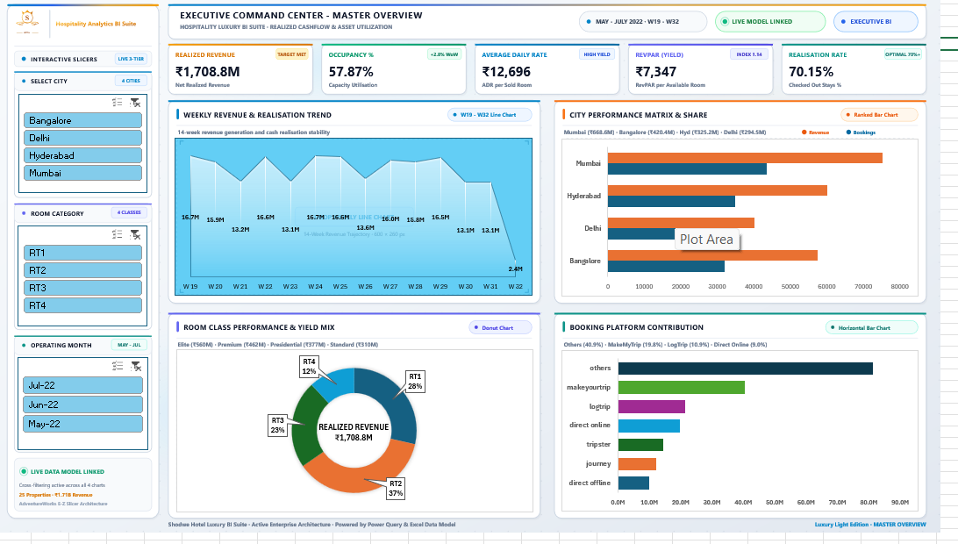

Slide 6
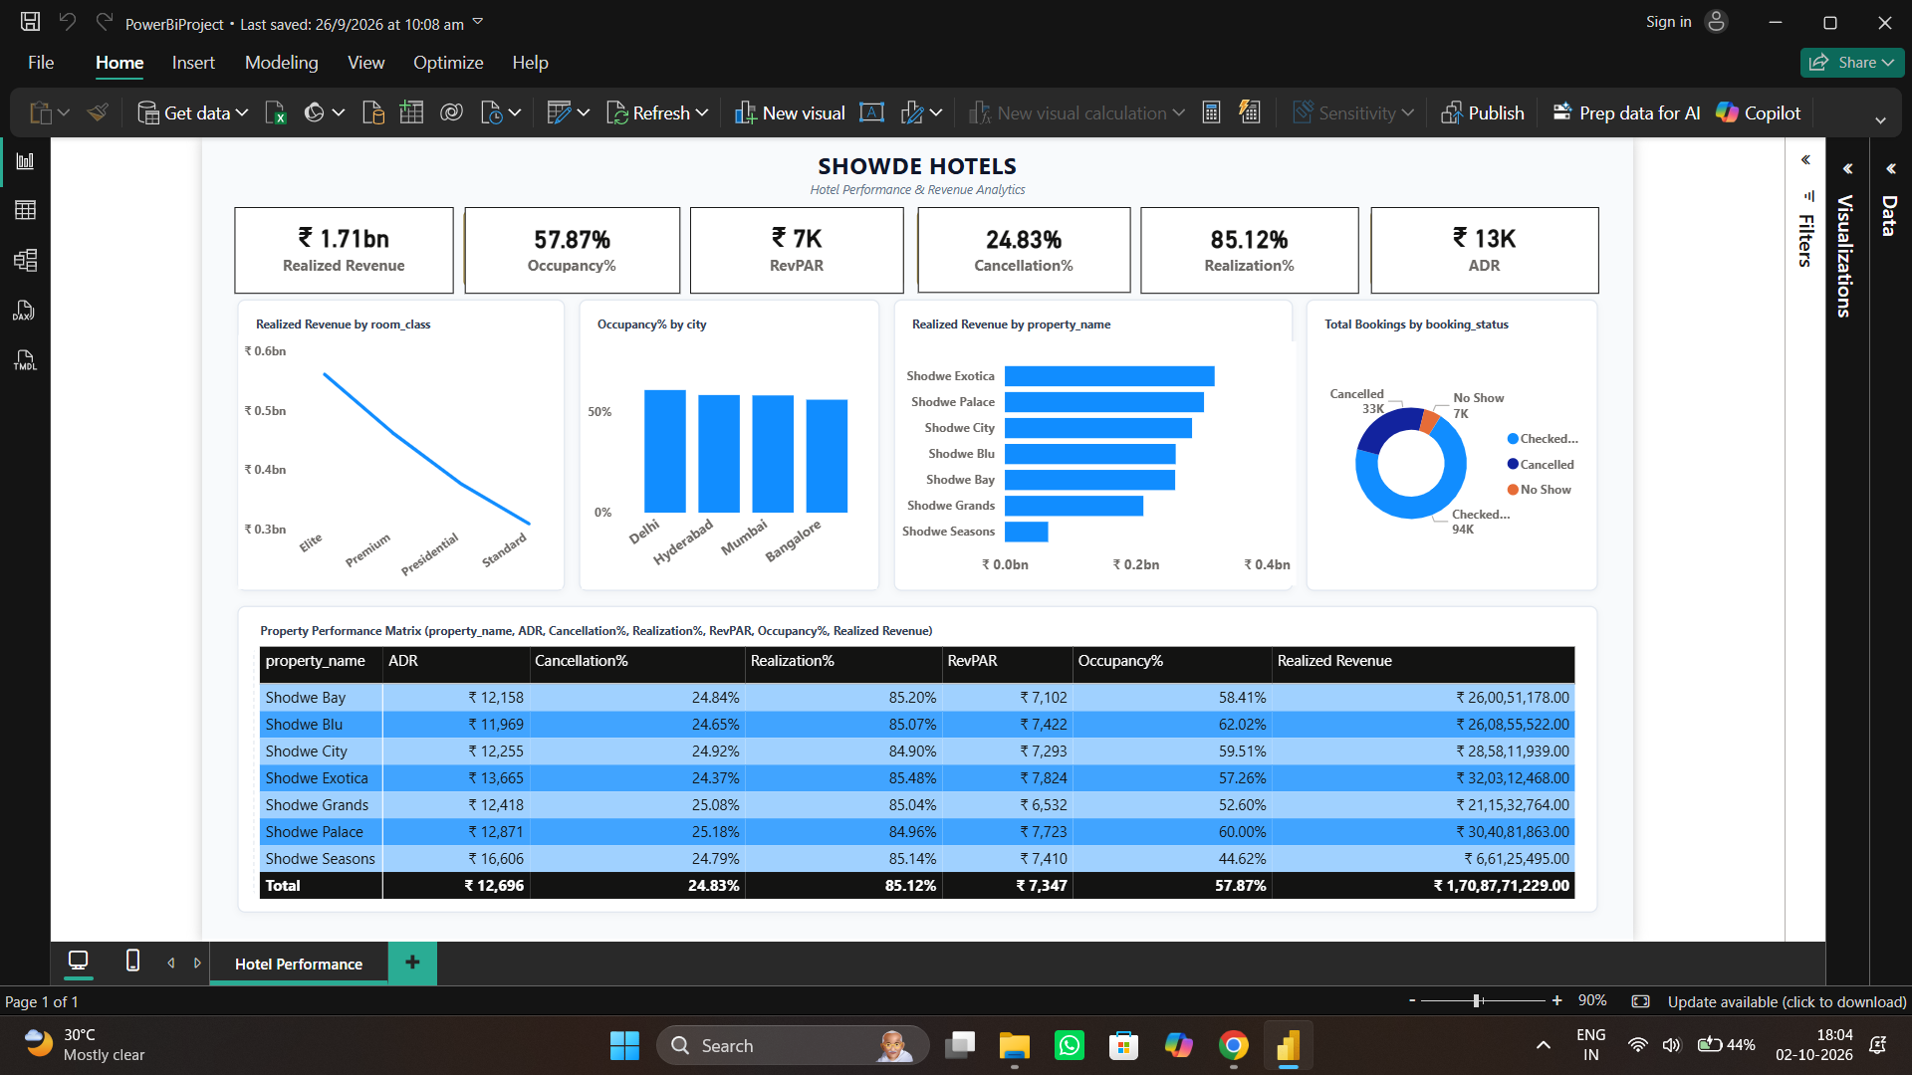
Power BI: Interactive Hotel Performance Dashboard
Executive view of revenue, occupancy, cancellation and property performance
What the dashboard communicates
• KPI cards summarize headline performance.
• Charts compare room classes, cities and properties.
• Booking-status visuals show checked-out, cancelled and no-show patterns.
• The property matrix supports side-by-side operational comparison.
Example screenshot supplied for this project
HOSPITALITY ANALYTICS | EXCEL • POWER BI • TABLEAU
05

Slide 7
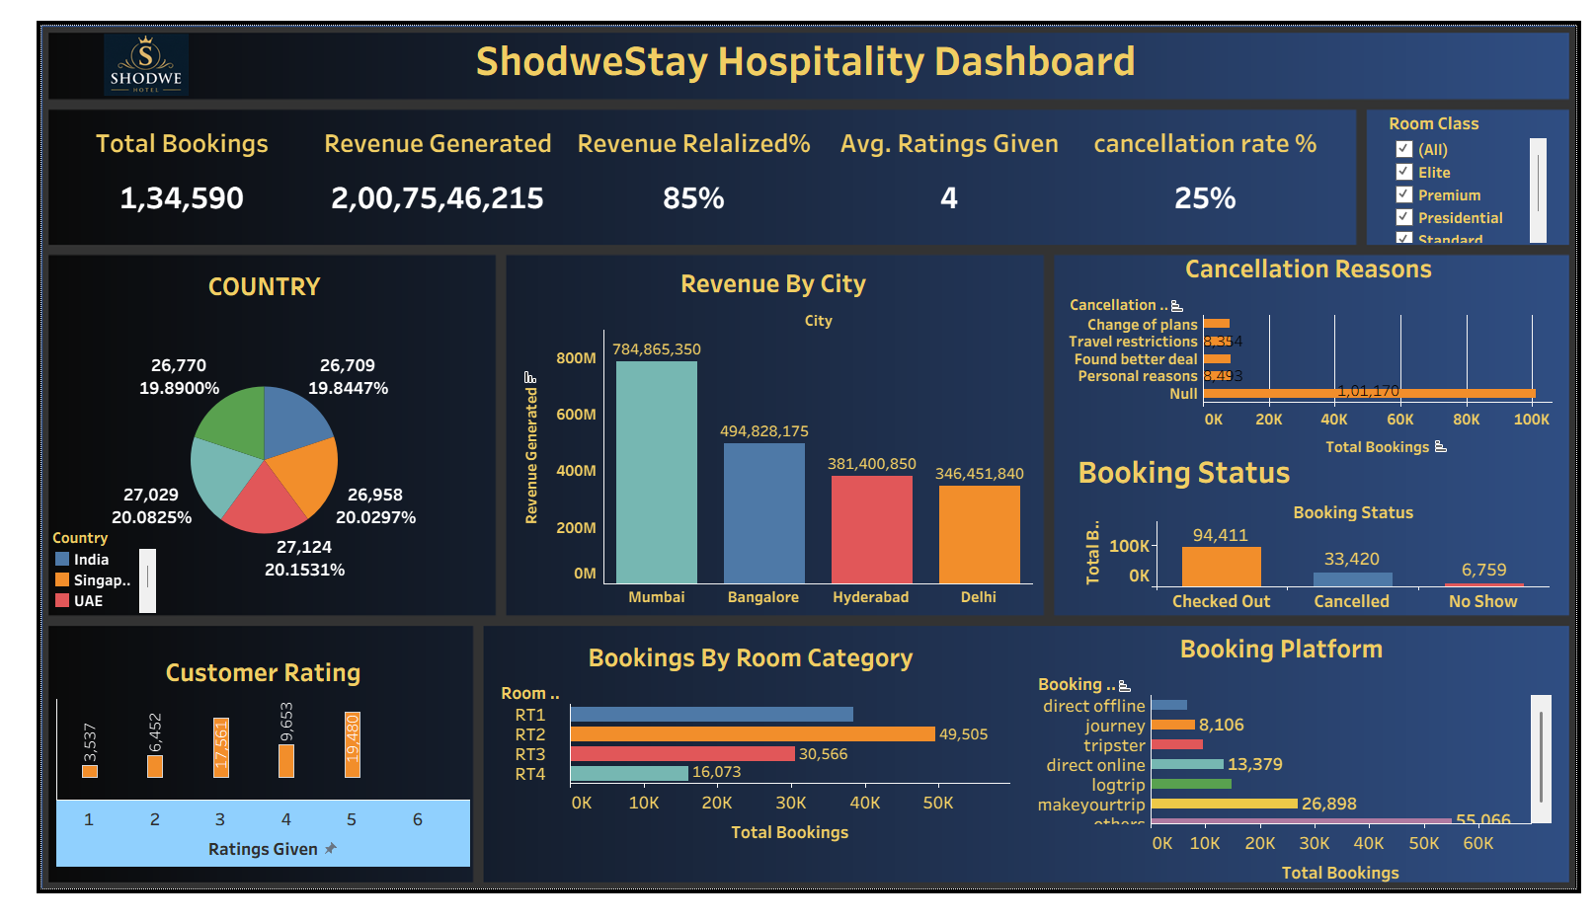
Tableau: Visual Exploration and Performance Comparison
Explore patterns with filters, comparisons and focused views
Suggested Tableau views
• Weekly revenue and realization trend.
• City-level revenue and booking comparison.
• Room-class performance and revenue mix.
• Booking-platform contribution.
• Interactive city, room category and month filters.
Reference dashboard mock-up
HOSPITALITY ANALYTICS | EXCEL • POWER BI • TABLEAU
06

Slide 8
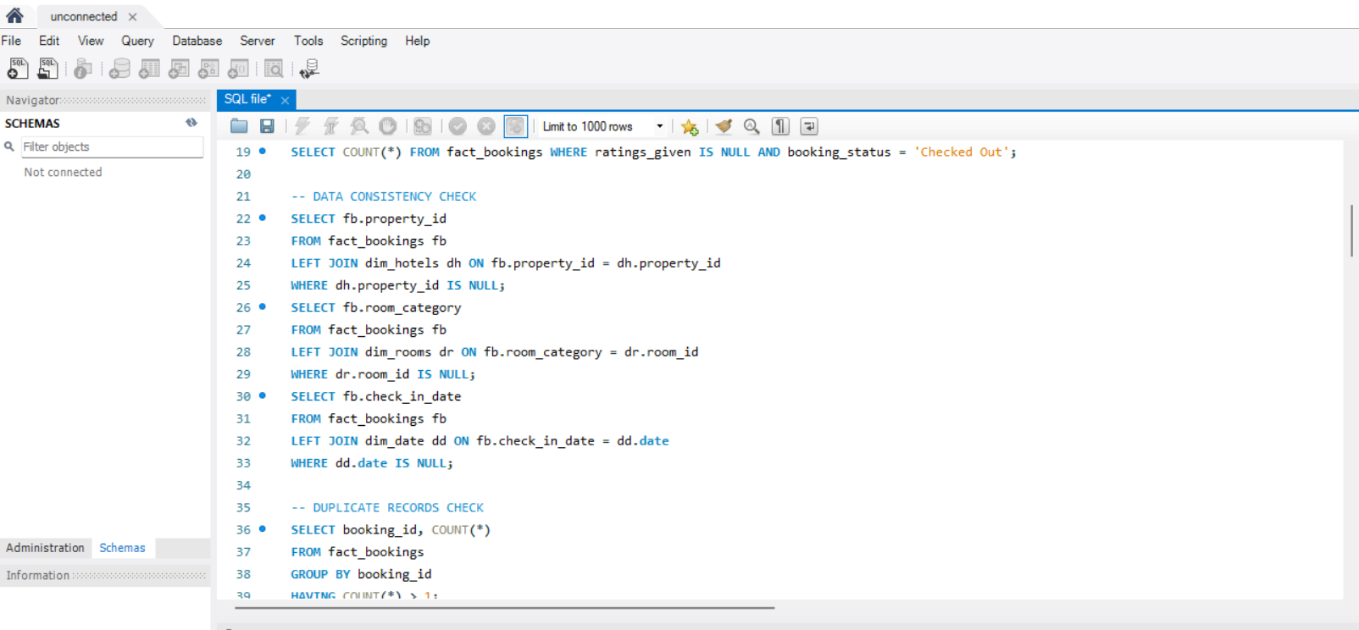
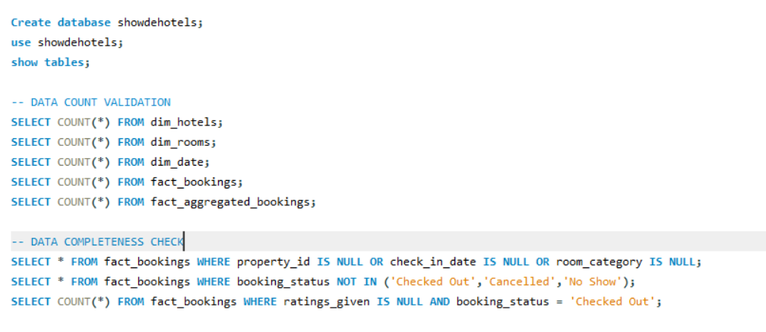
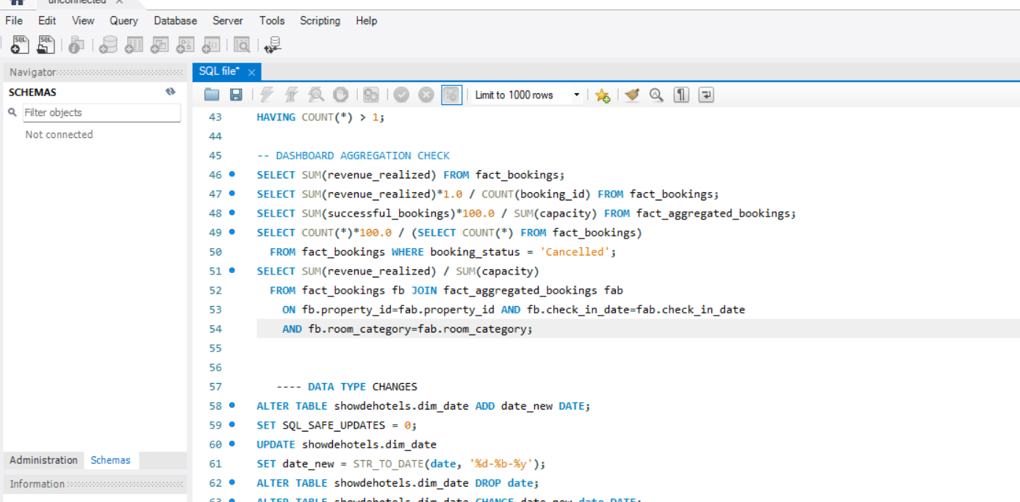
SQL Query

Slide 9
Insights Gained from the Project
After analyzing the hospitality dataset using Excel, Power BI, and Tableau, we gained valuable insights into hotel revenue, occupancy, booking patterns, cancellation rates, and property performance. The analysis showed an overall occupancy rate of 57.87%, a realized revenue of approximately ₹1.71 billion, and a cancellation rate of 24.83%. The city-wise analysis indicated that Mumbai generated the highest revenue among the four cities displayed, followed by Bangalore, Hyderabad, and Delhi. We also identified differences in occupancy and revenue across hotel properties, variations in room-category bookings, and differences in booking platform contributions. These insights help hotel management identify performance gaps, improve room utilization, manage cancellations, and make data-driven decisions to increase operational efficiency and revenue.

Slide 10
How to Interpret the Results
Use the visuals to investigate drivers, not just report totals
Revenue by city
Room-class mix
Cancellation patterns
Compare both total revenue and booking volume. High revenue may reflect more bookings, higher room rates or both.
Review booking share, average rate and occupancy together to understand which room categories create value.
Break down cancellations by platform, lead time, property and month to locate potential friction points.
Guest ratings
Booking platforms
Time trends
Compare ratings with property, room class and booking channel. Check sample sizes before drawing conclusions.
Measure booking contribution and cancellation rate by channel, not only total booking count.
Look for seasonality and sudden changes; compare equivalent periods where possible.
Important: the screenshots are visual references. Confirm all figures against the underlying dataset before presenting findings as final results.
HOSPITALITY ANALYTICS | EXCEL • POWER BI • TABLEAU
08

Slide 11
Business Recommendations
Translate dashboard findings into actions that can be measured
Revenue management
Review ADR and RevPAR by property and room class. Test rate adjustments against occupancy and demand.
Cancellation control
Identify high-cancellation channels and booking windows. Test clearer policies and reminder communications.
Channel strategy
Compare net revenue and cancellation rates across platforms before changing channel allocation.
Property operations
Use occupancy forecasts to align staffing, housekeeping and room availability.
Guest experience
Track ratings by property and issue type, then monitor whether service changes improve scores.
HOSPITALITY ANALYTICS | EXCEL • POWER BI • TABLEAU
10

Slide 12
Conclusion
From raw booking records to actionable hospitality insights
The project demonstrates how Excel, Power BI and Tableau can be used together to analyze hospitality data. Excel supports data preparation and initial analysis, Power BI provides an interactive management dashboard, and Tableau enables visual exploration of hotel performance.
By combining accurate data, consistent KPIs and meaningful visualizations, hotel managers can better understand revenue, occupancy, cancellations and booking patterns to support informed operational and commercial decisions.
Thank you | Questions?
HOSPITALITY ANALYTICS | EXCEL • POWER BI • TABLEAU
11

