Slide 1
COURSE 4 • FINAL PROJECT
Autonomous
Social Media
Content Studio
A manager-led multi-agent system for platform-specific content creation, review, and refinement.
LANGGRAPH • FASTAPI • LLMs
Project Presentation

Slide 2
01 / OVERVIEW
02
From one idea to platform-ready drafts
The system adapts a source idea into distinct drafts while keeping people in control.
THE PROBLEM
THE SOLUTION
THE OUTCOME
One message rarely works equally well across every social platform.
Creators need different formats, tones, and lengths—without repetitive manual rewriting.
A coordinated team of AI agents plans, drafts, reviews, and refines content for each selected platform.
A separate draft for each requested platform, ready for human review and copying—not automatic publishing.
SUPPORTED PLATFORMS
in
LinkedIn
X
X
◎
Instagram
▶
YouTube
f
Facebook
AUTONOMOUS SOCIAL MEDIA CONTENT STUDIO

Slide 3
02 / OBJECTIVES
03
What the system is designed to demonstrate
Aligned with the course goals for autonomous, production-oriented agent systems.
01
Stateful workflow
02
Role-based agents
03
Plan–Act–Check
Represent progress, plans, drafts, reviews, and refinement state.
Give the manager, platform agents, and reviewer clear responsibilities.
Generate drafts, score them against the plan, and feed back improvements.
04
Hierarchical delegation
05
Bounded optimization
06
Safe human control
Break the brief into structured platform-specific tasks.
Use parallel work and a limited refinement pass to balance quality and latency.
Validate inputs and outputs; leave final publishing decisions to the user.
AUTONOMOUS SOCIAL MEDIA CONTENT STUDIO

Slide 4
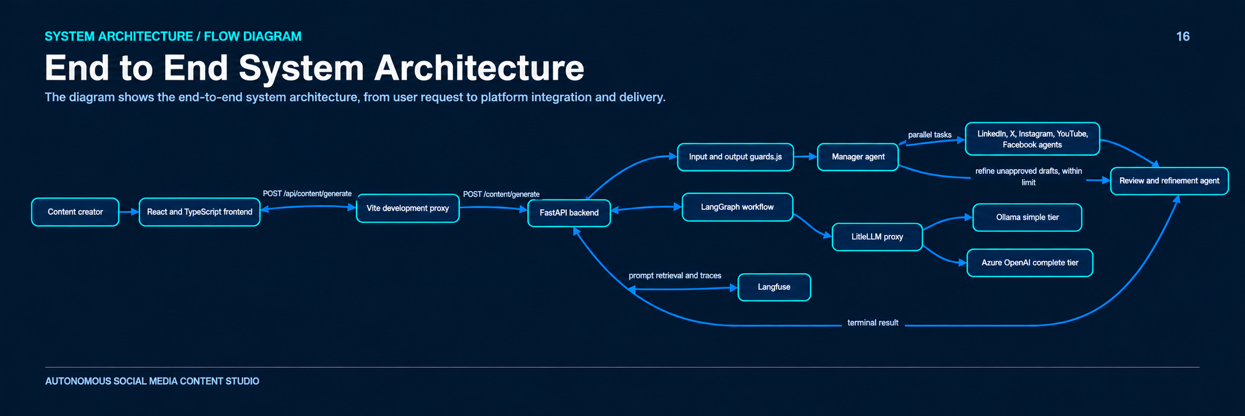

Slide 5
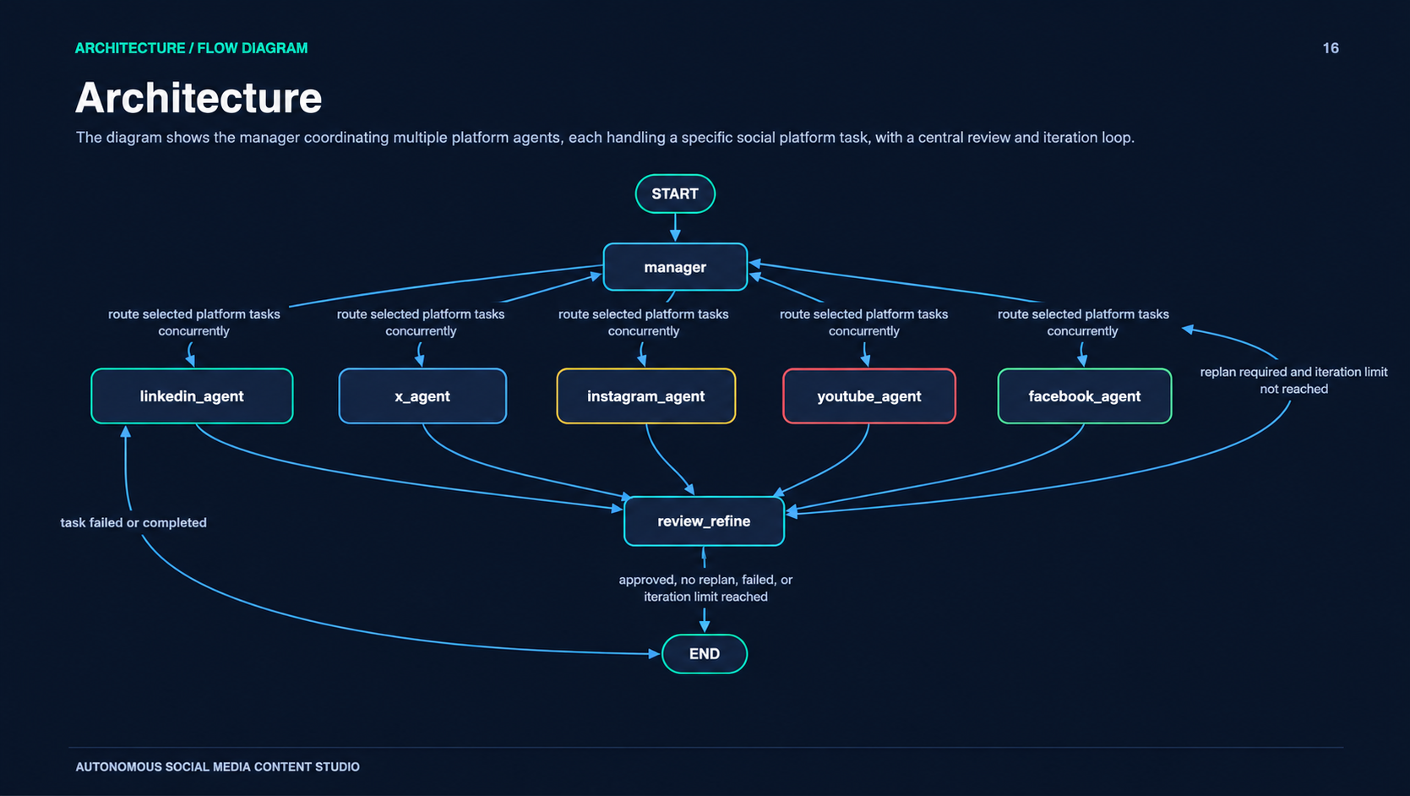

Slide 6
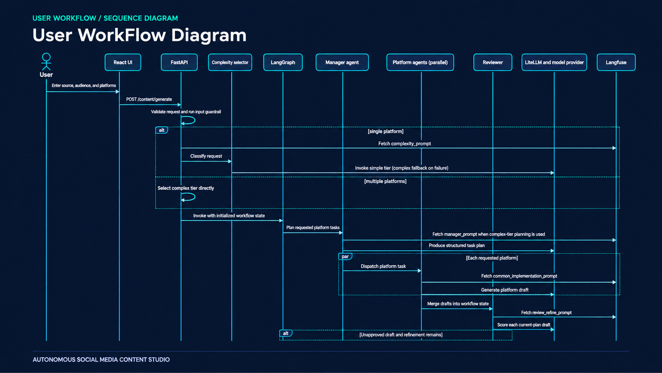

Slide 7
06 / STATE & CONTROL
07
Workflow state makes coordination explicit
The graph carries both current results and histories needed for review and refinement.
INPUT
source • audience • platforms
CONTROL RULES
PLAN
tasks • tone • format • key points
At least one supported platform
One latest result per platform
EXECUTION
per-platform runs and draft outputs
Reviewer threshold: 0.80
REVIEW
scores • statuses • feedback
One refinement pass maximum
Output safety check before response
REFINEMENT
iteration counter • revised plan
FINAL
latest draft per requested platform
AUTONOMOUS SOCIAL MEDIA CONTENT STUDIO

Slide 8
07 / TECHNOLOGY
08
A modular stack for UI, orchestration, and model access
Each layer has a defined responsibility and can be tested or configured independently.
FRONTEND
React 19 • TypeScript • Vite
Collect brief, track request state, show drafts, copy output
API
FastAPI • request/response schemas
Validate input, choose model tier, invoke workflow, check output
ORCHESTRATION
LangGraph • shared workflow state
Parallel branches, review routing, bounded refinement
MODEL ACCESS
LiteLLM • Ollama • Azure OpenAI
Simple tier and complex/review tiers via aliases
OBSERVABILITY
Langfuse prompts and traces
Retrieve production-labeled prompts; tracing is configurable
AUTONOMOUS SOCIAL MEDIA CONTENT STUDIO

Slide 9
08 / INTERFACE
09
A simple request contract, clear user states
The UI communicates progress and recovery paths while keeping the generated drafts reviewable.
REQUEST
SUCCESS
RECOVERY
POST /content/generate
content: required, up to 12,000 chars
platforms: at least one supported value
audience: optional, up to 180 chars
JSON response includes processed_content entries.
Each entry associates a platform with its generated draft.
422 validation • 503 service • 504 timeout • 500 workflow failure
UI shows concise messages rather than server internals.
UI STATES
Ready
Loading
Results
Notice / Error
Form + intro panel
Progress + cancel
Platform cards + copy
Guardrail or recovery message
AUTONOMOUS SOCIAL MEDIA CONTENT STUDIO

Slide 10
09 / GUARDRAILS
10
Human review is part of the design
Safety checks and bounded automation support a controlled content workflow.
INPUT SAFETY
OUTPUT SAFETY
HUMAN CONTROL
Validate schema, supported platforms, required content, and input guardrails before generation.
Run output guardrails after the graph returns; safety checks are useful but do not prove every claim is true.
Users review and copy drafts. The system has no social-account connection, scheduling, or automatic publishing.
CURRENT LIMITS
One refinement pass maximum
No persistent draft history across reloads
Health endpoint checks API process only, not every dependency
Cancellation stops the browser wait; backend work may continue
AUTONOMOUS SOCIAL MEDIA CONTENT STUDIO

Slide 11
10 / OPTIMIZATION
11
Quality with bounded cost and latency
The implementation uses workflow design choices that limit redundant work.
PARALLEL EXECUTION
MODEL TIERS
TARGETED REFINEMENT
Independent platform agents run as parallel graph branches instead of waiting for each other.
Single-platform requests are classified; multi-platform requests select the complex tier directly.
Only unapproved platforms are replanned, and the route allows one refinement cycle.
DESIGN TRADE-OFF
Bounded retries improve predictability and control cost, but a draft can still be returned when the refinement limit is reached.
No benchmark numbers are claimed here; latency and quality should be measured in a representative evaluation set.
AUTONOMOUS SOCIAL MEDIA CONTENT STUDIO

Slide 12
11 / LIVE DEMO
12
A concise end-to-end walkthrough
Demonstrate both the user experience and the underlying agent coordination.
01
Enter a source idea
Example: launch announcement for a new local café.
02
Choose audience + platforms
Select LinkedIn, Instagram, and X; submit the brief.
03
Observe the workflow
Explain validation, manager planning, parallel drafting, and review.
04
Inspect the outputs
Compare tone and format; show one platform card and copy action.
05
Discuss refinement + limits
Show feedback routing, bounded retry, and human publishing control.
AUTONOMOUS SOCIAL MEDIA CONTENT STUDIO

Slide 13
TAKEAWAY
One brief.
Five specialized agents.
A reviewed result.
The Social Media Content Studio demonstrates manager-led delegation, parallel platform drafting, reflection, bounded refinement, and human control.
QUESTIONS?
Thank you

