Slide 1
Objective - The Objective of the analysis is to predict whether the customer is churn or not.
Project Flow:
Understanding the Dataset
Perform EDA data cleaning by treating missing values, duplicates records removal, conversion of categorical, scaling and visualization
Feature Engineering Analysis to Understand the important Features and their contribution to Response Variable, Removal of unimportant features
Building the appropriate model by using different balancing techniques, evaluation technique and suitable algorithm
Finalize the Model Based on Maximum Accuracy Possible.

Slide 2
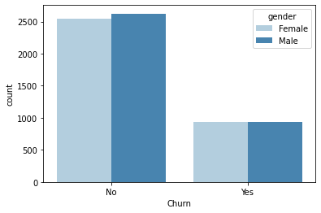
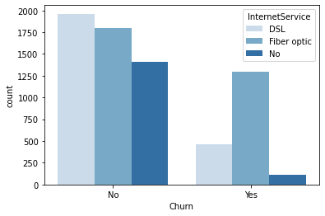
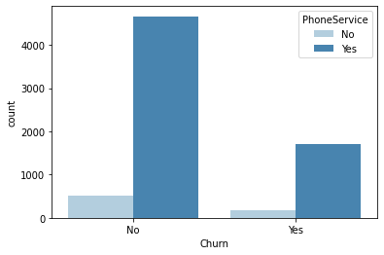
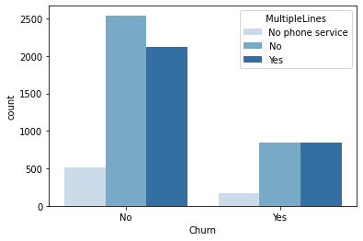
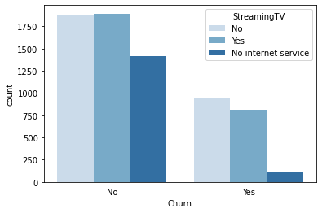
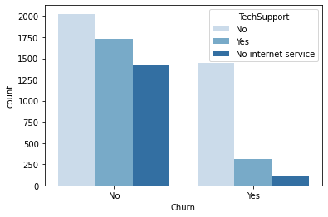
Data visualization of variables against output variable(Relationship of variables) – Below are sample graphs

Slide 3
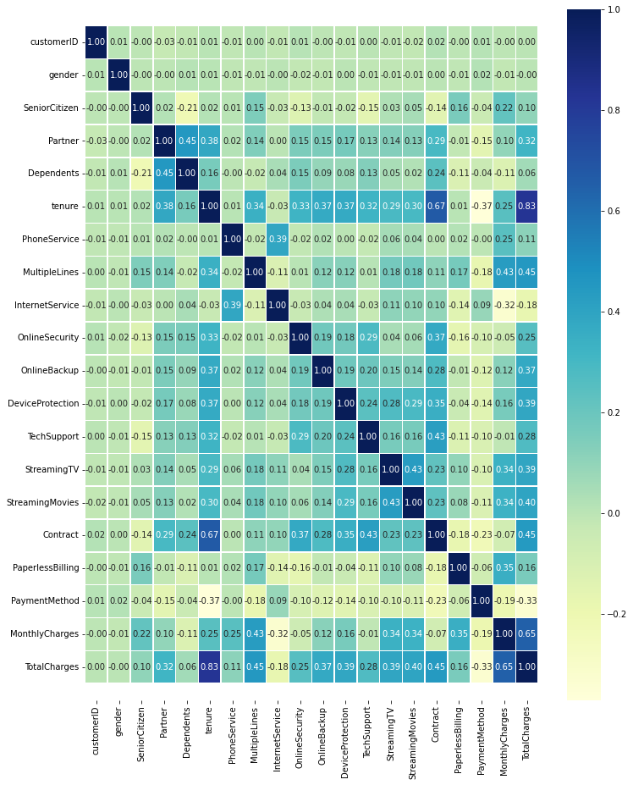
Collinearity among all variables to check relationship among all variables

Slide 4
Model Building Strategy:
1. Based on the EDA, the algorithm required for the dataset is ‘Supervised Classification’
3.Evaluation Techniques (using optimal K-value)
  Random Cross Validation
  Stratified Fold Cross Validation
2. Algorithms:
  Logistics Regression
  Gradient Boosting Classifier
  Naive Bayes
  KNN
  Decision Tree
  Random Forest
  SVM
4. Data Balancing Technique:
  SMOTE Upsampling
  SMOTE-ENN Upsampling

Slide 5
After data balancing Models accuracy and finalize the best model
Model accuracy based on F1 score metric:
Gradient Boosting classifier gives best accuracy among other algorithm
Algorithm | F1 Score | Accuracy
1. Logistic Regression | 92% | 92%
2.Random Forest | 95% | 95%
3. Gradient Boosting classifier | 97% | 97%
4. K- Nearest Neighbour | 93% | 92%
5. Decision Tree | 94% | 94%
6. Naïve Bayes | 90% | 89%
7. Support vector Machine | 94% | 93%

Slide 6
Thank you

