Slide 1

INFORMATION RETRIEVAL WITH LLMs
Interns:
Shubhangi Sanyal
Anurag Dey
Mentors:
Sarvesh Bhandaokar
Srijan BhusHan

Slide 2
Project overview
Building an advanced information retrieval engine with semantic search capabilities for custom data.
Capable of semantic search
Sites top k matching documents
Along with reference to the exact location of the retrieved text from the document
Notes:
This project aims to explore and implement Language Model-based approaches, specifically Leveraging Pre-trained Language Models (LLMs), to enhance information retrieval systems by transforming the traditional information retrieval process by optimizing the search, relevance, and contextual understanding of retrieved information.

Slide 3
Getting new data
Generating transcripts from CMI lecture videos
Tool used – Assembly AI
Generating queries and ground truths based on those transcripts

Slide 4

Experimenting with retrievers and re-rankers
Text splitter: Recursive Text Splitter
Retriever: LOTR Merger Retriever
Document compressor pipeline
Long context re-ordering
Re-ranker: Cohere

Slide 5
Experimenting with retrievers and re-rankers
QUERY: What are some challenges associated with data collection?
Ground Truth
Retriever’s response
Challenges include potential errors from manual data entry, variations in data collection methods leading to non-uniform data, and issues with standardizing data formats.
[Document(page_content="entered by somebody and then converted to electronic forms. So that would be, there would be two levels of potential sources for errors. The person writing down the information and then the person typing in the information. Now, gradually these kind of electronic forms are spilled in directly, so at least the source of the error is reduced to one step. But still, people mistype things. I mean, there are any number of situations where people type their email address wrong and so notifications don't reach them and so on. So there is this data collection. How do you collect the data and how do you clean it? And the third thing is, how do you make it uniform? So when data is being collected by different people, they may collect different things. And for instance, if you look at the government, typically the government collects data in different forms. For instance, there is a public distribution system which the ration shops, so they collect some information about who is collecting ration", metadata={'source': 'audio_1.txt'})

Slide 6
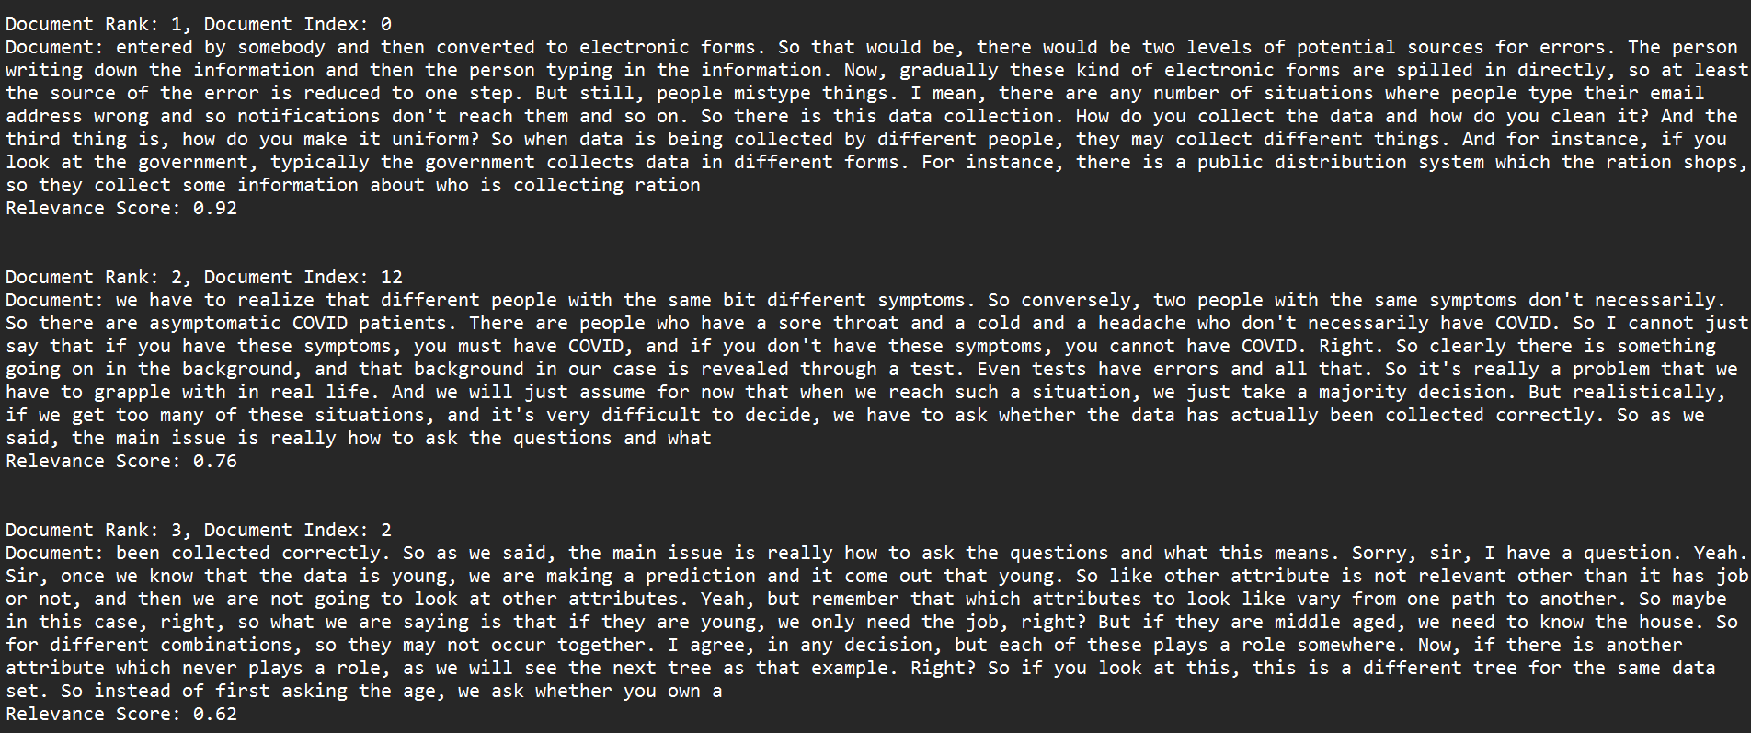
Experimenting with retrievers and re-rankers
QUERY: What are the advantages of the Apriori algorithm?
Retriever’s response after re-ranking

Slide 7
Experimenting with retrievers and re-rankers
QUERY: What are the advantages of the Apriori algorithm?
Ground Truth
Retriever’s response
Some advantages of the Apriori algorithm include its simplicity, scalability to large datasets, and ability to uncover meaningful associations between items in transactional data.
[Document(page_content="yet, first of all, a truly learning problem. It's more an algorithmic problem, but still, it's an interesting problem nonetheless, because I just want to illustrate how it affects the way in which we calculate what might be trivial with small data becomes nontrivial with large data. So this is the problem. So given a set of items, capital n, which is large, and a, given a set of transactions m, which is again large, and given these two ratios between zero and one, find every pair x and y such that x implies y is a valid association. So we can break up this thing into two steps. I mean, we want to first check whether x implies y is worth looking at at all. So we first look at the support part. We want to know whether x, sorry, yeah, we want to know whether the count divided by m is bigger than the support, which is the same as taking this m to the other side and saying whether the count is bigger than a certain fraction of the total. So the first idea is to identify those sets whose", metadata={'source': 'audio_1.txt'})

Slide 8
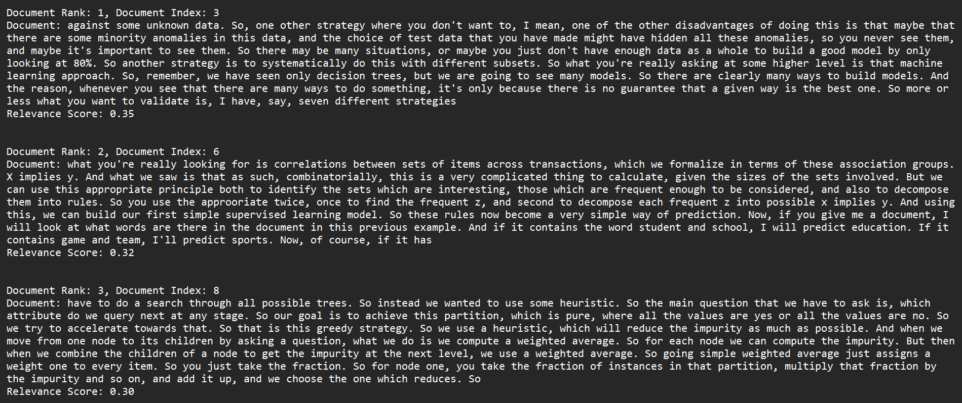
Experimenting with retrievers and re-rankers
QUERY: What are some challenges associated with data collection?
Retriever’s response after re-ranking

Slide 9
Experimenting with retrievers and re-rankers
QUERY: What distinguishes training data in supervised learning, and what is its purpose?
Ground Truth
Retriever’s response
Training data in supervised learning consists of labeled examples, where each item is associated with its correct category or class. The purpose of training data is to enable the model to learn patterns and relationships between attributes and categories, facilitating accurate predictions on new data.
Document(page_content='whatever, income, stuff like that. So each row in the table will be one item, and there will be a special column which indicates what category, depending on the classification problem that we are dealing with, what category it is. And the goal of supervised learning is to now construct, given a new row, a new item, a new combination of these attributes, which is not seen before, try to predict what would be the most appropriate category to assign. So these items which are given with the labels. So these are called labels. So these items are called training data. So we have labeled training data, which consists of some information which has been collected in the past, some historical information about items and their classification. And we want to find a model that generalizes the training data. So since normally this categorization corresponds to some kind of classification, this is typically called a classification problem. So classification problem could be a binary problem. It', metadata={'source': 'audio_3.txt'})

Slide 10
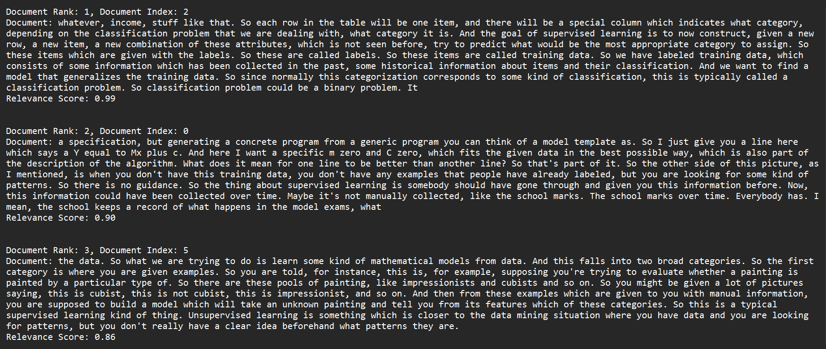
Experimenting with retrievers and re-rankers
QUERY: What distinguishes training data in supervised learning, and what is its purpose?
Retriever’s response after re-ranking

Slide 11
Experimenting with retrievers and re-rankers
QUERY: What is cross-validation?
Ground Truth
Retriever’s response
Cross-validation is a technique used to evaluate the performance of machine learning models by dividing the dataset into multiple subsets, training the model on one subset, and testing it on another. This process is repeated multiple times, allowing for a more robust assessment of the model's generalization ability.
[Document(page_content="But there may be more subtle things. Somebody might be talking about events, some kind of pop music events, and another person may be talking about some spiritual gatherings. And one person may be interested in pop music events, and another person may not be. And another person may be interested in spiritual gatherings, and the first person may not be. So then you can train these things. So in that sense, which words signal junk and which words don't signal junk is also a parameter of the model. Just like in this linear fit, the shape of the line is a parameter. So this is the learning part. So what we are going to do is look at different types of models, as I said, and then we will look at this parameter adjustment. How does the data actually determine the model, the concrete model? How do we build the best model that we can get for the given data? That's the algorithm. So we have a kind of model template. So we have a model template on this side, we have training data, and what we", metadata={'source': 'audio_1.txt'})

Slide 12
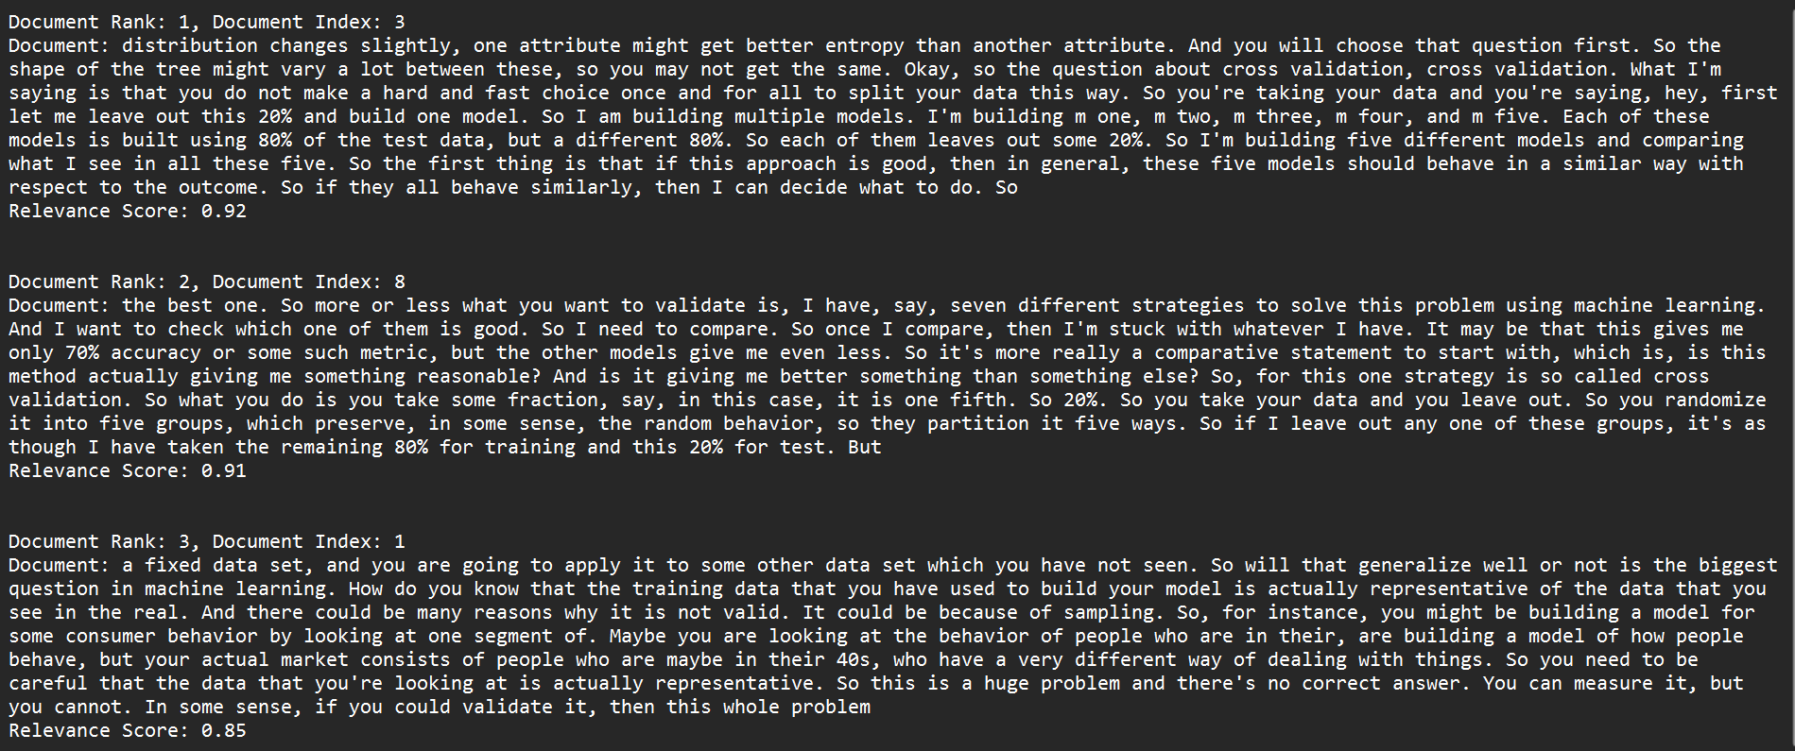
Experimenting with retrievers and re-rankers
QUERY: What is cross-validation?
Retriever’s response after re-ranking

Slide 13
Experimenting with retrievers and re-rankers
QUERY: What is the process of building the decision tree classifier, and how is it trained on the dataset?
Ground Truth
Retriever’s response
The decision tree classifier is built using the DecisionTreeClassifier function from Scikit-learn. The parameters configured earlier, such as the random state and maximum depth, are applied to the classifier. Subsequently, the fit function is used to train the classifier on the provided dataset, which consists of input features (x) and target labels (y). This process initializes the decision tree object with the specified parameters and trains it to learn patterns and relationships within the dataset.
Document(page_content="about what's going on behind the algorithm in order to make best use of it when it is not producing an answer which is acceptable to you. But as far as using it per se, all you need to do is set up the appropriate. So here it's a decision tree, but pretty much the same. So these two steps that you see here, these two steps. So this is a pretty canonical style of programming. In this scikitlearn, you import the right type of classifier, you build a classifier of that type with the parameters that you think are reasonable for your application, and then you pass it the training data and say fit. Now here, one thing we have not done, for instance, is to segregate out, we talked about training and test data. We have not done that. So that's also something that you can do. Before you set it up, you might get all the iris data and then you might want to keep part of it aside. So we will see as we go along how to do all these things. But for the moment, it's taking all the iris data which has", metadata={'source': 'audio_5.txt'})

Slide 14
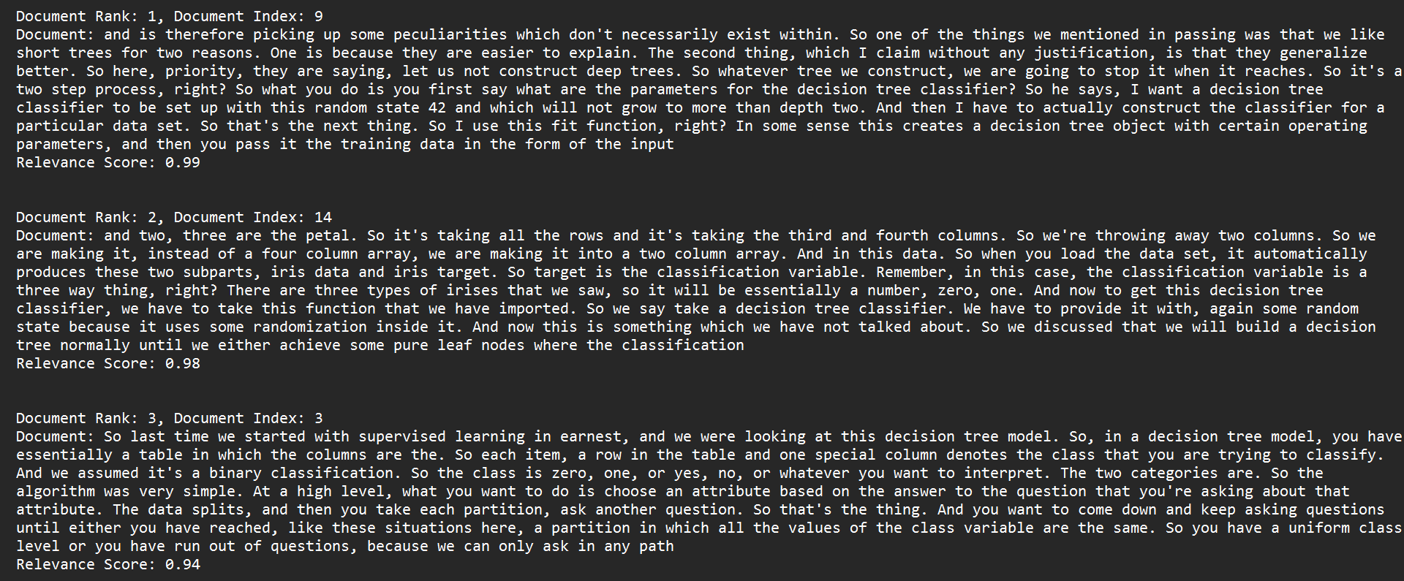
Experimenting with retrievers and re-rankers
QUERY: What is the process of building the decision tree classifier, and how is it trained on the dataset?
Retriever’s response after re-ranking

Slide 15
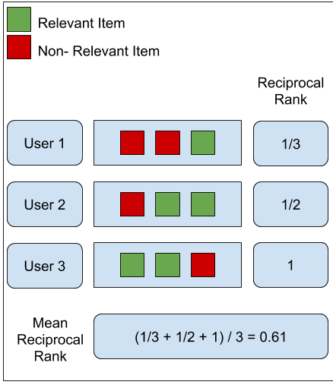
Evaluating the retriever
MEAN RECIPROCAL RANK
evaluates the quality of information retrieval systems.
helps understand the average position of the first relevant item across all user lists.
MRR values range from 0 to 1, where "1" indicates that the first relevant item is always at the top.
Higher MRR means better system performance.

Slide 16
THANK YOU
Created and Presented by:
Anurag Dey anurag@cmi.ac.in
Shubhangi Sanyal shubhangi@cmi.ac.in

