Slide 1
Speech Emotion Recognition
Applied Machine Learning
30th April, 2024
Saikat Bera | Sayantan Mondal | Shreyan Chakraborty | Shubhangi Sanyal

Slide 2
Project Overview
Project Overview
End-to-End Speech Emotion Classifier
Using various datasets to classify speech audio into 7 different categories of emotions by employing certain deep learning models
Project Relevance
Datasets
Neutral
Happy
Sad
Angry
Fear
Disgust
Surprise
Data Preprocessing
Train & Test
Our best model has been put in action through deployment.
Deployment

Slide 3
Project Relevance
Project Overview
Analysis of spoken language to detect human emotions and affective states.
Relies on changes in vocal properties such as tone, pitch, and inflection to capture emotional nuances.
Similar to how animals like dogs and horses can interpret human emotions by observing vocal cues.
Project Relevance
Datasets
Use cases involve:
Data Preprocessing
Customer Service and Call Centers
Healthcare
Human-Computer Interaction
Entertainment and Gaming
Market Research
Security and Surveillance
Language Learning
Train & Test
Deployment
Notes:
Speech Emotion Recognition (SER) has a variety of applications across different industries and fields. Some key uses of SER include:
1. **Customer Service and Call Centers**: SER can help improve customer interactions by identifying customer emotions in real-time and providing feedback to agents to adjust their responses.
2. **Healthcare**: In therapy sessions or mental health assessments, SER can provide insights into a patient's emotional state, aiding in diagnosis and treatment.
3. **Human-Computer Interaction**: SER can enhance user experiences by allowing devices to respond to the user's emotional state, providing more personalized and empathetic interactions.
4. **Entertainment and Gaming**: In video games and interactive media, SER can be used to create adaptive storylines and character responses based on the player's emotions.
5. **Market Research**: SER can gauge emotional reactions to products or advertisements, offering insights into consumer preferences and potential improvements.
6. **Security and Surveillance**: SER can be used to detect stress or anxiety in individuals, potentially serving as an early warning system in security scenarios.
7. **Language Learning**: SER can help language learners by providing feedback on their pronunciation and emotional expression, aiding in more natural and effective communication.
Overall, SER adds a layer of emotional intelligence to technology and human interactions, enabling more nuanced and effective communication.

Slide 4
Knowing the data
Project Overview
Project Relevance
RAVDESS
CREMA-D
SAVEE
TESS
Contains 1440 audio files
Features professional actors expressing various emotions at two intensity levels
Neutral North American accent.
Comprises 7,442 original audio clips from 91 diverse actors
Features 12 sentences expressed with six emotions at four intensity levels
Data with reduced risk of overfitting.
Features audio recordings from four male speakers
Six discrete emotion categories along with a neutral category
Data with a male-only representation.
Comprises audio recordings from two female actresses
Seven emotions across 200 target words
Resource with representation of female speakers.
Datasets
Data Preprocessing
Train & Test
Deployment
Notes:
Here we use a total of 4 datasets namely:
Ravdess (Ryerson Audio-Visual Database of Emotional Speech and Song)
CREMA-D (Crowd Sourced Emotional Multimodal Actors Dataset)
SAVEE (Surrey Audio-Visual Expressed Emotion)
TESS (Toronto Emotional Speech Set)
We then concat these to create a massive dataset of over 12,000 audio files conveying multiple emotions. We use an open-source library
for audio and music analysis called 'Librosa'. We use it to extract the Audio Data (which essentially is a 1D array representing the
amplitude of the audio signal at that time) and Sample Rate (an integer which represents the number of samples of the audio signal per second,
typically measured in Hertz(Hz)). We apply some data augmentation techniques such as: adding noise, and altering the pitch. Then we extract
features from the audio such as zero-crossing-rate (ZCR) which measures the rate at which the audio signal changes it's sign and mfcc (mel-frequency cepstral coefficients) which reperesent the short term power of the audio signal. We finally, append evverything to the feature matrix and for the target
variable, we simply append the corresponding emotion. Clubbing these together and saving them as a .csv file, makes the next task much easier, to simply load and fit the model.

Slide 5
Data Pre-processing
Project Overview
Project Relevance
For RAVDESS, CREMA-D, TESS, and SAVEE dataset, we created a Data Frame containing the file paths and their corresponding emotions.
Data visualization and exploration to get the count plot of emotions and sample mel-spectrograms.
Datasets
Data Preprocessing
The individual Data Frames were concatenated into a single Data Frame
Audio data augmentation techniques like adding noise, stretching, shifting, and pitch alteration was done.
Train & Test
Deployment

Slide 6
Feature Extraction:
Project Overview
Project Relevance
ZCR
MFCC
Combined 4 datasets
12000 audio files
Parallelize the feature extraction process for all audio files
Feature
Engineering
Datasets
Data Preprocessing
Librosa
extract the Audio Data and the sample rate from each audio file
adding noise
altering the pitch
Train & Test
Data
Augmentation
Feature Matrix
Labelled Emotion
Deployment
Notes:
We concat these 4 datasets to create a massive dataset of over 12,000 audio files
We also use Librosa to handle all the audio files
We extract the Audio Data and the sample rate from each audio file
Applied certain data augmentation techniques like adding noise to the audio and altering the pitch
We then feature engineer ZCR, MFCC out of the Audio Data and sample rate to improve the model further
Finally clubbing these values for original and augmented data together for the feature matrix and the target variable is the corresponding emotion
Finally clubbing these together and saving as a .csv to fit the models

Slide 7
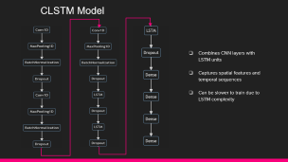
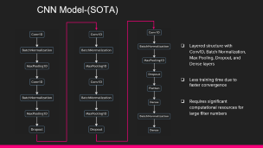
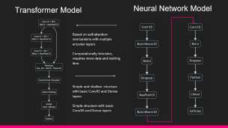
Training Various Models
Project Overview
Project Relevance
We have experimented with various models and architectures
Datasets
Data Preprocessing
Train & Test
CNN - (SOTA)
CLSTM
Simple NN &
Transformer
Deployment
Notes:
CNN- Design & Purpose
- Layered structure with Conv1D, Batch Normalization, Max Pooling, Dropout, and Dense layers.
- Suited for image classification, feature extraction from one-dimensional data.
512 filters in conv 1d

Slide 8
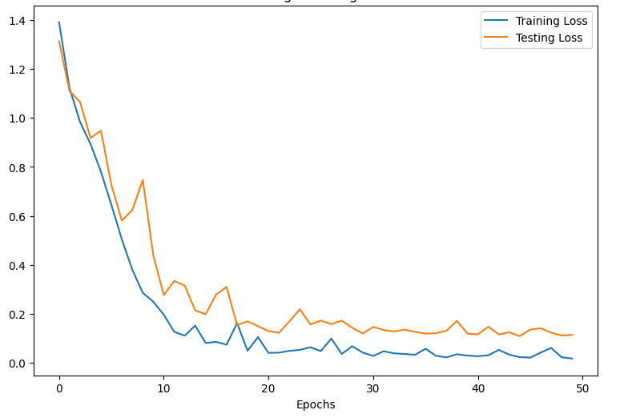
Model Testing Results
Project Overview
 | Epochs | Accuracy
CNN | 50 | 97%
CLSTM | 130 | 82%
Neural Network | 1000 | 80%
Transformer | 500 | 75%
Project Relevance
Convolutional Neural Network (CNN)
- Effective in capturing spatial features
Convolutional Long Short-Term Memory (CLSTM)
- Captured both spatial and temporal dependencies
Neural Network (NN)
- Performed well comparatively, even though being the smallest model
Transformer
- Even though having more number of parameters than NN model, it did not have sufficient amount of data to perform well
Datasets
Data Preprocessing
Training and Testing
loss of CNN model
Train & Test
Deployment
Notes:
The model evaluation results showcase varying levels of accuracy across different architectures
Convolutional Neural Network (CNN) achieved the highest accuracy of 97%, indicating its effectiveness in capturing spatial features
Convolutional Long Short-Term Memory (CLSTM) model followed with an accuracy of 82%, demonstrating its ability to capture both spatial and temporal dependencies
Neural Network (NN) model and Transformer model attained accuracies of 80% and 75% respectively, highlighting their performance in processing sequential data and capturing contextual information

Slide 9
Deployment
Project Overview
Saving files
Best model architecture and configuration
Best model weights and parameters
Standard scaler object
One-hot encoder object
Version matching
Using requirements.txt
Python scripts
Pre-processing and prediction functions
Streamlit front end coding
Project Relevance
Some challenges faced
Experimenting with pre-processing parameters
Training neural nets and fine-tuning the parameters
Matching all versions and Python environment
Ran into dependency issues
Datasets
Data Preprocessing
Train & Test
Deployment

Slide 10
Responsibilities
Saikat Bera | Sayantan Mondal | Shreyan Chakraborty | Shubhangi Sanyal
Deployment & Data Pre-processing | Training & Validating CLSTM and CNN | Training & Validating Transformer and NN | Data Pre-processing & Deployment
Secondary Responsibility: Git, presentation, version control

Slide 11
Thank You
No questions please ☺

Slide 12
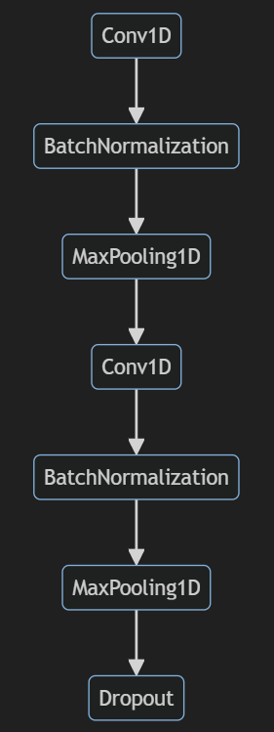
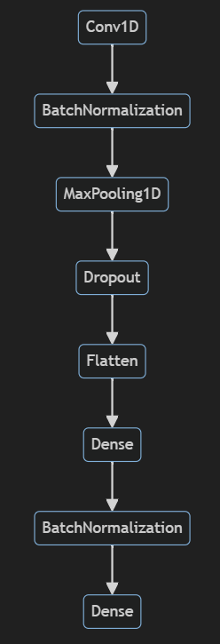
CNN Model-(SOTA)
Layered structure with Conv1D, Batch Normalization, Max Pooling, Dropout, and Dense layers
Less training time due to faster convergence
Requires significant computational resources for large filter numbers
Notes:
CNN- Design & Purpose
- Layered structure with Conv1D, Batch Normalization, Max Pooling, Dropout, and Dense layers.
- Suited for image classification, feature extraction from one-dimensional data.
512 filters in conv 1d

Slide 13
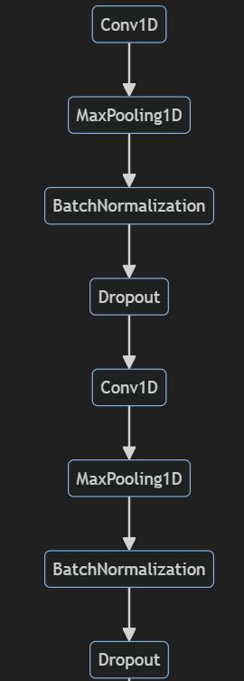
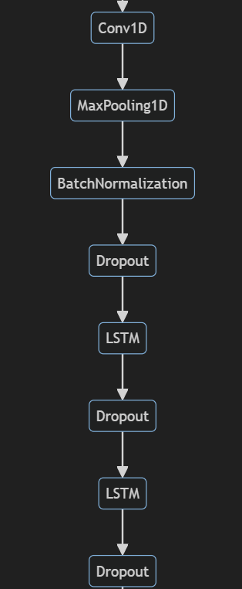
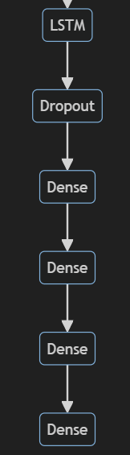
CLSTM Model
Combines CNN layers with LSTM units
Captures spatial features and temporal sequences
Can be slower to train due to LSTM complexity

Slide 14
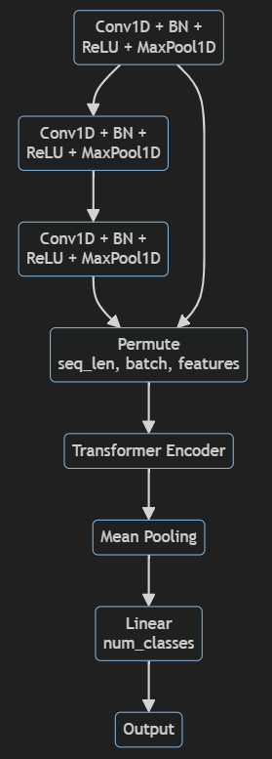
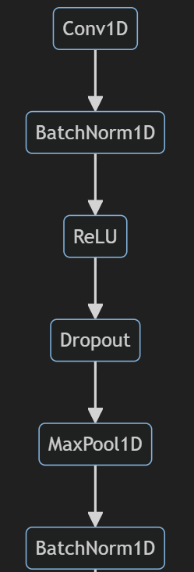
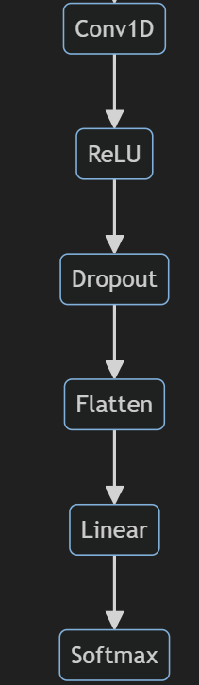
Transformer Model
Neural Network Model
Based on self-attention mechanisms with multiple encoder layers
Computationally intensive, requires more data and training time
Simple and shallow structure with basic Conv1D and Dense layers
Simple structure with basic Conv1D and Dense layers

