Slide 1
AWS

Slide 2
CLOUD
Practice of using remote servers on internet for carrying out tasks rather than using your own.
On demand delivery of computing resources, database storage, applications, IT resources etc. through cloud service via internet is called cloud computing.
No capacity planning in advance
Deployment-> few clicks to make changes in deployment instead of weeks
Maintenance-> done by AWS
Backup-> backup of data centers costly generally(recovery immediately in AWS)

Slide 3
ADVANTAGES
Trade capital expenses for variable expenses.
Benefit from massive economies of scale
Stop guessing capacity Increase speed and agility
Stop spending money on running and maintaining data centers
Go global in minutes (thus low latency)

Slide 4
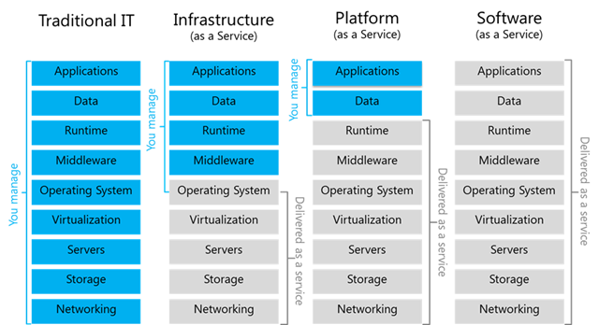
SERVICE MODELS
Traditional IT
Infrastructure as a service (EC2 instances, virtual machines)
Platform as a service (Google Forms)--> only deployment required
Software as a service (You Tube, Netflix, Gmail, Slack)--> login and use

Slide 5
DEPLOYMENT MODELS
Public (Govt sites)--> any one can login
Private --> only employees of org can access (One Drive)
Hybrid ---> public + pvt
Community---> shared among several org (LIC process same for every org---> so they can share same infra)

Slide 6
AWS
Secure cloud services platform offering compute power, database storage, content delivery etc.
Pay as u go (no capital investment)
helps in controlling, auditing and managing identity, configuration and usage.

Slide 7
AWS SERVICES
(COMPUTE TAB) EC2(IAAS) -> SERVER
EBS(elastic box service)-> STORAGE-> like hard disk-> can be connected to EC2 instance)
EFS(Elastic file sharing)-> STORAGE-> Shared by different ec2 instances
S3(Simple Storage Service)-> Storage
RDS-> Relational database service-
(Networking) VPS-> Virtual Private Cloud -> for placing servers-> outside VPC no one will have access to that server
(COMPUTE TAB) Auto Scaling -> for increasing capacity

Slide 8
CloudWatch -> watch all other cloud services-> for monitoring
CloudTrail -> maintains logs-> which service used by whom and how-> that log can then be stored in a storage service like S3, EBS etc.
(COMPUTE TAB)Elastic Beanstalk -> PaaS -> don't have to worry about platform fror hosting, takes care of that --> run and manage web apps
(APPLICATION INTEGRATION TAB)SNS (Simple Notification Service) , SQS(Simple Queue Service)-> for sending mail to user-> e.g. in case of unAuth access attempt
(COMPUTE TAB) LAMBDA (Server less Service)(IAAS) -> we don't need to worry about background, takes care of it --> servers initiated on backend automatically
Direct connect (costly)(VPN not costly)-> establish connection between aws server(some servers that were migrated to AWS) and local machine(on-premises)
CodeCommit(version control)
Code build(build code)]
code deploy(deploy code)
code pipeline->integrates code commit+build+deploy so continuous addition and continuous deployment takes place i.e. CACD pipeline. Like Jenkins

