Slide 1
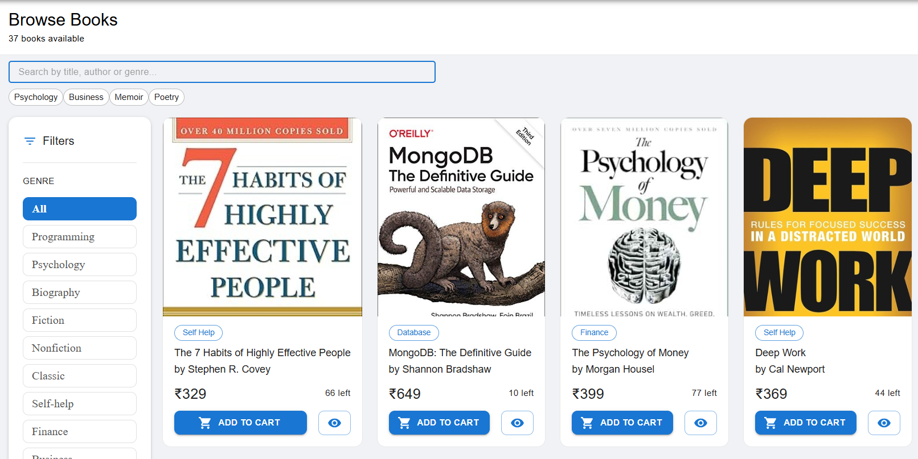
PROJECT PRESENTATION
Live Application
● ● ● bookstore.vercel.app
Smart Bookstore
📚 Bookstore
Browse Books
37 books available
Management System
Book cards grid...
MERN Stack
SHUBHANJALI
IIIT Allahabad · 2026
Proceed to Checkout

Slide 2
AGENDA
01
Introduction & Problem Statement
02
Tech Stack — MERN Overview
03
System Architecture & Design
04
Key Modules & Features
05
Database Design
06
Implementation Highlights
07
Testing & Deployment
08
Results & Future Work
↓ live system

Slide 3
Why a Smart Bookstore System?
No Online Presence
✅ The Solution
Bookstores manage inventory manually with spreadsheets causing errors
✓ Full-stack MERN web application
✓ Online book browsing & search
No Payment Integration
Cash-only transactions limit customer reach and revenue tracking
✓ Stripe payment gateway
✓ Real-time order tracking
No Order Tracking
Customers have no visibility into order status or delivery updates
✓ Admin & customer roles
✓ Email order confirmations
No Access Control
✓ Deployed on Vercel + Render
Anyone can add, edit or delete books causing data integrity issues
✓ MongoDB Atlas cloud database
This system replaced all above pain points — one platform for bookstore management

Slide 4
The MERN Stack
M
E
R
N
MongoDB
Express.js
React.js
Node.js
NoSQL Database
Backend Framework
Frontend Library
Runtime Environment
Document-based, flexible schema
Routing & middleware pipeline
Component-based UI
JavaScript on the server
Hosted on MongoDB Atlas
REST API with MVC pattern
Material-UI v5 + Redux Toolkit
Powers Express backend
Mongoose ODM for validation
JWT authentication
React Router v6
Nodemailer + Stripe SDK
6 collections designed
5 route files
12 pages built
100% JS full-stack

Slide 5
System Architecture
PRESENTATION LAYER
React.js + Redux Toolkit + Material-UI v5
→ Axios HTTP + JWT Bearer token
APPLICATION LAYER
← JSON responses + CORS
Node.js + Express.js REST API + JWT Auth
→ Axios HTTP + JWT Bearer token
DATA LAYER
← JSON responses + CORS
MongoDB Atlas + Mongoose ODM + EmailLog
External Services: Stripe API · Gmail SMTP (Nodemailer) · MongoDB Atlas · Render · Vercel

Slide 6
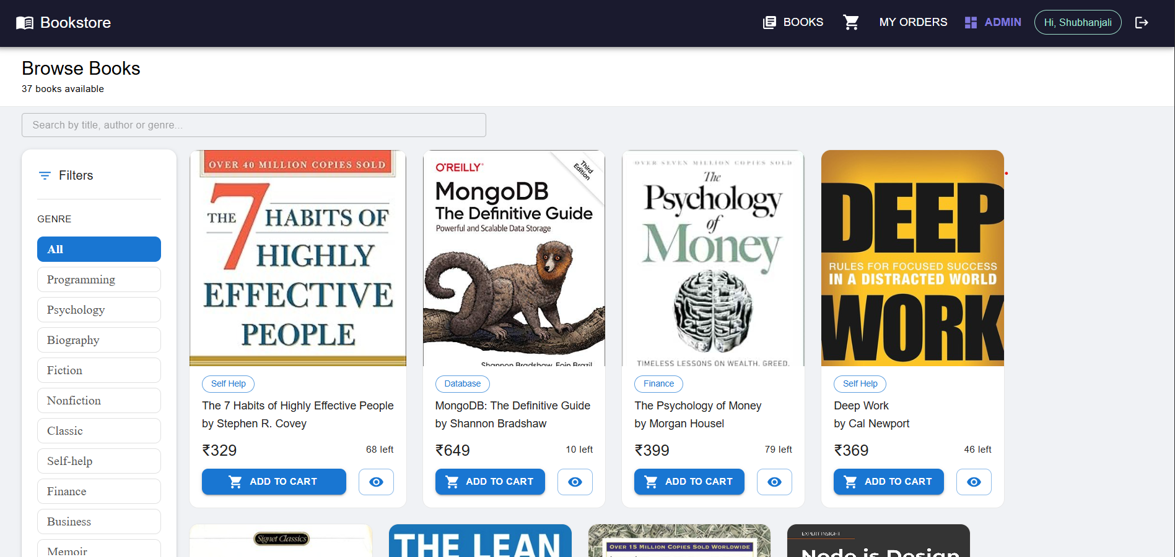
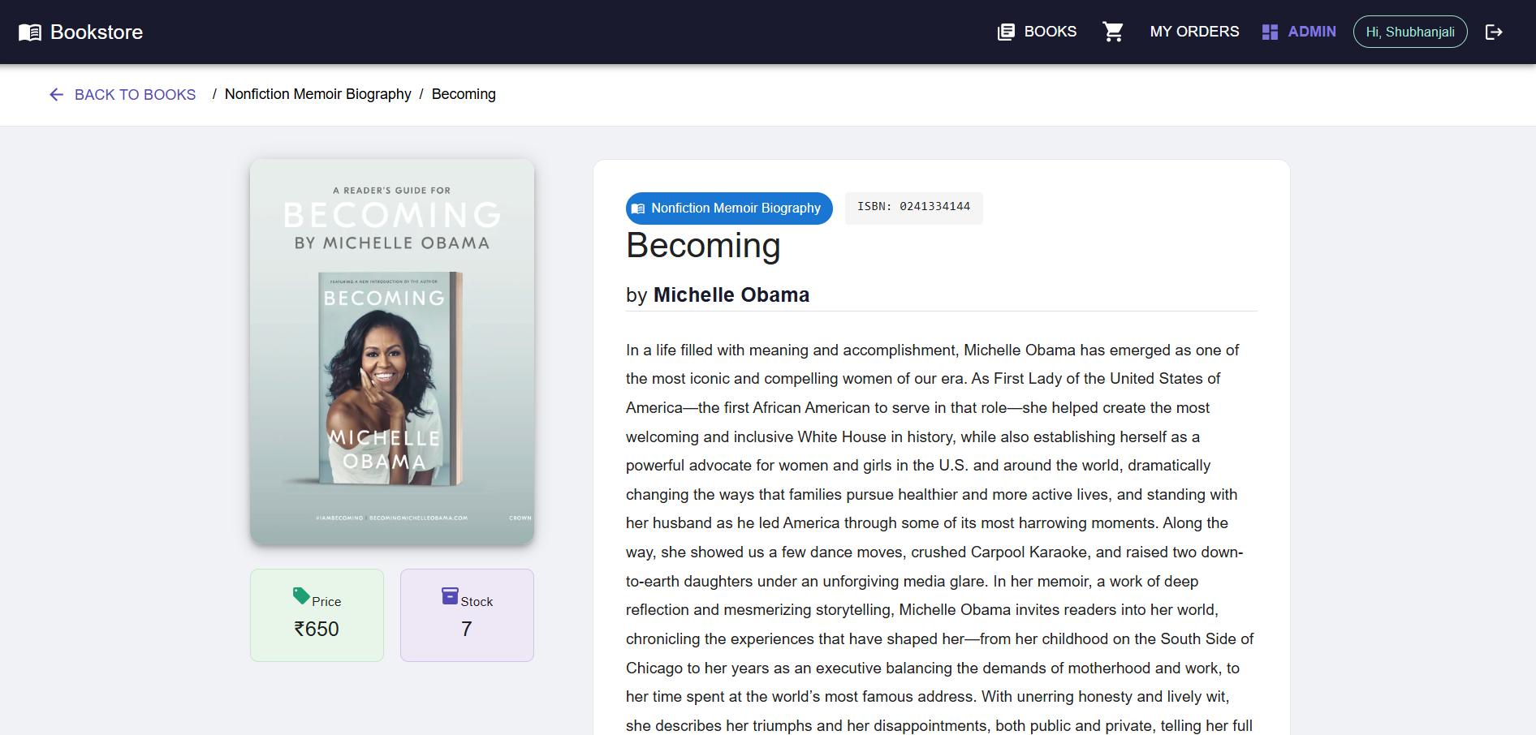
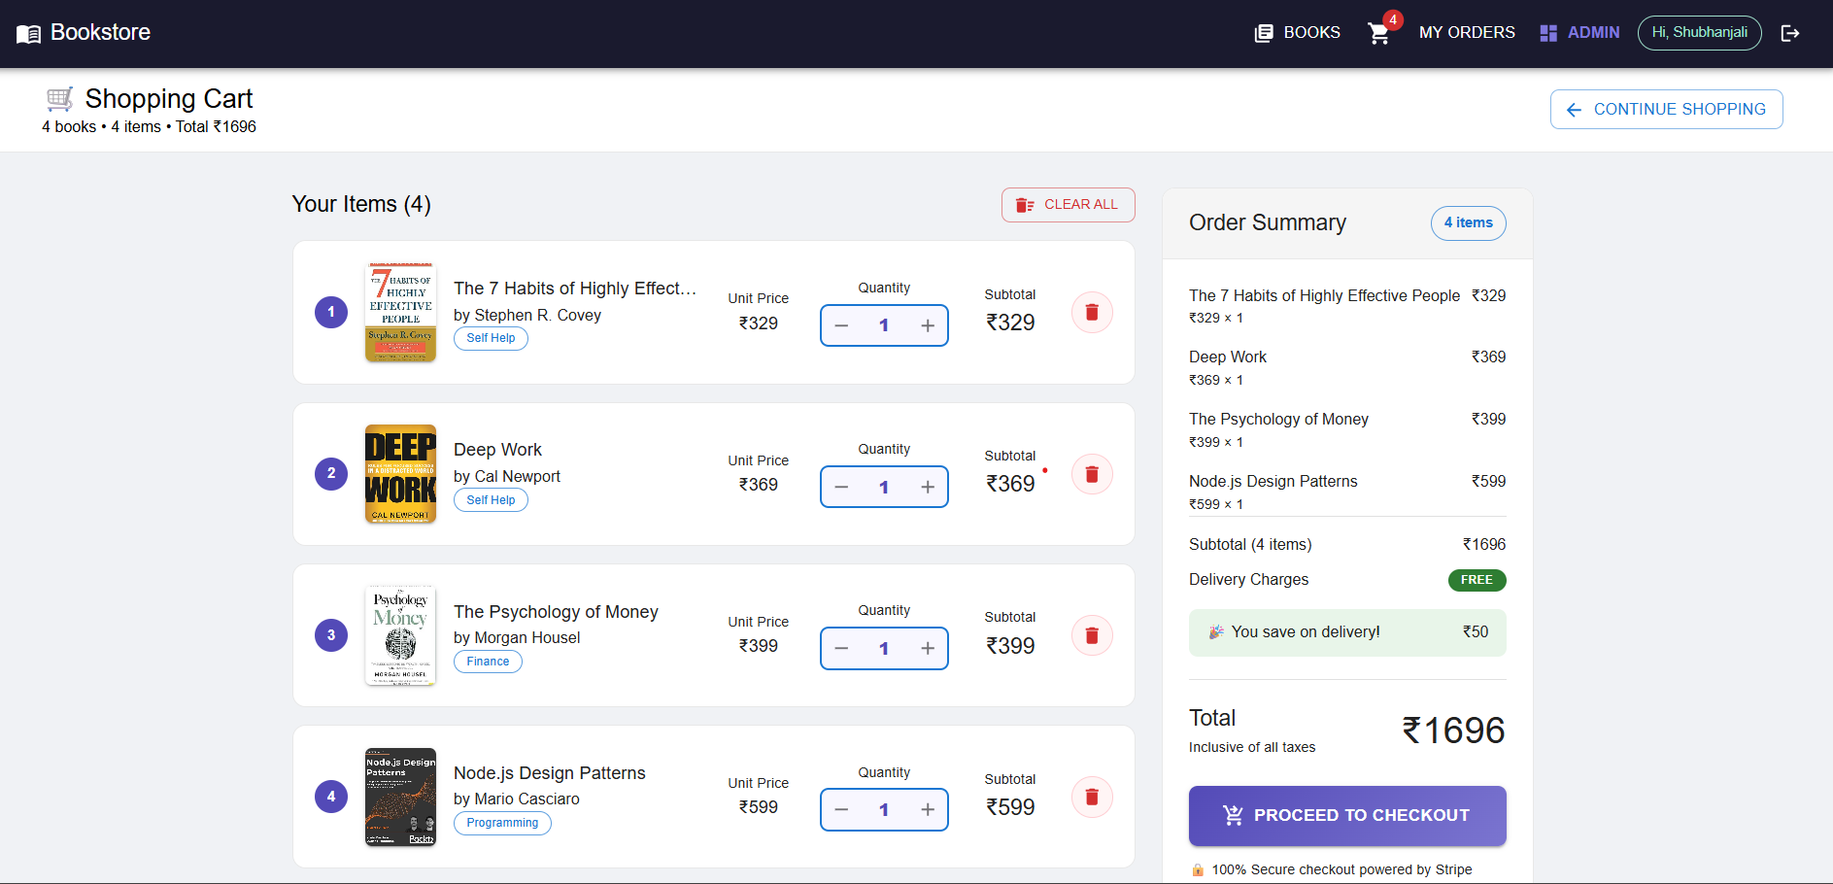
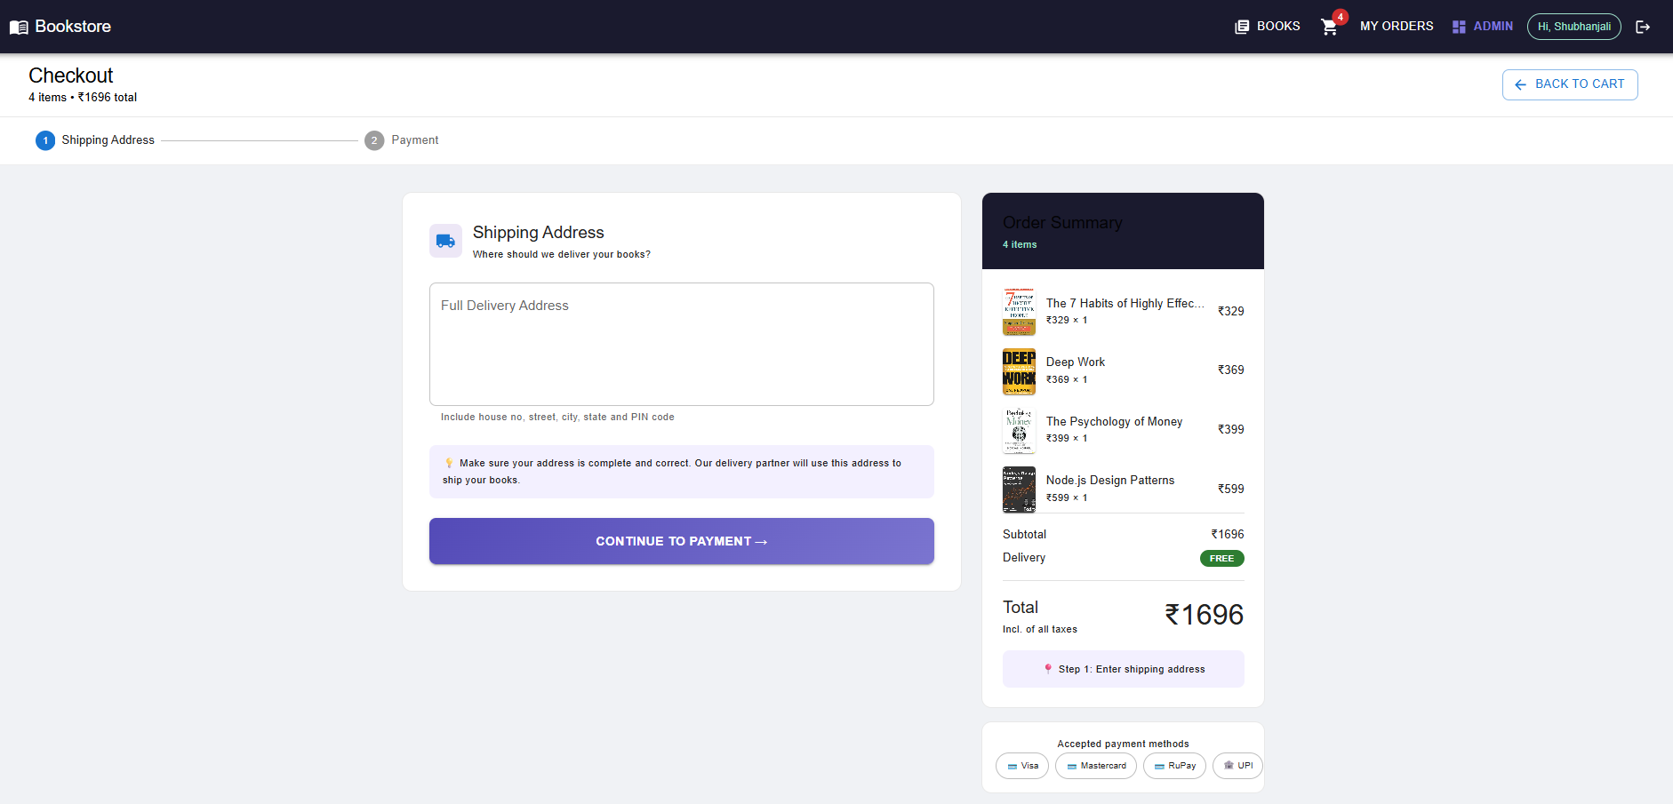
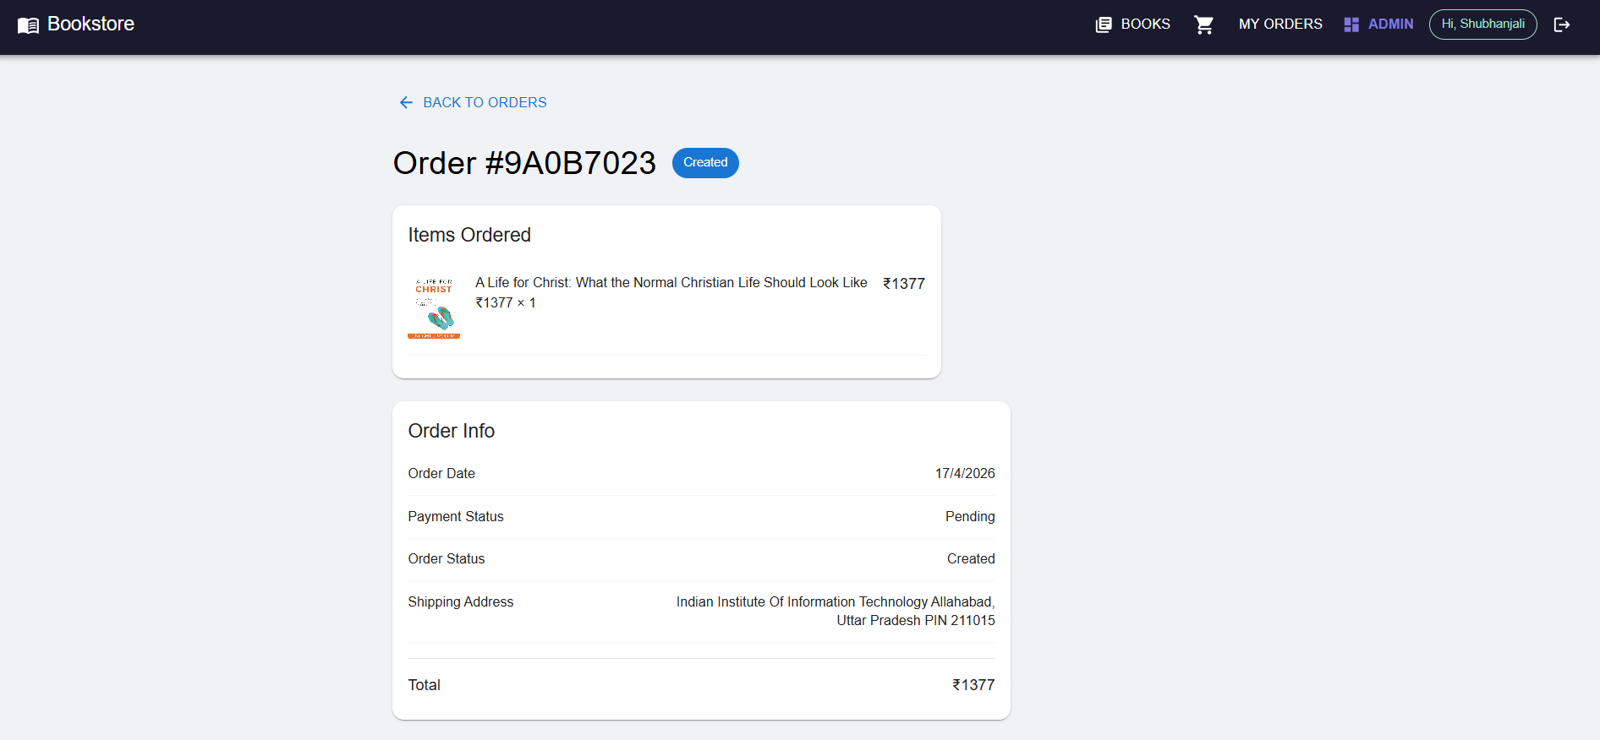
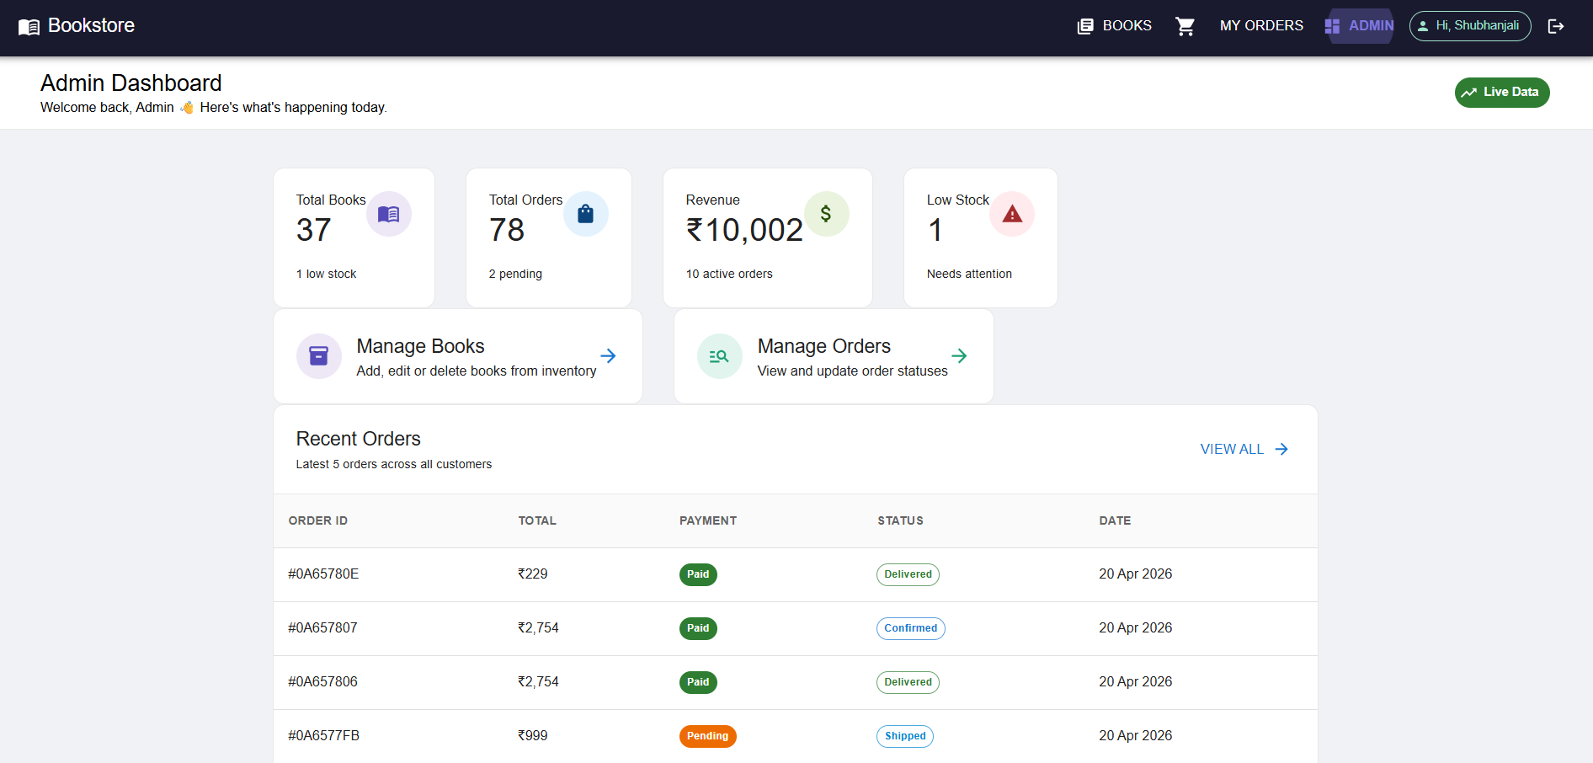
Key Modules — Live Features
Browse Books
Book Detail Page
Shopping Cart
Browse Books
Book Detail Page
Shopping Cart
Sidebar filter + search + genre chips + 4-col grid
2-column layout with image, price, stock, buy buttons
Item management, quantity control, order summary
Stripe Checkout
My Orders
Admin Dashboard
Stripe Checkout
My Orders
Admin Dashboard
2-step: shipping address → Stripe card payment
Order history with status chips and detail view
Stats cards, revenue, low stock alerts, recent orders

Slide 7
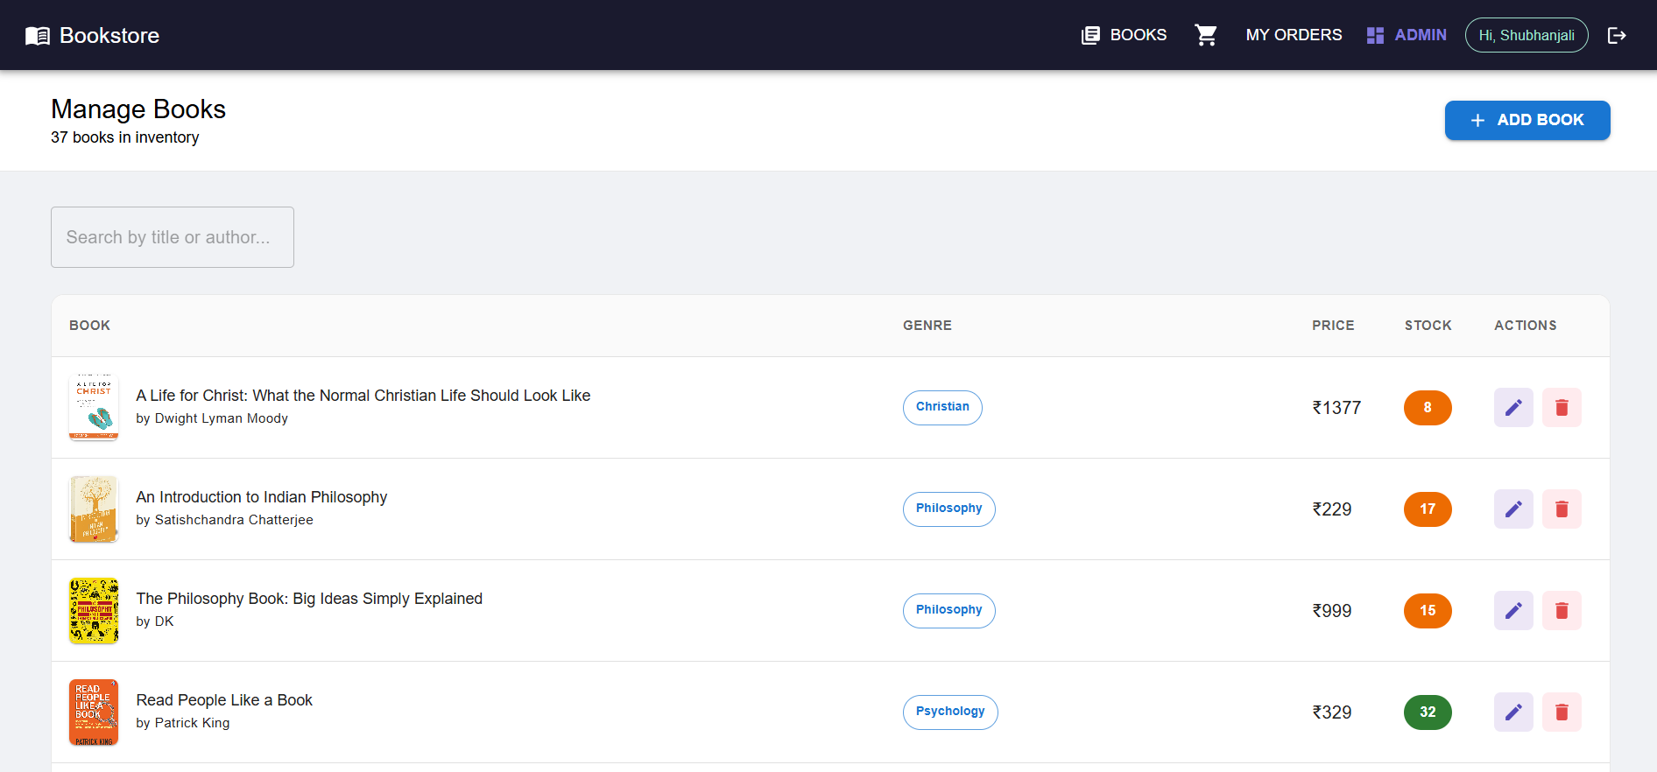
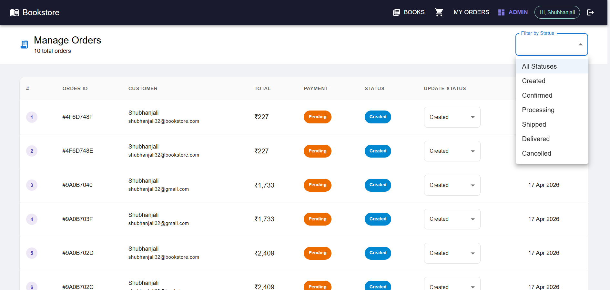
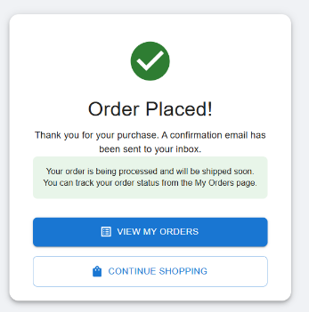
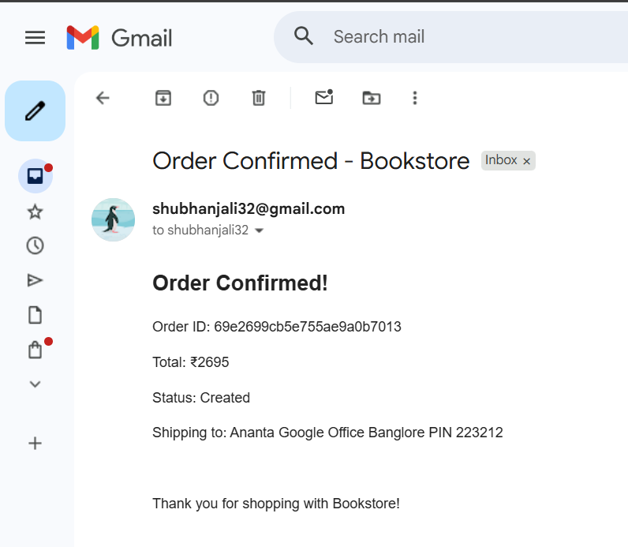
Admin Modules — Live Features
Admin Books CRUD
Admin Orders
Admin Books CRUD
Admin Orders
Add, edit, delete books with dialog form + search
View all orders, update status via dropdown per row
Order Success
Email Notifications
Order Success
Email Notifications
Confirmation page + email sent to customer inbox
Gmail Nodemailer + EmailLog saved to MongoDB

Slide 8
Database Design (MongoDB)
Users
Books
Orders
_id, name, email
_id, title, author
_id, userId*
password (bcrypt)
genre, price, stock
totalPrice, status
role, phone, address
isbn, description
paymentStatus
createdAt, updatedAt
imageUrl, createdAt
shippingAddress
OrderItems
Payments
EmailLogs
_id, orderId*
_id, orderId*
_id, userId*
bookId*, quantity
paymentIntentId
emailType, status
price at purchase
amount, currency
recipientEmail
createdAt
status, transactionDate
sentAt
* = ObjectId reference (Mongoose populate())

Slide 9
Implementation Highlights
Frontend (React.js)
Backend (Node.js + Express)
✓ Material-UI v5 — Cards, Dialogs, Tables
✓ JWT authentication — 30-day token expiry
✓ Redux Toolkit — 5 slices, async thunks
✓ bcrypt — password hashing (salt rounds 10)
✓ React Router v6 — protected routes by role
✓ 5 controllers — auth, book, order, payment, email
✓ Axios interceptor — auto-attaches JWT token
✓ Stripe PaymentIntent + webhook handler
✓ React Hook Form + Yup — form validation
✓ Nodemailer — Gmail order confirmation email
✓ Stripe.js — confirmCardPayment integration
✓ EmailLog model — tracks all sent emails
✓ React Toastify — toast notifications
✓ Admin middleware — role-based access control
✓ BookFilter sidebar + BookSearch component
✓ CORS configured for Vercel + localhost

Slide 10
Stripe Payment Flow
1
2
3
4
5
6
Add to Cart
Create Order
Payment Intent
Stripe Confirm
Webhook Fires
Email Sent
Redux cart
state only
(no backend)
POST /api/orders
status: Pending
POST /api/payment
/create-intent
clientSecret
confirmCard
Payment()
test card
payment_intent
.succeeded
event
Order Confirmed
+ EmailLog
saved
Result: Order status → Confirmed | Email delivered to customer | EmailLog saved in MongoDB | Revenue updated in Admin Dashboard

Slide 11
Testing & Deployment
37
47
17
2
Users
Registered
Books
Created
APIs
Tested
Roles
Tested
Vercel
Render
MongoDB Atlas
Stripe
Frontend
Backend
Database
Payments
Zero-config React deploy
Auto-deploys on git push
CDN-distributed globally
ENV: VITE_API_URL
Node.js Web Service
Auto-deploys from GitHub
HTTPS endpoint provided
ENV: MONGO_URI, JWT_SECRET
Managed cloud MongoDB
Auto backups + scaling
6 collections, 20+ docs
ENV: Connection string
PaymentIntent API
Webhook for confirmation
Test mode verified
ENV: STRIPE_SECRET_KEY
CI/CD: Every push to main branch triggers automatic redeploy on Vercel & Render

Slide 12
Results & Outcomes
< 2s
Page Load Time
Live Dashboard
Total Books: 37
Total Orders: 78
17/17
APIs Working
Revenue (Paid): ₹10,000+
Low Stock: 0
100%
Email Delivery
Admin Dashboard ✅
Email Logs: Verified ✅
Stripe Webhook: Working ✅
12/12
Pages Complete
Deployed on Vercel + Render ✅

Slide 13
Future Enhancements
Book Reviews
Advanced Search
Razorpay Integration
Star ratings + customer reviews with moderation system
Elasticsearch full-text search by content, genre, price range
Add UPI, net banking, EMI as additional payment options
Mobile App
Analytics Dashboard
Wishlist Feature
React Native app sharing Redux business logic with web app
Sales trends, revenue reports, bestseller tracking charts
Save books for later, get price drop notifications via email

Slide 14
Thank You
Admin Dashboard
Order Success Page
Stats + Orders + Books Management
Stripe payment confirmed + email sent
SHUBHANJALI
B.Tech IT | IIIT Allahabad | Smart Bookstore Management System · 2025–26

