Slide 1
Autoencoder for Image Denoising
Shubhankar Poundrik
Nakshatra Yalagach
Anushruti H

Slide 2
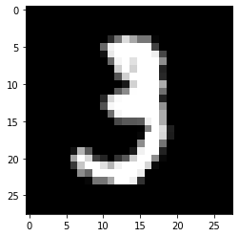
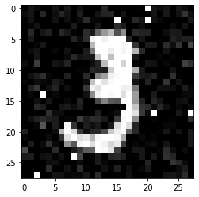
Noise in images
Original Image
Noisy image
Images can suffer from various types of noise
We add Gaussian and salt-and-pepper noise to original image

Slide 3
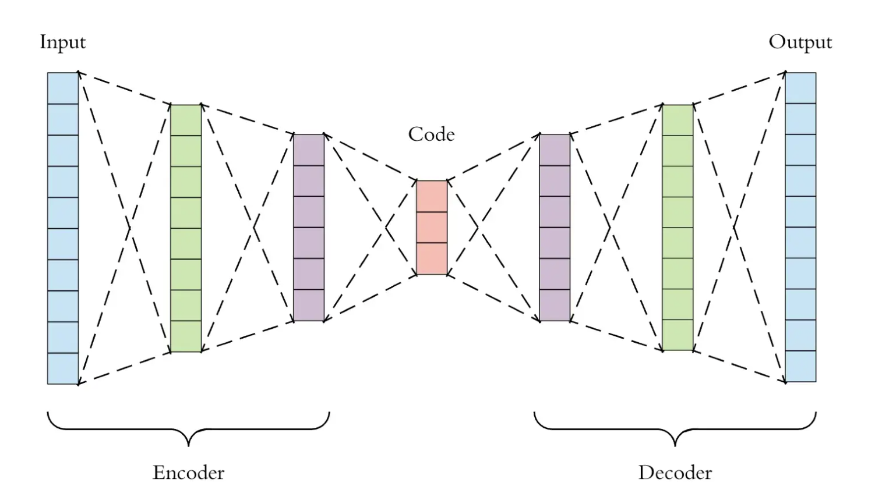
Fully Connected Autoencoder

Slide 4
Architecture
Both the encoder and decoder are fully-connected feedforward neural networks.
Data is “compressed” at the layer of smallest width.
Goal: To obtain an denoised image as output.

Slide 5
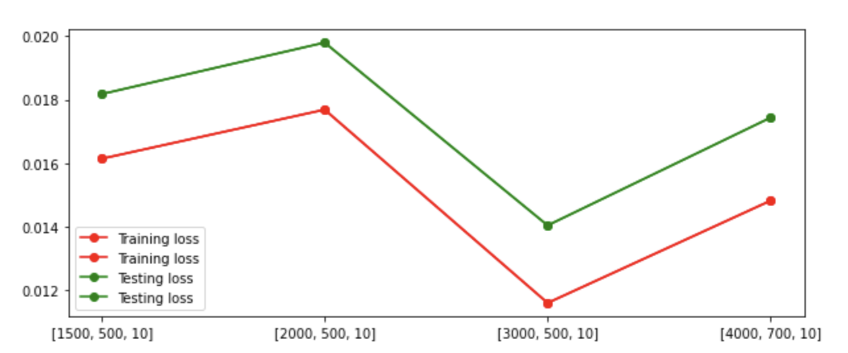
Results - Fully Connected

Slide 6
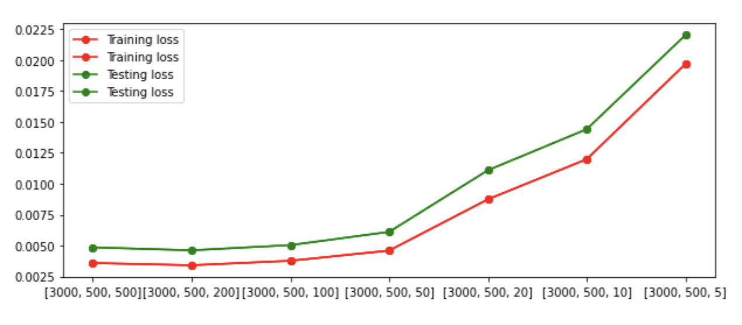
Results - Fully Connected
If the feature map (middle) layer is too small, the reconstruction is not good due to the loss of data.
The loss converges to a value for large width of narrowest (middle/feature map) layer.

Slide 7
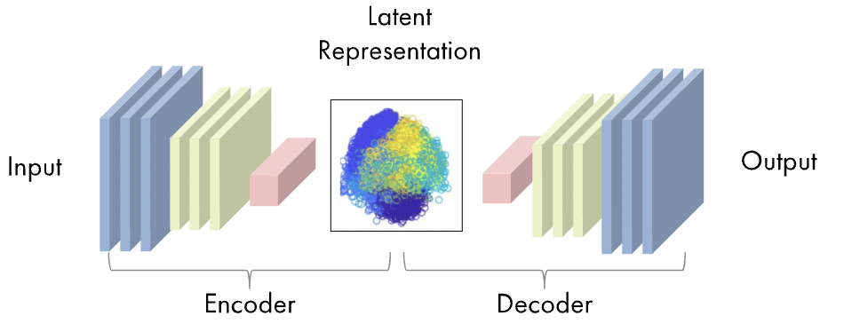
Convolutional Autoencoders

Slide 8
How Do the Convolutional Autoencoders Work?
Convolution Layer
Padding
Strides
ReLU
Max Pooling Layer

Slide 9
Convolutional Layer

Slide 10
Maxpool Layer

Slide 11
Model design
Input(shape=(28, 28, 1)),
Conv2D(16, (3, 3), activation='relu', padding='same', strides=2),
Conv2D(8, (3, 3), activation='relu', padding='same', strides=2),
Conv2DTranspose(8, kernel_size=3, strides=2, activation='relu', padding='same'),
Conv2DTranspose(16, kernel_size=3, strides=2, activation='relu', padding='same'),
Conv2D(1, kernel_size=(3, 3), activation='sigmoid', padding='same')

Slide 12
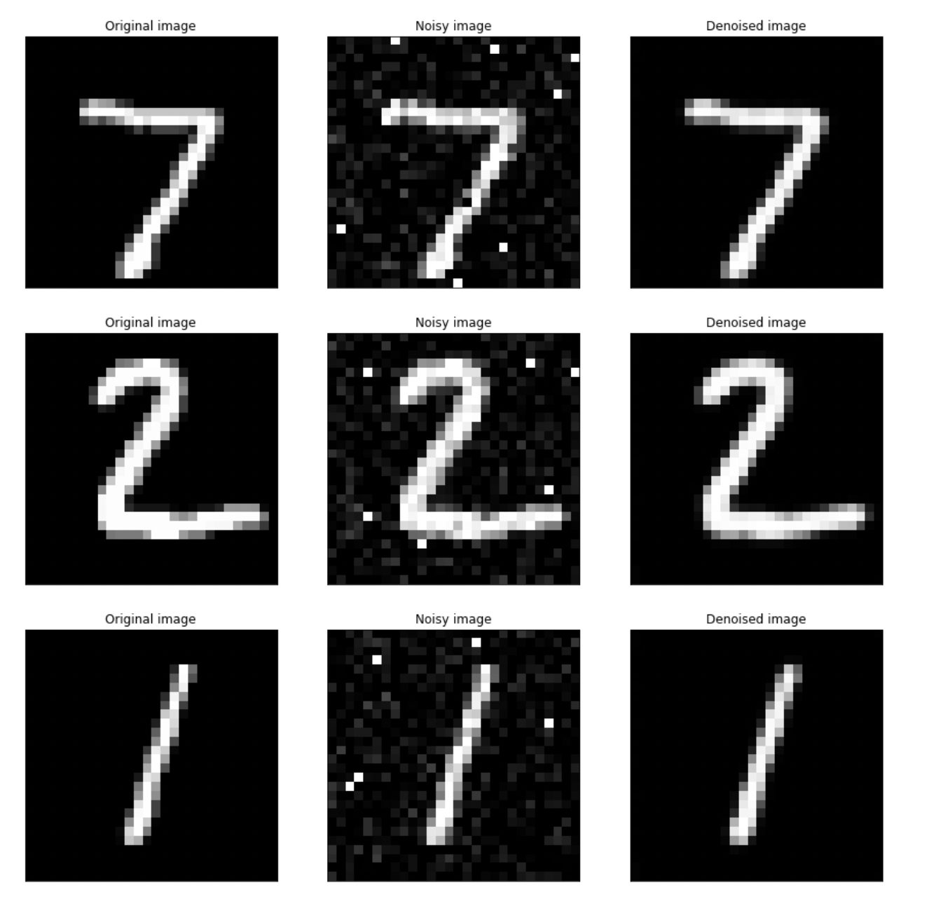
Results - CNN
Training loss:
0.0026
Testing loss:
0.0026
Total params: 3,217
VS
Best fully connected AE Testing loss: 0.0049
Params: 7,721,794

Slide 13
KNN
Instance-based Learning or Lazy Learning: The function is only approximated locally and all computation is deferred until classification.
Algorithm is used for both classification and regression.
Classification: The KNN algorithm works by finding the closest training examples in the feature space and using their class labels to predict the class of the new example.
Regression: The KNN algorithm predicts the value of the new example by taking the average of the values of its nearest neighbors.
KNN is called a non-parametric method because it does not make any assumptions about the functional form of the underlying distribution of the data.
Hyperparameter Testing was performed on the following:
K value: 1,3,5,7,9
Distance: euclidean, manhattan, minkowski, cosine, jaccard, hamming

Slide 14
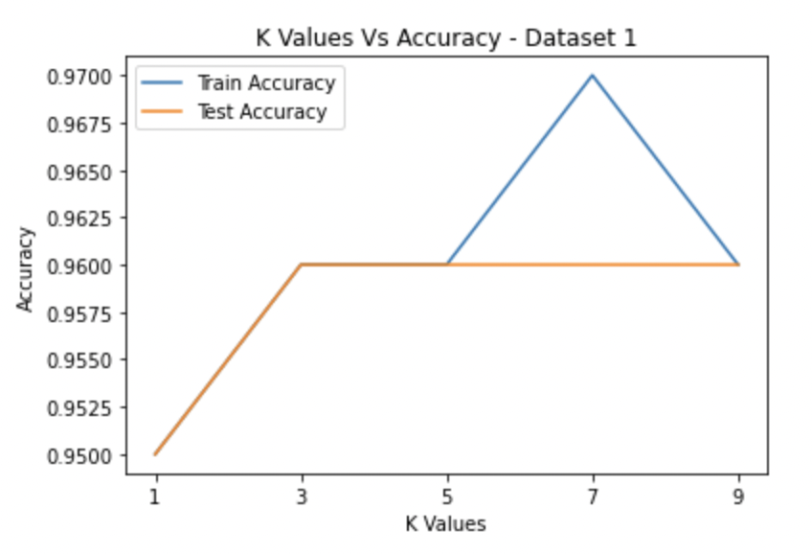
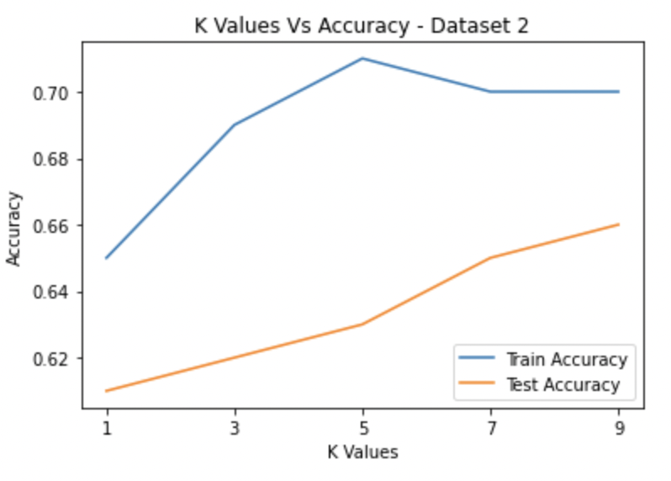
KNN - Hyperparameter Testing
Determining Optimal K value

Slide 15
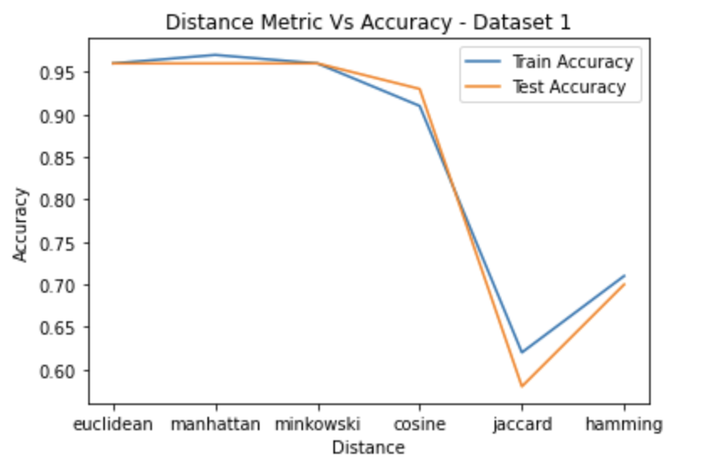
KNN - Hyperparameter Testing
Determining Optimal Distance Metrics

Slide 16
KNN - Hyperparameter Testing
Best Parameters for Dataset -1
K = 3, 5, 7 and 9 with test accuracy of 0.96
Distance metric = Euclidean, Manhattan. Minkowski with test accuracy of 0.96
Best Parameters for Dataset - 2
K = 9 with test accuracy of 0.66
Distance metric = Hamming with test accuracy of 0.72

Slide 17
Decision Tree
Comes under the concept of supervised learning.
Next step is decided based on the response of the previous step.
We have used the gini index to evaluate the splits in the dataset.
The accuracy obtained on the dataset 1 is : 91.2%
The accuracy obtained on the dataset 2 is : 64.7%

Slide 18
Decision Tree - Hyperparameter Tuning
Used gridsearchCV for hyperparameter tuning.
Parameter grid :
'criterion' : ['gini','entropy'],
'max_depth': [2, 3, 5],
'min_samples_split': [2, 3, 5],
'min_samples_leaf': [1,5,8]
For dataset 1 : The maximum accuracy obtained from using these best parameters is : 96%, Precision : 0.96, Recall : 0.97, f1-score : 0.97, AUC : 0.95
For dataset 2 : The maximum accuracy obtained from using these best parameters is : 70%, Precision : 0.71, Recall : 0.91, f1-score : 0.80, AUC : 0.5874

Slide 19
Decision Tree - Best Parameters
Dataset 1 :
'criterion': entropy
'max_depth': 3
'min_samples_leaf': 1
'min_samples_split': 2
Dataset 2: '
criterion': 'gini'
'max_depth': 2
'min_samples_leaf': 5
min_samples_split': 2

Slide 20
Random Forest
Group of decision trees with very low correlation between them.
Class of supervised machine learning algorithm.
The accuracy we obtained for the dataset 1 is : 95.9%
The accuracy obtained for the dataset 2 is : 64.74%

Slide 21
Random Forest - Hyperparameter Tuning
Parameter grid :
'max_depth': 10
'max_features': 'auto'
'min_samples_leaf': 1
'min_samples_split': 2
'n_estimators': 200
For dataset 1 : The maximum accuracy obtained from using these best parameters is : 96%, Precision : 0.97, Recall : 0.96, f1-score : 0.97, AUC : 0.9577
For dataset 2 : The maximum accuracy obtained from using these best parameters is : 70%, Precision : 0.78, Recall : 0.85, f1-score : 0.81, AUC : 0.6856

Slide 22
Random Forest - Best Parameters
Dataset 1 :
'max_depth': 10
'max_features': 'auto'
'min_samples_leaf': 1
'min_samples_split': 2
'n_estimators': 200
Dataset 2 :
'max_depth': 20
'max_features': 'auto'
'min_samples_leaf': 1
'min_samples_split': 5
'n_estimators': 300

Slide 23
Support Vector Machine
Employed to find the hyperplane that would best divide the dataset into 2 classes.
SVM algorithm chooses a hyperplane as the best when the distance between the hyperplane and the support vectors are to be maximum.
The accuracy on the test set for dataset 1 was found to be : 95.6%
The accuracy on the test set for dataset 2 was found to be : 79.56%

Slide 24
SVM - Hyperparameter Tuning
Parameter grid :
'C': [0.1, 1, 10]
'gamma': [1, 0.1, 0.01]
'kernel': ['linear']
For dataset 1 : The maximum accuracy obtained from using these best parameters is : 97%, Precision : 0.96, Recall : 0.91, f1-score : 0.93, AUC : 0.9152
For dataset 2 : The maximum accuracy obtained from using these best parameters is : 77%, Precision : 0.79, Recall : 0.90, f1-score : 0.84, AUC : 0.7097

Slide 25
SVM - Best Parameters
Dataset 1 :
'C': 1
'gamma': 1
'kernel': 'linear'
Dataset 2 :
'C': 10
'gamma': 1
'kernel': 'linear'

Slide 26
Boosting
Ensemble learning algorithm.
Goal: To combine the weak models into a single strong model that is able to make accurate predictions on new data.
Involves training a sequence of weak models in a way that each model tries to correct the mistakes of the previous model.
The model implemented uses decision trees as the weak models.
Hyperparameter Testing was performed on the following:
Max_depth

Slide 27
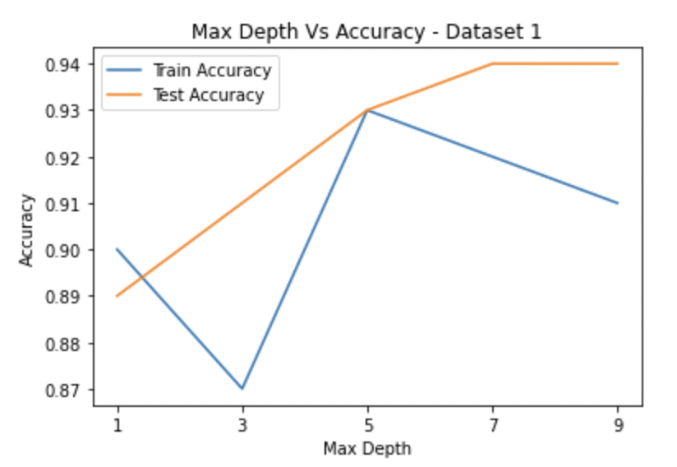
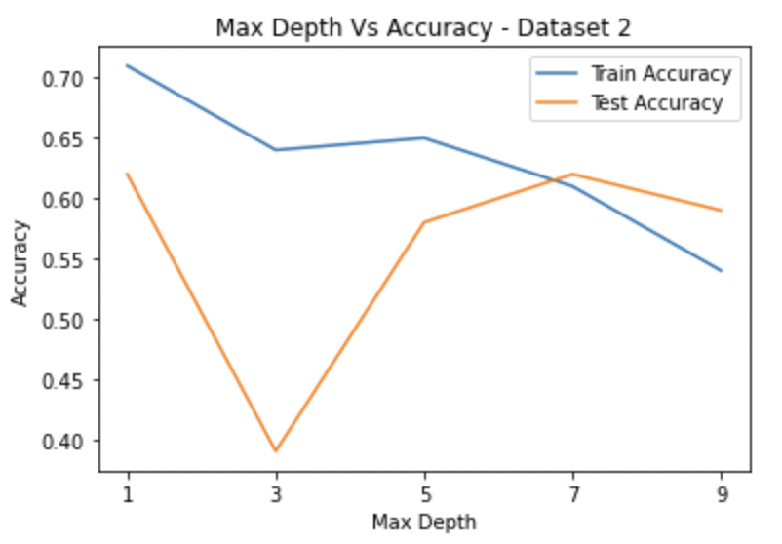
Boosting - Hyperparameter Testing
Determining Optimal Max Depth value

Slide 28
Boosting - Hyperparameter Testing
Best Parameters for Dataset -1
Max Depth = 7 and 9 with test accuracy of 0.94
Best Parameters for Dataset - 2
Max Depth = 1 and 7 with test accuracy of 0.62

Slide 29
Neural Network
Neural networks are a type of machine learning algorithm that is inspired by the structure and function of the human brain.
They are composed of many interconnected units called neurons, which process and transmit information.
The weights of the connection b/w neurons are adjusted to fit the model to the training data.
The algorithm uses a process called gradient descent, which involves calculating the gradient of the error with respect to the weights of the connections between neurons.
This gradient is then used to update the weights in a way that reduces the error.
This process is repeated for many iterations, allowing the network to gradually learn and improve its performance.

Slide 30
Neural Network - Hyperparameter tuning
Hidden nodes tested:[100, 10], [1000, 100], [20_000, 1000]
Learning rate tested: 0.01, 0.001, 0.0001
Weight initialization tested: HeNormal(), RandomNormal(mean=0.0, stddev=0.05, seed=42), Constant(0.1)
Best hyperparameters: Hidden units = [1000, 100], learning rate = 0.001, Weight initialization = <keras.initializers.initializers_v2.RandomNormal object at 0x7fc29e4a2e80>

Slide 31
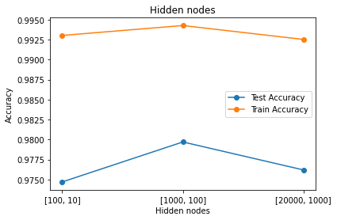
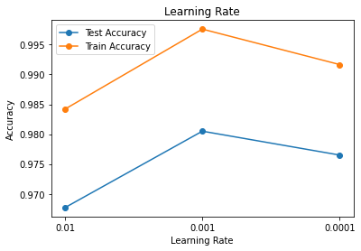
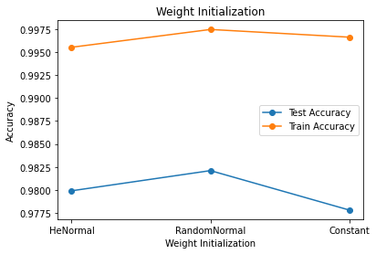
Neural Network - Accuracies for different hyperparameters

Slide 32
Logistic Regression
The algorithm fits the given data to a sigmoid / logistic function using gradient descent.
The equation for logistic regression can be written as,
Here the parameter to estimate is beta.
For Logistic Regression, no hyperparameter tuning is required.

Slide 33
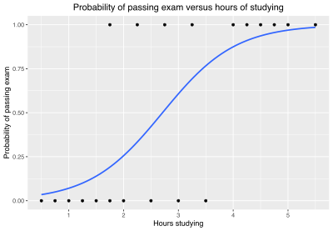
Logistic Regression
Dataset 1
Average across folds:
Accuracy = 0.965, precision = 1.000, recall = 0.903, f1 = 0.948, AUC = 0.952
Test set results:
Accuracy = 0.956, precision = 0.956, recall = 0.935, f1 = 0.945, AUC = 0.953
Dataset 2
Average across folds:
Accuracy = 0.729, precision = 0.652, recall = 0.520, f1 = 0.575, AUC = 0.683
Test set results:
Accuracy = 0.785, precision = 0.615, recall = 0.615, f1 = 0.615, AUC = 0.733

Slide 34
Thank You!
Q & A

