Slide 1

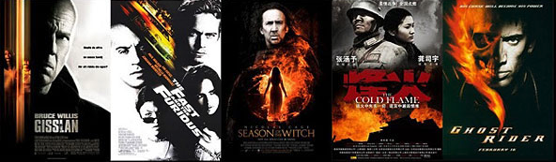
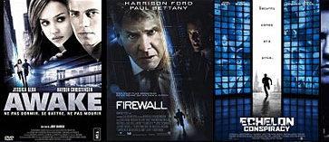
Movie Recommender System with DSS Using R Shiny app
Sudeep Kurian, Cassandra Liu
Shubhansh Jain, Muthuraja Palaniappan
Notes:
Today, we are going to introduce you our movie recommendation system through the order of business problem, analytical problem, solutions and shiny app presentation.

Slide 2
Outline
Business Problem
Analytics Problem
Solutions
Shiny App Presentation
Notes:
Today, we are going to introduce you our movie recommendation system through the order of business problem, analytical problem, solutions and shiny app presentation.

Slide 3
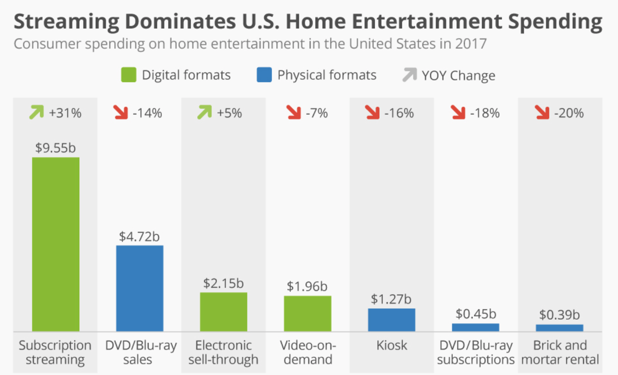
business problem
Source: Statista
Notes:
In 2017, U.S consumer spending on Home Entertainment through digital formats increased significantly and it would continue to grow, while spending on all physical formats dropped.

Slide 4
aNALYTICS PROBLEM
OBJECTIVES:
The users -> get recommended movies as per their ‘taste’ or ratings.
The business partners -> collect and learn about the users’ behavioral patterns.
Identify k nearest neighbor users that are similar to the new user
With User Based Collaborative Filtering (UBCF) approach, find Cosine similarity of new user with other users

Slide 5
Analytics problem
In order to achieve our objectives,
we need to collect
1) Comprehensive data about all the movies
2) User Ratings and information about all the movies
Design a Decision Support System
generate output(recommended movies) based on input (movie genre and similarity of users’ ratings and preferences).

Slide 6
Solution

Slide 7

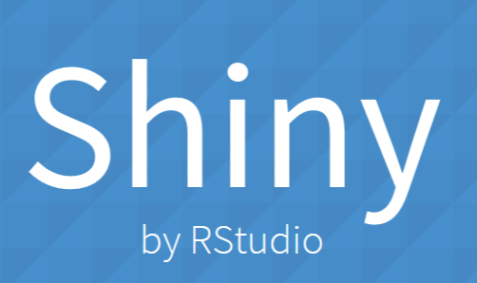
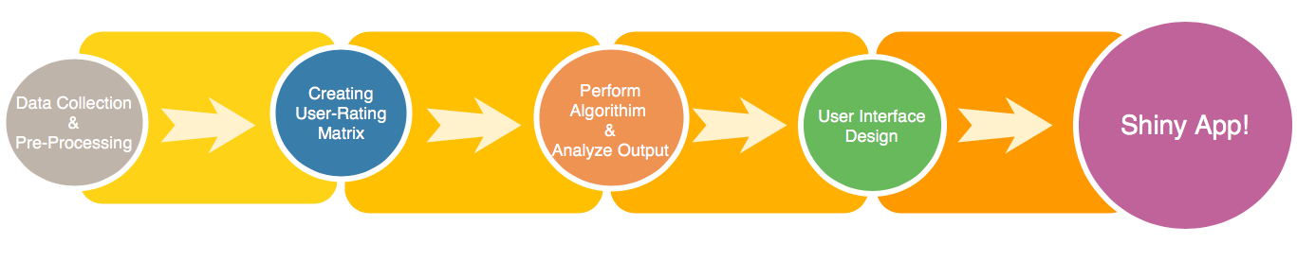
Workflow
Perform Algorithm
&
Analyze Output
Algorithm

Slide 8
dATA
Data Source:
MovieLens -> Open Source Database of 10,000 Movies & User Ratings
Tmdb -> metadata about movies
Includes movie genre, synopsis, IMDB ID, poster path
Data Pre-processing:
Create Poster Path -> Tmdb + Poster Path
Clean IMDB ID, Movie Name
Create new data table for movie genre dummy variables

Slide 9
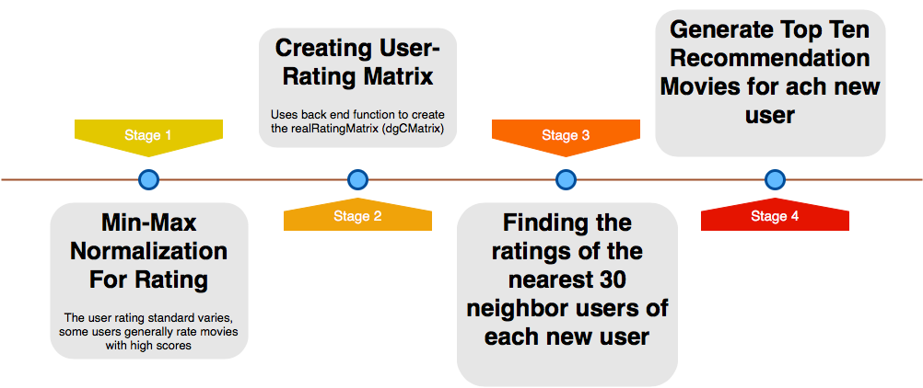
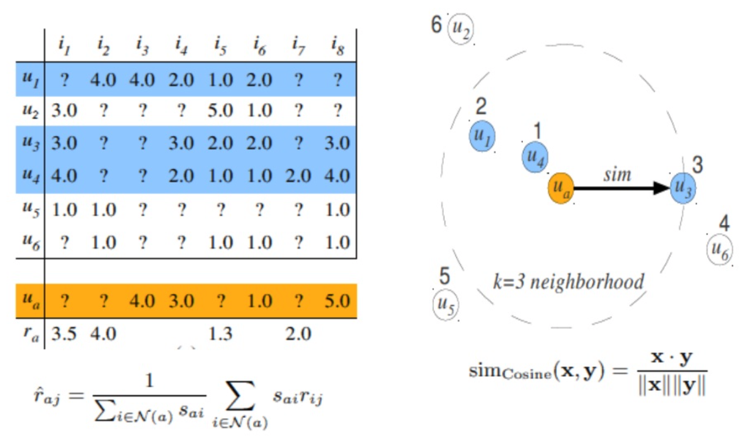
Methodology User-based collaborative filtering
Generate Top Ten Recommendation Movies for each new user
User-Based CF
Source: RecommenderLab

Slide 10
Shiny app Functionality
https://sudeep2711.shinyapps.io/final/​

Slide 11
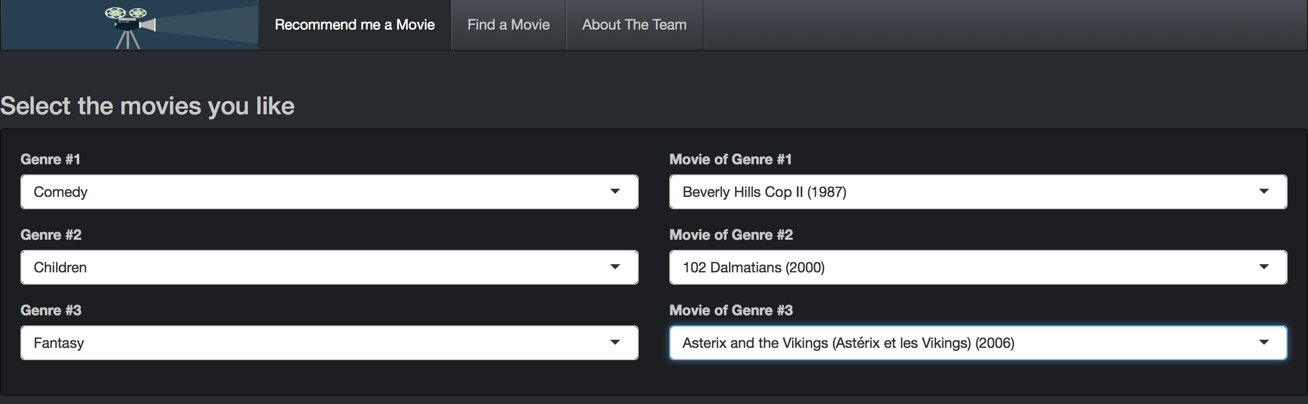
User interface design
Select up to three genres of movies you are interested in
Select your favorite movie in each genre

Slide 12
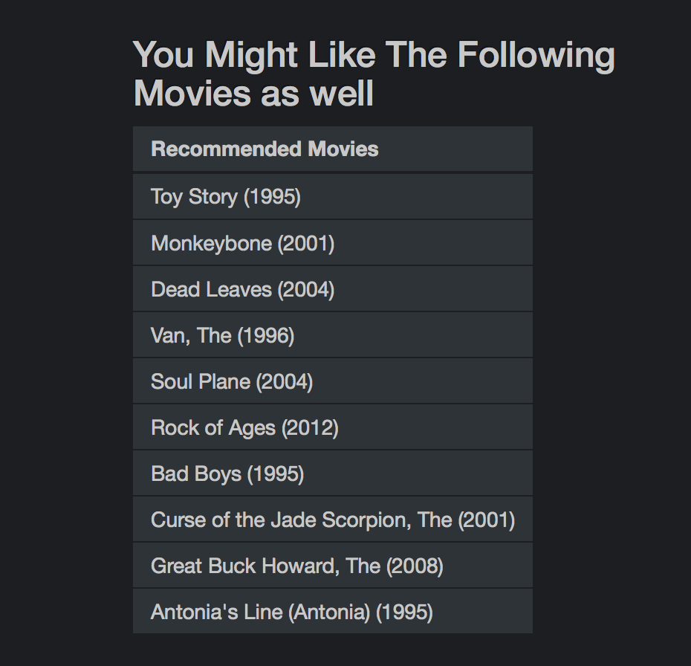
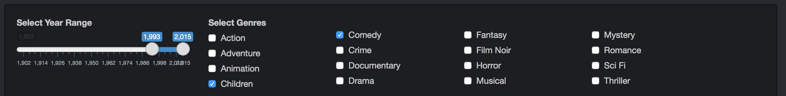
User interface design
Our system will generate ten recommended movies for the user
There are also two additional features that can filter the recommended movies by year and by genre!

Slide 13
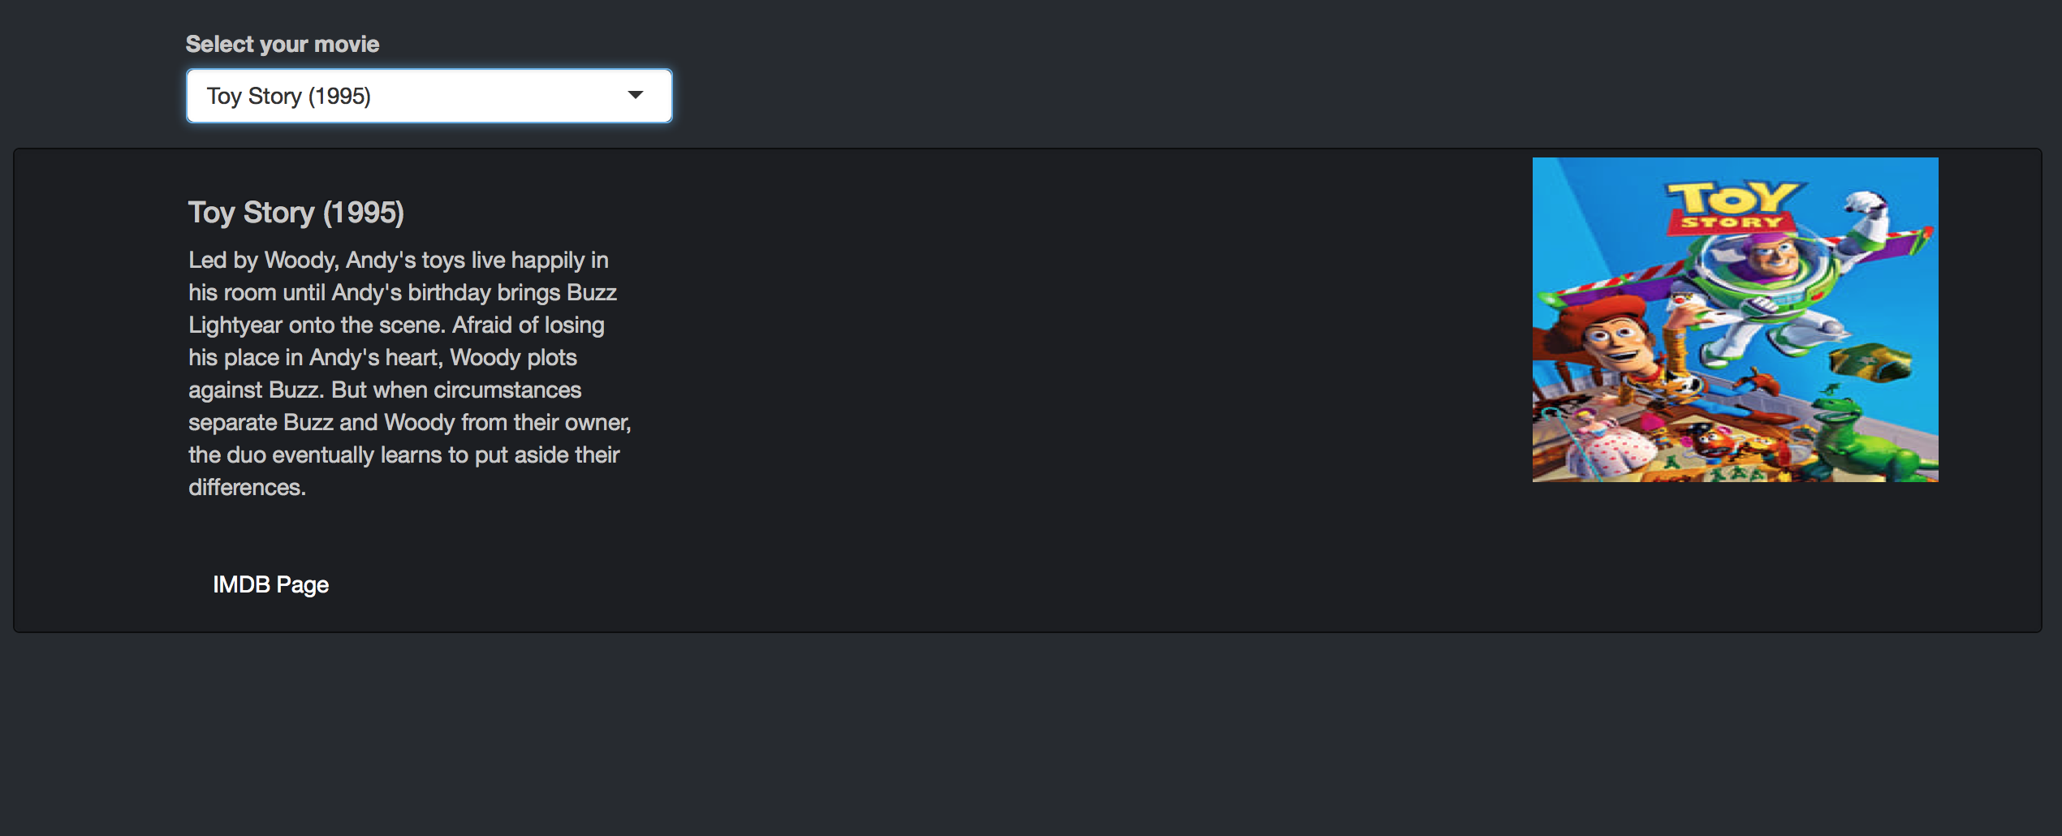
User interface design
On the 2nd tab, you can look up any movie in the system.
Our system will show the general information and the poster of the movie.
For more details, our system also provides IMDB Link.

Slide 14
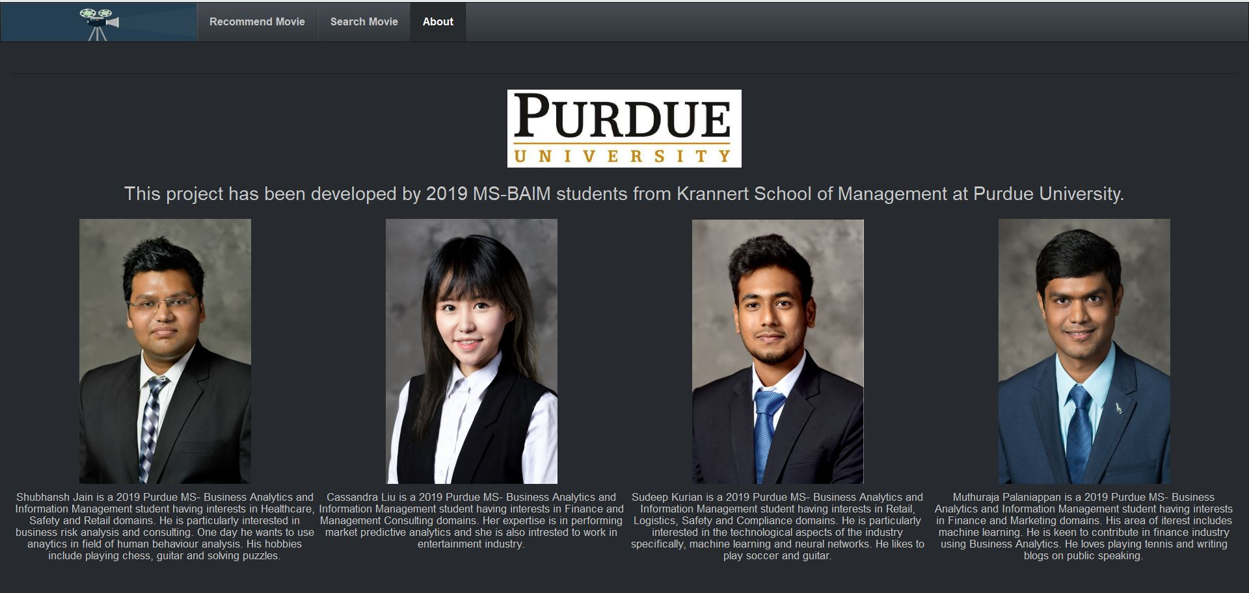
Thank you!
Email: kurians@purdue.edu ; palaniam@purdue.edu
jain297@purdue.edu; liu1498@purdue.edu
For Further questions!

