Slide 1
Docker-Compose
BY- Shubhanshu Nishad

Slide 2
Agenda
What is Docker Compose?
3 steps of Docker Compose
Building Block of Docker Compose
Docker Compose file Format
Basic of Docker

Slide 3

Did you know?
There are 3,00,000 Docker Compose files in GitHub Today.

Slide 4
Title and Content Layout with Chart

Slide 5

Before Docker Compose ,Let’s see some Docker concept
Docker : Docker is a software platform that allows you to build, test, and deploy applications quickly. Docker packages software into standardized units called containers that have everything the software needs to run including libraries, system tools, code, and runtime.

Slide 6
Containers : A Docker container image is a lightweight, standalone, executable package of software that includes everything needed to run an application
Images : A Docker image is a file used to execute code in a Docker container. Docker images act as a set of instructions to build a Docker container, like a template. Docker images also act as the starting point when using Docker.

Slide 7
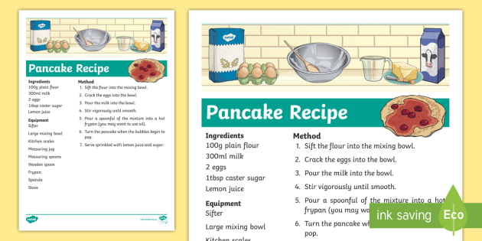

Docker image
Docker Container

Slide 8
How can you transfer your docker container to your friends ?
🧐🧐

Slide 9
Answer
Cook your Food
Make a recipe, share it on internet
Now, Your friend able to download recipe of your food.
Create container
Push your container image to docker Hub of your container
Now, Your friend able to pull image of your container

Slide 10
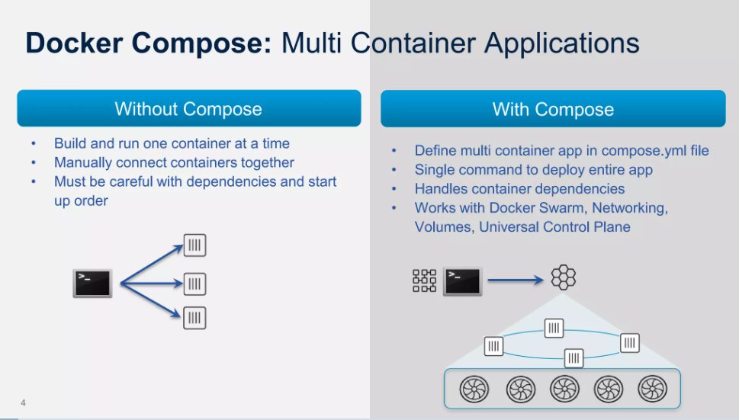

Slide 11
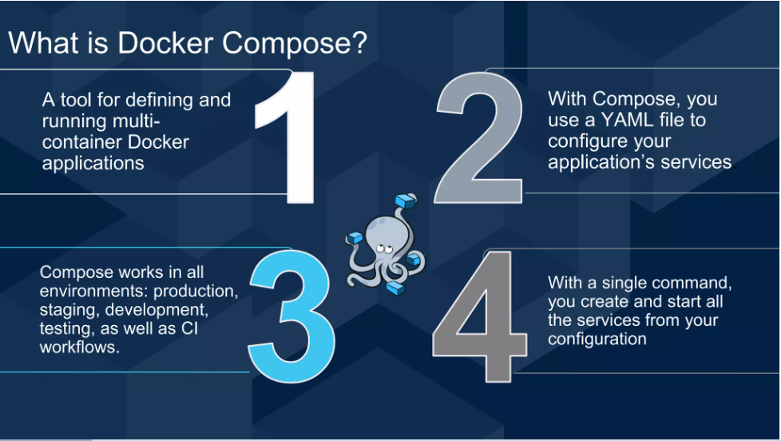

Slide 12
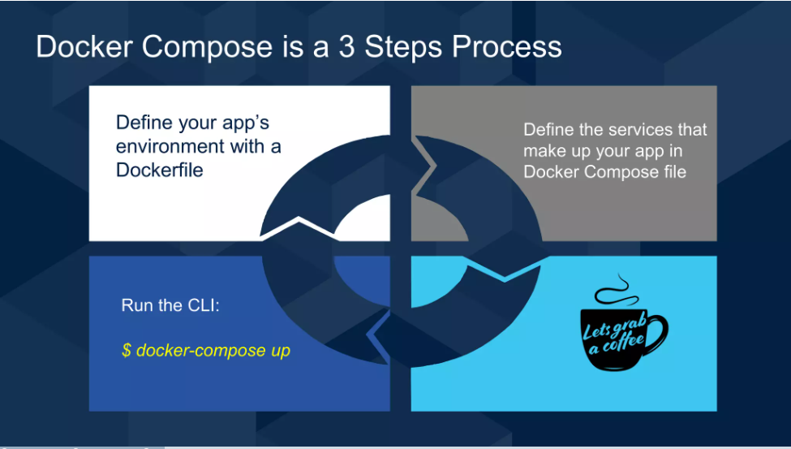

Slide 13
Hand’s On

Slide 14
Any Queries…

Slide 15


