Slide 1
Workshop Introduction to DevOps
Presented by : Gcloud Club

Slide 2
Objectives of this workshop
What is DevOps?
Why is DevOps used in the Industry?
The types of tools that are used in DevOps.

Slide 3
What is DevOps?
DevOps culture is a set of practices that reduce the barriers between developers, who want to innovate and deliver faster, on the one side and, on the other side, operations, who want to guarantee the stability of production systems and the quality of the system changes they make.
DevOps culture is also the extension of agile processes (scrum, XP, and so on), which make it possible to reduce delivery times and already involve developers and business teams, but are often hindered because of the non-inclusion of Ops in the same teams

Slide 4
Advantages of DevOps
The culture of collaboration: This is the very essence of DevOps—the fact that teams are no longer separated by silos specialization but, on the contrary, these people are brought together by making multidisciplinary teams that have the same objective: to deliver added value to the product as quickly as possible.
Processes: To expect rapid deployment, these teams must follow development processes from agile methodologies with iterative phases that allow for better functionality quality and rapid feedback.
Tools: The choice of tools and products used by teams is very important in DevOps. Indeed, when teams were separated into Dev and Ops, each team used their specific tools—deployment tools for developers and infrastructure tools for Ops—which further widened communication gaps.

Slide 5
Various Tools that are used in DevOps.
Docker
Kubernetes
Jenkins
Ansible
Git/github
Gitlabs
AWS Cloud / Google Cloud

Slide 6
Docker
The main functionality of docker is that it allows us to create containers. With Docker, you get a guarantee that if a feature is working in one environment, it will work in others as well. Containers simplify the build/test/deploy pipelines in DevOps.

Slide 7
Kubernetes
What is it and why do we need it?

Slide 8
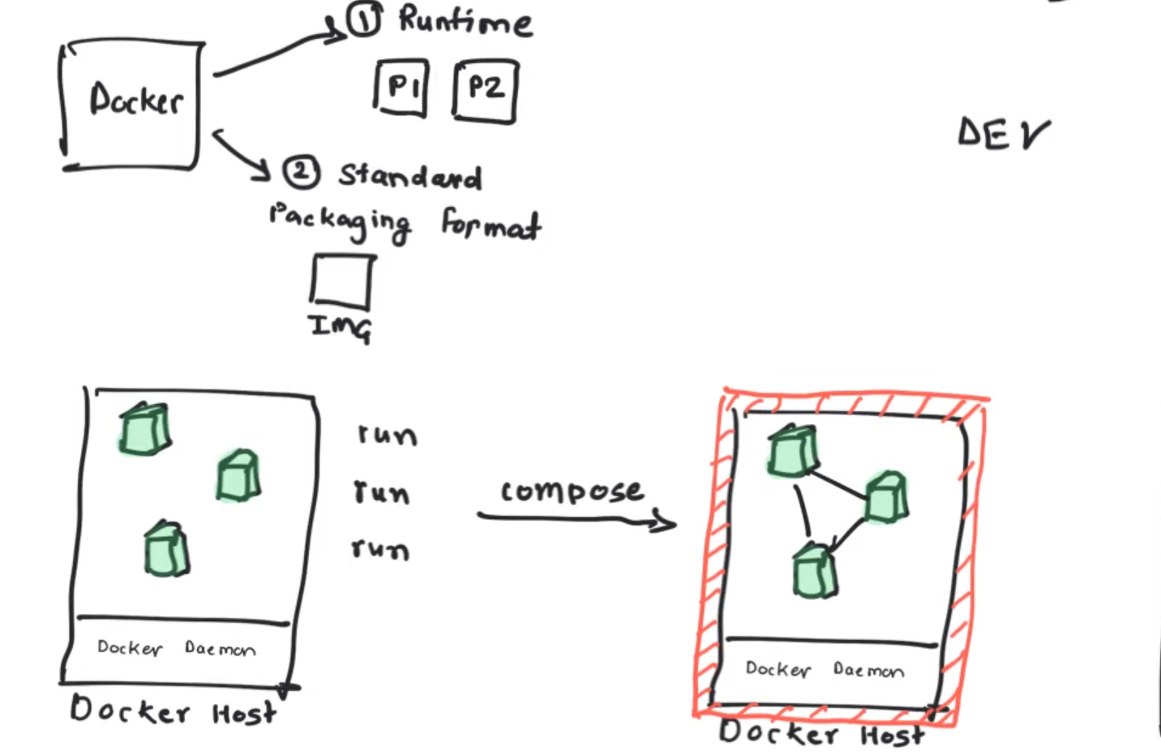

Slide 9
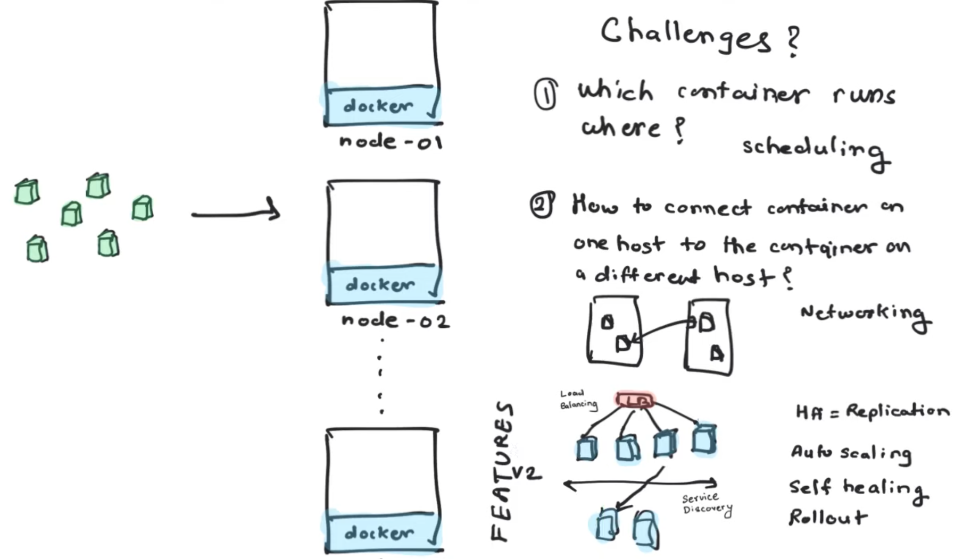

Slide 11
Jenkins
Jenkins is an open - source automation server
Used to automate parts of the software developmentprocess
It helps software teams facilitate Continuous Integration and Continuous Deployment / Delivery.
Jenkins is highly extensible
Developers making code changes in parallel want to make sure that their changes integrate without errors.

Slide 12
Ansible
Free: Ansible is an open-source tool.
Very simple to set up and use: No special coding skills are necessary to use Ansible’s playbooks (more on playbooks later).
Powerful: Ansible lets you model even highly complex IT workflows.
Flexible: You can orchestrate the entire application environment no matter where it’s deployed. You can also customize it based on your needs.
Agentless: You don’t need to install any other software or firewall ports on the client systems you want to automate. You also don’t have to set up a separate management structure.
Efficient: Because you don’t need to install any extra software, there’s more room for application resources on your server.
(Alternatives of ansible include chef , puppet , etc.)

Slide 13
Github and Gitlab
Github – It is used for source control management of the project. It is done so that we keep records of all the previous versions of our project.
Gitlab – It is a DevOps Platform that empowers organizations to maximize the overall return on software development by delivering software faster and efficiently, while strengthening security and compliance. It allows us to track various information about our project / software.

Slide 14
AWS Cloud /Google Cloud
AWS and GCP features the widest range of service offerings under PaaS, SaaS, and IaaS categories including compute, identity and access management (ACM), networking, and storage. While AWS offers public, private, and hybrid clouds, its focus is more on the public cloud.

Slide 15
Additional Tools
Apart from these generic tools that are used in DevOps , there is a huge variety of tools that work in other aspects. Tools like SignalFx , Appdynamics , raygun are used to monitor various type of data and response times for various scenarios.
There are also testing tools like selenium and gremlin that test the automation and microservices of the deployed project.

Slide 16
Conclusion
DevOps tool is critical for the automation of the software development life cycle. The DevOps approach is evolving at a very fast pace and emerging tools have been designed to incorporate those with little or no programming knowledge, micro-services and containerization, and other recent technologies. To select the right stack of DevOps tool(s), it is important to consider the following:
Integration with other systems and tools
Compatibility with a range of platforms
Customization capabilities
Both community and client support
Performance
Scaling capabilities
Compatibility with cloud platforms
Price

