Slide 1
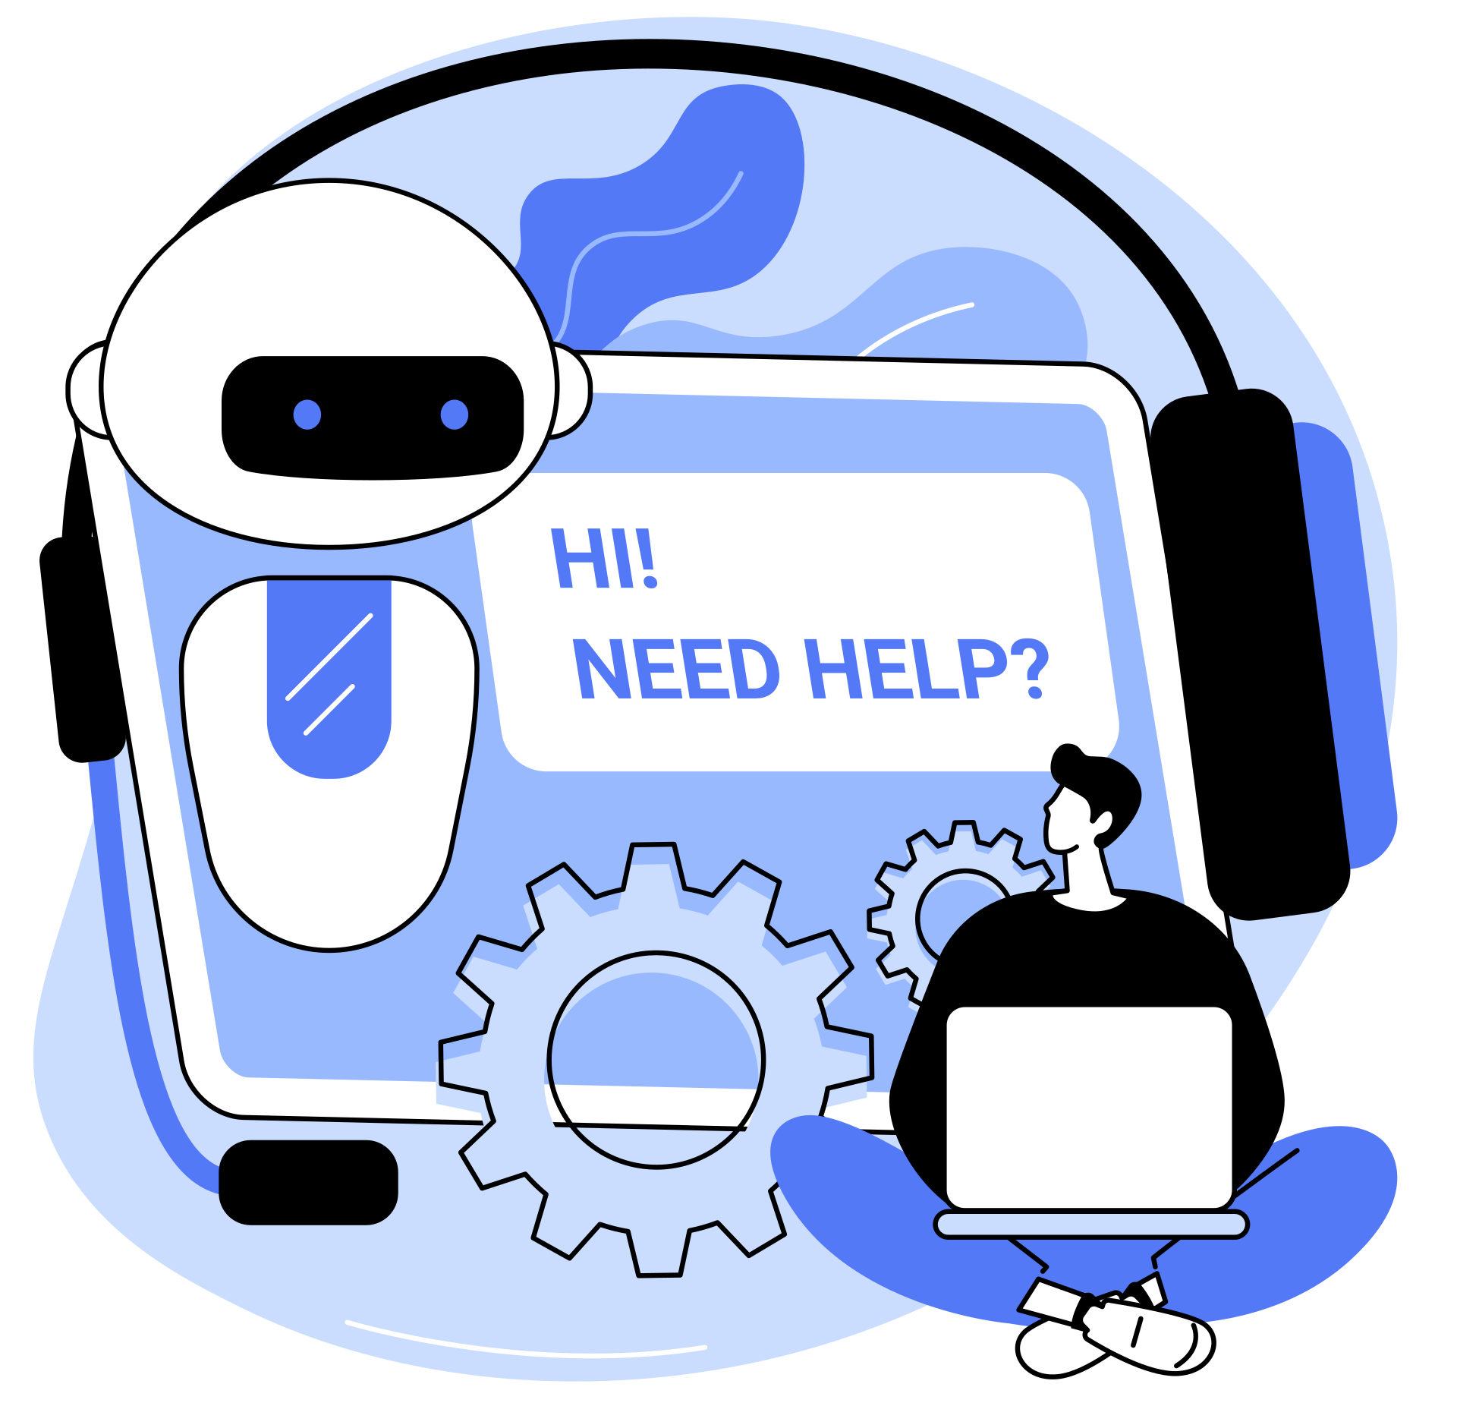
EFFECT OF ARTIFICIAL
INTELLIGENCE ON
Job Insecurity & Entrepreneurial Intent

Slide 2

Contents
1
Need of Research
2
Objectives
3
Methodology
4
Discussion of Result
5
Way forward
6
References

Slide 3

Need of Research
Artificial Intelligence (AI) has greatly changed the Job Market dynamics of the world. This prompts the need to understand this new age and the effect it has on:
an individual’s level of Job Security.
an individual’s Entrepreneurial Intentions

Slide 4
Objectives
Analyze the impact of AI on Job Security
Analyze the impact of AI on Entrepreneurial Intent
Explore Demographics with Latent Variables
Help formulate the steps ahead
We need to capture an individual’s attitude towards AI, their level of Technology Adoption, their perceived Job Insecurity and Entrepreneurship along with demographic factors.

Slide 5
Methodology
Find relationship between variables
Formulate a Questionnaire
Conduct the Survey
Construct the Model
Use Scales explored in the Literature Review to make a questionnaire for capturing latent variables.
Reach out to students, unemployed and employed folks to capture their attitudes and intents.
Use Formative and Reflective constructs for an effective PLS-SEM analysis. Explore any mediation effects applicable as per theory.
Introduce Demographic factors for a better understanding of respondents.
Validate the Model
Validate and Analyze the model and the items within it. Explore the explainability of the model. Explore the predictability of the model.

Slide 6
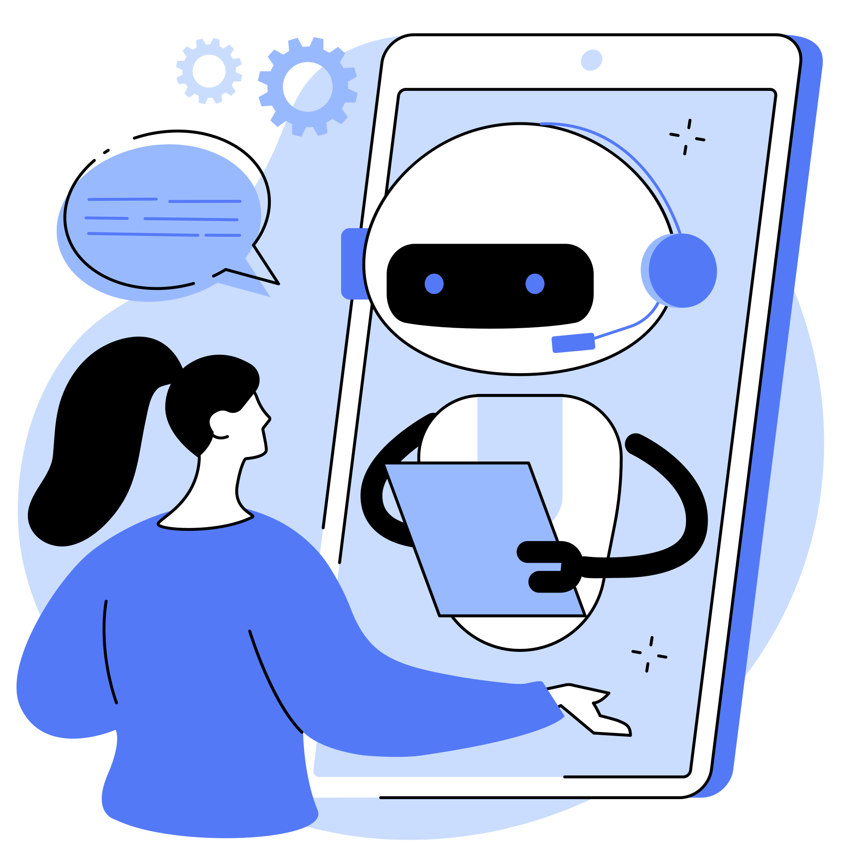
Discussion of Result

Slide 7
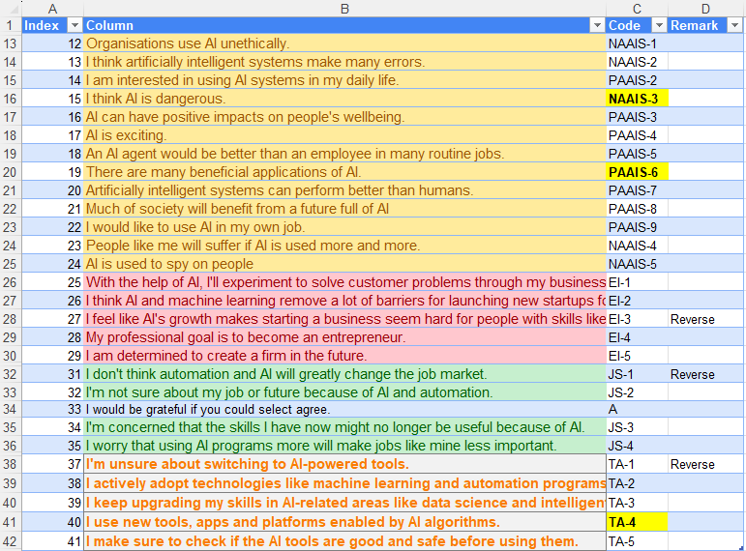
DATA
The scales used in the questionnaire ->
* Highlighted scales are the
Global Items for Formulating Items
** Some scales are encoded Reversely

Slide 8
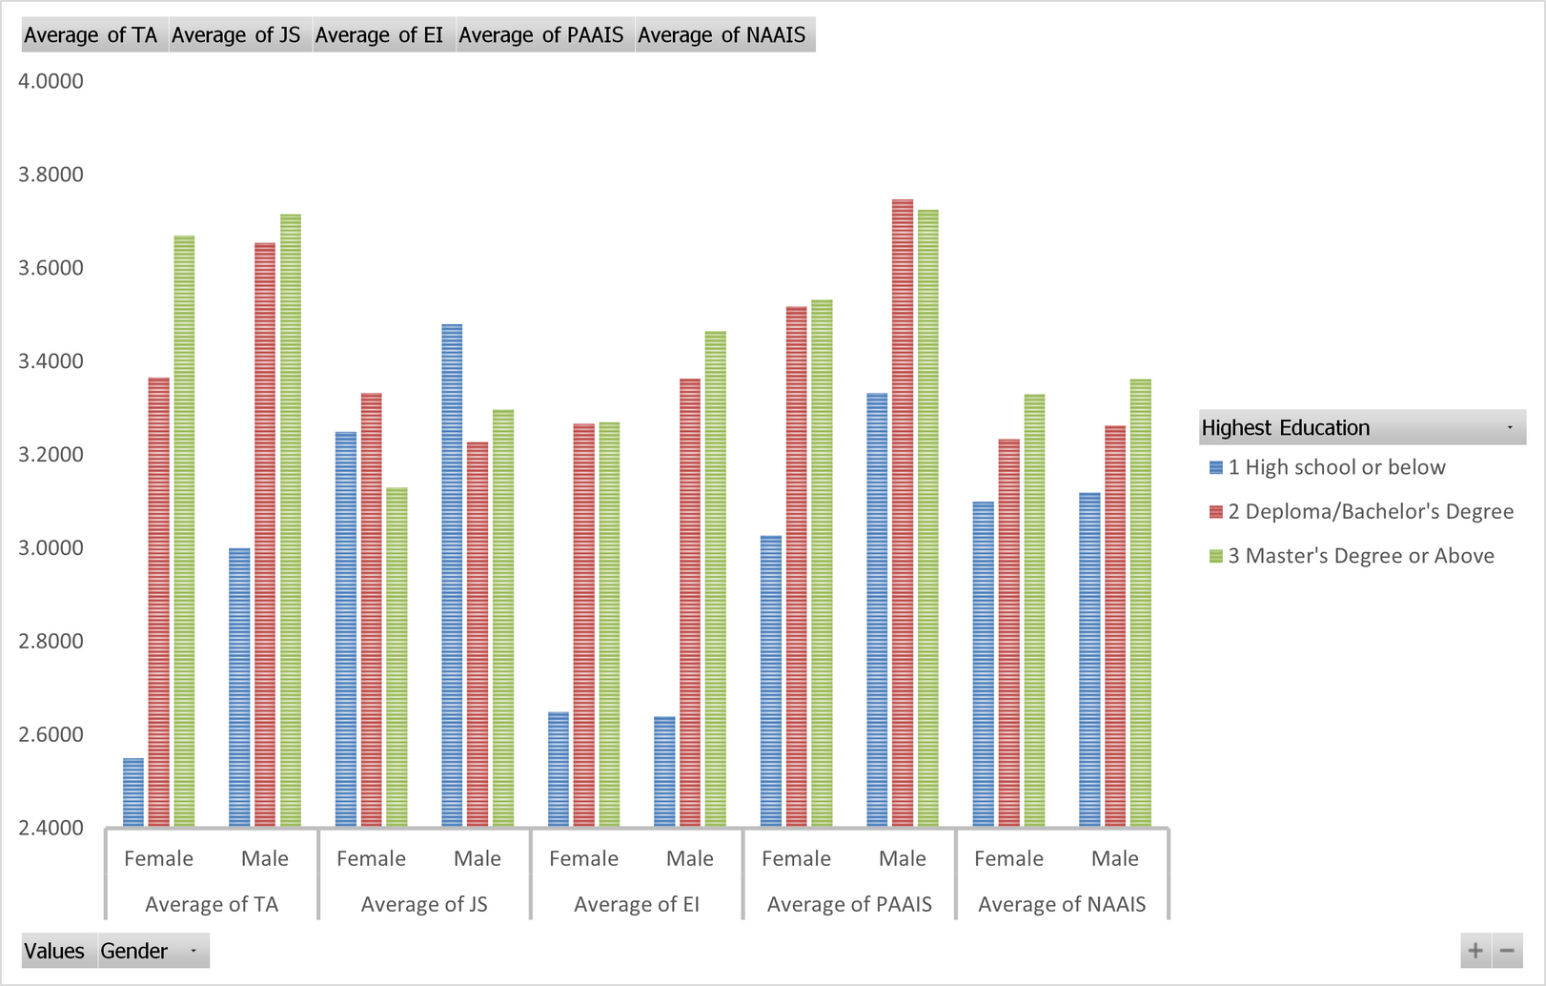
Exploratory DAta analysis
Gender & Education

Slide 9
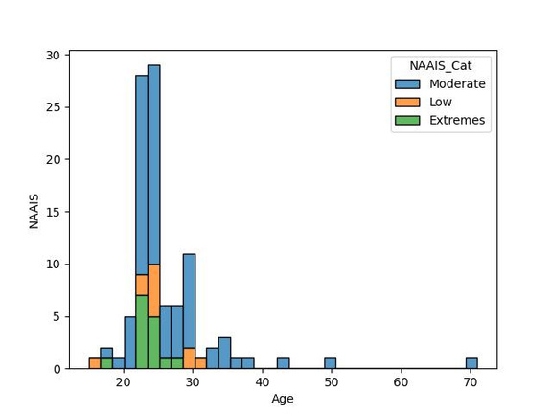
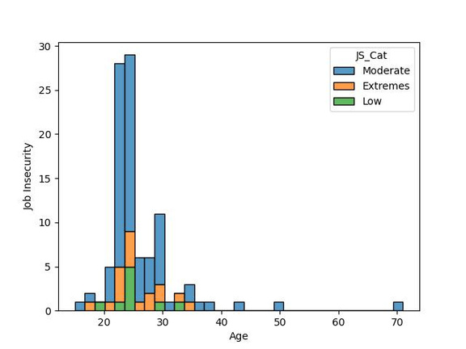
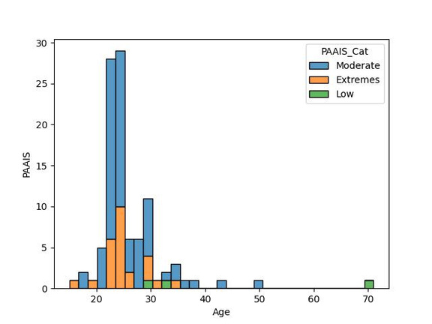
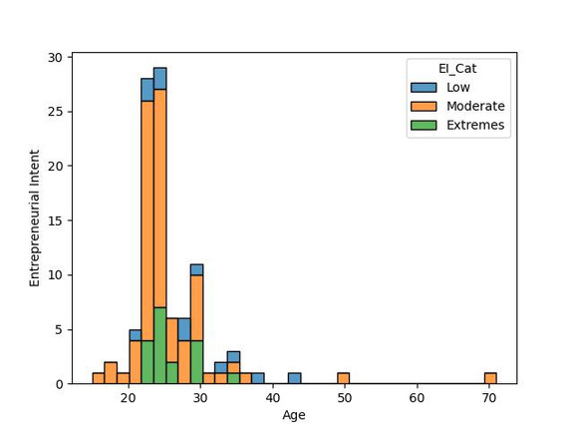
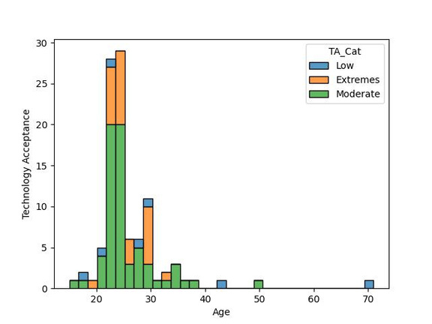
exploratory DAta analysis
Latent Variable distribution

Slide 10
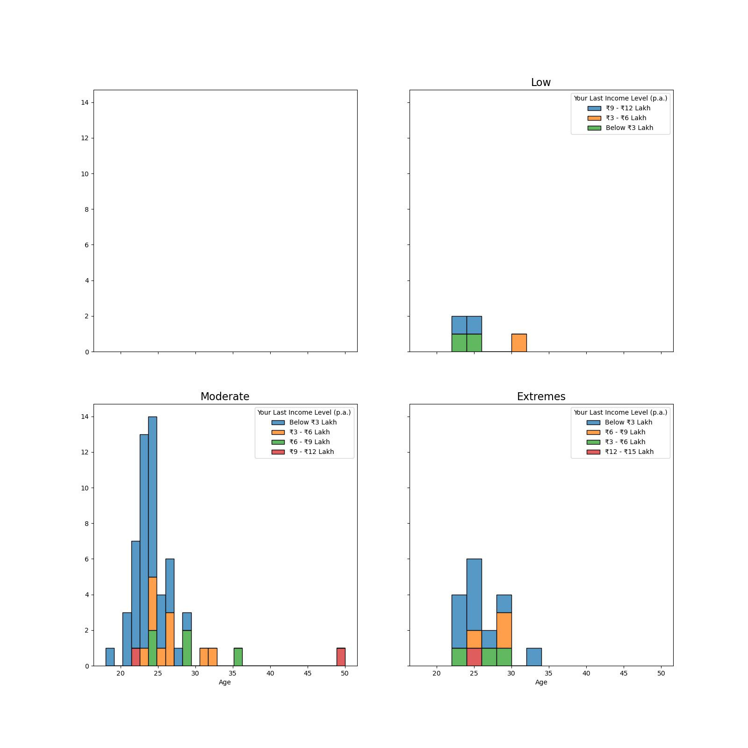
exploratory DAta analysis
INcome effect on Entrepreneurship

Slide 11
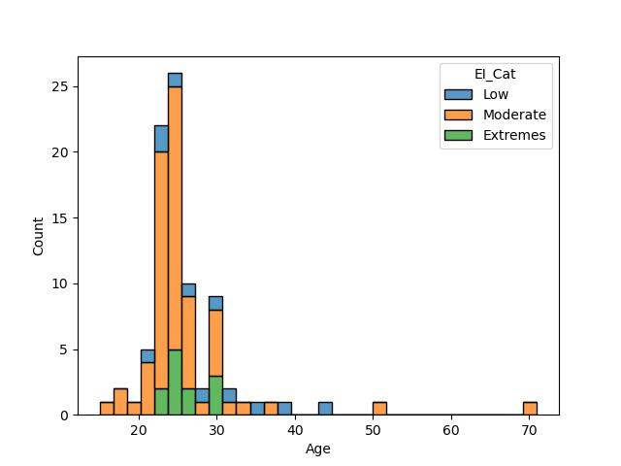
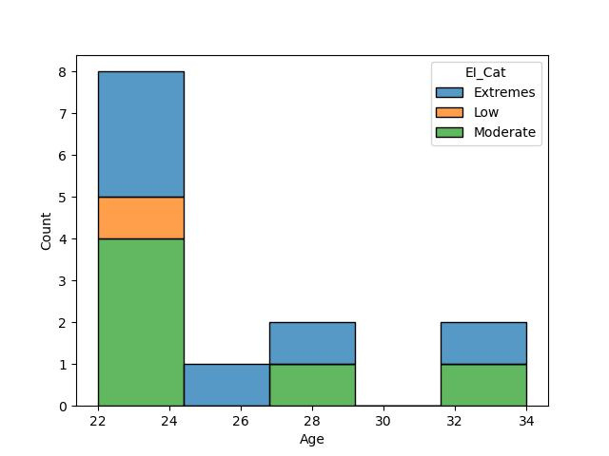
exploratory DAta analysis
Entrepreneurship and Experience

Slide 12
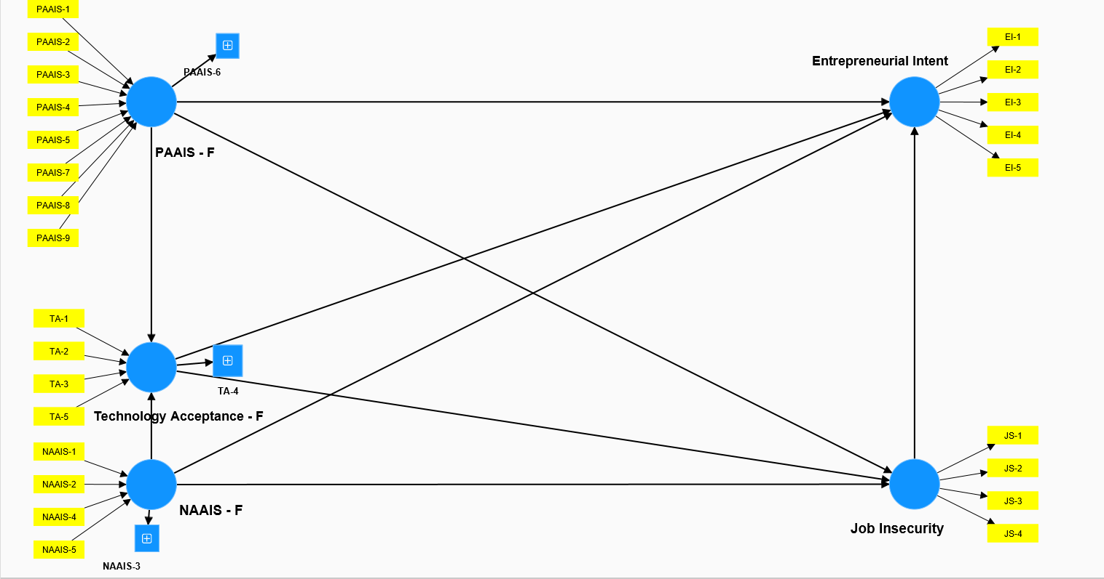
Initial Model

Slide 13
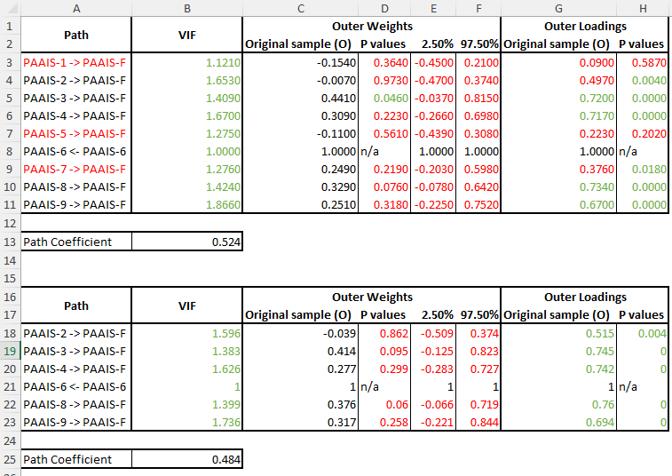
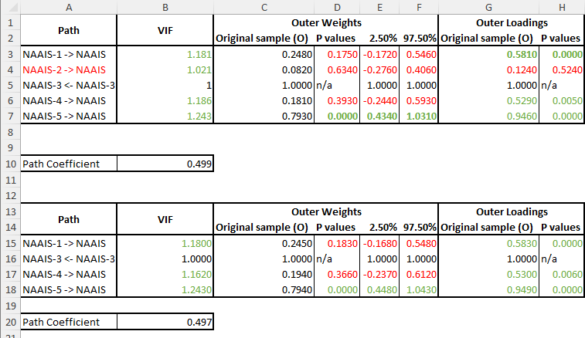
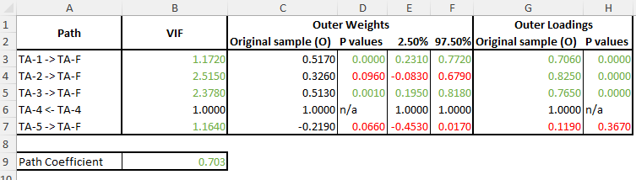
Formulative Model

Slide 14
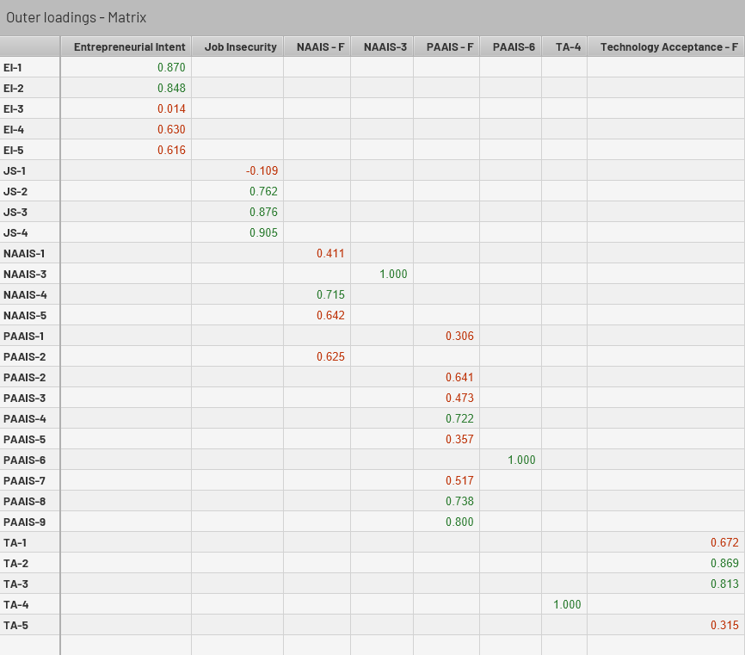
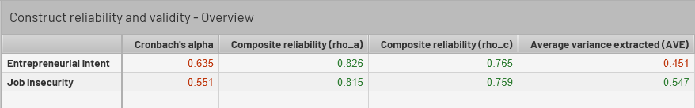
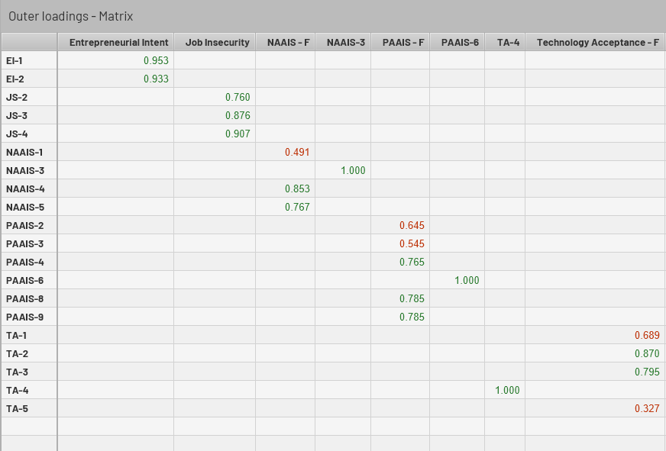
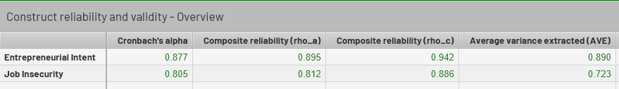
Reflective Model

Slide 15
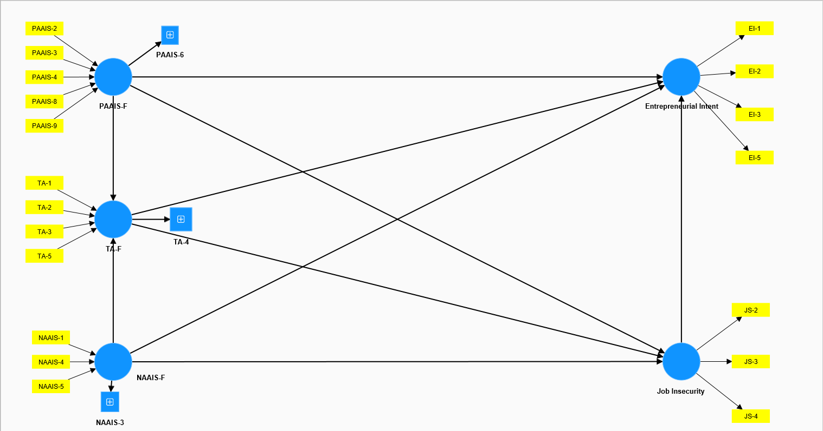
Construct Validated Model

Slide 16
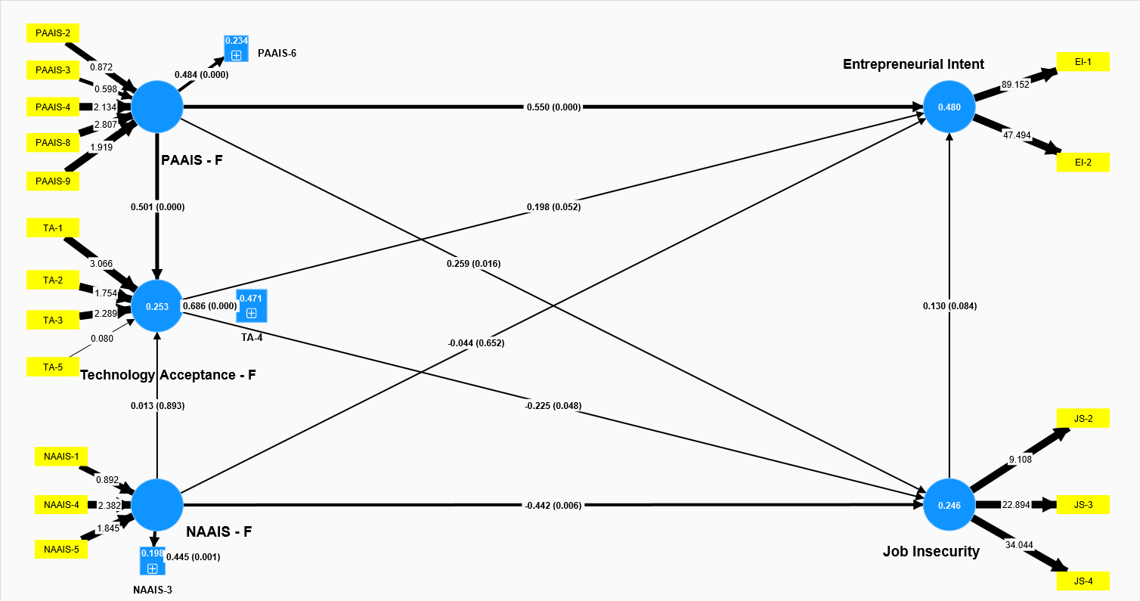
model Testing

Slide 17
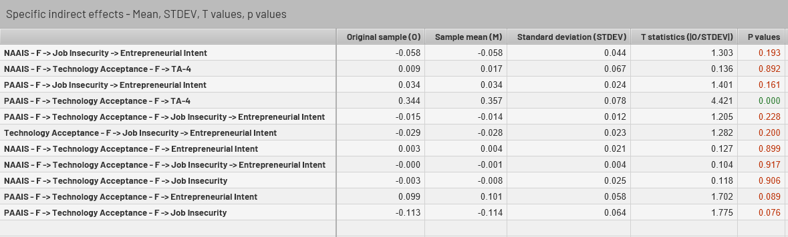
Mediation testing
No indirect effect has a significant effect on the Endogeneous Variables -> Job Insecurity & Entrepreneurial Intent

Slide 18
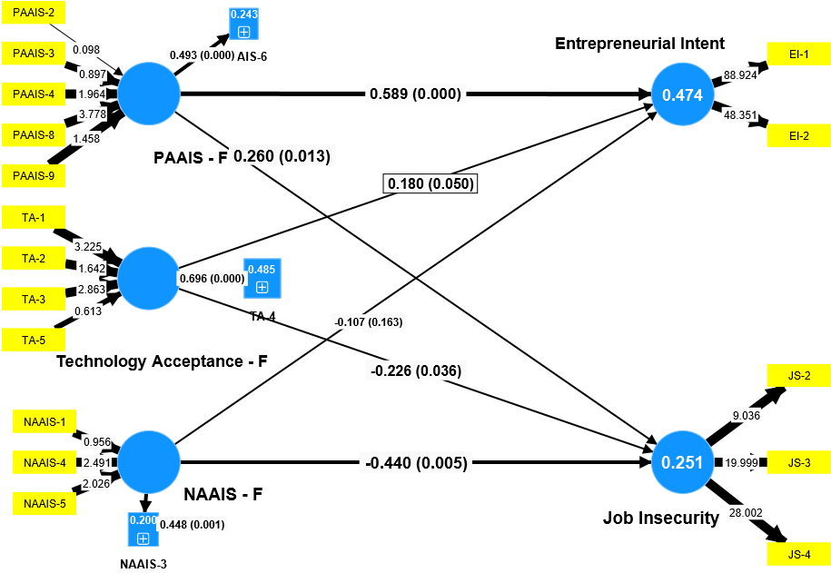
Final Model

Slide 19
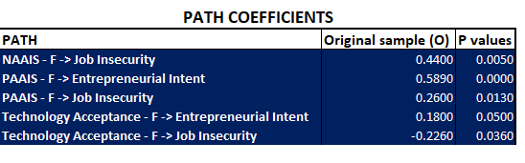
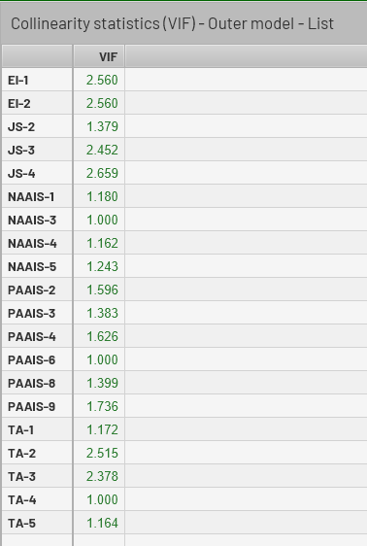
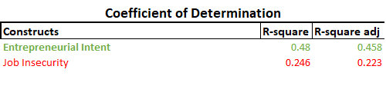
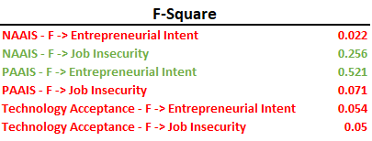
Assessment

Slide 20
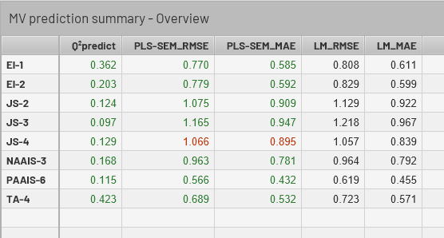
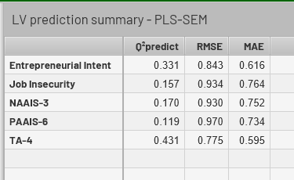
Prediction
The Latent Variables have decent predictive relevance with EI having better performance in PLS-SEM compared to LM. While Job Insecurity has moderately better PLS-SEM predictive relevance.

Slide 21

Insights
NAAI affects an individual’s Job Insecurity
PAAI affects an individual’s Entrepreneurial Intent
PLS-SEM is moderately better than a standard LM
The model has moderate predictive prowess

Slide 22
Way Forward
Limited research in this field
Confirmation of the results
Develop the Theory Further
Enhance the explainability and predictability of the model

Slide 23
References
Ochmann, M., et al. (2020). The influence of algorithm aversion and anthropomorphic agent design on the acceptance of AI-based job recommendations. Proceedings of the 41st International Conference on Information Systems, India 2020. https://aisel.aisnet.org/icis2020/is_workplace_fow/is_workplace_fow/4
Aghion, P., et al. (2019). Artificial Intelligence, Growth and Employment: The Role of Policy. Economie et Statistique / Economics and Statistics. https://doi.org/10.24187/ecostat.2019.510t.1994
Zarifhonarvar, M. (2023). Economics of ChatGPT: A Labor Market View on the Occupational Impact of Artificial Intelligence. SSRN. https://papers.ssrn.com/sol3/papers.cfm?abstract_id=4350925
Golin, M., & Rauh, C. (2022). The Impact of Fear of Automation. Cambridge Working Papers in Economics. https://ideas.repec.org/p/cam/camdae/2269.html
Reim, W., Åström, J., & Eriksson, O. (2020). Implementation of Artificial Intelligence (AI): A Roadmap for Business Model Innovation. MDPI (A! 2020). https://doi.org/10.3390/ai1020011
Vasiljeva, T., Kreituss, I., & Lulle, I. (2021). Artificial Intelligence: The Attitude of the Public and Representatives of Various Industries. MDPI (JRFM 2021). https://doi.org/10.3390/jrfm14080339
Bonfiglioli, A., et al. (2023). Artificial Intelligence and Jobs: Evidence from US Commuting Zones. CESifo Working Paper. https://papers.ssrn.com/sol3/papers.cfm?abstract_id=4608807
Chui, M., Manyika, J., & Miremadi, M. (2018). What AI can and can't do (yet) for your business. McKinsey. https://www.mckinsey.com/capabilities/quantumblack/our-insights/what-ai-can-and-cant-do-yet-for-your-business
Schmalbach, B., Kalkbrenner, A., Bassler, M., et al. (2020). Psychometric properties of a short version of the Job Anxiety Scale. BMC Medical Research Methodology. https://doi.org/10.1186/s12874-020-00974-4
Marangunić, N., & Granić, A. (2015). Technology acceptance model: A literature review from 1986 to 2013. Springer. https://doi.org/10.1007/s10209-014-0348-1
Bankins, S., & Formosa, P. (2023). The Ethical Implications of Artificial Intelligence (AI) For Meaningful Work. Journal of Business Ethics. https://doi.org/10.1007/s10551-023-05339-7
Srivastava, A. K. (1977). Job anxiety scale. Indian Journal of Industrial Relations. https://www.jstor.org/stable/27768625
Hou, F., et al. (2019). Entrepreneurial Intention Model. Frontiers in Psychology. https://doi.org/10.3389/fpsyg.2019.00916
Bruner, R., et al. (2007). Technology Adoption Scale. Progress in Wireless Communications Research. https://www.researchgate.net/publication/277020646_PREDICTING_INNOVATIVENESS_DEVELOPMENT_OF_THE_TECHNOLOGY_ADOPTION_SCALE
Valliere, L. (2015). Entrepreneuring Intent Scale. Procedia - Social and Behavioral Sciences. https://doi.org/10.1016/j.sbspro.2015.01.294

Slide 24
References
Wang, C., Ahmad, S. F., et al. (2021). An empirical evaluation of technology acceptance model for Artificial Intelligence in E-commerce. Heliyon. https://doi.org/10.1016/j.heliyon.2023.e18349
Schepman, A., & Rodway, P. (2022). The General Attitudes towards Artificial Intelligence Scale. International Journal of Human–Computer Interaction. https://doi.org/10.1080/10447318.2022.2085400
Kieslich, K., Lünich, M., & Marcinkowski, F. (2020). The Threats of Artificial Intelligence Scale. International Journal of Social Robotics. https://doi.org/10.1007/s12369-020-00734-w
Nomura, T., et al. (2006). Altered Attitudes of People toward Robots - Negative Attitudes toward Robots Scale. Proceedings of the 2006 AAAI Workshop on HumanImplications of Human-Robot Interaction. https://www.researchgate.net/publication/228368017_Altered_attitudes_of_people_toward_robots_Investigation_through_the_Negative_Attitudes_toward_Robots_Scale
Schepman, A., & Rodway, P. (2020). Initial validation of the general attitudes towards Artificial Intelligence Scale. Computers in Human Behavior Reports. https://doi.org/10.1016/j.chbr.2020.100014
Goswami, A., & Dutta, S. (2016). Gender Differences in Technology Usage—A Literature Review. Open Journal of Business and Management. http://dx.doi.org/10.4236/ojbm.2016.41006
Roopa, S., & Rani, M. S. (2012). Questionnaire Designing for a Survey. Journal of Indian Orthodontic Society. https://doi.org/10.5005/jp-journals-10021-1104
Muschalla B, Linden M, Olbrich D. (2010). The relationship between job-anxiety and trait-anxiety--a differential diagnostic investigation with the Job-Anxiety-Scale andthe State-Trait-Anxiety-Inventory. Elsevier Ltd. https://doi.org/10.1016/j.janxdis.2010.02.001
Thommie Burström, Vinit Parida, Tom Lahti, Joakim Wincent. (2021). AI-enabled business-model innovation and transformation in industrial ecosystems: A framework,model and outline for further research. Elsevier Ltd. https://doi.org/10.1016/j.jbusres.2021.01.016
Kim, Seong-Won & Lee, Youngjun. (2023). Investigation into the Influence of Socio‑Cultural Factors on Attitudes toward Artificial Intelligence. Education and Information Technologies. https://doi.org/10.1007/s10639-023-12172-y
Irene Albarran ´ Lozano, Jose Manuel Molina & Covadonga Gijon. (2021). Perception of Artificial Intelligence in Spain. Elsevier Ltd. https://doi.org/10.1016/j.tele.2021.101672
Kelley, Patrick Gage et al. (2021). Exciting, Useful, Worrying, Futuristic: Public Perception of Artificial Intelligence in 8 Countries. Association for Computing Machinery. https://doi.org/10.1145/3461702.3462605
Presbitero, A. and Teng-Calleja, M. (2023). Job attitudes and career behaviors relating to employees' perceived incorporation of artificial intelligence in the workplace: a career self-management perspective. Emerald Insight. https://doi.org/10.1108/PR-02-2021-0103
Peng, G., & Bhaskar, R. (2023). Artificial Intelligence and Machine Learning for Job Automation: A Review and Integration. Journal of Database Management. http://dx.doi.org/10.4018/JDM.318455
Regmi, P. R., et al. (2016). Guide to the design and application of online questionnaire surveys. Nepal Journal of Epidemiology. https://doi.org/10.3126%2Fnje.v6i4.17258

