Slide 1
TenderGenAI: Enhancing Tender Management with RAG

Slide 2
Introduction to Tender Management in Healthcare
Industry Context:
GE Healthcare's need for efficient tender management in handling complex and large-scale contracts for healthcare instruments.
the importance of speed, compliance, and accuracy in responding to tender requests.
Challenges:
Manual, time-consuming review of tender documents.
Risk of missing compliance requirements.
Inefficiencies in retrieving and analyzing past data for strategic insights.

Slide 3
Problem Statement and Approach
Problem Statement:
Solution
The tender management process is bogged down by labor-intensive document reviews, compliance challenges, and data retrieval inefficiencies, impacting our competitiveness and accuracy.
RAG (Retrieval-Augmented Generation) Approach:
Explains how RAG combines retrieval capabilities with generative AI for targeted data extraction and question-answering from document-heavy datasets.
Tool Stack:
AWS services + Databricks for data indexing and retrieval.
Streamlit for user interface, providing easy access to the AI-powered tool.

Slide 4
Technical Workflow and Demo
RAG Technical Workflow:
Step 1: Data Ingestion & Indexing – AWS services index tender PDFs and structure them for retrieval.
Step 2: Retrieval & Generation – RAG retrieves relevant document sections and generates responses based on user queries.
Step 3: User Interaction – Streamlit UI lets users easily interact with the tool, retrieving summaries, compliance requirements, and competitive insights.

Slide 5
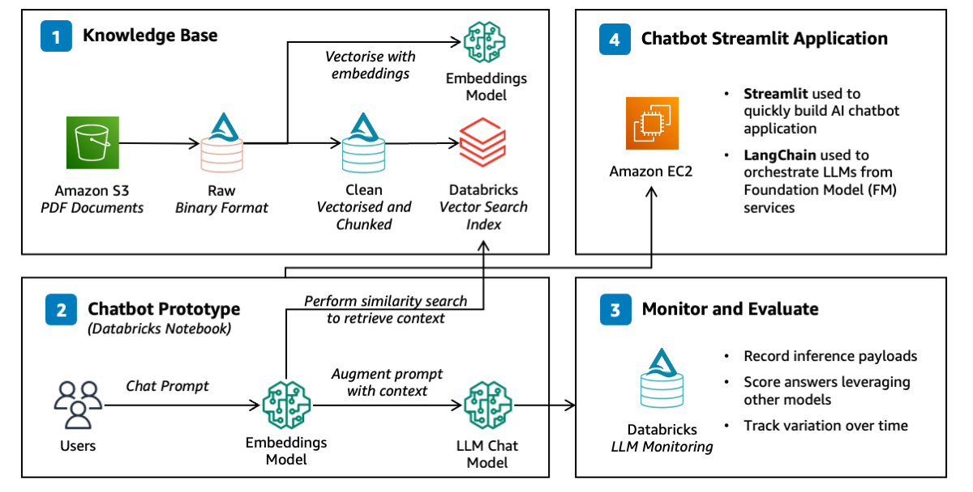

Slide 6
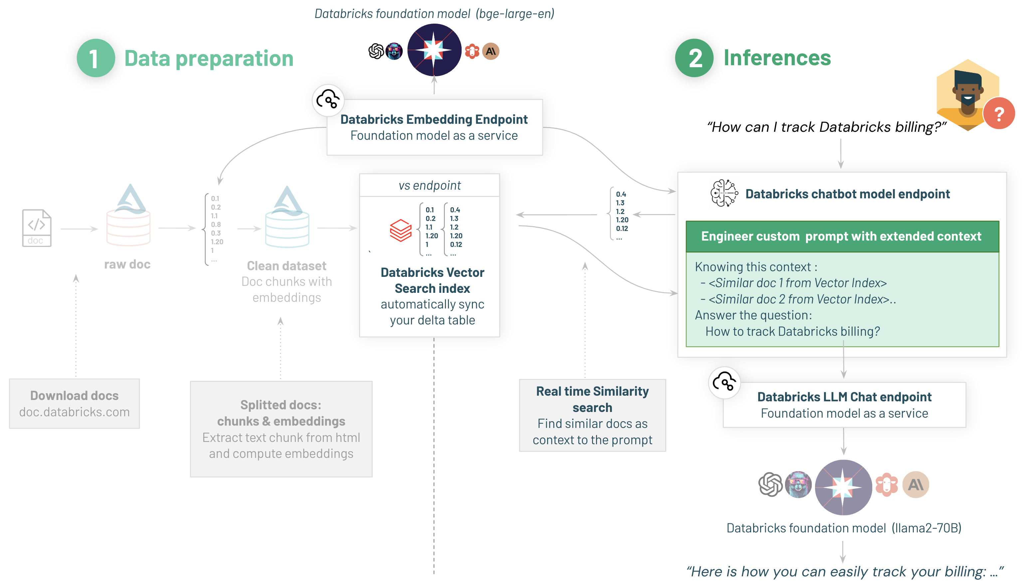

Slide 7

Benefits & Future Potential
Benefits:
Time Savings: Reduces document review time by up to 70%.
Improved Accuracy: Minimizes compliance risks by automating requirement matching.
Strategic Insights: Enables quick access to competitor data, past submissions, and insights.
Future Potential:
Expanding to handle a wider range of documents and improve response customization.
Potential for integration into GE Healthcare’s broader data ecosystem for real-time analytics.
Closing Statement:
"Our RAG-powered solution redefines how GE Healthcare approaches tender management, enabling faster, smarter, and more strategic decisions in a competitive market."

Slide 8
THANK YOU
Shubhashis Sinha
Hiram Hernandez

