Slide 1
DETECTION OF ROUGE DRONE
SHUBHASHISH DAS
CS 33
SEM 1

Slide 2
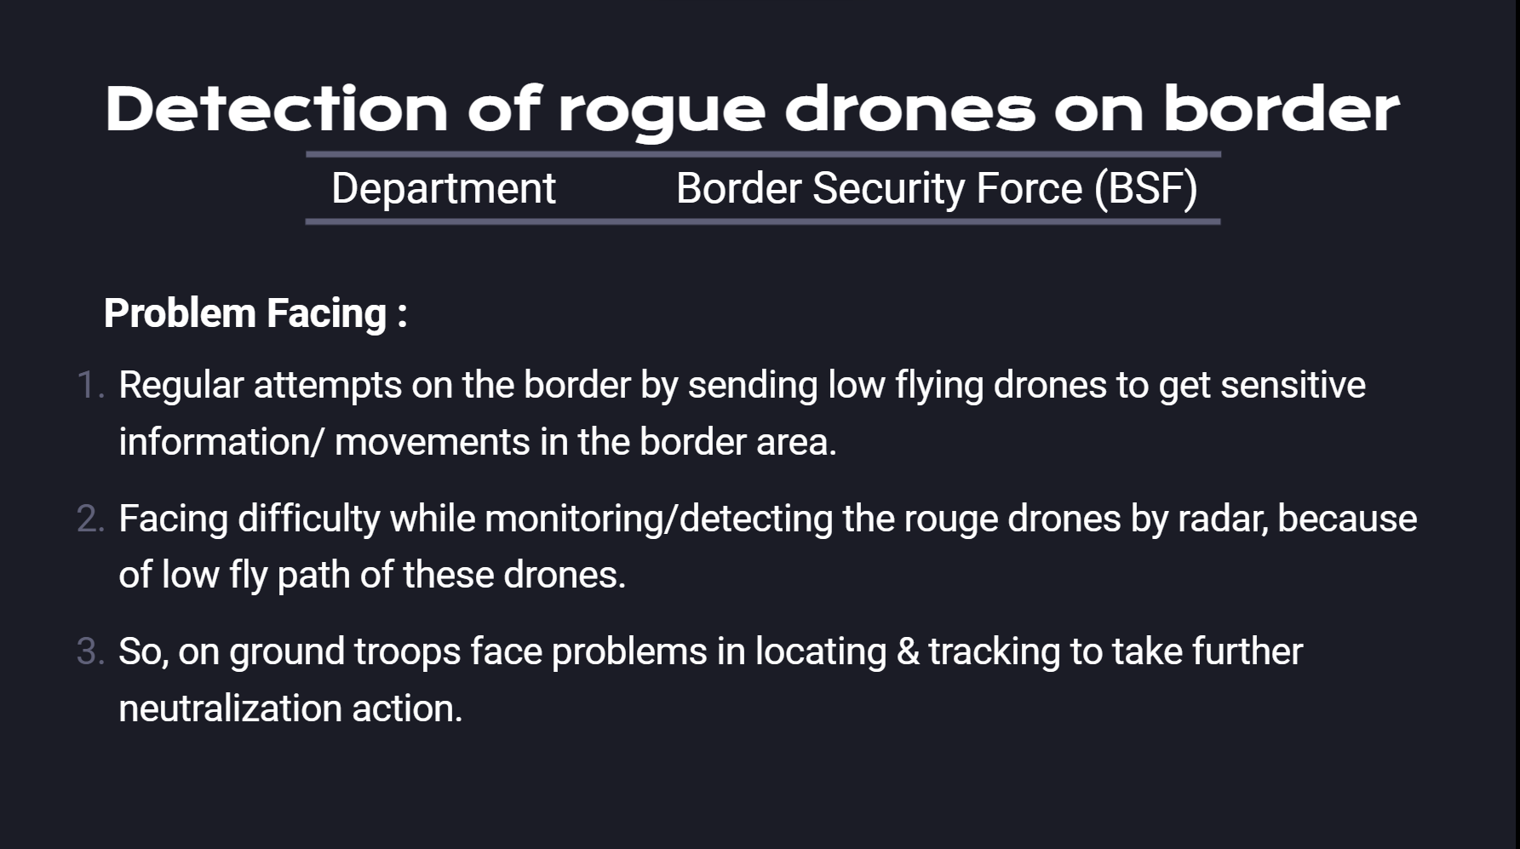

Slide 3
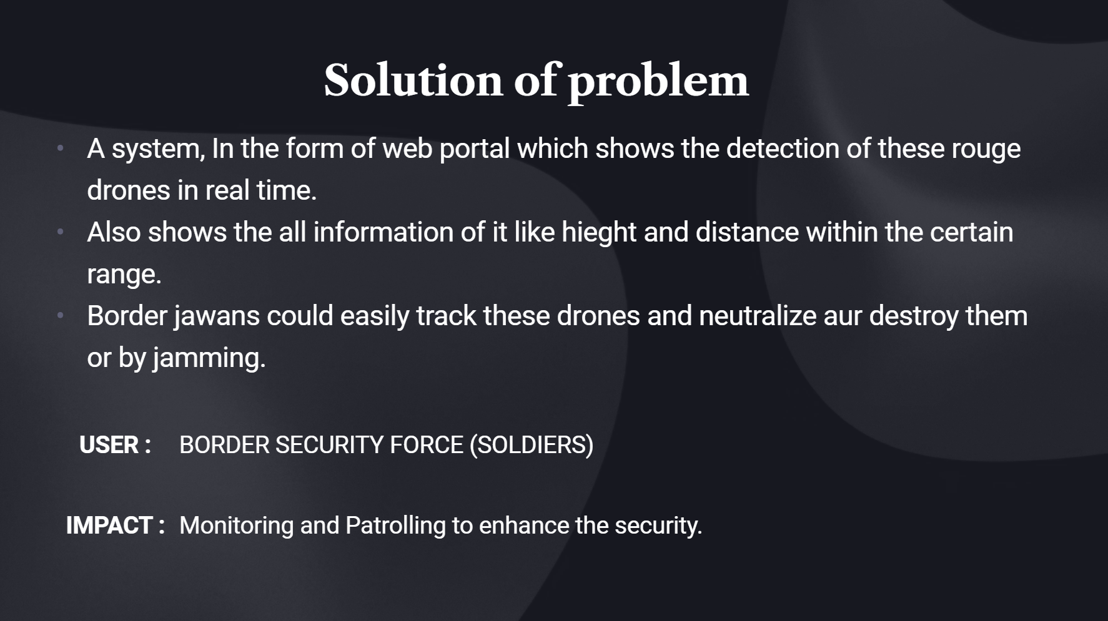

Slide 4


