Slide 1


PenguinPredictor App
Species Classification with Machine Learning
An interactive machine learning application built with Streamlit that predicts penguin species based on physical characteristics
Palmer Penguins Dataset
 Machine Learning
 Data Science
 Python
Shubh Patel
Slide 1/8
Made with Genspark

Slide 2
Introduction & Dataset
Palmer Penguins Dataset
The Palmer Penguins dataset contains size measurements for three penguin species observed on three islands in the Palmer Archipelago, Antarctica. It serves as an alternative to the classic Iris dataset for data visualization and machine learning examples.
 344 samples  8 variables  3 islands
Problem Statement
Build a machine learning model that can accurately classify penguin species based on physical measurements and location data.
Palmer Penguins Dataset Visualization
Penguin Species
Adelie
Chinstrap
Gentoo
Small penguins with short bills and distinctive white eye rings.
Medium-sized with black line under chin and longer bills.
Largest of the three species with longer flippers.
Shubh Patel
Slide 2/8
Made with Genspark

Slide 3
Machine Learning Approach
Random Forest Classifier
A Random Forest is an ensemble learning method that builds multiple decision trees and merges their predictions to improve accuracy and control overfitting.

Multiple Decision Trees
Creates multiple decision trees on randomly selected data samples
⧫
Feature Selection
Randomly selects features at each split to ensure diversity
Random Forest Classifier visualization
100 95%+
Decision Trees Accuracy

Majority Voting
Final prediction determined by majority vote from all trees
3

Robust to Overfitting
Ensemble approach helps prevent overfitting to training data
Classes
Why Random Forest?
Handles both categorical & numerical features
Provides feature importance metrics
Works well with relatively small datasets
Resistant to outliers and noise
Implementation Details
Our implementation uses scikit-learn's RandomForestClassifier with optimized hyperparameters to classify penguins into three species (Adelie, Chinstrap, or Gentoo) based on physical measurements.
from sklearn.ensemble import RandomForestClassifier model = RandomForestClassifier(n_estimators=100) model.fit(X_train, y_train)
Shubh Patel
Slide 3/8
Made with Genspark

Slide 4
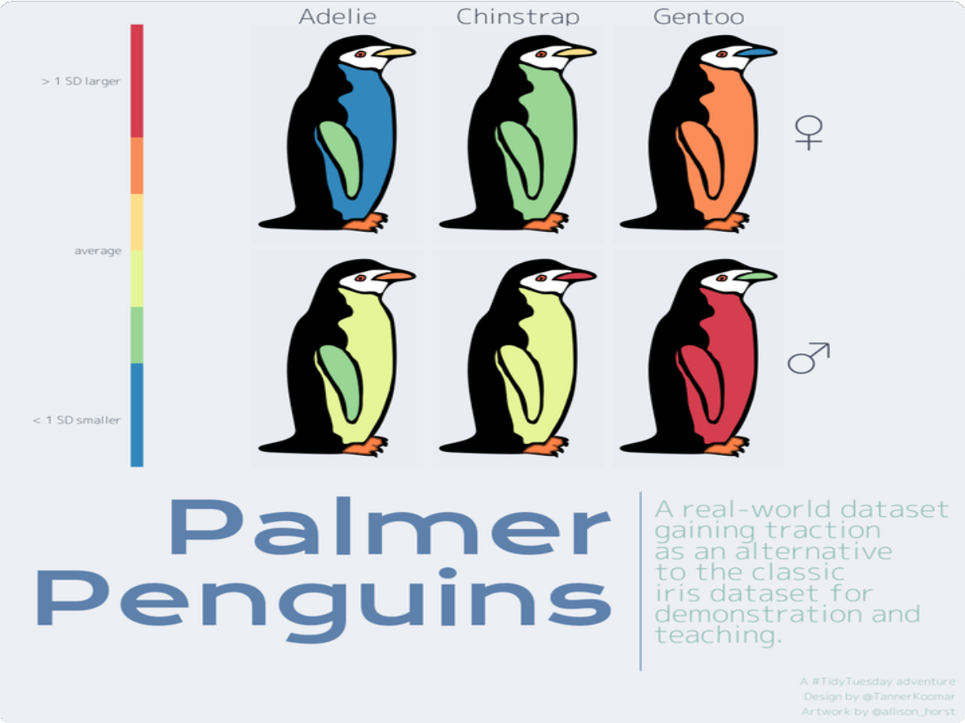
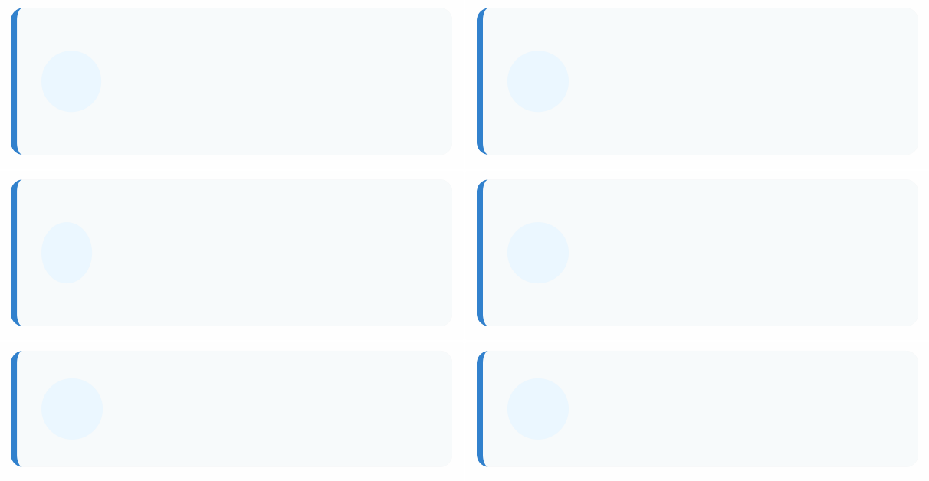

Features & Input Parameters
Penguin Physical Measurements
Bill Length (mm)
 Length from tip of bill to base

Bill Depth (mm)
Height of closed bill at base
Flipper Length (mm)
↔ Length of flipper from shoulder joint

Body Mass (g)
Weight in grams

Island
Torgersen, Biscoe, or Dream
⚤
Gender
Male or Female
 Feature Importance
Our Random Forest model identified Bill Length and Flipper Length as the most important features for species classification, followed by Body Mass and Bill Depth.
Interactive User Interface
Bill Length (mm)
42.3
Input Parameters in Action
 Users can adjust all parameters using sliders and dropdown menus in the Streamlit interface
 The app displays real-time predictions as inputs change
 Prediction probabilities for each species are shown as progress bars
 Input validation ensures parameters stay within realistic ranges
32.1
59.6
Species Identification Example
Species | Probability
Adelie | 12%
Chinstrap | 5%
Gentoo | 83%
Predicted Species: Gentoo
Shubh Patel
Made wit_{S}h_{l}G_{id}e_{e}ns₄pa/r₈k

Slide 5
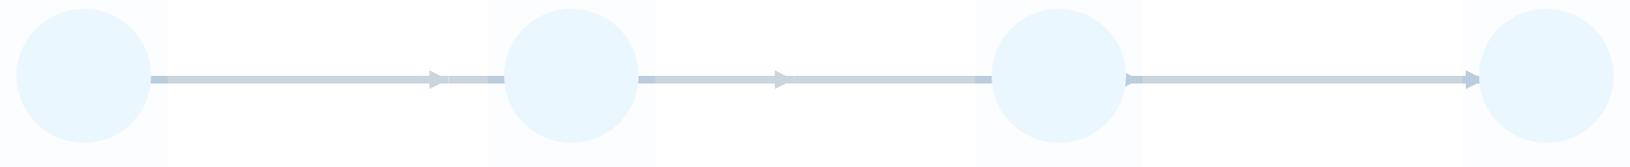
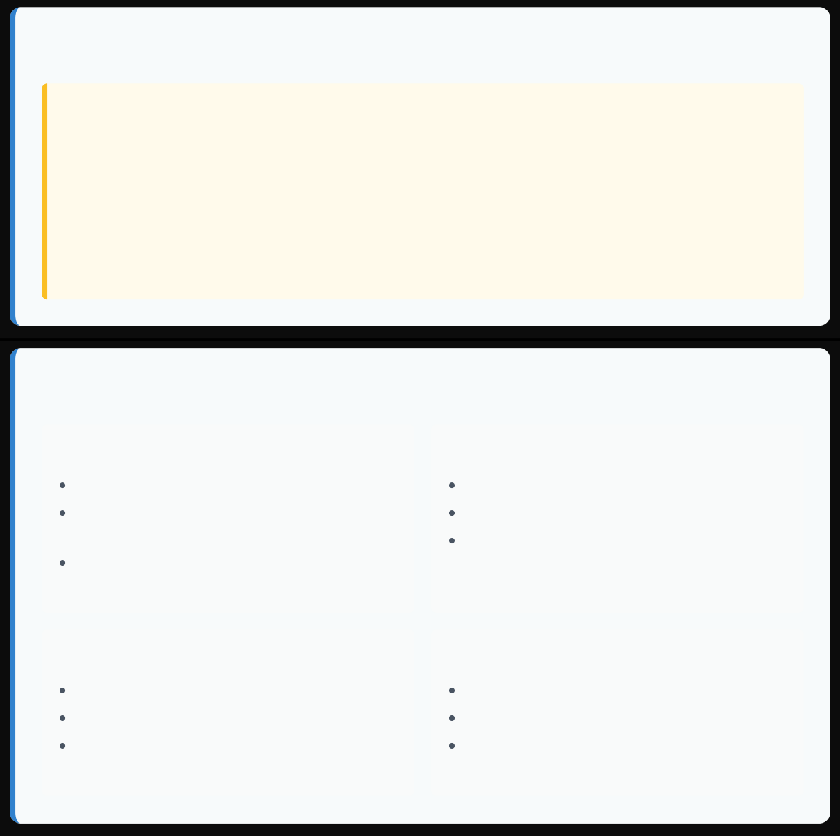

Project Architecture & Workflow





1. Data Loading
2. Preprocessing
3. Model Training
4. Prediction
5. Visualization
Loading cleaned Palmer Penguins dataset
Encoding categorical features
Training Random Forest Classifier
Real-time species prediction
Displaying results via Streamlit UI
Streamlit Framework Architecture
The app is built using Streamlit, which provides a Python-based framework for creating web interfaces with minimal code.
User Interaction Flow
 The app follows a simple, intuitive interaction pattern:
User adjusts input parameters via sliders and dropdowns in the sidebar
App instantly processes inputs through the trained model
Prediction results display in the main panel with probabilities
Data visualizations update to reflect current inputs
 App Structure
Single Python script with modular sections for data, model, and UI components
 Reactive Framework
Automatically updates predictions when user inputs change
☁ Deployment
Hosted on Streamlit Cloud for easy web access
Technical Implementation
Data Flow
Data Processing
Pandas for data manipulation
One-hot encoding for categorical features
Automated handling of missing values
Model Training
scikit-learn RandomForestClassifier Optimized hyperparameters Probability estimation enabled
Load and clean dataset from source URL
Split data into features (X) and target variable (y)
Encode categorical variables with one-hot encoding
Train Random Forest model on processed data
Use user input for real-time prediction
User Interface
Streamlit widgets for inputs Progress bars for probabilities
Expandable data exploration sections
Deployment
Version control with Git Hosted on Streamlit Cloud
Environment management with requirements.txt
 Live Demo: https://sp-machinelearning.streamlit.app
Shubh Patel

Slide 6










Technologies Used
User Interface
→
Data Processing
→
Machine Learning
→
Deployment
Streamlit
Pandas & NumPy
scikit-learn
Streamlit Cloud



Python
Core programming language used for data processing, machine learning model development, and application logic.
Version 3.x Backend
Streamlit
Open-source Python framework used to build and deploy the interactive web application with minimal code.
Web UI Interactive Components
Pandas
Data manipulation library used for cleaning, transforming, and analyzing the penguin dataset.
Data Frames Data Cleaning



NumPy
Library for numerical computing that supports array operations and mathematical functions.
scikit-learn
Machine learning library providing the Random Forest Classifier implementation for species prediction.
GitHub & Streamlit Cloud
Version control and cloud hosting platforms for code repository and live application deployment.
Numerical Arrays
Mathematical Operations
RandomForestClassifier
Model Training
Version Control
Continuous Deployment
 The project demonstrates the power of combining Python's data science ecosystem with modern web frameworks to create interactive machine learning applications with minimal code.
Shubh Patel

Slide 7
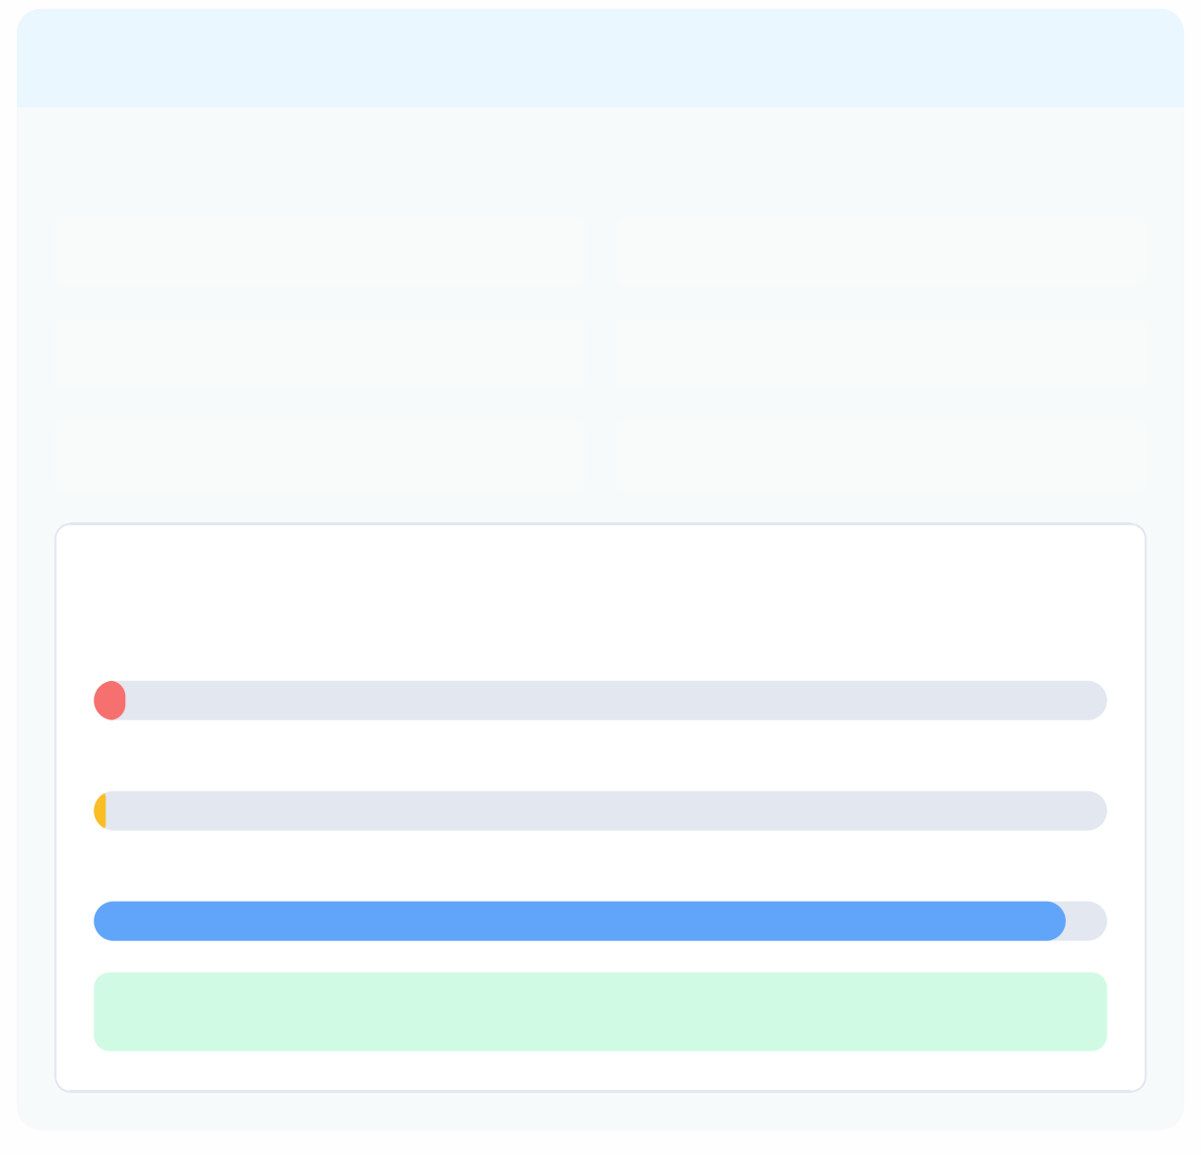

Demo and Results
 Streamlit App Interface
 Prediction Showcase
 Live demo available at: sp-machinelearning.streamlit.app
Example: Gentoo Penguin Prediction
PenguinPredictor App Interface
Island: Biscoe
Gender: Male
The Streamlit interface provides intuitive controls for users to adjust penguin parameters and instantly see prediction results.
Bill Length: 47.5 mm
Bill Depth: 15.0 mm
Flipper Length: 215 mm
Body Mass: 5400 g
 Model Evaluation
Prediction Probabilities:
Adelie
96%
Overall Accuracy
0.95
F1 Score
3%
Chinstrap
1%
0.96
Precision
0.94
Gentoo
96%
Recall
 Predicted Species: Gentoo
 Key Findings
✓
The Random Forest model achieved excellent performance with over 95% accuracy in classifying penguin species.
✓
Feature importance analysis showed that flipper length and bill length were the most predictive measurements.
✓
Gentoo penguins were the most distinct and easiest to classify with near- perfect accuracy.
✓
Some confusion occurred between Adelie and Chinstrap species due to overlapping physical characteristics.
Feature Importance
Flipper Length
0.43
Bill Length
0.28
Body Mass
0.17
Shubh Patel
Slide 7/8
Made with Genspark

Slide 8


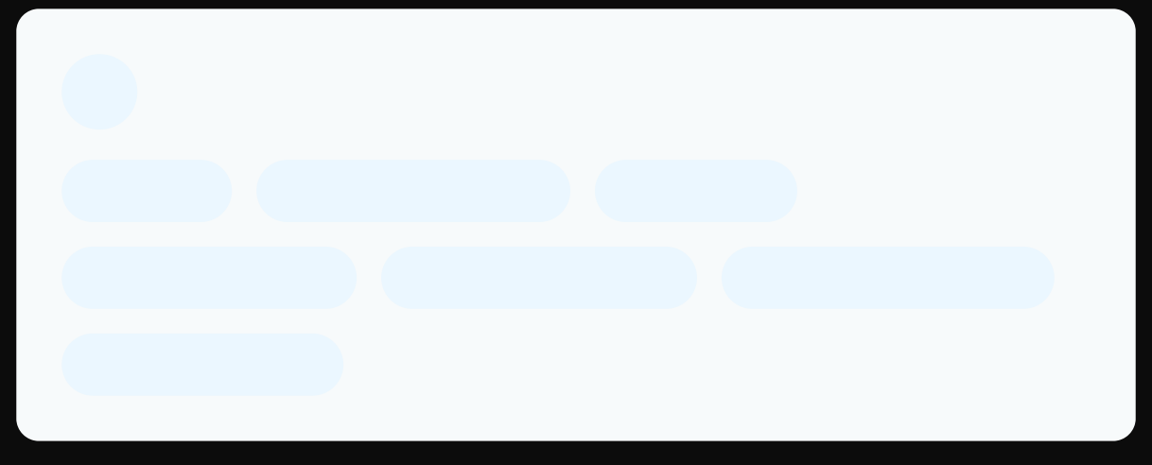
Conclusion
Project Summary
 Learning Outcomes
The PenguinPredictor app successfully demonstrates how machine learning can be applied to biological classification problems and deployed as an interactive web application.
› Gained practical experience in the entire machine learning pipeline from data preprocessing to model deployment
› Enhanced understanding of classification algorithms and feature importance analysis
› Developed skills in creating interactive web applications without extensive web development knowledge
› Improved data visualization techniques for communicating model results
"This project bridges data science and interactive web applications, making complex machine learning models accessible to anyone interested in penguin biology."
⭐ Key Benefits
 Created an intuitive interface for non-technical users to access machine learning predictions
 Achieved high classification accuracy (95%+) with a Random Forest model
 Demonstrated practical application of feature engineering for categorical variables
 Developed educational tool for understanding penguin species classification
Future Improvements
+
Add Image Classification
Incorporate computer vision to identify penguins from images
+ Expand Dataset
Include more penguin species and environmental factors
+ Model Comparison
Add multiple ML models to compare prediction performance
+ User Accounts
Allow researchers to save their predictions and analyses
 Skills Developed
Access the Project
 Python  Machine Learning
 Streamlit
 Live Demo  GitHub Repo
Thank you for your interest in the PenguinPredictor project!
 Data Processing  Data Visualization ☁ Cloud Deployment
 Version Control
Developed by Shubh Patel
Shubh Patel
Made wit_{S}h_{l}G_{id}e_{e}ns₈pa/r₈k

