Slide 1
British Airway Reviews Analysis

Slide 2
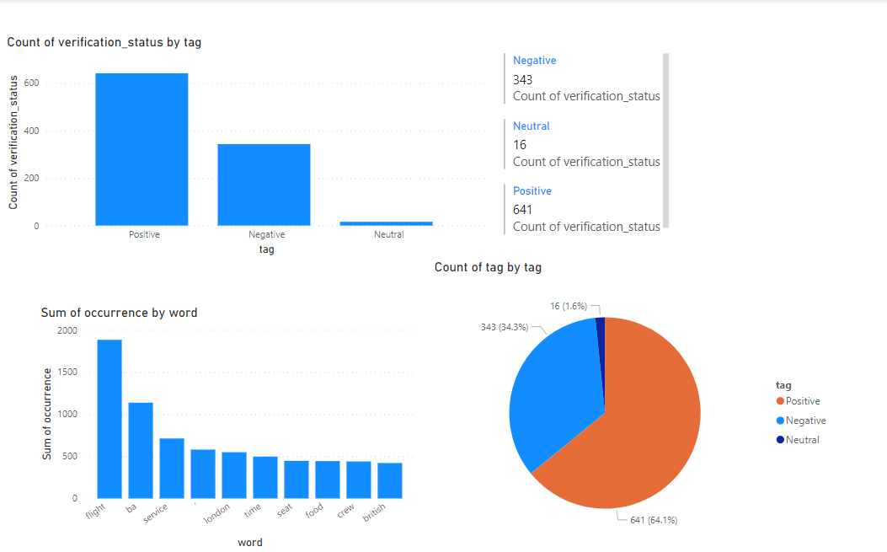
Findings
Key topics
The frequency chart below shows that the key topics within the reviews include flight, bad, service,’, London, time ,seat, food, crew, British, showing that people are actively talking about their experience and staff.
Sentiment
Out of 1000 reviews, 641 were positive, 343were negative and 16 were neutral. This means the majority of reviews were polarised as either positive or negative.

