Slide 1
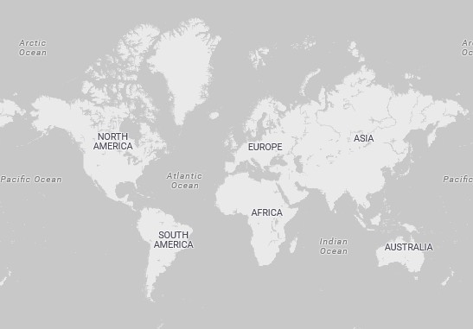

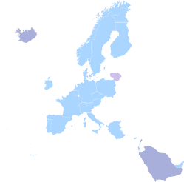



Country and Quantity
Quantity 1 2 3 4
Power BI Desktop
5 6 7 8 9 10 11 12 13 14 15 16
Sum of revenue by Year and Month
Sum of revenue
1.0M
0.5M
Jan 2011
Mar 2011
May 2011
Jul 2011
Sep 2011
Nov 2011
Sum of revenue by CustomerID
14646
18102
17450
16446
14911
12415
14156
17511
16029
CustomerID
© 2023 TomTom,, © 2023 Miiccrrossofftt Corrporrattiion,, © OpenSttrreettMap
Count of revenue and Sum of Quantity by Country
Count of revenue Sum of Quantity 10K
0K
50K
100K
150K
Sum of revenue
200K
250K
300K
Count of revenue
0.2M
Sum of Quantity
5K
8.91M
Sum of revenue
5M
Sum of Quantity
0K
Germany
France
EIRE
Spain
Netherlands
Belgium
Switzerland
Australia
Sweden
Japan
0.0M
Country

