Slide 1
Bootstrap
Ms. Divya Singhal
Assistant Professor
KIET Group of Institutions, Delhi- NCR, Ghaziabad

Slide 2
What is Responsive Web Design?
Responsive web design is about creating web sites which automatically adjust themselves to look good on all devices, from small phones to large desktops.
Bootstrap is the most popular HTML, CSS, and JavaScript framework for developing responsive, mobile-first web sites.
Bootstrap is completely free to download and use!

Slide 3
What is Bootstrap?
Bootstrap is a free front-end framework for faster and easier web development
Bootstrap includes HTML and CSS based design templates for typography, forms, buttons, tables, navigation, modals, image carousels and many other, as well as optional JavaScript plugins
Bootstrap also gives you the ability to easily create responsive designs

Slide 4
Bootstrap History
Bootstrap was developed by Mark Otto and Jacob Thornton at Twitter, and released as an open source product in August 2011 on GitHub.
Advantages of Bootstrap:
Easy to use: Anybody with just basic knowledge of HTML and CSS can start using Bootstrap
Responsive features: Bootstrap's responsive CSS adjusts to phones, tablets, and desktops
Mobile-first approach: In Bootstrap 3, mobile-first styles are part of the core framework
Browser compatibility: Bootstrap is compatible with all modern browsers (Chrome, Firefox, Internet Explorer, Safari, and Opera)

Slide 5
Where to Get Bootstrap?
There are two ways to start using Bootstrap on your own web site.
Download Bootstrap from getbootstrap.com
If you want to download and host Bootstrap yourself, go to getbootstrap.com, and follow the instructions there.
Include Bootstrap from a CDN
If you don't want to download and host Bootstrap yourself, you can include it from a CDN (Content Delivery Network).
MaxCDN provides CDN support for Bootstrap's CSS and JavaScript. You must also include jQuery.

Slide 6
Bootstrap CDN
You must include the following Bootstrap’s CSS, JavaScript, and jQuery from MaxCDN into your web page.
<!-- Latest compiled and minified Bootstrap CSS --> <link rel="stylesheet"href="https://maxcdn.bootstrapcdn.com/bootstrap/3.3.7/css/bootstrap.min.css">
<!-- Latest compiled Bootstrap JavaScript --> <script src="https://maxcdn.bootstrapcdn.com/bootstrap/3.3.7/js/bootstrap.min.js"></script>
<!-- latest jQuery library --> <script src="https://code.jquery.com/jquery-latest.js"></script>
Advantage of using the Bootstrap CDN:
Many users already have downloaded Bootstrap from MaxCDN when visiting another site. As a result, it will be loaded from cache when they visit your site, which leads to faster loading time. Also, most CDN's will make sure that once a user requests a file from it, it will be served from the server closest to them, which also leads to faster loading time.

Slide 7
Create Web Page with Bootstrap (1)
Add the HTML5 doctype
Bootstrap uses HTML elements and CSS properties that require the HTML5 doctype.
Always include the HTML5 doctype at the beginning of the page, along with the lang attribute and the correct character set:
<!DOCTYPE html>
<html lang="en"> <head> <meta charset="utf-8"> </head>
</html>

Slide 8
Create Web Page with Bootstrap (2)
Bootstrap is mobile-first
Bootstrap 3 is designed to be responsive to mobile devices. Mobile-first styles are part of the core framework.
To ensure proper rendering and touch zooming, add the following <meta> tag inside the <head> element:
<meta name="viewport" content="width=device-width, initial-scale=1">
The width=device-width part sets the width of the page to follow the screen-width of the device (which will vary depending on the device).
The initial-scale=1 part sets the initial zoom level when the page is first loaded by the browser.

Slide 9

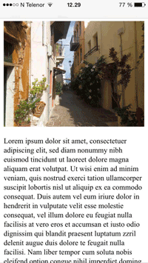

| Viewport |
The viewport is the user's visible area of a web page.
The viewport varies with the device, and will be smaller on a mobile phone than on a computer screen.
<meta name="viewport" content="width=device-width, initial-scale=1.0">

Slide 10
Create Web Page with Bootstrap (3)
Containers
Bootstrap also requires a containing element to wrap site contents.
There are two container classes to choose from:
The .container class provides a responsive fixed width container. (See Sample)
The .container-fluid class provides a full width container, spanning the entire width of the viewport. (See Sample)
Note: Containers are not nestable (you cannot put a container inside another container).

Slide 11
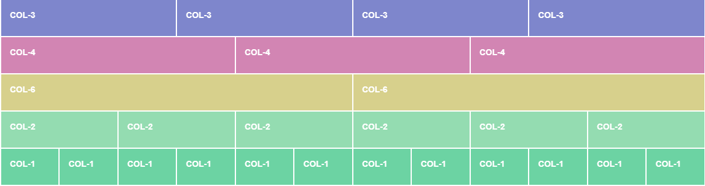

| Bootstrap Grid |
The Bootstrap grid system classes: xs (<576px wide) sm ( >576px wide) md (for >768px wide) lg ( >992px wide) xl ( >1200px wide) XXl (For >1400px wide)

Slide 12
Bootstrap Grids
Bootstrap’s grid system allows up to 12 columns across the page.
If you do not want to use all 12 columns individually, you can group the columns together to create wider columns:
<div class="col-md-12">Span 12 columns</div>
<div class="col-md-6">Span 6</div><div class="col-md-6">Span 6</div>
<div class="col-md-4">Span 4</div><div class="col-md-8">Span 8</div>
<div class="col-md-4">Span 4</div><div class="col-md-4">Span 4</div> <div class="col-md-4">Span 4</div>
Bootstrap's grid system is responsive, and the columns will re-arrange automatically depending on the screen size.

Slide 13
Grid Classes
The Bootstrap grid system has four classes:
xs (for phones)
sm (for tablets)
md (for desktops)
lg (for larger desktops)
The classes above can be combined to create more dynamic and flexible layouts.

Slide 14
Basic Structure of a Bootstrap Grid
<div class="row"> <div class="col-*-*"></div> </div> <div class="row"> <div class="col-*-*"></div> <div class="col-*-*"></div> <div class="col-*-*"></div> </div> <div class="row"> ... </div>
First; create a row (<div class="row">). Then, add the desired number of columns (tags with appropriate .col-*-*classes). Note that numbers in .col-*-* should always add up to 12 for each row.

Slide 15
Bootstrap Tables
A basic Bootstrap table has a light padding and only horizontal dividers.
The .table class adds basic styling to a table:
Striped Rows
The .table-striped class adds zebra-stripes to a table:
Bordered Table
The .table-bordered class adds borders on all sides of the table and cells:
Hover Rows
The .table-hover class enables a hover state on table rows:
Responsive Tables
The .table-responsive class creates a responsive table. The table will then scroll horizontally on small devices (under 768px). When viewing on anything larger than 768px wide, there is no difference:

Slide 16
Bootstrap Images
Rounded Corners
The .img-rounded class adds rounded corners to an image (IE8 does not support rounded corners):
Circle
The .img-circle class shapes the image to a circle (IE8 does not support rounded corners):
Thumbnail
The .img-thumbnail class shapes the image to a thumbnail:
Responsive Images
Images comes in all sizes. So do screens. Responsive images automatically adjust to fit the size of the screen.
Create responsive images by adding an .img-responsive class to the <img> tag. The image will then scale nicely to the parent element.
The .img-responsive class applies display: block; and max-width: 100%; and height: auto; to the image:

Slide 17
Bootstrap Buttons
Button Styles
Bootstrap provides seven styles of buttons with the following classes:
.btn-default
.btn-primary
.btn-success
.btn-info
.btn-warning
.btn-danger
.btn-link

Slide 18
Bootstrap Button Elements
The button classes can be used on the following elements:
<a>
<button>
<input>

Slide 19
Button Sizes
Bootstrap provides four button sizes with the following classes:
.btn-lg
.btn-md
.btn-sm
.btn-xs

Slide 20
Block Level Buttons
A block level button spans the entire width of the parent element.
Add class .btn-block to create a block level button:

Slide 21
Active/Disabled Buttons
A button can be set to an active (appear pressed) or a disabled (unclickable) state:
The class .active makes a button appear pressed, and the class .disabled makes a button unclickable:

Slide 22
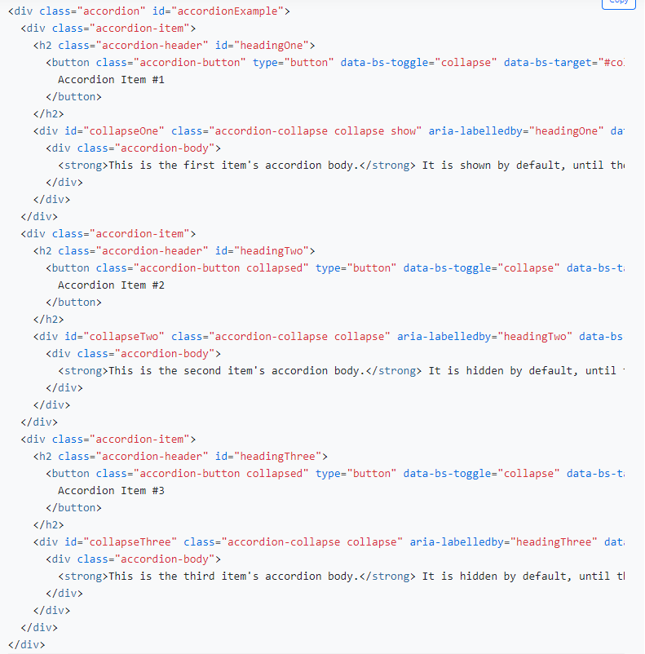
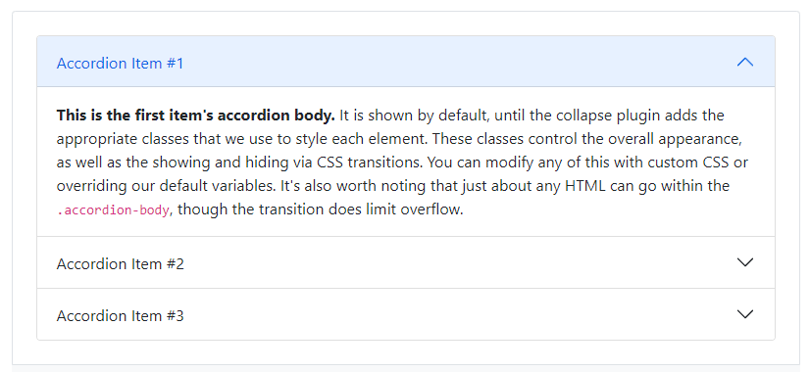
| Components |
Many more reusable components built to provide iconography, dropdowns, input groups, navigation, alerts, and much more.
Accordion

Slide 23
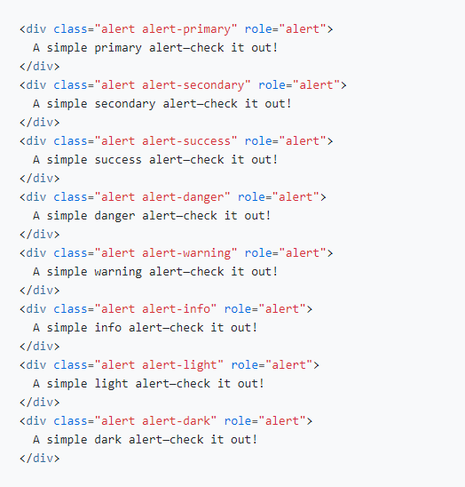
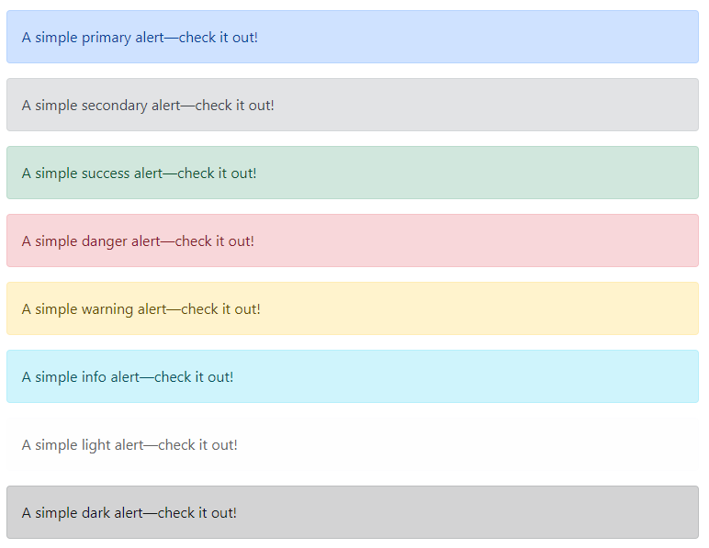
| Components |
Alerts

Slide 24
| Components |
Accordion
Alerts
Badge
Breadcrumb
Buttons
Button group
Card
Carousel
Close button
Collapse
Dropdowns
List group
Modal
Navs & tabs
Navbar
Offcanvas
Pagination
Popovers
Progress
Scrollspy
Spinners
Toasts
Tooltips

Slide 25
| Advantages of Bootstrap |
Fewer Cross browser bugs
A consistent framework that supports major of all browsers and CSS compatibility fixes
Lightweight and customizable
Responsive structures and styles
Several JavaScript plugins using the jQuery
Good documentation and community support
Loads of free and professional templates, WordPress themes and plugins
Great grid system

Slide 26
THANK YOU!

