Slide 1
Unit-1
Introduction to Web Technology
Ms. Divya Singhal
Assistant Professor
KIET Group of Institutions, Delhi- NCR, Ghaziabad

Slide 2
The Origins of the WWW
WWW was invented by Tim Berners-Lee at CERN (1989)
Hypertext across the Internet (replacing FTP)
Three constituents: HTML + URL + HTTP
HTML is an SGML(standard generalized markup language) language for hypertext
URL is an notation for locating files on serves
HTTP is a high-level protocol for file transfers
Hypertext, for easy navigation among resources (e.g., HTML)

Slide 3
What is WWW?
WWW stands for World Wide Web.
A technical definition of the WWW is − All the resources and users on the Internet that are using HTTP.
HTTP stands for Hypertext Transfer Protocol.
This is the protocol being used to transfer hypertext documents that makes the World Wide Web possible.

Slide 4
URI
Every resource available on the Web -- HTML document, image, video clip, program, etc. -- has an address that may be encoded by a Universal Resource Identifier, or "URI".
URIs typically consist of three pieces:
The naming scheme of the mechanism used to access the resource.
The name of the machine hosting the resource.
The name of the resource itself, given as a path.

Slide 5

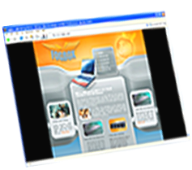


How the Web Works?
World Wide Web (WWW) use classical client / server architecture
  Hyper Text Transfer Protocol is text-based request-response protocol
Server running Web Server Software (IIS, Apache, etc.)
Client running a Web Browser
HTTP
HTTP
Server response

Slide 6
What is a Web Page?
Web pages are text files containing HTML
HTML – Hyper Text Markup Language
  A notation for describing
    document structure (semantic markup)
    formatting (presentation markup)
The markup tags provide information about the page content structure
Notes:
*
07/16/96
(c) 2007 National Academy for Software Development - http://academy.devbg.org. All rights reserved. Unauthorized copying or re-distribution is strictly prohibited.*
<number>##

Slide 7
What is the Internet?
The Internet is a massive network of networks, a networking infrastructure.
It connects millions of computers together globally, forming a network in which any computer can communicate with any other computer as long as they are both connected to the Internet.
Information that travels over the Internet uses many different set of rules which are known as protocols.

Slide 8
HTTP Protocol
HTTP (Hypertext Transfer Protocol) is the set of rules for transferring files (text, graphic images, sound, video, and other multimedia files) on the WWW.
As soon as a Web user opens their Web Browser, the user is indirectly making use of HTTP.
HTTP is an application protocol that runs on top of the TCP/IP suite of protocols (the foundation protocols for the Internet).

Slide 9
HTTP Protocol
The term HTTP was coined by Ted Nelson.
The standard port for HTTP connections is port 80.
HTTP/0.9 was the first version of the HTTP and was introduced in 1991.
HTTP/1.0 is specified in RFC 1945 and was introduced in 1996.
HTTP/1.1 is specified in RFC 2616 and was officially released in January 1997.

Slide 10
HTTPS Protocol
Hypertext Transfer Protocol Secure, HTTPS is a protocol which uses HTTP on a connection encrypted by transport-layer security. HTTPS is used to protect transmitted data from eavesdropping.
HTTPS uses port 443 to transfer its information.
HTTPS is first used in HTTP/1.1 and is defined in RFC 2616.

Slide 11
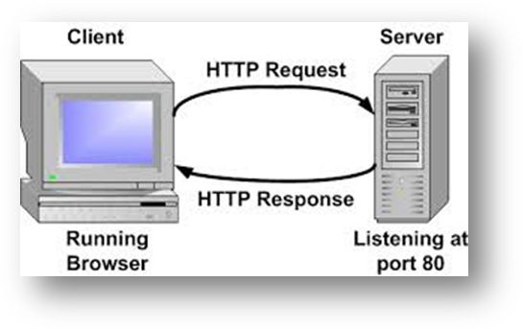
HTTP Request & Response

Slide 12
HTTP Request
Request Method
  GET
  POST
  PUT
  DELETE
  Etc….
Request Header Fields
  Accept-Charset, Accept-Encoding, Accept-Language, User-Agent, Host

Slide 13
HTTP Response
Response Header Fields
  Date, Server, Last-Modified, Content-Length, Content-Type
Status Code
  1** : Information
  2** : Success
  3** : Redirection
  4** : Client Error
  5** : Server Error

Slide 14
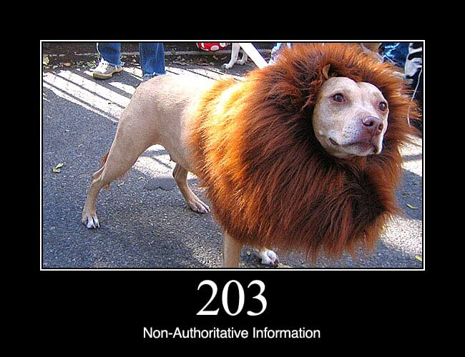
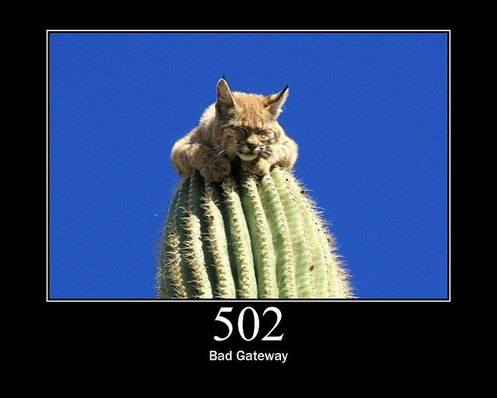

HTTP Status Codes

Slide 15




Web Browsers
A web browser or Internet browser is a software application for retrieving, presenting, and traversing information resources on the World Wide Web.
An information resource is identified by a Uniform Resource Identifier (URI) and may be a web page, image, video, or other piece of content.
Hyperlinks present in resources enable users to easily navigate their browsers to related resources
Mozila Firefox
Google Chrome
Opera
Internet Explorer

Slide 16
Web Server?
A Web server is a system program that uses HTTP to serve the files that form Web pages to users, in response to their requests, which are forwarded by their computers' HTTP clients (using Browser).
Dedicated computers and appliances that host web sites is also called Web Servers.

Slide 17
List of Web Servers
Apache from Apache Foundation
IIS from Microsoft
nginx (pronounced engine X) from NGNIX.
NetWare server from Novel.
Google Web Server (GWS) from Google.
Domino servers from IBM.

Slide 18
Web Design Issues
Browser & Operating Systems
Bandwidth and Cache
Display Resolution
Look & Feel
Page Layout and Linking
Locating Information
Making Design user-Centric
Sitemap

Slide 19
a) Browser & Operating Systems
Web pages are written using different HTML tags and viewed in browser window.
The different browsers and their versions greatly affect the way a page is rendered, as different browsers sometimes interpret same HTML tag in a different way.
Different versions of HTML also support different sets of tags.
The support for different tags also varies across the different browsers and their versions.
Same browser may work slightly different on different operating system and hardware platform.
To make a web page portable, test it on different browsers on different operating systems.

Slide 20
b) Bandwidth and Cache
Users have different connection speed, i.e. bandwidth, to access the Web sites.
Connection speed plays an important role in designing web pages, if user has low bandwidth connection and a web page contains too many images, it takes more time to download.
Generally, users have no patience to wait for longer time than 10-15 seconds and move to other site without looking at contents of your web page.
Browser provides temporary memory called cache to store the graphics.
When user gives the URL of the web page for the first time, HTML file together with all the graphics files referred in a page is downloaded and displayed.

Slide 21
c) Display Resolution
Display resolution is another important factor affecting the Web page design, as we do not have any control on display resolution of the monitors on which user views our pages.
Display or screen resolution is measured in terms of pixels and common resolutions are 800 X 600 and 1024 X 786.
We have three choices for Web page design.
  Design a web page with fixed resolution.
  Make a flexible design using HTML table to fit into different resolution.
  If the page is displayed on a monitor with a higher resolution, the page is displayed on left hand side and some part on the right-hand side remains blank. We can use centered design to display page properly.
  Ideally we should use some frameworks for designing like Bootstrap/Material design.

Slide 22
d) Look & Feel
Look and feel of the website decides the overall appearance of the website.
It includes all the design aspects such as
  Web site theme
  Web typography
  Graphics
  Visual structure
  Navigation etc…

Slide 23
e) Page Layout and Linking
Website contains of individual web pages that are linked together using various navigational links.
Page layout defines the visual structure of the page and divides the page area into different parts to present the information of varying importance.
Page layout allows the designer to distribute the contents on a page such that visitor can view it easily and find necessary details.

Slide 24
f) Locating Information
Webpage is viewed on a computer screen and the screen can be divided into five major areas such as center, top, right, bottom and left in this particular order.
The first major area of importance in terms of users viewing pattern is the center, then top, right, bottom and left in this particular order

Slide 25
g) Making Design user-Centric
It is very difficult for any Web designer to predict the exact behavior of the Web site users.
However, idea of general behavior of common user helps in making design of the Web site user centric.
Users either scan the information on the web page to find the section of their interest or read the information to get details.

Slide 26
h) Sitemap
A Sitemap is a model of a website's content designed to help both users and search engines navigate the site.
Many a times Web sites are too complex as there are a large number of sections and each section contains many pages.
It becomes difficult for visitors to quickly move from one part to other.
Once the user selects a particular section and pages in that section, user gets confused about where he/she is and where to go from there.
To make it simple, keep your hierarchy of information to few levels or provide the navigation bar on each page to jump directly to a particular section.

Slide 27
Planning a Website
The most important activity in a website development is planning.
To achieve higher success of the website in terms of user satisfaction, better planning is needed.
Before we start developing a website, we should ask question such as
  Why are we developing this website?
  What do we achieve by developing this website?
  Who are the people who will use this website?
  What are the information contents?
  How are these contents organized? What are the possible ways?

Slide 28
Effective Navigation
The most important design element in the web design after page layout is navigation design.
Navigation means the ways to move from one page to another page in a Web site using hyperlinks provided on the page.
If navigation design is not proper then user feels the problem in moving around the pages in your site in a desired manner or gets confused and leaves the site.

Slide 29
Tips for Effective Navigation
Navigation links are either text based, i.e. a word or a phrase is used as a link, or graphical, i.e. a image, a icon or a logo is used as a link.
Navigation links should be clear and meaningful.
It should be consistent.
Link should be understandable.
Organize the links such that contents are grouped logically.
Provide search link, if necessary, usually on top of the page.
Use common links such as ‘about us’ or ‘Contact us’.
Provide the way to return to first page.
Provide the user with information regarding location
Horizontal navigation bar can be provided on each page to directly jump to any section

Slide 30
Features of Web 2.0
Folksonomy | Social Tagging
  Traditional Web like Yahoo Directory and DMOZ uses a pre-defined classification of Information like category & sub category.
  On the other hand Web 2.0 without sticking to the existing framework of classification , allows user to create free classification/ arrangement of information.
  This is also known as Social tagging.
Wikis
  Wikis - sites like Wikipedia and others enable users from around the world to add and update online content
Social Networking
  Sites like Facebook and MySpace allow users to build and customize their own profiles and communicate with friends.

Slide 31
Features of Web 2.0 (Cont.)
User Participation
  In traditional web the contents are solely provided by the website owner or company, but in web 2.0 the users participate in content sourcing. This is also known as Crowd sourcing. Examples: Wikipedia & YouTube.
Long Tail
  The traditional web was like a retail business the product is sold directly to user and the revenue generated. But in web 2.0 the niche product is not sold directly but offered as a service on demand basis and income is generated as monthly fee and pay per consumption.
Rich User Experience
  Traditional web are built with HTML and CSS CGI and had been offered as a static page. On the other hand Web 2.0 uses Ajax(Asynchronous JavaScript + XML) presenting dynamic, rich user experience to users.

Slide 32
What is HTML?
Hypertext markup language
It is not a programming language
It is a markup language and uses tags.
It is an interpreted & Declarative language
Browsers are used to view the HTML document.
Examples: IE , Netscape navigator
Tags are not case sensitive.
Each HTML tag describes different document content

Slide 33
Creating HTML Pages
An HTML file must have an .htm or .html file extension
HTML files can be created with text editors:
  NotePad, NotePad ++
Or HTML editors (WYSIWYG Editors):
  Microsoft FrontPage
  Macromedia Dreamweaver
  Netscape Composer
  Microsoft Word
  Visual Studio
Notes:
*
07/16/96
(c) 2007 National Academy for Software Development - http://academy.devbg.org. All rights reserved. Unauthorized copying or re-distribution is strictly prohibited.*
<number>##

Slide 34
HTML Structure
HTML is comprised of “elements” and “tags”
  Begins with <html> and ends with </html>
Elements (tags) are nested one inside another:
Tags have attributes:
HTML describes structure using two main sections: <head> and <body>
Every tag has opening and closing brackets
There are two types of tags:
a) Empty tags : Tags that do not require end tag Ex: <br/>
b) Container : These tags contain both opening and end tag.
Ex:
<html>…………</html>
<head> ………</head>
Notes:
*
07/16/96
(c) 2007 National Academy for Software Development - http://academy.devbg.org. All rights reserved. Unauthorized copying or re-distribution is strictly prohibited.*
<number>##

Slide 35
Parts of HTML document
An HTML document has two distinct parts: a head, a body
Head : This a header portion. We can use title,script and meta data tags in this portion. The head is used for text and tags that do not show directly on the page.
Body: This is the place where we can enter text, table ,graphics and other work.
The body is used for text and tags that are shown directly on the page.

Slide 36
HTML Code Formatting
The HTML source code should be formatted to increase readability and facilitate debugging.
  Every block element should start on a new line.
  Every nested (block) element should be indented.
  Browsers ignore multiple whitespaces in the page source, so formatting is harmless.
For performance reasons, formatting can be sacrificed
Notes:
*
07/16/96
(c) 2007 National Academy for Software Development - http://academy.devbg.org. All rights reserved. Unauthorized copying or re-distribution is strictly prohibited.*
<number>##

Slide 37
Versions
HTML | 1991
HTML 2.0 | 1995
HTML 3.2 | 1997
HTML 4.01 | 1999
XHTML | 2000
HTML5 | 2012

Slide 38
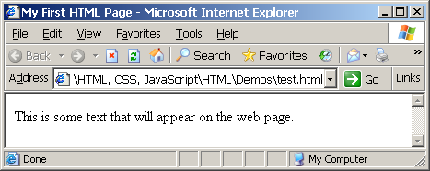
First HTML Page
test.html
<html>
<head>
<title>My First HTML Page</title>
</head>
<body>
<p>This is some text...</p>
</body>
</html>

Slide 39
HTML Structure
HTML is comprised of “elements” and “tags”
  Begins with <html> and ends with </html>
Elements (tags) are nested one inside another:
Tags have attributes:
HTML describes structure using two main sections: <head> and <body>
<html> <head></head> <body></body> </html>
<img src="logo.jpg" alt="logo" />

Slide 40
First HTML Page: Tags
<!DOCTYPE HTML>
<html>
<head>
<title>My First HTML Page</title>
</head>
<body>
<p>This is some text...</p>
</body>
</html>
Opening tag
Closing tag
An HTML element consists of an opening tag, a closing tag and the content inside.

Slide 41
First HTML Page: Header
HTML header
<!DOCTYPE HTML>
<html>
<head>
<title>My First HTML Page</title>
</head>
<body>
<p>This is some text...</p>
</body>
</html>

Slide 42
First HTML Page: Body
<!DOCTYPE HTML>
<html>
<head>
<title>My First HTML Page</title>
</head>
<body>
<p>This is some text...</p>
</body>
</html>
HTML body

Slide 43
First HTML Page
test.html
<!DOCTYPE HTML>
<html>
<head>
<title>My First HTML Page</title>
</head>
<body>
<p>This is some text...</p>
</body>
</html>

Slide 44
Basic HTML Tags
Headings
Paragraph
Colors
Fonts
List
Anchor Tag
Image
Table
Form

Slide 45
1) Headings
Headings are important because search engines use the headings to index the structure and content of your web pages.
  <h1> text </h1> -- largest of the six
  <h2> text </h2>
  <h3> text </h3>
  <h4> text </h4>
  <h5> text </h5>
  <h6> text </h6> -- smallest of the six
align="position" --left (default), center or right

Slide 46
2) <p> paragraph
<p> defines a paragraph
Add align="position" (left, center, right)
Multiple <p>'s do not create blank lines
Use <br> for blank line
Fully-specified text uses <p> and </p>, but </p> is optional

Slide 47
3) Colors
Values for bgcolor and color
  many are predefined (red, blue, green, ...)
  all colors can be specified as a six character hexadecimal value: #RRGGBB
  #FF0000 – red
  #888888 – gray
  #00FF00 –green
  #000000 – black

Slide 48
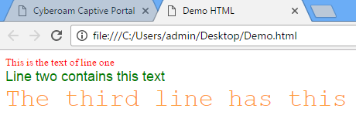
4) Fonts
The <font> tag specifies the font face, font size, and color of text.
The <font> tag is not supported in HTML5.
<font color="red" size="2" face="Times Roman">
This is the text of line one </font>
<font color="green" size="4" face="Arial">
Line two contains this text </font>
<font color="#FF9933" size="6" face="Courier“>
The third line has this additional text </font>

Slide 49
5) List
Ordered List
  Block-A
  Block-B
  Block-C
  Block-D
Unordered List
  Block-A
  Block-B
  Block-C
  Block-D
  Block-A
  Block-B
  Block-C
  Block-D
  Block-A
  Block-B
  Block-C
  Block-D
  Block-A
  Block-B
  Block-C
  Block-D
  Block-A
  Block-B
  Block-C
  Block-D
  Block-A
  Block-B
  Block-C
  Block-D
  Block-A
  Block-B
  Block-C
  Block-D

Slide 50
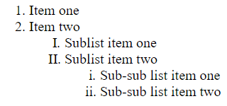
5.1) Ordered List
<ol>
<li> Item one </li>
<li> Item two </li>
<ol type="I" >
<li> Sublist item one </li>
<li> Sublist item two </li>
<ol type="i">
<li> Sub-sub list item one </li>
<li> Sub-sub list item two </li>
</ol>
</ol>
</ol> list/ordered_list_after.html
Types:
Type = 1 (default)
Type = a
Type = A
Type = I
Type = i
Output

Slide 51
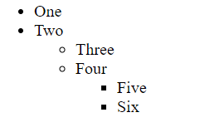
5.2) Unordered List
<ul>
<li> One </li>
<li> Two </li>
<ul type="circle">
<li> Three </li>
<li> Four </li>
<ul type="square">
<li> Five </li>
<li> Six </li>
</ul>
</ul>
</ul>
list/unordered_list_after.html
Types:
Type = disc (default)
Type = circle
Type = square
Output

Slide 52
6) <a> Anchor Tag (Hyperlinks)
The <a> tag defines a hyperlink, which is used to link from one page to another.
  Link to an absolute URL:
  If you get spam, contact <a href="http://www.microsoft.com">
  Microsoft </a> to report the problem.
  Link to a relative URL:
  See these <a href=“./index.php"> references </a>
  concerning our fine products.
  Link to a section within a URL:
  <a href=“#reference">
  Reference Section. </a>

Slide 53
7) Images
Syntax :
  <img src=“PathToImage”/>
src is required
alt will specify the text to display if the Image not found
width, height may be in units of pixels or percentage of page or frame
  width="357"
  height="50%“
  Images/images.html

Slide 54
Images (cont.)
<img src="dolphin.jpg" align="left" width="150" height="150" alt="dolphin jump!">
align=position | Image/Text Placement
Left | Image on left edge; text flows to right of image
Right | Image on right edge; text flows to left
Top | Image is left; words align with top of image
Bottom | Image is left; words align with bottom of image
Middle | Words align with middle of image

Slide 55
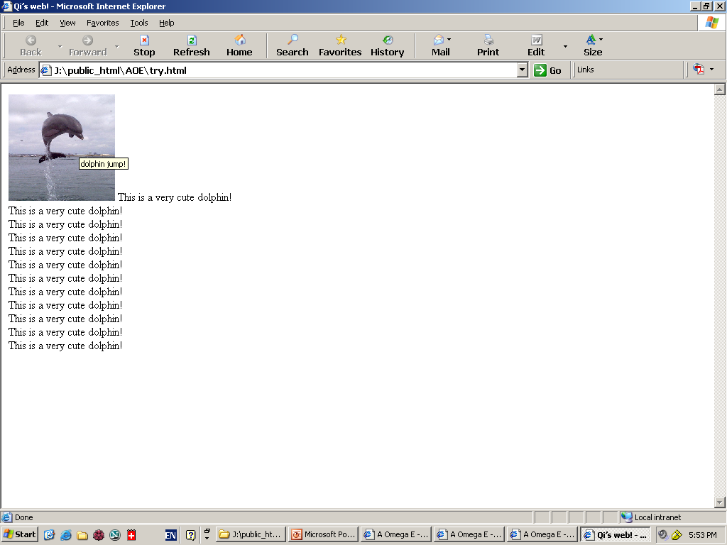
Image (cont.) => align=“bottom”

Slide 56
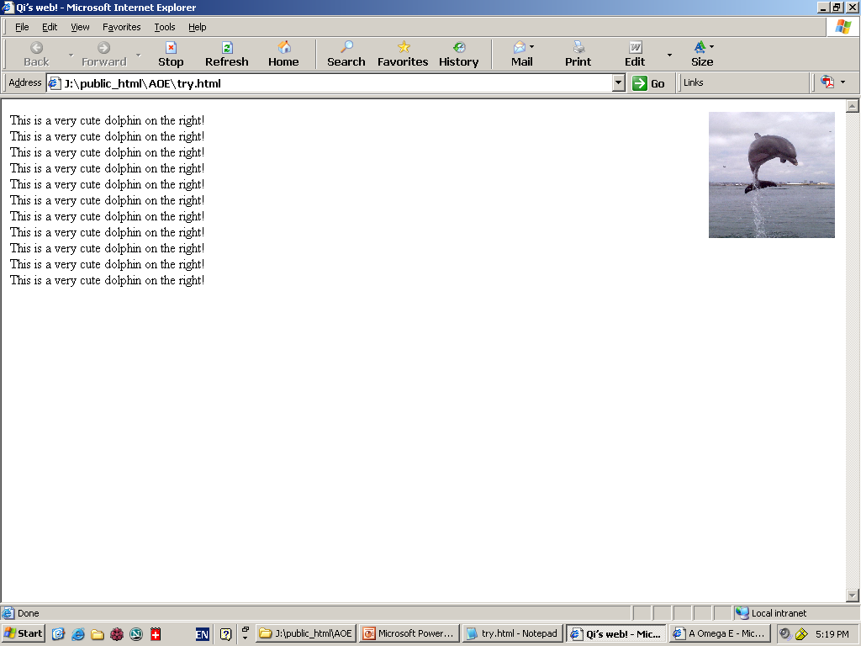
Image (cont.) => align=“right”

Slide 57
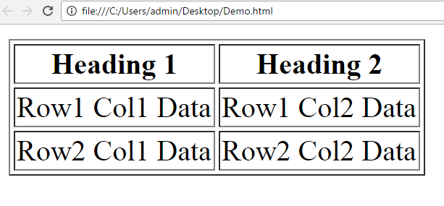
8) Table
<table> table tag
<caption> optional table title
<tr> table row
<th> table column header
<td> table data element
  <table border=1>
  <caption>Table Caption</caption>
  <tr>
  <th>Heading1</th>
  <th>Heading2</th>
  </tr>
  <tr>
  <td>Row1 Col1 Data</td>
  <td>Row1 Col2 Data</td>
  </tr>
  <tr>
  <td>Row2 Col1 Data</td>
  <td>Row2 Col2 Data</td>
  </tr>
  </table>
Others/table.html
table/basic_topic.html

Slide 58
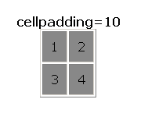
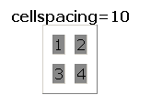
Table Element Attributes
align=position -- left, center, right for table
border=number -- width in pixels of border (default 0)
cellspacing=number -- spacing in pixels between cells, default about 3
cellpadding=number -- space in pixels between cell border and table element, default about 1
width=number[%]-- width in pixels or percentage of page/frame width

Slide 59
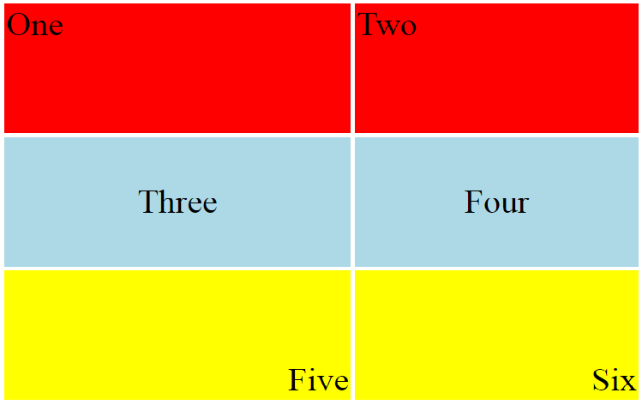
Table Row <tr> Attributes
Valid for the table row:
align -- left, center, right
valign -- top, middle, bottom
bgcolor -- background color
<table align="center" width="300" height="200">
  <tr align="left" valign="top" bgcolor="red">
    <td>One</td>
    <td>Two</td>
  </tr>
  <tr align="center" valign="middle" bgcolor="lightblue">
  <td>Three</td>
  <td>Four</td>
  </tr>
  <tr align="right" valign="bottom" bgcolor="yellow">
  <td>Five</td>
  <td>Six</td>
  </tr>
</table>

Slide 60
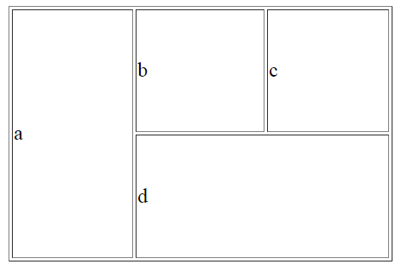
Irregular Table
a
b
c
Valid for the table cell:
colspan
- how many columns this cell occupies
rowspan
- how many rows this cell occupies
<table align="center" width="300" height="200" border="1">
<tr>
<td colspan="1" rowspan="2">a</td>
<td colspan="1" rowspan="1">b</td>
<td colspan="1" rowspan="1" >c</td>
</tr>
<tr>
<td colspan=“2" rowspan="1">d</td>
</tr>
</table>
d

Slide 61
9) HTML Form
<form> is just another kind of HTML tag
HTML forms are used to create GUIs on Web pages
  Usually the purpose is to ask the user for information
  The information is then sent back to the server
A form is an area that can contain form elements
  The syntax is: <form parameters> ...form elements... </form>
  Form elements include: buttons, checkboxes, text fields, radio buttons, drop-down menus, etc
  Other kinds of HTML tags can be mixed in with the form elements
  A form usually contains a Submit button to send the information in the form elements to the server
  The form’s parameters tell browser how to send the information to the server (there are two different ways it could be sent)

Slide 62
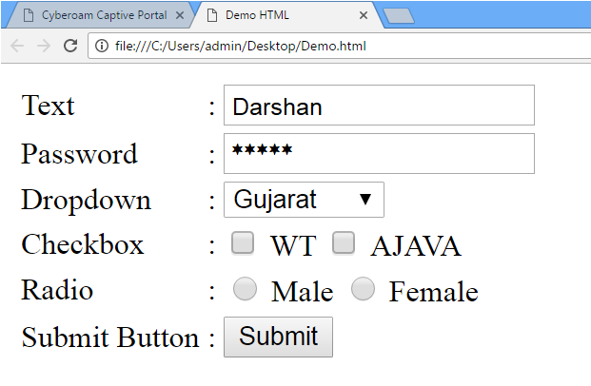
9) HTML Form

Slide 63
The <form> Tag
The <form arguments> ... </form> tag encloses form elements (and probably other HTML as well)
The arguments to form tell what to do with the user input
  action="url" (required)
    Specifies where to send the data when the Submit button is clicked
  method="get" (default)
    Form data is sent as a URL with ?form_data info appended to the end
    Can be used only if data is all ASCII and not more than 100 characters
  method="post"
    Form data is sent in the body of the URL request
    Cannot be bookmarked by most browsers
  target="target"
    Tells where to open the page sent as a result of the request
    target= _blank means open in a new window
    target= _top means use the same window
    Forms/disp.html

Slide 64




Input tags
Text field
  Example: <input type=“text” name=“inputname”/>
Password field
  Example: <input type=“password” name=“inputname”/>
Radio buttons
  Example:
  <input type="radio" name="gender"> Male
  <input type="radio" name="gender"> Female
Check boxes
  Example:
  <input type="checkbox" name="Roll1"> Roll No 1 <br/>
  <input type="checkbox" name="Roll2"> Roll No 2 <br/>
  <input type="checkbox" name="Roll3"> Roll No 3 <br/>

Slide 65
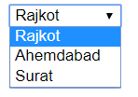
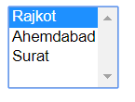
Input tags (cont.)
Dropdown list
  <select> tag is used to create a drop-down list in HTML.
  <option> tags inside the <select> tag define the available options in the list.
  Example:
    <select>
    <option value=“1”>Rajkot</option>
    <option value=“2”>Ahemdabad</option>
    <option value=“3”>Surat</option>
    </select>
  Example (multiple select):
    <select multiple="multiple">
    <option value=“1”>Rajkot</option>
    <option value=“2”>Ahemdabad</option>
    <option value=“3”>Surat</option>
    </select>

Slide 66
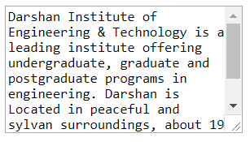

Input tags (cont.)
Text area
  <textarea> tag defines a multi-line text
  input control.
  Example :
    <textarea rows=“8” cols=“30”>
    Darshan Institute of Engineering & Technology is a leading institute ….
    </textarea>
Submit Button
  Submit button is used to submit the data
  to the form action url.
    Example :
      <input type=“submit” value=“Add City”>

Slide 67
Links
Links are used to link with different pages with the current web page.
<a>……</a> is used to link with the web pages.
Attributes are : href
Href: hyper reference to the another page. This would appear in underlined and different color from other text.
Links/links_external.html

Slide 68
Link
The <link> tag defines the relationship between a document and an external resource.
The <link> tag is most used to link to style sheets.
The <link> element is an empty element, it contains attributes only.
This element goes only in the head section, but it can appear any number of times.
Attributes are : charset,href,hreflang,rel,target,type

Slide 69
Meta
Metadata is data (information) about data.
The <meta> tag provides metadata about the HTML document. Metadata will not be displayed on the page, but will be machine parsable.
Meta elements are typically used to specify page description, keywords, author of the document, last modified, and other metadata.
The <meta> tag always goes inside the <head> element.
The metadata can be used by browsers (how to display content or reload page), search engines (keywords), or other web services.
Metadata is always passed as name/value pairs.
Ex:
<meta name="keywords" content="HTML, CSS, XML, XHTML, JavaScript" />
<meta http-equiv="refresh" content="30" />
<meta http-equiv="Content-Type" content="text/html;charset=ISO-8859-1" />

Slide 70
Attributes :
Content text - The required content attribute gives the value associated with the http-equiv or name attribute.
http-equiv content-type - Provides an HTTP header for the information/value of the content attribute
Values are : content-style-type , expires , set-cookie , others
Ex: <meta http-equiv="cache-control" content="no-cache" />
<meta http-equiv="content-language" content="en-US" />
<meta http-equiv="expires" content="Fri, 30 Dec 2011 12:00:00 GMT" />
name - The name attribute provides a name for the information/value of the content attribute.
If the http-equiv attribute is set, the name attribute should not be set.
Values are : author, description ,keywords , generator , revised, others
Ex: <meta name="keywords" content="HTML,CSS,XML,JavaScript" />
<meta name="author" content="Hege Refsnes" />
<meta name="description" content="Free Web tutorials" />

Slide 71
Character Entities
Character entities are used to display reserved characters in HTML.
Characters that are not present on your keyboard can also be replaced by entities. Html_entities_after.html
Character | Character Entity | Description
 | &nbsp; | Space
& | &amp; | Ampersand
“ | &quot; | Quote
< | &lt; | Less than
> | &gt; | Greater than
© | &copy; | Copyright
® | &reg; | Registered
™ | &trade; | Trademark
£ | &pound; | Pound
¢ | &cent; | Cent
÷ | &divide; | Divide

Slide 72
How Browser Works ?
Keyboard and Mouse
Output
To
Display
Controller
HTML Interpreter
Display
Drivers
Plug-Ins/
Other Interpreter
Response from web server
Network Interface
Other Clients
HTTP Client
Communication with web server

Slide 73
Image map
An image-map is an image with clickable areas.
The <area> tag defines an area inside an image-map
The <area> element is always nested inside a <map> tag.
The usemap attribute in the <img> tag is associated with the <map> element's name attribute, and creates a relationship between the image and the map.
Attributes :
coords - Specifies the coordinates of an area
href - URL - Specifies the hyperlink target for the area
nohref Specifies that an area has no associated. Values are :nohref
shape Specifies the shape of an area . Values are : default, rect, circle, poly
target - Specifies where to open the linked page specified in the href attribute . Values are: _blank , _parent , _self , _top

Slide 74
DIV
The <div> tag defines a division or a section in an HTML document.
The <div> tag is used to group block-elements to format them with styles.
The <div> element is very often used together with CSS, to layout a web page.
Browsers always place a line break before and after the <div> element.
Attribute:
align - Specifies the alignment of the content inside a <div> element
Values are : left, right, center, justify

Slide 75
Span
The HTML span element is a generic inline container for inline elements and content.
<span> used to group elements for styling purposes (by using the class or id attributes).
It has both opening and closing tags.

Slide 76
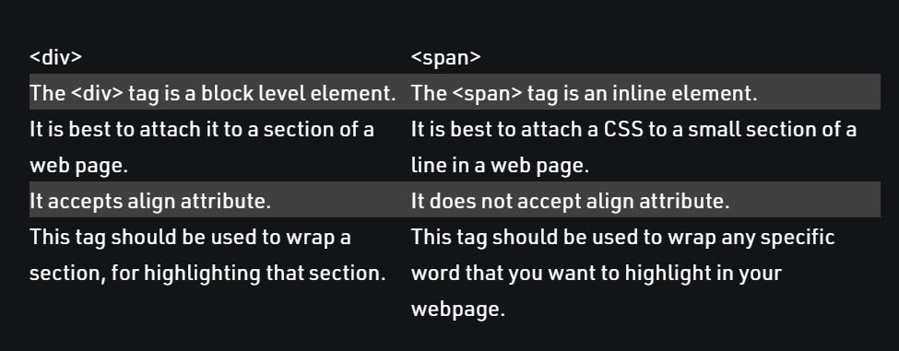

Slide 77
Introduction to HTML 5
The DOCTYPE declaration for HTML5 is very simple:
  <!DOCTYPE html>
The character encoding (charset) declaration is also very simple:
    <meta charset="UTF-8">
New HTML5 Elements:
  New semantic elements like <header>, <footer>, <article>, and <section>.
  New form control attributes like number, date, time, calendar, and range.
  New graphic elements: <svg> and <canvas>.
  New multimedia elements: <audio> and <video>.
  Some Elements Removed in HTML5
  Semantic_elements.html

Slide 78
Common Attributes
accesskey Specifies a shortcut key to activate/focus an element
class Specifies one or more classnames for an element (refers to a class in a style sheet)
contentEditable Specifies whether the content of an element is editable or not
Contextmenu Specifies a context menu for an element. The context menu appears when a user right-clicks on the element
dir Specifies the text direction for the content in an element
draggable Specifies whether an element is draggable or not
dropZone Specifies whether the dragged data is copied, moved, or linked, when dropped
hidden Specifies that an element is not yet, or is no longer, relevant
id Specifies a unique id for an element
lang Specifies the language of the element's content
spellCheck Specifies whether the element is to have its spelling and grammar checked or not
Style Specifies an inline CSS style for an element
tabindex Specifies the tabbing order of an element
title Specifies extra information about an element

Slide 79
Tag Description
<article> Defines an article
<aside> Defines content aside from the page content
<audio> Defines sound content
<bdi> Isolates a part of text that might be formatted in a different direction from other text outside it
<canvas> Used to draw graphics, on the fly, via scripting (usually JavaScript)
<command> Defines a command button that a user can invoke
<datalist> Specifies a list of pre-defined options for input controls
<details> Defines additional details that the user can view or hide
<embed> Defines a container for an external (non-HTML) application
<figcaption> Defines a caption for a <figure> element
<figure> Specifies self-contained content
<footer> Defines a footer for a document or section
<header> Defines a header for a document or section

Slide 80
Differences between HTML 4.0 and 5
In body tag , all layout attributes are removed.(alink,background,text,bgcolor,link,vlink)
Form : HTML5 has added two new attributes: autocomplete and novalidate, and removed the accept attribute.
Img : align, border, hspace, longdesc, and vspace is not supported in HTML5.
Meta : HTML5 has a new attribute, charset, <meta charset="UTF-8">
Table : HTML5 only supports the "border" attribute, and its value can be "1" or "".
Div : The align attribute not supported in HTML5.
A- In HTML 4.01, the <a> tag could be either a hyperlink or an anchor. In HTML5, the <a> tag is always a hyperlink, but if it has no href attribute, it is only a placeholder for a hyperlink.

Slide 81
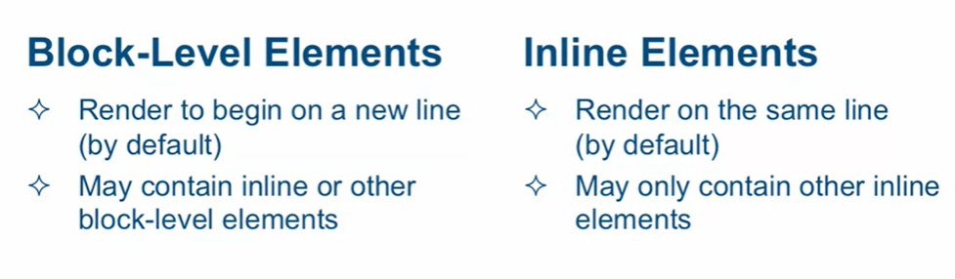
HTML Content

Slide 82
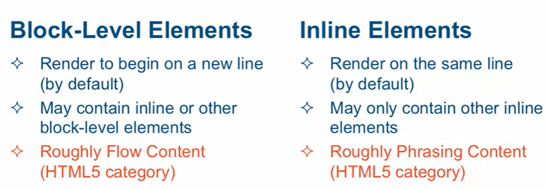
HTML 5 Content
Div-and-span.html

Slide 83
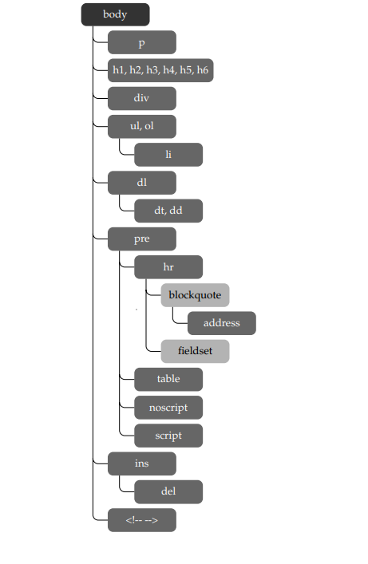
This diagram shows what is directly included in the body:

Slide 84
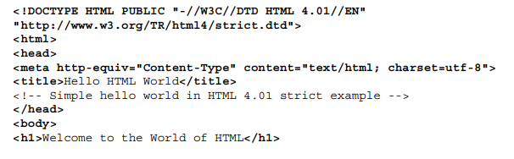
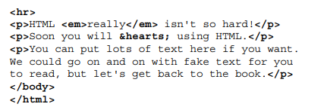

Slide 85
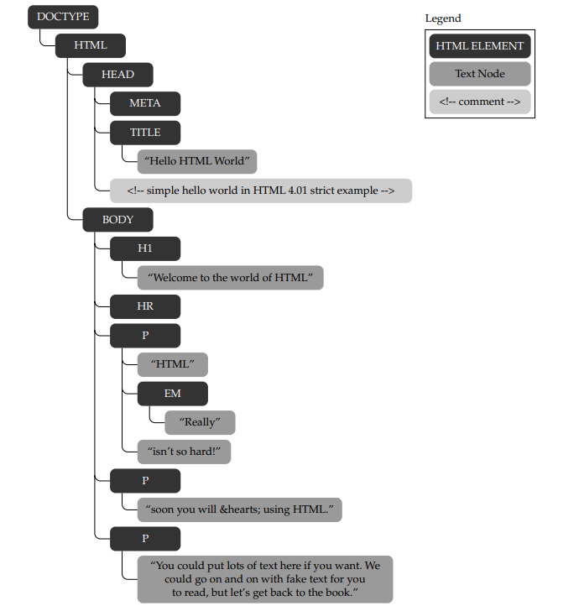
Parse Tree Structure- DOM

Slide 86
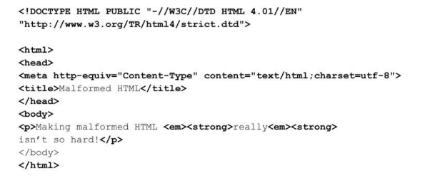
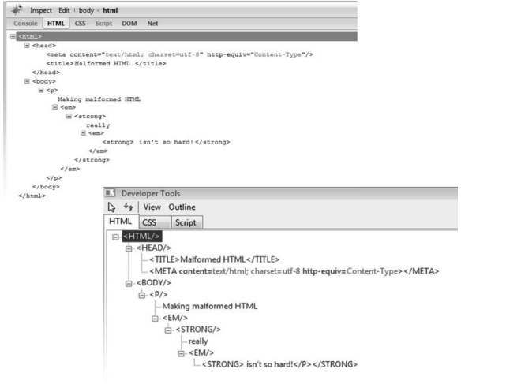
Ambiguous parse tree
Malformed.html

