Slide 1
Servlets
Ms. Divya Singhal
Assistant Professor
KIET Group of Institutions

Slide 2
Servlets- Introduction
Java servlets are server-side programs (running inside a web server) that handle clients' requests and return a customized or dynamic response for each request. The dynamic response could be based on user's input (e.g., search, online shopping, online transaction) with data retrieved from databases or other applications, or time-sensitive data (such as news and stock prices).
Java servlets typically run on the HTTP protocol. HTTP is an asymmetrical request-response protocol. The client sends a request message to the server, and the server returns a response message.
Functionally they operate in a very similar way to CGI scripts, however, being Java based they are more platform independent.

Slide 3
CGI- Common Gateway Interface
You can use it for handling client requests and generating dynamic content. When a client requests dynamic web pages, the web server performs the following steps:
It identifies the requested web page using the URL. This is the required CGI application.
It creates a new process to handle the client's request.
The CGI application is invoked within the process, and the request information is passed.
The response from the CGI application is collected.
Finally, the process is destroyed. The HTTP response is prepared and sent back to the client.
This approach of CGI is only suitable for handling a small number of clients. As the number of clients increases, the workload on the server increases. Thus the time required to process requests also increases. Creating and destroying a process for every request can be resource-intensive. This makes CGI less efficient as compared to other technologies such as Servlets and JSPs.

Slide 4
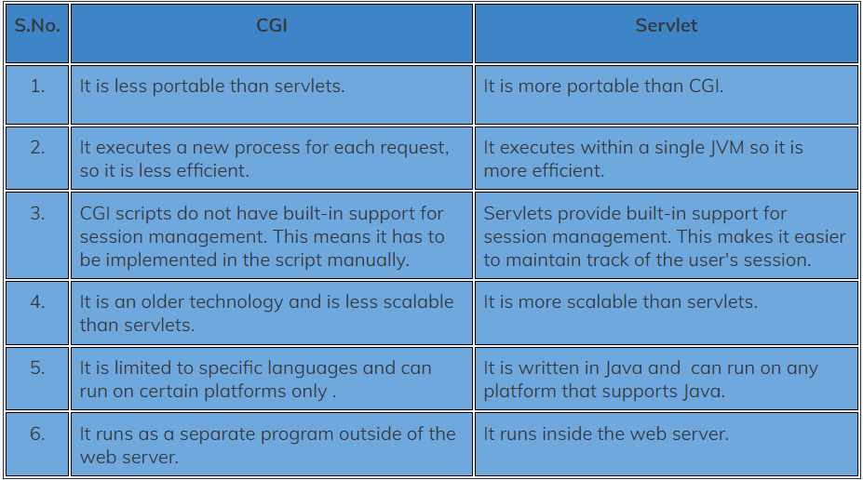
CGI vs Servlet

Slide 5
Server Side Technologies
Server-Side Technologies
There are many (competing) server-side technologies available: Java-based (servlet, JSP, JSF, Struts, Spring, Hibernate), ASP, PHP, CGI Script, and many others.
Java servlet is the foundation of the Java server-side technology, JSP (JavaServer Pages), JSF (JavaServer Faces), Struts, Spring, Hibernate, and others, are extensions of the servlet technology.
Pre-requisites
HTML, Java Programming Language, HTTP and Apache Tomcat Server, SQL and MySQL Database System, and many others.

Slide 6
Servlet- Applications
Processing data POSTed over HTTPS using an HTML form, including purchase order or credit card data. A servlet like this could be part of an order-entry and processing system, working with product and inventory databases, and perhaps an on-line payment system.
Allowing collaboration between people. A servlet can handle multiple requests concurrently; they can synchronize requests to support systems such as on-line conferencing.
Forwarding requests. Servlets can forward requests to other servers and servlets. This allows them to be used to balance load among several servers that mirror the same content. It also allows them to be used to partition a single logical service over several servers, according to task type or organizational boundaries.

Slide 7
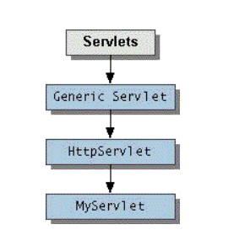
Servlet Architecture
The central abstraction in the Servlet API is the Servlet interface. All servlets implement this interface, either directly or, more commonly, by extending a class that implements it such as HttpServlet.

Slide 8
Servlet APIs
Servlet API allow to interact with the servlet container through requests and response. It comes in two packages, which are:
javax.servlet
javax.servlet.http

Slide 9
Servlet Architecture
The Servlet interface provides the following methods that manage the servlet and its communications with clients.
destroy()
Cleans up whatever resources are being held and makes sure that any persistent state is synchronized with the servlet's current in-memory state.
getServletConfig()
Returns a servlet config object, which contains any initialization parameters and startup configuration for this servlet.
getServletInfo()
Returns a string containing information about the servlet, such as its author, version, and copyright.
init(ServletConfig)
Initializes the servlet. Run once before any requests can be serviced.
service(ServletRequest, ServletResponse)
Carries out a single request from the client.
Servlet writers provide some or all of these methods when developing a servlet.

Slide 10
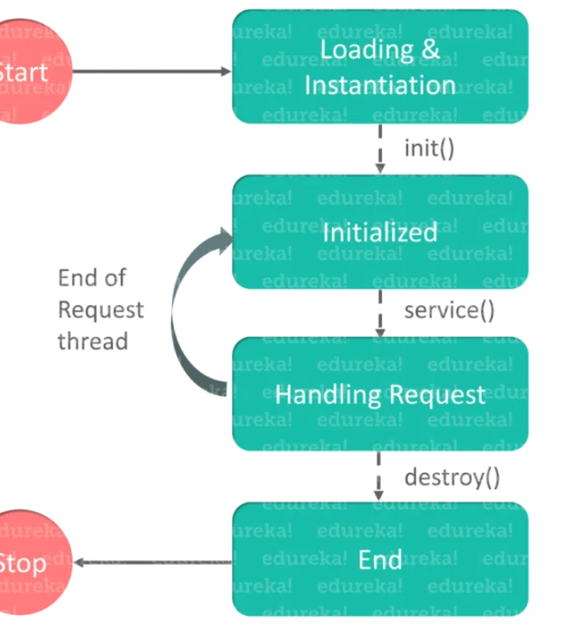
Servlet Life Cycle
The Servlet life cycle mainly includes the following four stages,
Loading a Servlet
Initializing the Servlet
Request handling
Destroying the Servlet

Slide 11
Servlet Life Cycle
When the web server (e.g. Apache Tomcat) starts up, the servlet container deploy and loads all the servlets.
The servlet is initialized by calling the init() method. The Servlet.init() method is called by the Servlet container to indicate that this Servlet instance is instantiated successfully and is about to put into service.
The servlet then calls service() method to process a client’s request. This method is invoked to inform the Servlet about the client requests.
The servlet is terminated by calling the destroy().
The destroy() method runs only once during the lifetime of a Servlet and signals the end of the Servlet instance.
init() and destroy() methods are called only once. Finally, a servlet is garbage collected by the garbage collector of the JVM.

Slide 12
Steps to Create Servlet
Create a directory structure
create a Dynamic Web Project
Create a Servlet
Compile the Servlet
Add mappings to the web.xml file
Start the server and deploy the project- Apache Tomcat Server
Access the servlet
for any servlet program, you need 3 files — index.html file, Java class file, and web.xml file.
Servlet_heading
Servlet_Demo

Slide 13
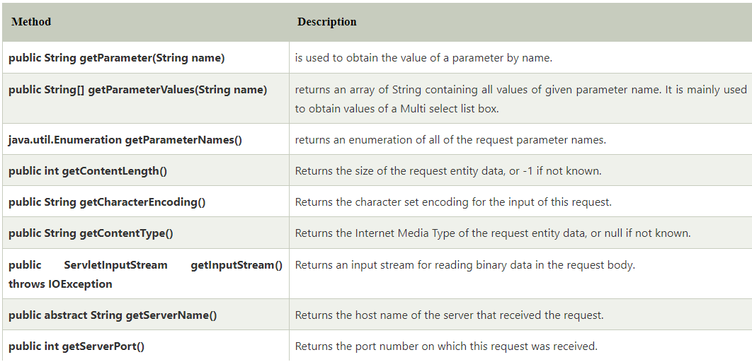
Servlet Request
An object of ServletRequest is used to provide the client request information to a servlet such as content type, content length, parameter names and values, header informations, attributes etc.

Slide 14
Servlet Response
The ServletResponse interface gives the servlet methods for replying to the client. It allows the servlet to set the content length and mime type of the reply, and provides an output stream, ServletOutputStream, and a Writer through which the servlet can send the reply data. Subclasses of ServletResponse give the servlet more protocol-specific capabilities.
For example, HttpServletResponse contains methods that allow the servlet to manipulate HTTP-specific header information.

Slide 15
Generic Servlet
A Generic servlet is a protocol-independent servlet that should always override the service() method to handle the client request.
The service() method accepts two arguments, ServletRequest object, and ServletResponse object.
The request object tells the servlet about the request made by the client while the response object is used to return a response back to the client.
Generic_Servlet

Slide 16
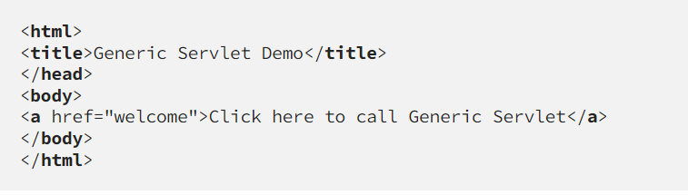
Example: Simple Example
Step 1: Index.html

Slide 17
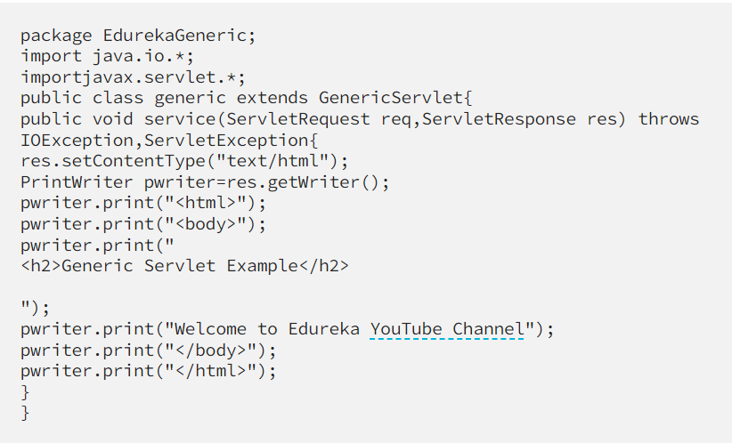
Example: Simple Example
Step 2: Add.java

Slide 18
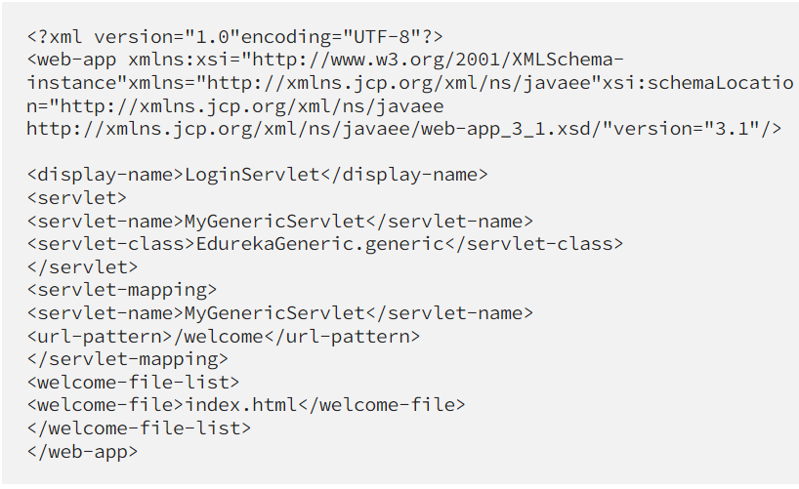
Example: Simple Example
Step 3: web.xml (The web.xml file will be present in the WEB-INF folder of your web content.)

Slide 19
HttpServlet
HttpServlet is a subclass of GenericServlet, an implementation of the Servlet interface.
The service() method of HttpServlet class dispatches requests to the methods doGet(), doPost(), doPut(), doDelete().
link
FirstWeb

Slide 20
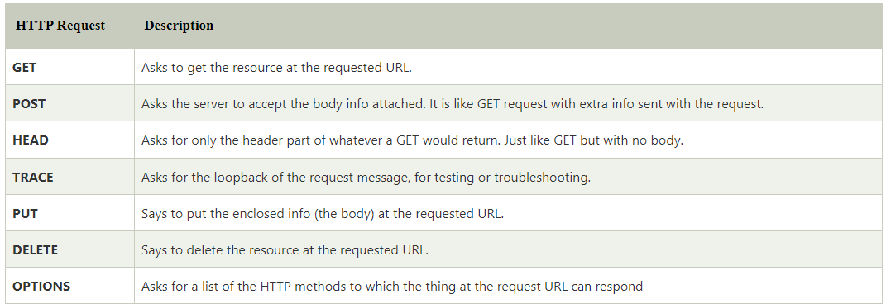
Http Request methods

Slide 21
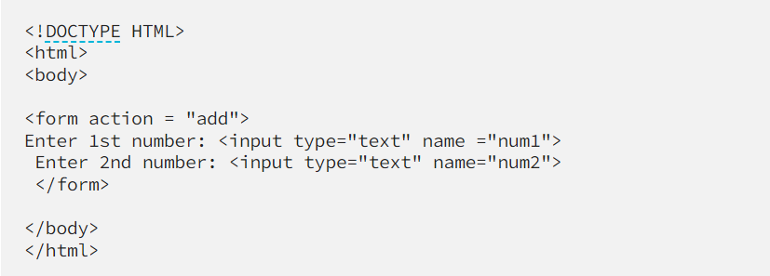
Example: add 2 numbers using servlets
Step 1: Index.html

Slide 22
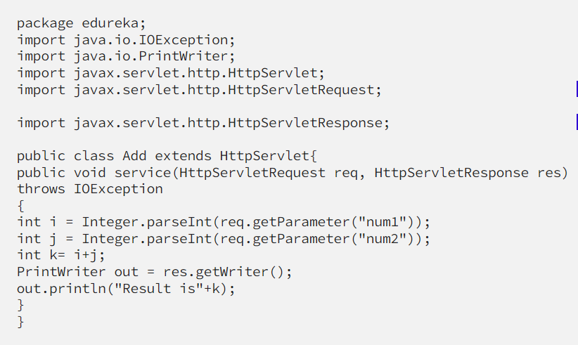
Example: add 2 numbers using servlets
Step 2: Add.java

Slide 23
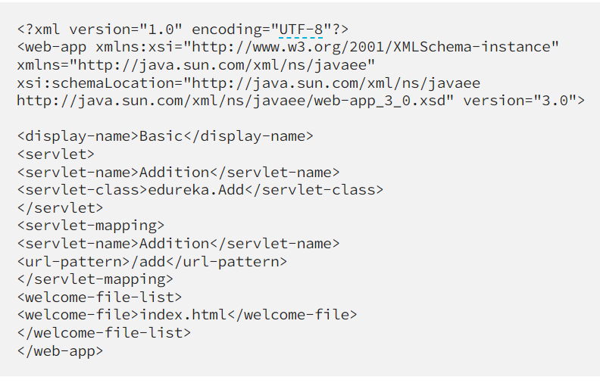
Example: add 2 numbers using servlets
Step 3: web.xml (The web.xml file will be present in the WEB-INF folder of your web content.)

Slide 24
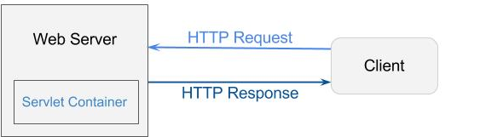
Some Terminologies
Servlet Container
Servlets are under the control of another Java application called a Servlet Container. When an application running in a web server receives a request, the Server hands the request to the Servlet Container – which in turn passes it to the target Servlet.
ServletConfig
An object of ServletConfig is created by the web container for each servlet. This object can be used to get configuration information from web.xml file.
If the configuration information is modified from the web.xml file, we don't need to change the servlet. So it is easier to manage the web application if any specific content is modified from time to time.

Slide 25
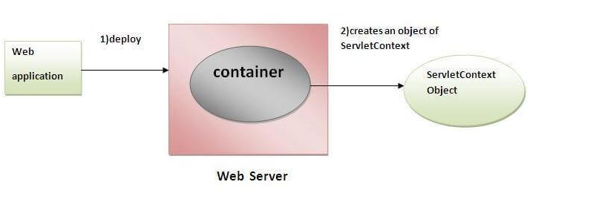
Some Terminologies
ServletContext Interface
An object of ServletContext is created by the web container at time of deploying the project. This object can be used to get configuration information from web.xml file. There is only one ServletContext object per web application.
If any information is shared to many servlet, it is better to provide it from the web.xml file using the <context-param> element.

Slide 26
Request Dispatcher
The RequestDispatcher interface provides the facility of dispatching the request to another resource it may be html, servlet or jsp. This interface can also be used to include the content of another resource also. It is one of the way of servlet collaboration.
There are two methods defined in the RequestDispatcher interface.
public void forward(ServletRequest request,ServletResponse response)throws ServletException,java.io.IOException
Forwards a request from a servlet to another resource (servlet, JSP file, or HTML file) on the server.
public void include(ServletRequest request,ServletResponse response)throws ServletException,java.io.IOException
Includes the content of a resource (servlet, JSP page, or HTML file) in the response.

Slide 27
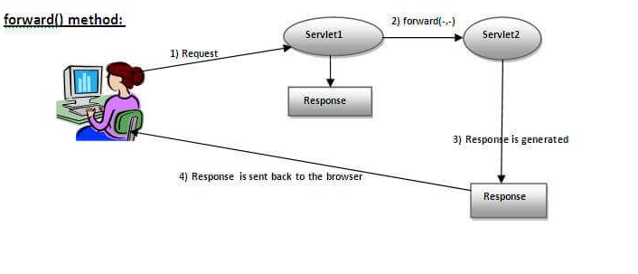
Forward()
response of second servlet is sent to the client. Response of the first servlet is not displayed to the user.
RequestDispatcher

Slide 28
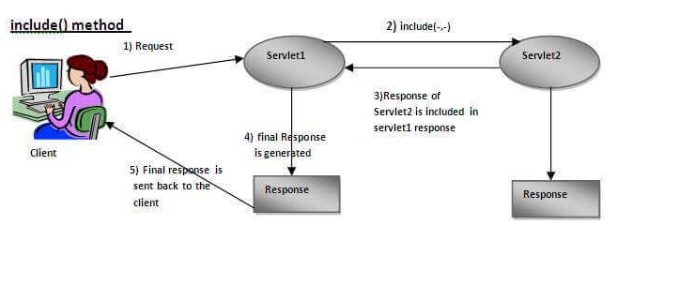
Include()
response of second servlet is included in the response of the first servlet that is being sent to the client.
RequestDispatcher

Slide 29
SendRedirect()
The sendRedirect() method of HttpServletResponse interface can be used to redirect response to another resource, it may be servlet, jsp or html file.
It accepts relative as well as absolute URL.
It works at client side because it uses the url bar of the browser to make another request. So, it can work inside and outside the server.
RequestDispatcher

Slide 30
Forward() vs SendRedirect()
Forward() | SendRedirect()
Forward is a server-side redirect. When a forward is invoked, it happens entirely on the server, and the client (typically a web browser) is not aware that it occurred. | sendRedirect() is a client-side redirect. It sends an HTTP response to the client with a new URL, instructing the client's browser to make a new request to that URL.
The URL in the client's browser remains unchanged. From the client's perspective, it appears as if they are interacting with the original URL. | The client's browser receives the new URL in the response and makes a fresh request to that URL. This change is visible in the browser's address bar.
The request and response objects are reused within the same request-response cycle. This means that a forward allows data to be shared between the source servlet and the target resource using request attributes. | Since it results in a new client request, sendRedirect() starts a new request-response cycle. Information cannot be directly shared between the original request and the redirected request.
Forwards are typically used for internal processing within the application, such as including common headers or footers, dispatching control to another servlet, or implementing MVC (Model-View-Controller) patterns. | sendRedirect() is typically used to direct clients to external resources, such as different websites or different web applications. It's also used when you want to explicitly change the URL visible to the client.

Slide 31
Session Tracking
Session Tracking is a way to maintain state (data) of an user. It is also known as session management in servlet.
Http protocol is a stateless so we need to maintain state using session tracking techniques. Each time user requests to the server, server treats the request as the new request. So we need to maintain the state of an user to recognize to particular user.

Slide 32
Session Tracking Techniques
There are four techniques used in Session tracking:
Cookies
Hidden Form Field
URL Rewriting
HttpSession

Slide 33
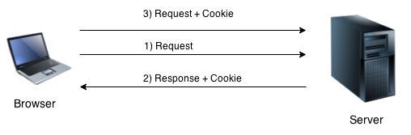
Cookies in Servlet
A cookie is a small piece of information that is persisted between the multiple client requests.
By default, each request is considered as a new request. In cookies technique, we add cookie with response from the servlet. So cookie is stored in the cache of the browser. After that if request is sent by the user, cookie is added with request by default. Thus, we recognize the user as the old user.
CookiesSession

Slide 34
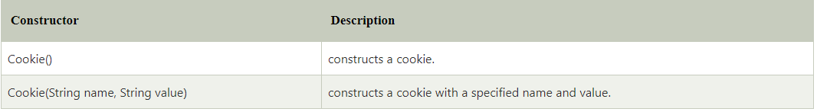
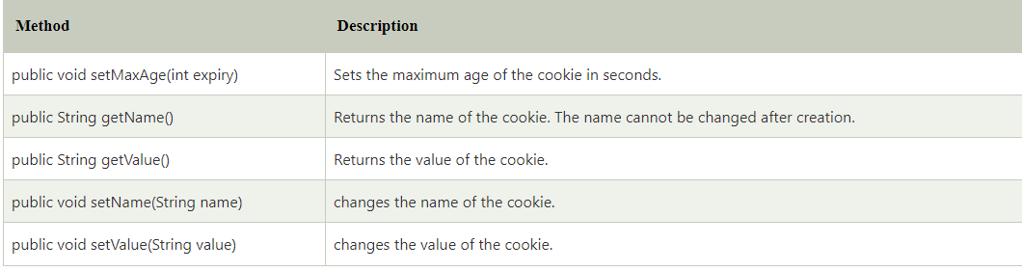
Cookie class & Methods

Slide 35
Hidden Form Field
In case of Hidden Form Field a hidden (invisible) textfield is used for maintaining the state of an user.
In such case, we store the information in the hidden field and get it from another servlet. This approach is better if we have to submit form in all the pages and we don't want to depend on the browser.
link

Slide 36
URL Rewriting
In URL rewriting, we append a token or identifier to the URL of the next Servlet or the next resource. We can send parameter name/value pairs using the following format:
url?name1=value1&name2=value2&??
When the user clicks the hyperlink, the parameter name/value pairs will be passed to the server. From a Servlet, we can use getParameter() method to obtain a parameter value.
RequestDispatcher

Slide 37
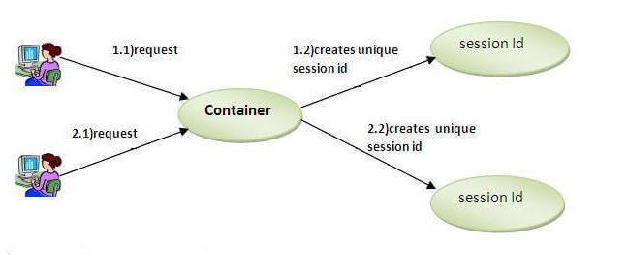
HttpSession interface
Container creates a session id for each user. The container uses this id to identify the particular user. An object of HttpSession can be used to perform two tasks:
bind objects
view and manipulate information about a session, such as the session identifier, creation time, and last accessed time.
HhttpSession

