Slide 1


Slide 2
ABOUT
HTML stands for Hyper Text Markup Language , it is a complete code package which allows the user to create web pages . It includes text and graphics .
HYPERTEXT : It is the text used to link various web pages . It is the text on a web page , which on clicking opens a new web page .
MARK-UP : It means highlighting the text either by underlining or displaying it in different colors , or both .
LANGUAGE : It refers to the way of communication between web pages , which has its own syntax and rules .

Slide 3
CHARACTERISTICS
Some of the advantages of HTML are :
Easy to understand and modify .
Provides a more flexible way to design web pages along with text .
Added graphics , video and sound make the website more interactive .
Links can also be added to help readers to browse through information of their interests .
Web pages designed in HTML are widely used in marketing .
One can display HTML documents on any platform such as Macintosh, Windows , Unix , MacOS etc.

Slide 4
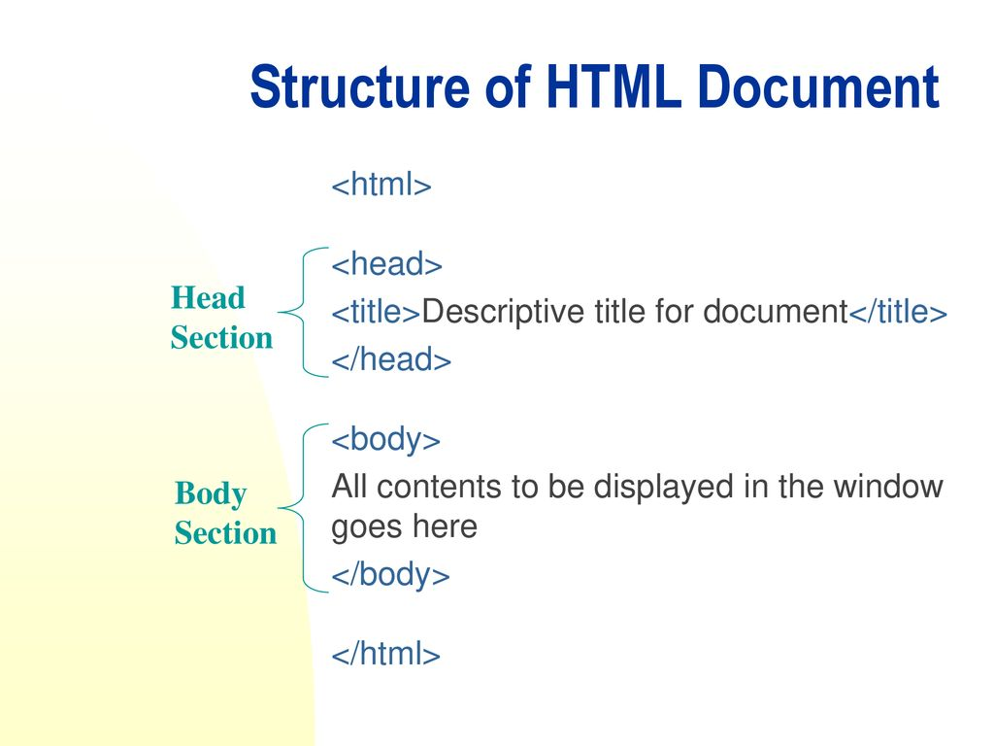
HTML DOCUMENT STRUCTUTE
The general structure of HTML has two sections : Head and Body .
HEAD SECTION : The head section contains title , meta , link tags .
BODY SECTION : The body section includes text , graphics , and other HTML elements that provide control and formatting of a page .

Slide 5

DESCRIBING TAGS
The tags are not case sensitive .
Every opening tag must have a closing tag . The closing tag has a forward slash (/) . However , some tags only have an opening tag like img , video tags .
The HTML document starts with <HTML> tag and ends with </HTML> tag , which identifies that it is a standard HTML document . If the commands are not enclosed in tags then a web browser will assume the commands as text .
The HEAD tag is the HTML document header . It lies above the <BODY> tag and just below the <HTML> tag . It contains information about the web page , but you will not be able to see it in browser window . It contains no text within itself .

Slide 6
DESCRIBING TAGS CONTD.
The <TITLE> tag has to be given within the <HEAD> tag . It contains the title of the document . The title is displayed the title bar at the top of the browser window and not inside the window itself . The title should be short and include less than 64 characters .
The <BODY> tag contains the text which gets displayed on the web page along with other tags and attributes . In the Body tag, we use formatting elements , images , heading , list , hypertext links to enhance the appearance of a web page .

Slide 7


DOWNLOADING CODE
EDITOR
We will be using Visual Studio Code as the code editor for HTML .
Link to download : https://code.visualstudio.com/download
After the downloading is complete we are all set to start with making our own website .

Slide 8
WORKING WITH TAGS
A tag comprises of text enclosed in angle brackets < > . If we do not use brackets , then the web browser will assume the command as text . These tags are also known as elements .
All tags have their own attributes and default values . Each tag in HTML follows specific rules and syntax .
These tags are not case sensitive . For example , <tag name> and <TAG NAME > will have the same effect .
The HTML elements can be categorized as :
Container Elements
Empty Elements

Slide 9
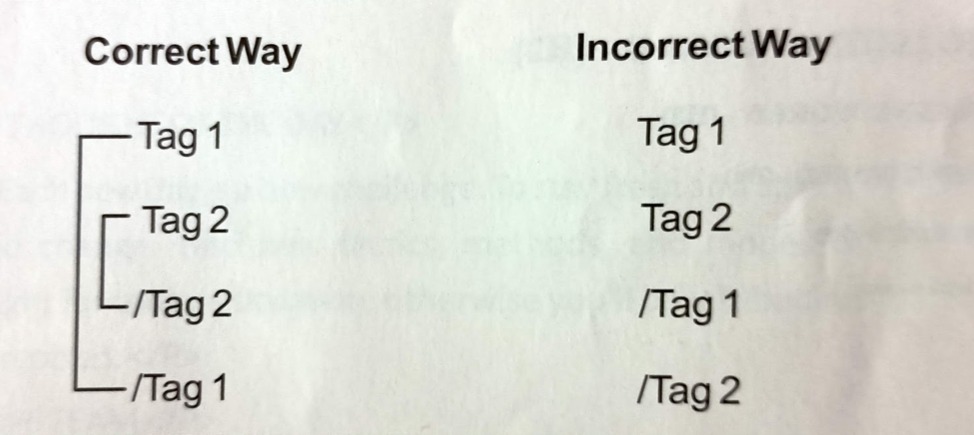
USING TAGS
While using tag sets as containers , we should always balance the flow . We should keep the containers nested that means embedded within each other .

Slide 10
CONTAINER ELEMENTS
TYPES
HEADING
This tag is used to define different heading levels in an HTML document. There are six heading levels ,H1 to H6 . H1 being of largest size and then in decreasing order till H6 . It is not essential to use these heading levels in hierarchy . These tags are written inside body tag .
<!DOCTYPE html>
<html lang="en">
<head>
<title>Using Heading </title>
</head>
<body>
<h1>This is heading -H1 ..</h1>
<h2>This is heading -H2 ..</h2>
<h3>This is heading -H3 ..</h3>
<h4>This is heading -H4 ..</h4>
<h5>This is heading -H5 ..</h5>
<h6>This is heading -H6 ..</h6>
</body>
</html>

Slide 11
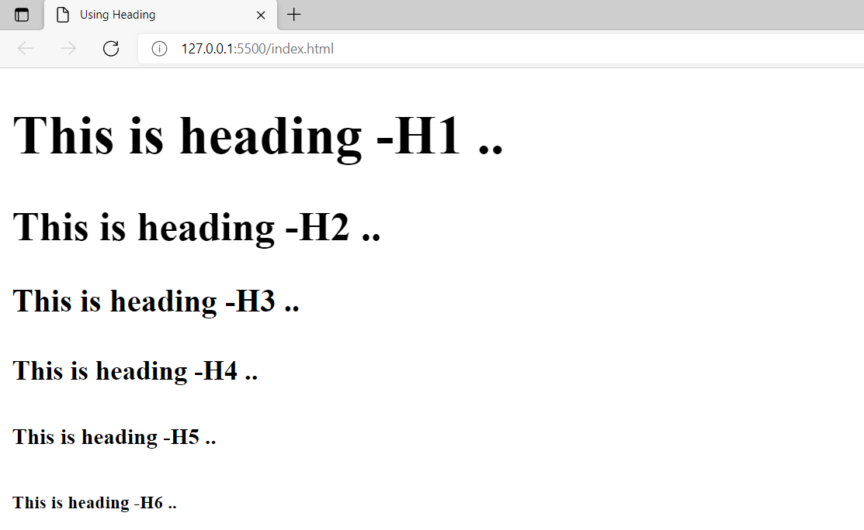

Slide 12
PARAGRAPH
To display a long piece of text on a web browser , paragraph element <p> is used , which marks a block of text as a paragraph . To mark the end of a paragraph </p> element is used .
SYNTAX :
<p> ---- Starts a new paragraph
<p align=“center”> ---- Aligns the text in center
<p align=“right”> ---- Aligns the text to the right side
<p align=“left”> ---- Aligns the text to the left side
<p align=“justify”> ---- Aligns the text from both left and right margins
CENTER TAG
The Center tag is used to align your text to the center of the page . It automatically inserts a line break after the closing center tag .
COMMENTS IN HTML
Sometimes you want to write notes for yourself in an HTML document , but don’t want them to be displayed in the browser window .
To do so , type the following syntax :
<!-- comment to write -->

Slide 13
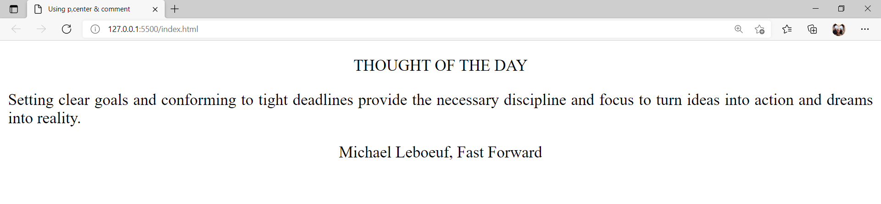
<!DOCTYPE html>
<html lang="en">
<head>
<title>Using p,center & comment</title>
</head>
<body>
<p align='center'>THOUGHT OF THE DAY</p>
<p align='justify'>Setting clear goals and conforming to tight deadlines provide the necessary discipline and focus to turn ideas into action and dreams into reality.</p>
<!--Center tag is used for writer's name -->
<center>Michael Leboeuf, Fast Forward</center>
</body>
</html>

Slide 14
CHANGING THE APPEARANCE
OF TEXT
FONT STYLE TAGS : These tags change the appearance of text . They are also known as physical markup .
BOLD: The bold tag is used , when you need to emphasize the text .
Syntax: <b>Write text here </b>
ITALIC: This element marks up the text in italic style .
Syntax: <i> Write text here </i>
UNDERLINE: This tag underlines the text .
Syntax: <u> Write text here </u>
STRIKE: This element draws a line through the middle of the text .
Syntax: <s>Write text here </s>
SUBSCRIPT AND SUPERSCRIPT: To display text to number in subscript and superscript .
Syntax: <sub>Write text here </sub> , <sup>Write text here</sup>

Slide 15
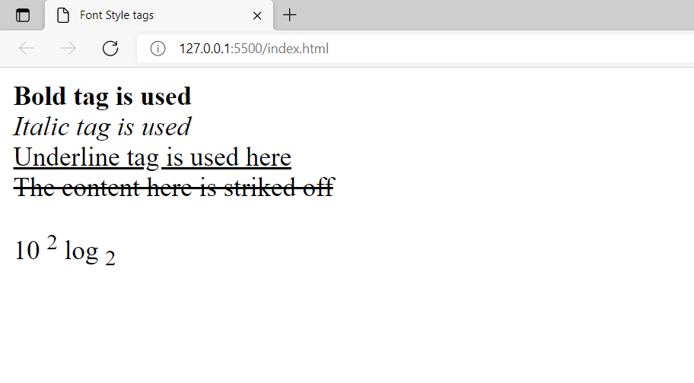
<!DOCTYPE html>
<html lang="en">
<head>
<title>Font Style tags </title>
</head>
<body>
<b>Bold tag is used</b><br>
<i>Italic tag is used</i><br>
<u>Underline tag is used here</u><br>
<s>The content here is striked off</s><br>
<p>10 <sup>2</sup> log <sub>2</sub> </p>
</body>
</html>

Slide 16
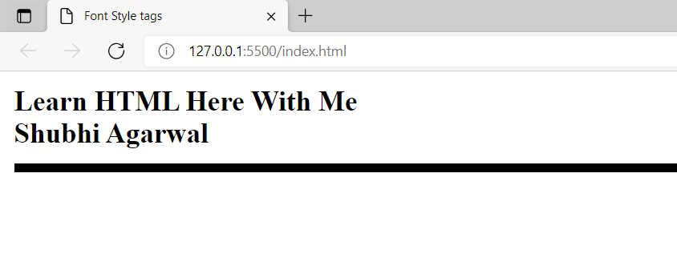
EMPTY ELEMENT TYPES
BR (Break) : This tag breaks a line and displays the proceeding text from the next line , without giving any space between the two lines . It should be given at the end of the line after which a new line is required .
Syntax: <br>
HR : It is used as a separator between blocks of text . The <hr> element draws a horizontal line across the page . The size attribute of <hr> is given values in terms of pixel .
The color attribute helps to set colour of line .
<!DOCTYPE html>
<html lang="en">
<head>
<title>Font Style tags </title>
</head>
<body>
<b>Learn HTML Here With Me </b>
<br>
<b>Shubhi Agarwal</b>
<hr size="5" color="black">
</body>
</html>

Slide 17
CHARACTER ENTITIES
Some characters are reserved in HTML . To display such reserved characters , we use the Character entities in the HTML source code .
&lt : This entity name displays <(less than) sign on the browser .
&gt : This entity name displays >(Greater than) sign on the browser .
&amp : This entity name displays & sign on the browser .
&nbsp : This entity displays blank space on the browser .
To learn more about HTML entities visit :
https://www.w3schools.com/html/html_entities.asp

Slide 18


