Slide 1


Slide 2



USING LIST AND IMAGES
Bullets are the most efficient way of presenting information in a precise manner . HTML supports various elements to create list for displaying items inn a specific order .
The types of list that HTML provides are :
Unordered List
Ordered List
Definition List
Directory List
Menu List

Slide 3
<UL> UNORDERED LIST
The unordered list is used when the list of items are not to be displayed in any particular order . The browser will display the bullets before the list of items . The list begins and ends with <ul> and </ul> tags respectively .
<LI> LIST ITEM
To display listed items contained in any of the two list types i.e., Unordered and Ordered list , each item in the list is marked using <li> tag . The <li> tag is an empty element that does not require a closing tag.
1. To make an unordered list , type <ul> before the list .
2. Enter the <li> (list items) tag followed by the individual item .
3. At the end of the entire list , type </ul>

Slide 4
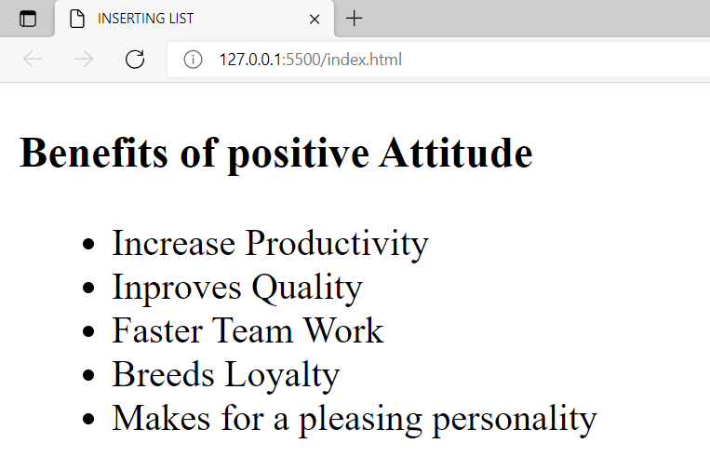
<!DOCTYPE html>
<html lang="en">
<head>
<title>INSERTING LIST </title>
</head>
<body>
<h3>Benefits of positive Attitude </h3>
<ul>
<li>Increase Productivity </li>
<li>Inproves Quality </li>
<li>Faster Team Work</li>
<li>Breeds Loyalty </li>
<li>Makes for a pleasing personality</li>
</ul>
</body>
</html>

Slide 5
UL ELEMENT – TYPE ATTRIBUTE
The “type” attribute specifies the type of bullet that can be used with <ul> tag . Three values that can be defined with <ul> tag are disc , square and circle . Default value for <ul> tag is disc .
DISC ---- Specifies a filled circle
CIRCLE ---- Specifies a non-filled circle
SQUARE ---- Specifies a filled square bullet

Slide 6
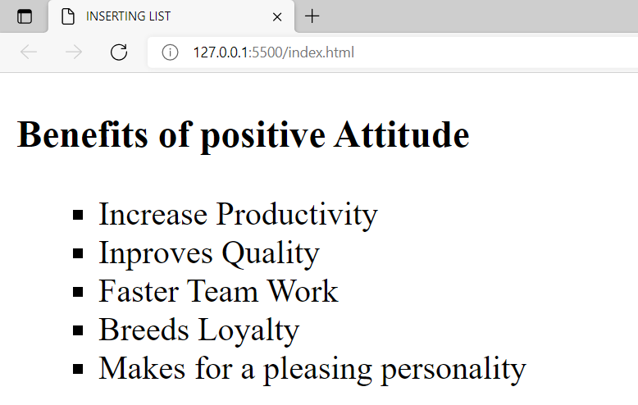
<!DOCTYPE html>
<html lang="en">
<head>
<title>INSERTING LIST </title>
</head>
<body>
<h3>Benefits of positive Attitude </h3>
<ul type="square" >
<li>Increase Productivity </li>
<li>Inproves Quality </li>
<li>Faster Team Work</li>
<li>Breeds Loyalty </li>
<li>Makes for a pleasing personality</li>
</ul>
</body>
</html>

Slide 7
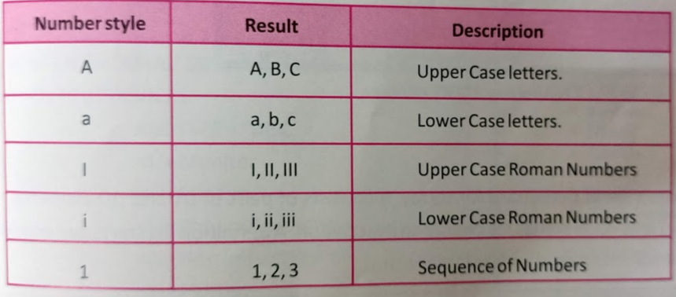
<OL> ORDERED LIST
The ordered list is used to display the list of items in a specific order . By default , numbers are displayed in a web browser when an ordered list is used but the style can be changed using the Type attribute . To specify the item , Value attribute is used . Ordered list automatically starts with the number 1, but you can start the list with a different number using Start attribute .

Slide 8
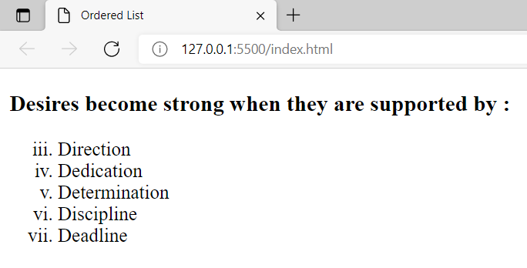
<!DOCTYPE html>
<html lang="en">
<head>
<title>Ordered List</title>
</head>
<body>
<h3>Desires become strong when they are supported by : </h3>
<ol type="i" start="3">
<li>Direction</li>
<li>Dedication</li>
<li>Determination</li>
<li>Discipline</li>
<li>Deadline</li>
</ol>
</body>
</html>

Slide 9
DEFINITION LIST
A definition list <dl> is used to present a list of definitions for terms . It consists of pairs of dt and dd elements . <dt> element is used to define the term part and <dd> stands for definition description . A definition list starts and ends with a <dl> tag .
<!DOCTYPE html>
<html lang="en">
<head>
<title>Definition List</title>
</head>
<body>
<h3>Definition List</h3>
<dl>
<dt>Cascading Style Sheets</dt>
<dd>Style sheets are used to provide presentational suggestions .</dd>
<dt>Content Management</dt>
<dd>Process of collecting , managing and publishing content to media .</dd>
</dl>
</body>
</html>

Slide 10
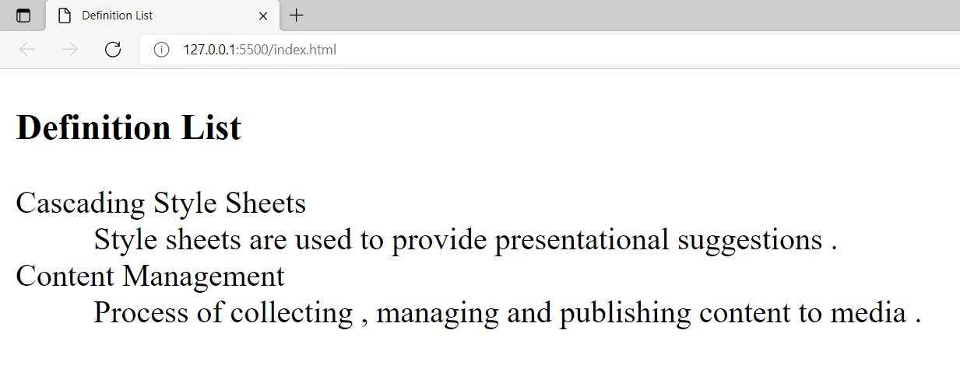

Slide 11
NESTED LIST
When a list is created within a list it is called a nested list . This means that one set of elements can be embedded within another set of elements .
<!DOCTYPE html>
<html lang="en">
<head>
<title>nested list</title>
</head>
<body>
<h3>Nested list</h3>
<ol>
<li>Input Devices</li>
<ul type="sqaure">
<li>Keyboard</li>
<li>Mouse</li>
<li>Scanners</li>
<li>Joystick</li>
<li>Digital Camera</li>
</ul>
<li>Output Devices</li>
<ul type="circle">
<li>Monitor</li>
<li>printer</li>
<li>Plotter</li>
<li>Impact Printer</li>
</ul>
</ol>
</body>
</html>

Slide 12
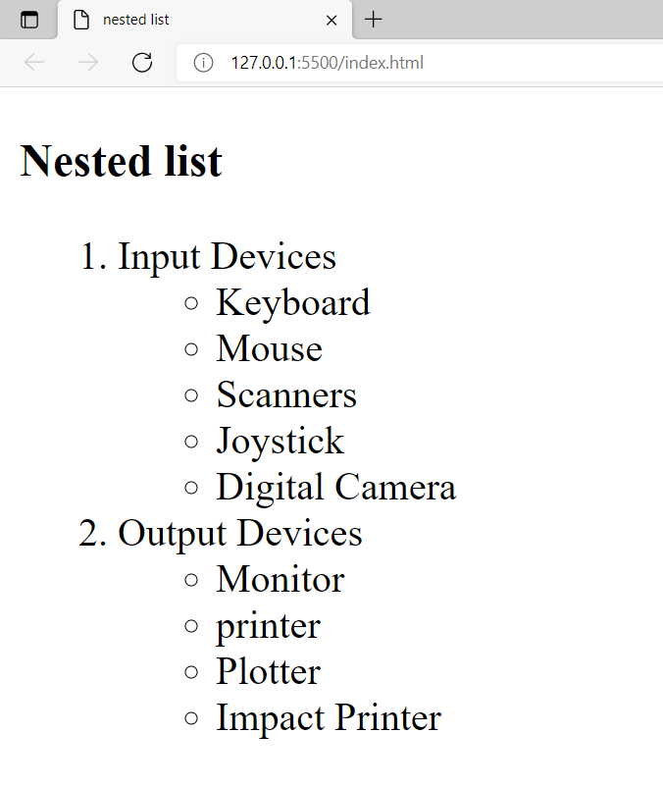

Slide 13
INSERTING IMAGES
Besides text , you can display graphics , drawings , paintings , charts , maps or photograph on the web page . These images make the web page more appealing . Images can be used as a navigational tool to help users browse through the internet . The web browser supports various graphic formats .
The widely used formats are GIF and JPG formats .
To add the image to a web page , type the tag <img src=“image.jpg” alt=“Image is here” >
While specifying the image file , one should be well aware of its location, is the location is wrong the alt part will be shown in place of image .
Image is an empty element that has various attributes .

Slide 14
ALIGNING IMAGES
This attribute aligns the image according to the value assigned to it . If a value is not specified with Align , then navigator uses button by default .
ALIGN TO LEFT
ADDING BORDER TO IMAGE
<html>
<head>
<title>Image Align</title>
</head>
<body>
<img src=“SantaWorkshop.Jpg”Align=“Left”>
The picture is Left Align<br>
</body>
</html>
<html>
<head>
<title>Adding Border</title>
</head>
<body>
<center><img src = “SantaWorkshop.gif” border = 5 > </center>
</body>
</html>

Slide 15


