Slide 1
Guided Capstone Project
Big Mountain Resort Ticket Prices
By: Shubhangi Gautam

Slide 2
Problem Identification
Target: Increase overall revenue of the Big Mountain Resort.
by increasing the ticket prices.
decreasing the operational cost.

Slide 3
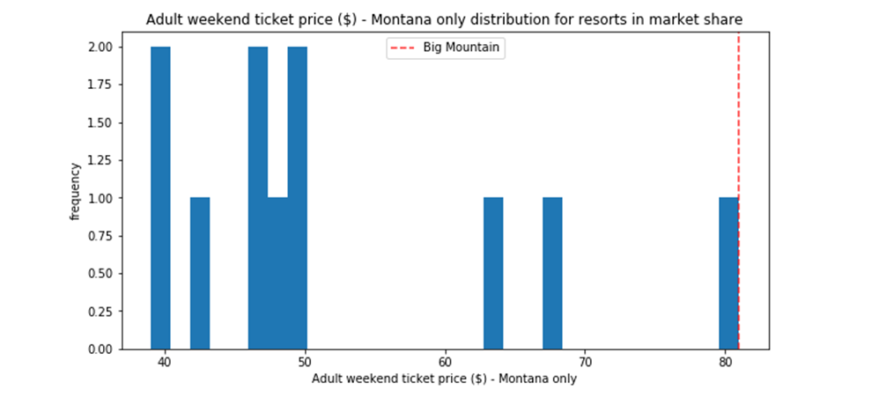
Ticket Price of Big Mountain in Montana
It has the highest ticket price among its competitors in the state.

Slide 4
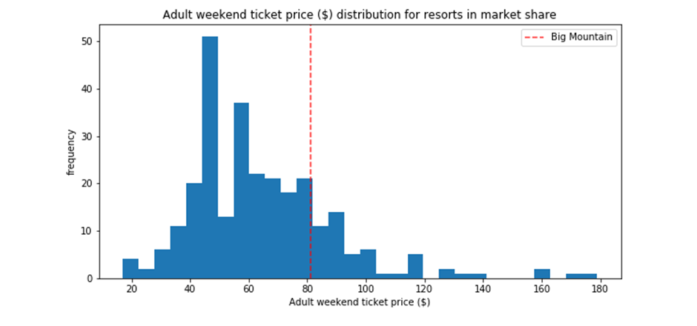
Ticket Price of Big Mountain Compared to Other Resorts

Slide 5
Modelling Output
Model is predicting the ticket price to almost $94 - almost a 16% increase from the current ticket price.

Slide 6
Other Modelling Outputs
People will pay more for certain facilities.
Increase the vertical drop, chair lift, snow making area and runs shows potential for a significant increase in ticket price and revenue for the resort.

Slide 7
Conclusion
Resort is the most expensive among the state.
Resort could charge a ticket price of $89 - a 10% increase from current price

