Slide 1
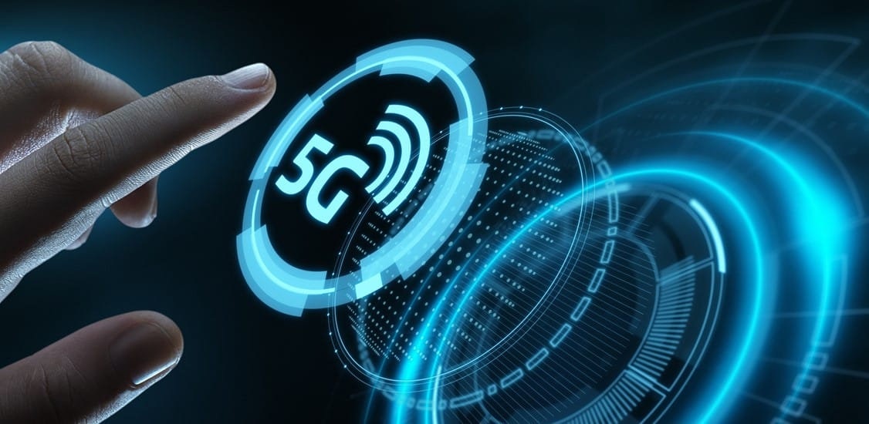
5G Technology
Presented by : - Shubhi Verma

Slide 2
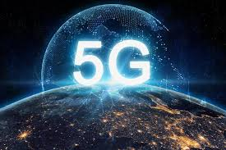
Index
Introduction
Evolution of different generation
5G vision
Need of 5G
Architecture
Hardware & Software required
Features
Advantages & disadvantages

Slide 3
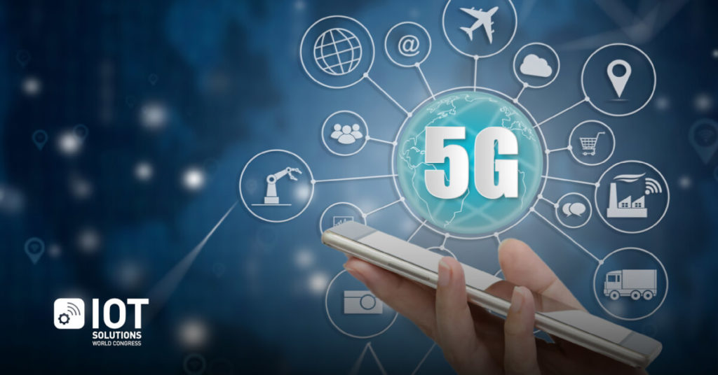
Introduction
In this presentation we will discuss 5G Technology
5G Technology stands for 5th generation technology .
5G Technology will change the means to use cell phones with very high bandwidth

Slide 4
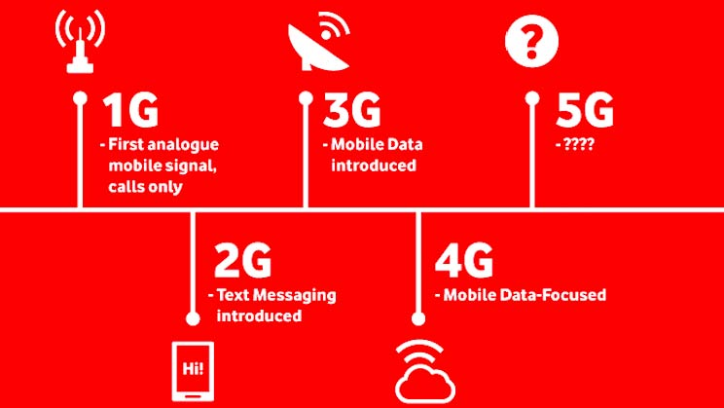
10X- 100X connected Devices
1000X mobile data
5X lower latency
10X-100X end-user Data Rates
2G
3G
4G
5G
10X Battery life for low power devices

Slide 5
5G vision
5G envisions to design a real wireless world, that is free from obstacles of the earlier generations.
This requires an integeration of networks
This technology is meant to deliver
Higher multi-Gbps peak data speeds
Ultra low latency, more reliability
Massive network capacity
Increased availability
More uniform user experience to more users.
Higher performance and improved efficiency empower new user experiences and connects new industries.

Slide 6
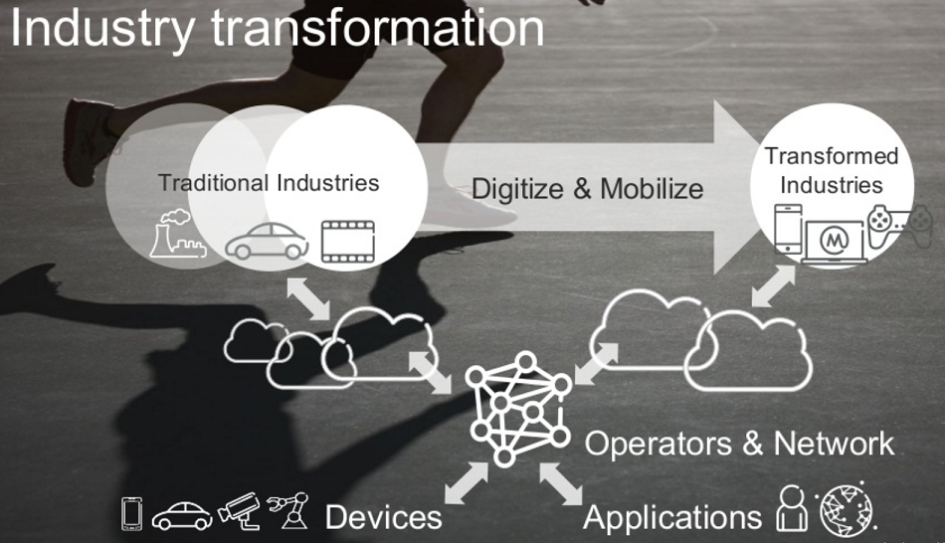
Why we need 5G

Slide 7
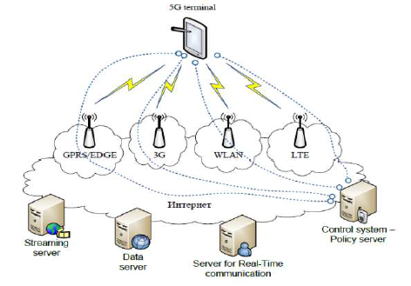
ARCHITECTURE

Slide 8
ARCHITECTURE
GPRS(General packet radio service)
It is to transmit data upto 60 kbps.
It is also consume less battery during sending & reciving mail or to browse internet.
EDGE(Exchange data rate for GSM evoluton)
It is advanced version of GPRS.
It provide data speed of 473kbps.
WLAN(Wireless LAN)
It provides short range high speed mobile data device signels.
LTE(Long term evolution)
It stand for high speed data transmitted for mobile network.
Its speed upto 100mbps.

Slide 9
Hardware & Software of 5G
5G Hardware
Uses UWB(Ultra wide band) networks with higher BW at low energy level.
BW is of 4000mbps, which is 400 times faster than todays wireless network
5G Software
LAN
WWWW(World Wide Wireless Web)
Unified IP
Encryption

Slide 10
Advantages & Disadvantages
Long battery life
Higher data rates
More efficient
High security
Developing infrastructure needs high cost

Slide 11
THANK YOU

