Slide 1

prideBnB
Travel With Pride
NIU-HACKATHON 2022
TEAM C.O.D.E

Slide 2


Prospects of prideBnB
01
Motive of App
Why prideBnB?
Societal Impacts
02
Technicalities
Working of prideBnB
Features
Enhancements Proposed
03
Team Roles
Workflow Management
Roles and Responsibility

Slide 3
Problems Faced
We’re not welcome — or safe — in all parts of the world.
People make a lot of assumptions about us.
We worry a lot about coming out — or being outed.
Stats and Reviews by Booking.com
34 percent of LGBTQ+ travelers from India would like increased breadth of information and visibility on a destination’s LGBTQ+ friendliness, including local laws, cultural information, hate crime statistics and religious sensibilities.

Slide 4

An app to assist LGBTQ+ community to find hotels and destinations with good hospitability.
It gives curated list of destinations based on rating where LGBTQ+ communities are welcomed.
It is important to ensure safety and the locations recommended here are safe.
It helps to be a part of greater facilitator in travel and tourism needs of LGBTQ+ communities.

Slide 5
Why prideBnB?
Categories
Maps
Community
prideBnB provides different categories of hotels, beaches, marriage destinations which are LGBTQ friendly.
Get pin point map locations and contact information of the hotels
One place for planning tour and travel across India.
Reviews
Popular Results
Find reviews of hotels , resorts, beaches about their hospitality.
Give ratings too
The Results are indexed based on ratings given to the particular hotels and destinations

Slide 6




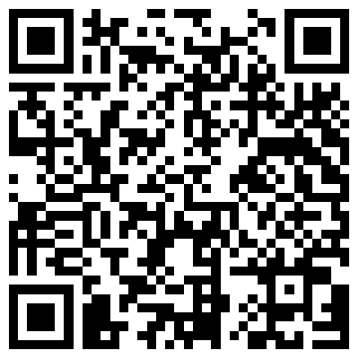
prideBnB
App to assist LGBTQ+ community to find hotels and destinations
with good hospitability.
Travel With Pride
It gives curated list of destinations based on rating where LGBTQ+ communities are welcomed.
It is important to ensure safety and the locations recommended here are safe.
It helps to be a part of greater facilitator in travel and tourism needs of LGBTQ+ communities.
34 percent of LGBTQ+ travelers from India would like increased breadth of informatioN on a destination’s LGBTQ+ friendliness
including local laws, cultural information, hate crime statistics and religious sensibilities.
Travel With Pride
NIU- HACKATHON
TEAM C.O.D.E

Slide 7
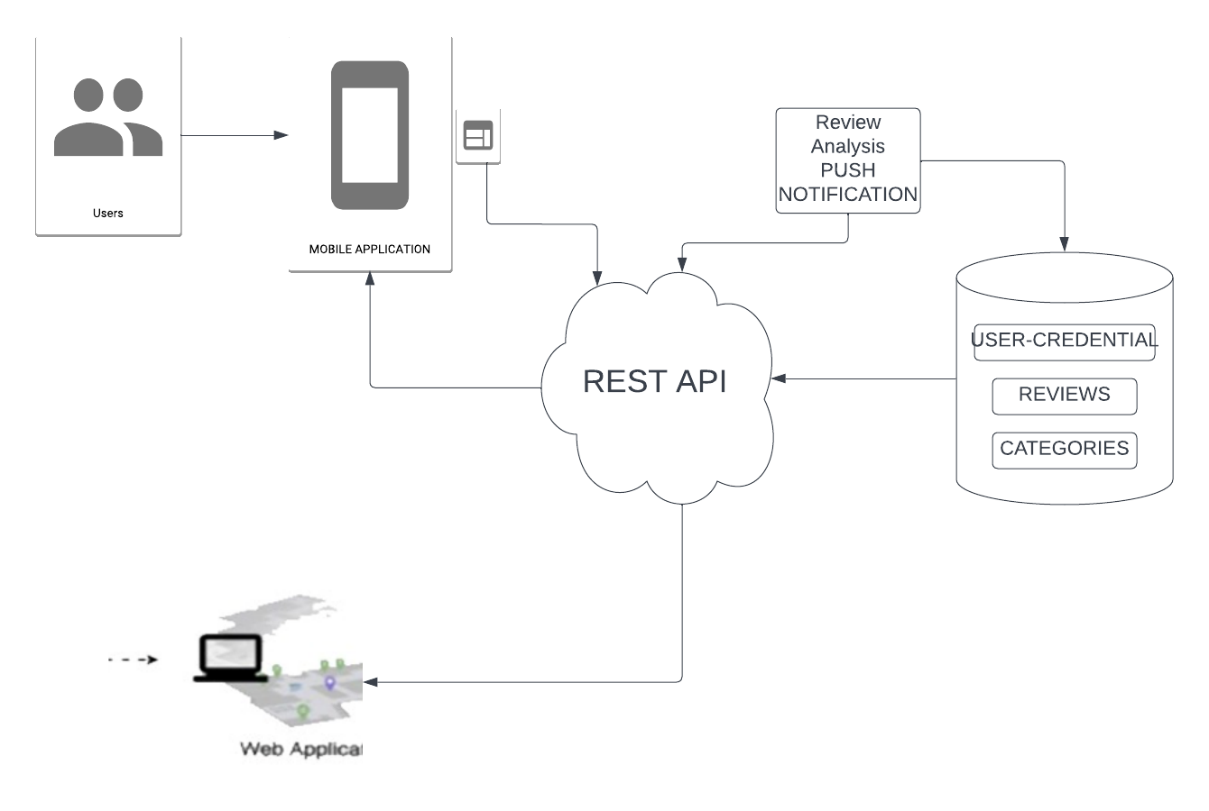
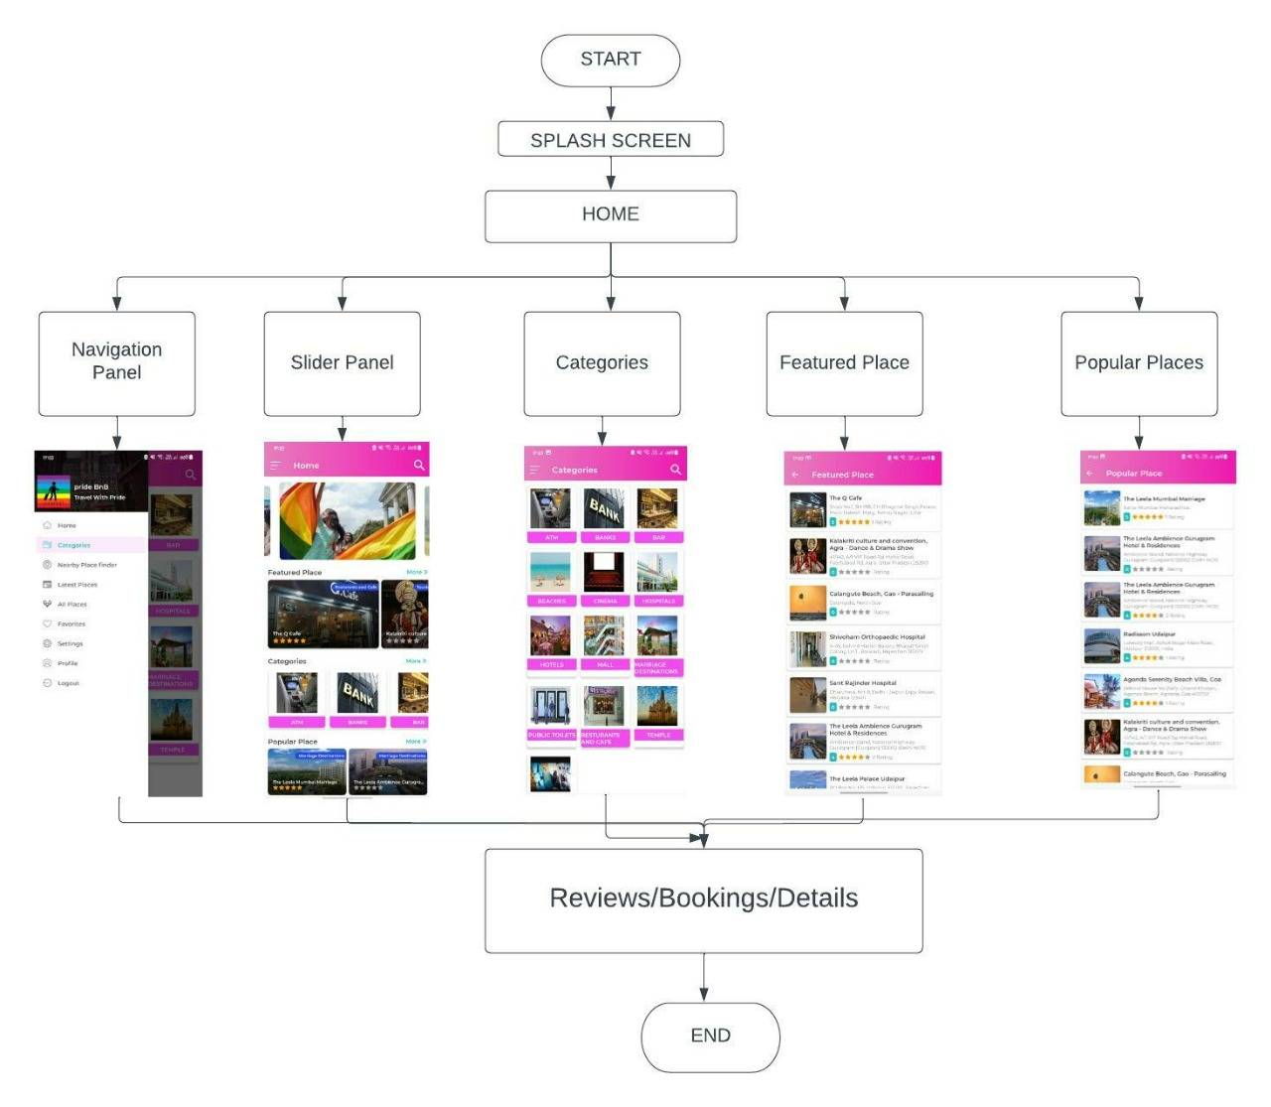
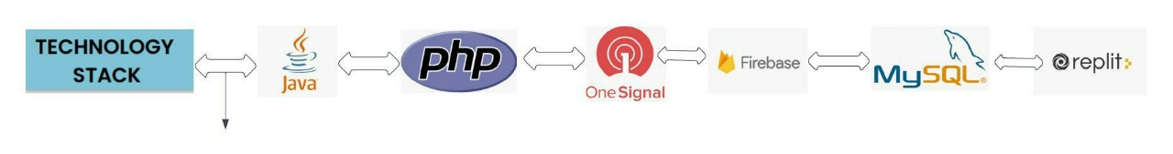
TECH STACK
WORKFLOW DIAGRAM
Feature of prideBnB
create User Profile, explore various categories of Hotels, Hospitals, Places and
destinations.
Search and get the curated results of places based on ratings and review.
Apply various filters to get desired result. Get information as such reviews,
ratings and location.
Get direction to booking of preferred location.
Tap and know about the LGBTQ+ rights in different states of India.
Notes:
Feature of prideBnB
create User Profile, select "I identify as" option and explore.
Explore various categories of Hotels, Hospitals, Places and destinations.
Search and get the curated results of places based on ratings and review.
Apply various filters to get desired result.
Get information as such reviews, ratings and location.
Get direction to booking of prefered location.
Tap and know about the LGBTQ+ rights in different states of India.
Write reviews and be a guide to others.

Slide 8

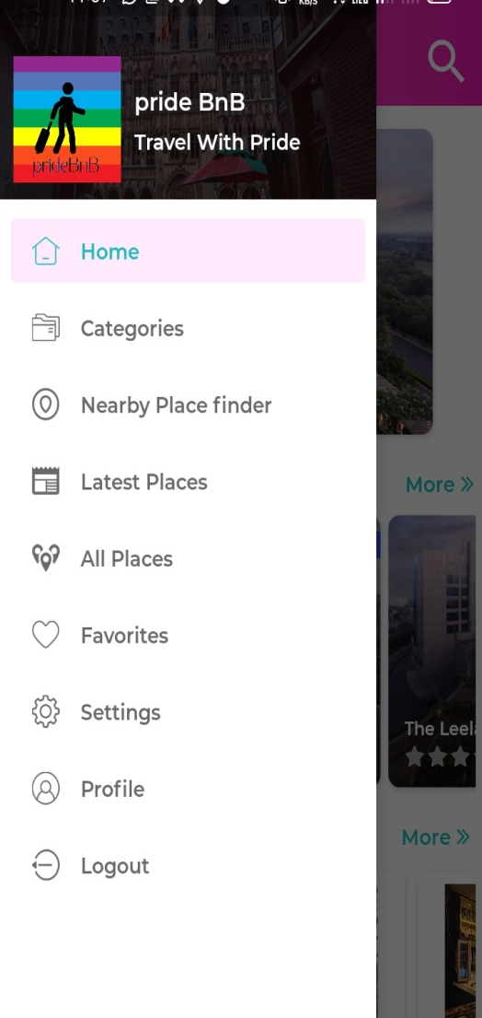
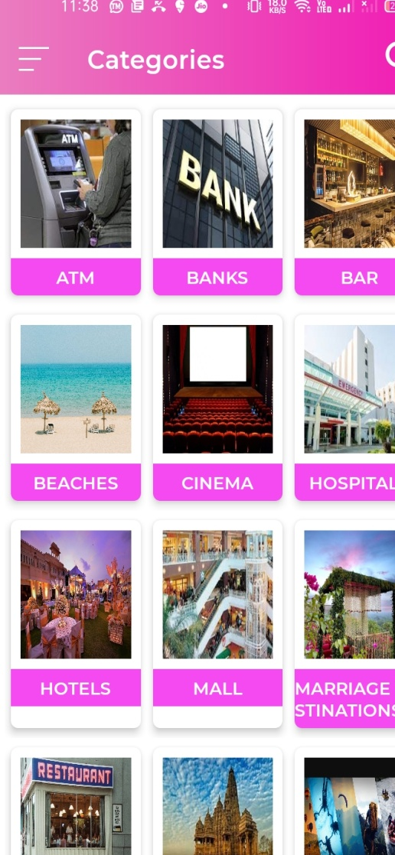
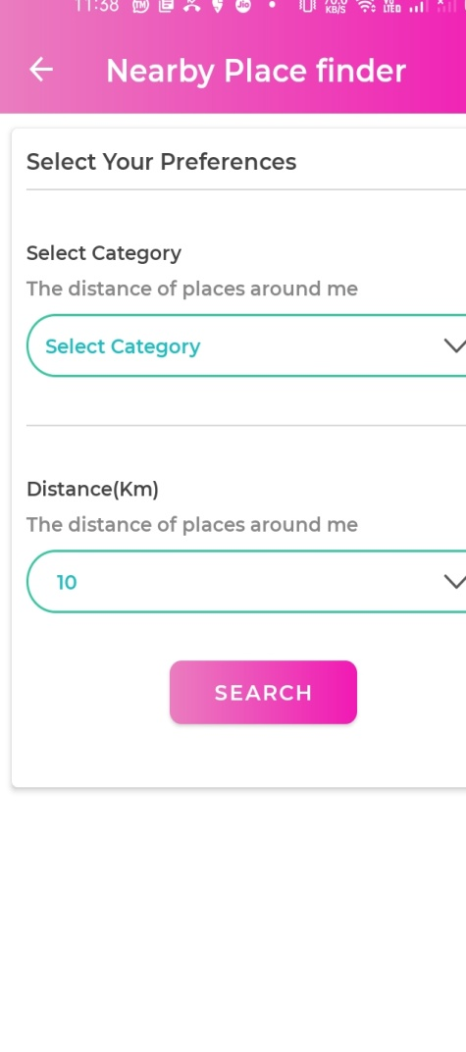
Categories
USERS
prideBnB provides different categories of hotels, beaches, marriage destinations which are LGBTQ friendly.
prideBnB users can get information on LGBTQ+ friendliness of a location
Maps
HOTELS
Get pin point map locations and contact information of the hotels
Hotel owners can increase their hospitality and reach
Reviews
REVENUE
Find reviews of hotels , resorts, beaches about their hospitality.
Give ratings too
Revenue can be generated by indexing hotels, Ads, booking directions
Popular Results
Popular Results
prideBnB
The Results are indexed based on ratings given to the particular hotels and destinations
Increase safety of travels of LGBTQ+ community

Slide 9

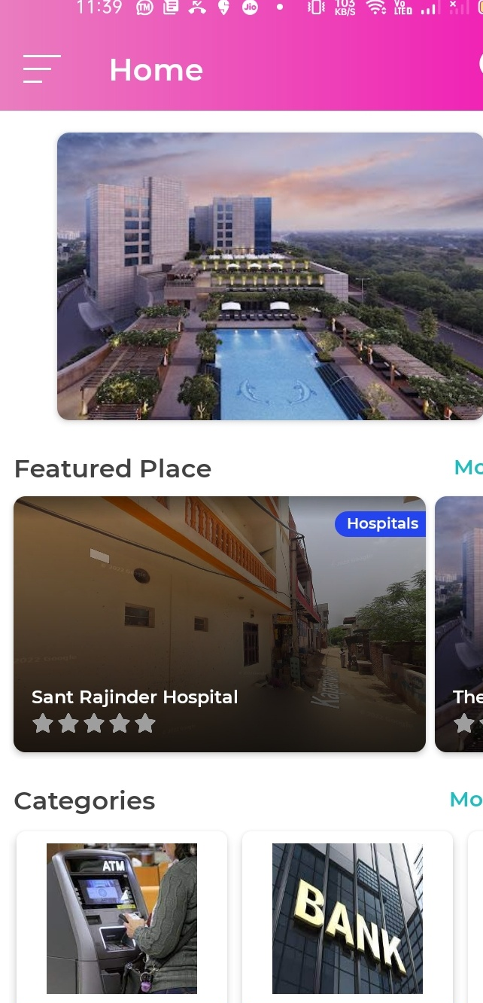


Slide 10

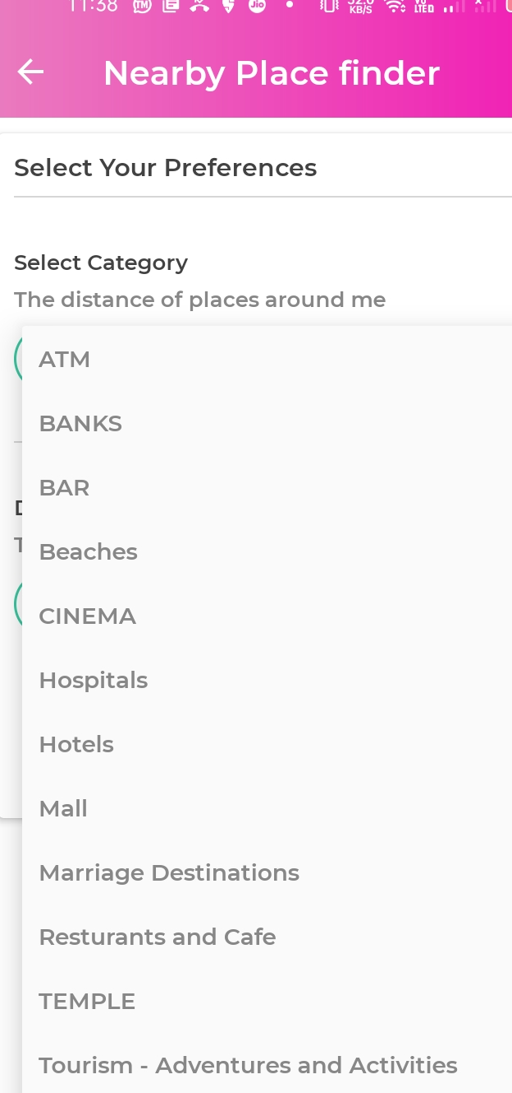
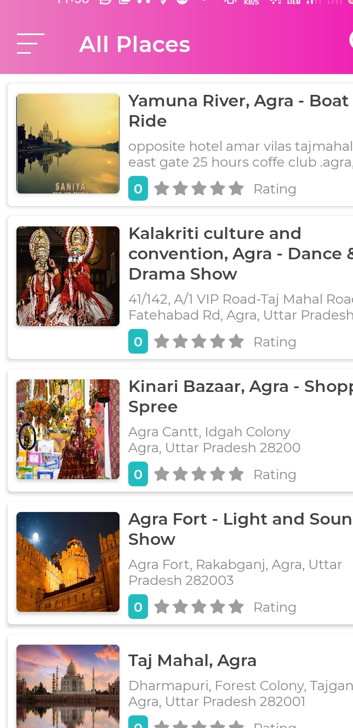

Slide 11
Technology Stack Used
Android-JAVA
PHP
One Signal for push notifications
Firebase login
MySQL
Cpanel- Dashboard
Domain Provider- freenom

Slide 12
THANK YOU
Team C.O.D.E

