Slide 1
DIWALI SALES
CUSTOMER & REVENUE ANALYTICS
DATA → INSIGHT → ACTION
A data-driven business intelligence report
SALES PERFORMANCE
Customer segmentation • Regional performance • Product demand • Growth opportunities
Prepared using the supplied Jupyter Notebook and sales dataset

Slide 2
Executive summary
Key findings from the customer and sales analysis
TOTAL REVENUE
UNIQUE CUSTOMERS
ORDER QUANTITY
AVERAGE CUSTOMER AGE
₹10.62 Cr
3,755
28,007
35.4 years
Female customers account for the largest revenue share (₹7.43 Cr).
Customers aged 26–35 form the highest-revenue age segment.
Uttar Pradesh leads state revenue, while the Central zone leads zonal revenue.
Food is the highest-revenue product category.
Government employees record the highest average transaction amount by occupation.
DIWALI SALES ANALYTICS • PYTHON / PANDAS
02

Slide 3
Project scope & methodology
Analytical scope, preparation steps and metric definitions
Dataset: 11,251 transaction records and 14 retained source columns after removing the unused unnamed field.
Tools: Python, pandas, NumPy, Matplotlib and Seaborn.
Preparation: standardized text fields and mapped marital-status codes to Married / Unmarried.
Revenue = sum of Amount; order volume = sum of Orders; customer count = distinct User_ID.
Average order value (AOV) = total revenue divided by total Orders within each group.
Data quality: 12 records have missing Amount values; these are excluded from revenue totals.
DIWALI SALES ANALYTICS • PYTHON / PANDAS
03

Slide 4
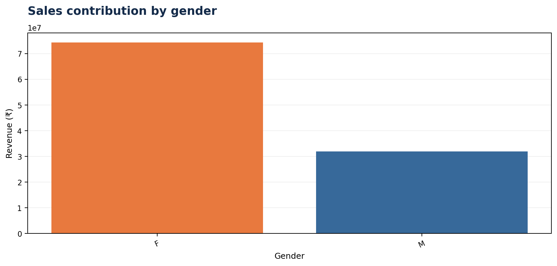
Customer profile | Gender
Female customers lead both revenue contribution and order volume
Interpretation
Revenue leader: Female customers.
Share of total revenue: 70.0%.
Order volume: 19,568.
Action: test audience-specific campaigns and compare conversion rates and basket size across segments.
DIWALI SALES ANALYTICS • PYTHON / PANDAS
04

Slide 5
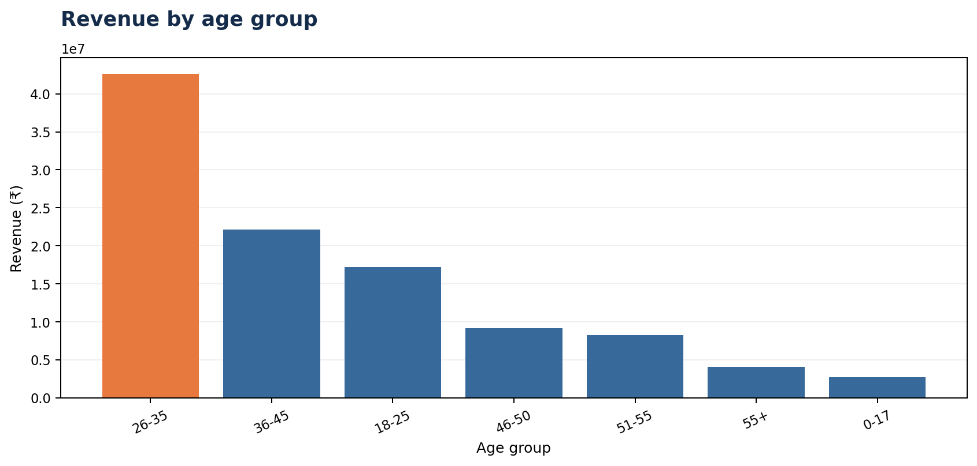
Customer profile | Age
Customers aged 26–35 generate the highest revenue
Interpretation
Top revenue segment: ages 26–35.
Revenue: ₹4.26 Cr (40.1% of total).
Mean age in the dataset: 35.4 years.
Most represented individual age: 30 (397 distinct customers).
Action: prioritize relevant offers for this segment while monitoring performance among older customers.
DIWALI SALES ANALYTICS • PYTHON / PANDAS
05

Slide 6
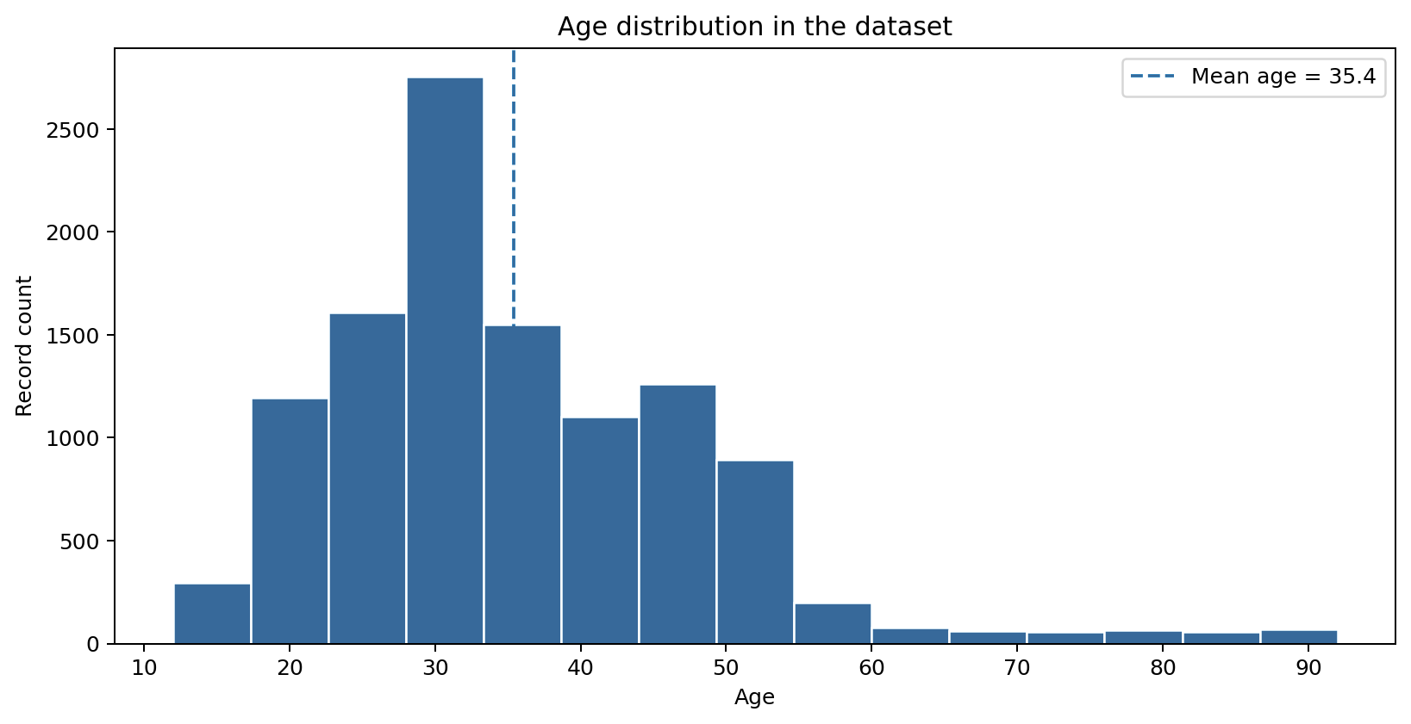
Customer profile | Age distribution
Age distribution provides additional context for segment-level revenue
Interpretation
Mean age across source records: 35.4 years.
Age 30 is the most represented individual age (397 distinct customers).
The histogram counts records, so repeat customer IDs may appear more than once.
For customer-level demographic estimates, aggregate or deduplicate by User_ID.
DIWALI SALES ANALYTICS • PYTHON / PANDAS
05

Slide 7
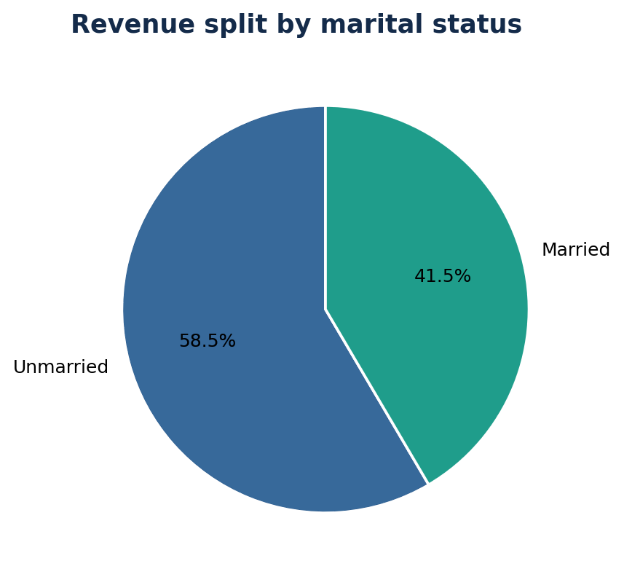
Customer profile | Marital status
Unmarried customers account for the greater revenue and order share
Interpretation
Leading segment: Unmarried customers.
Revenue: ₹6.21 Cr.
Order volume: 16,258.
Action: compare campaign response and average basket value by marital segment before reallocating marketing spend.
DIWALI SALES ANALYTICS • PYTHON / PANDAS
06

Slide 8
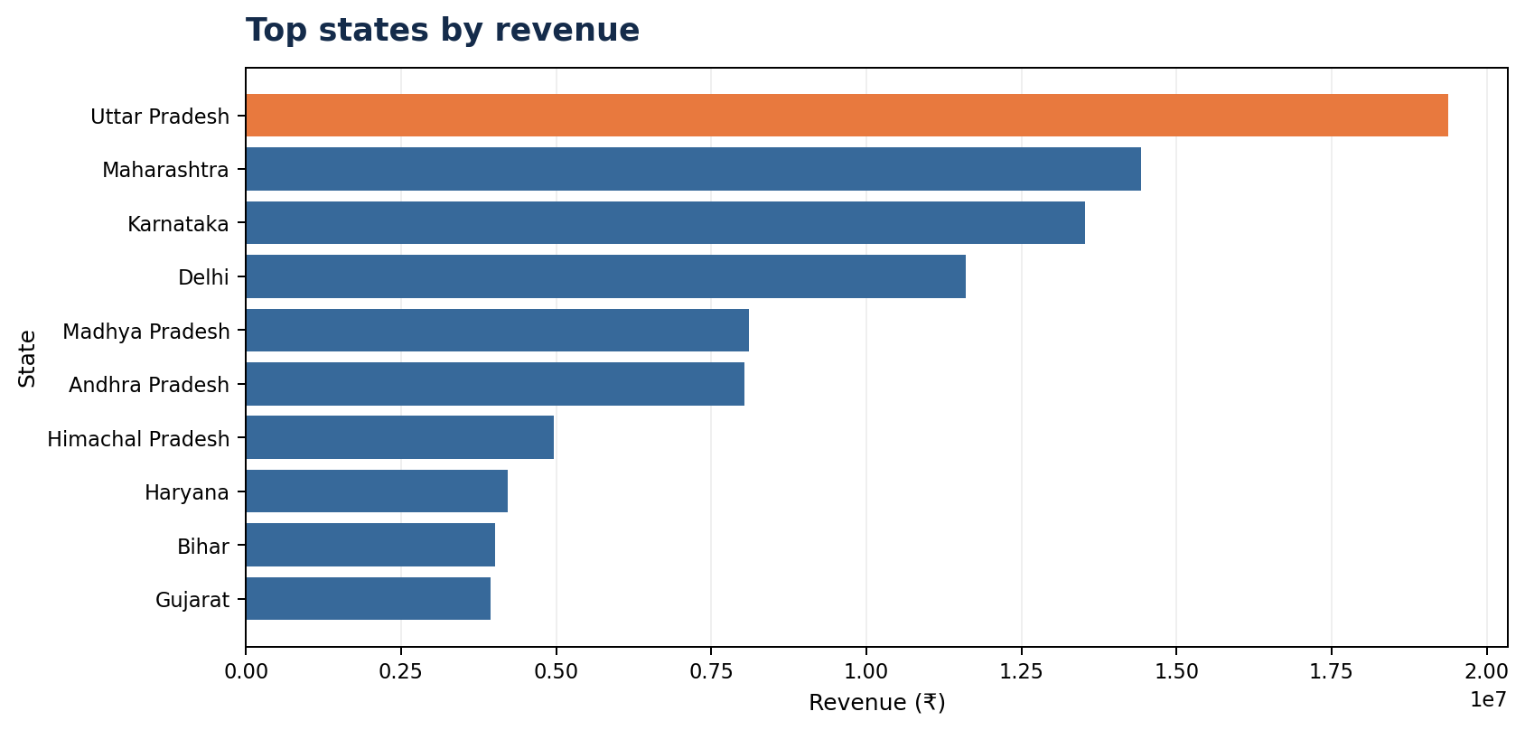
Regional performance | State revenue
Uttar Pradesh ranks first in state-level revenue
Interpretation
Leading state: Uttar Pradesh.
Revenue: ₹1.94 Cr.
The top-10 ranking can inform regional campaign planning.
Action: evaluate revenue alongside order volume, audience reach and marketing investment before allocating budget.
DIWALI SALES ANALYTICS • PYTHON / PANDAS
07

Slide 9
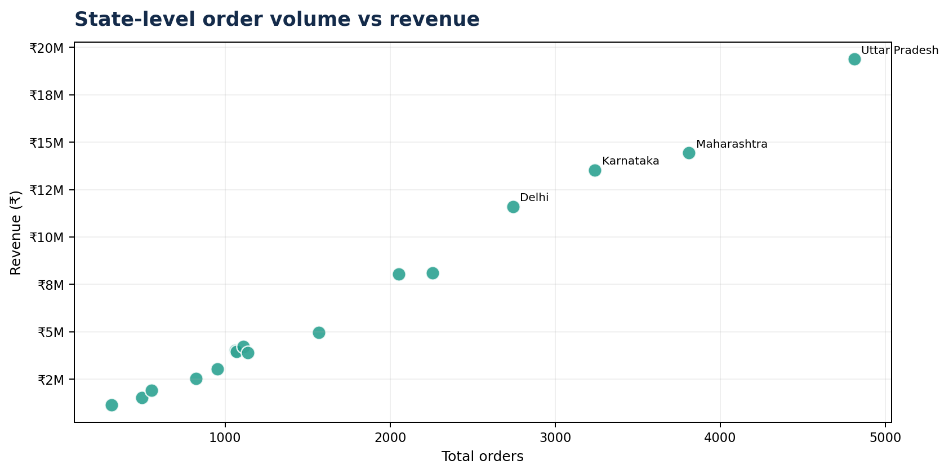
Regional opportunity | Orders vs revenue
Identify states with high order volume but comparatively lower revenue
Interpretation
Each point represents a state; rightward positions indicate more orders and higher positions indicate greater revenue.
High order volume paired with lower revenue may indicate a lower average order value.
State flagged by the rank comparison: Kerala.
Next step: review category mix, discounts, product mix and order value in the flagged state.
DIWALI SALES ANALYTICS • PYTHON / PANDAS
08

Slide 10
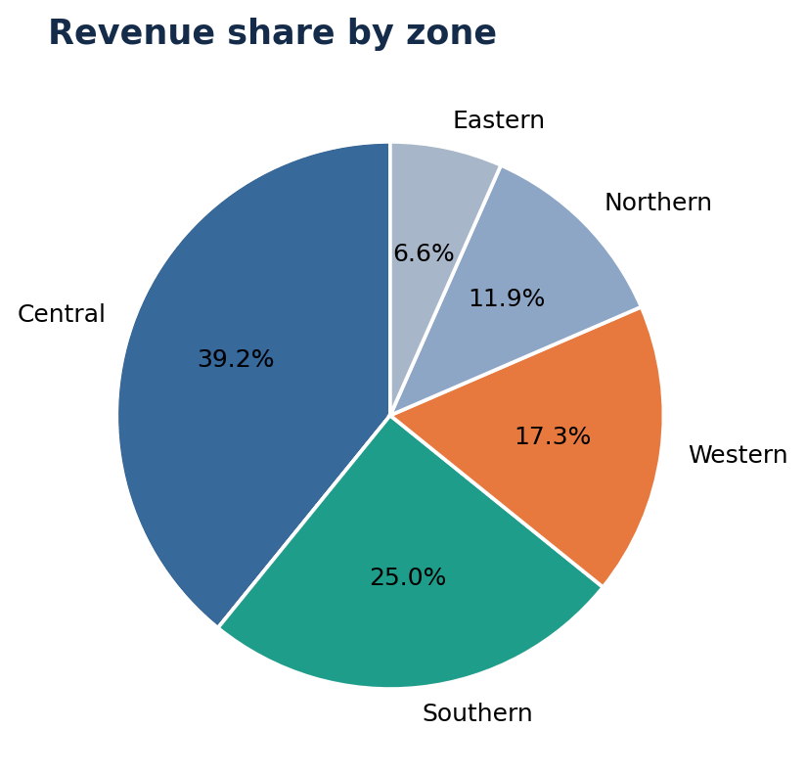
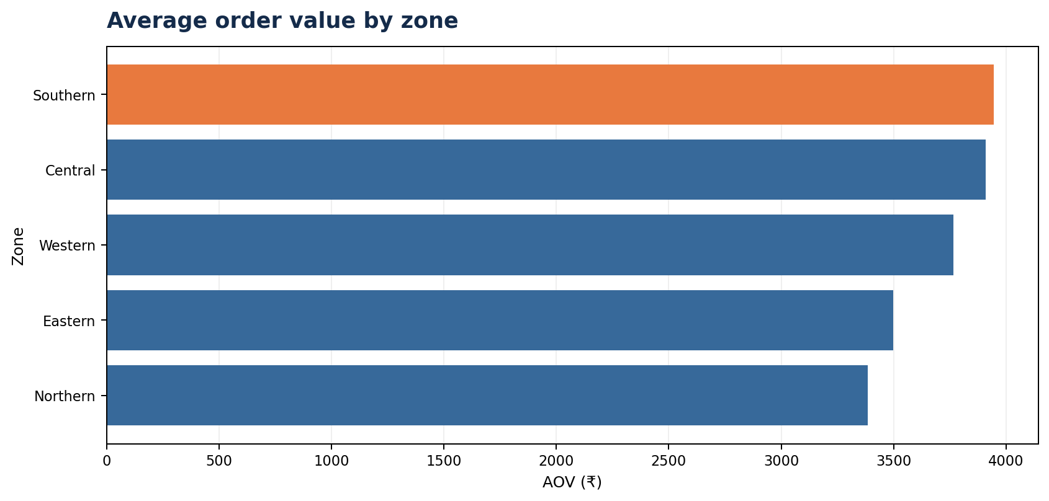
Regional performance | Zone revenue & AOV
Central leads zonal revenue; Southern records the highest average order value
Revenue leader: Central zone (₹4.16 Cr)
AOV leader: Southern zone (₹3,945 per order)
DIWALI SALES ANALYTICS • PYTHON / PANDAS
09

Slide 11
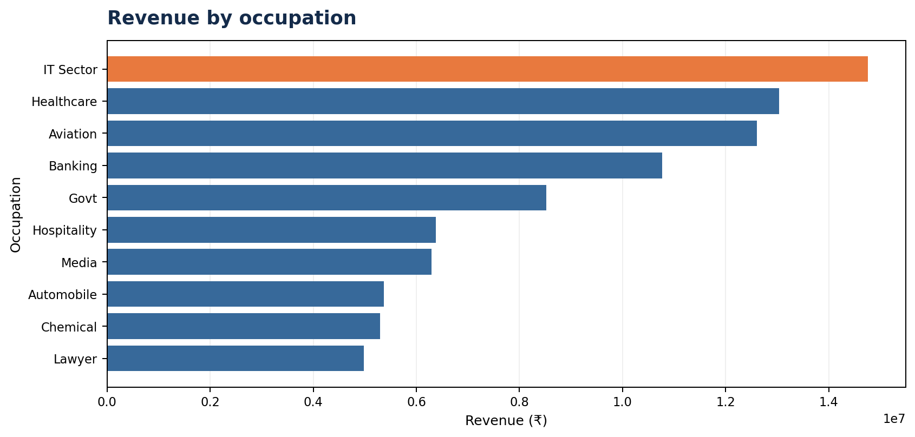
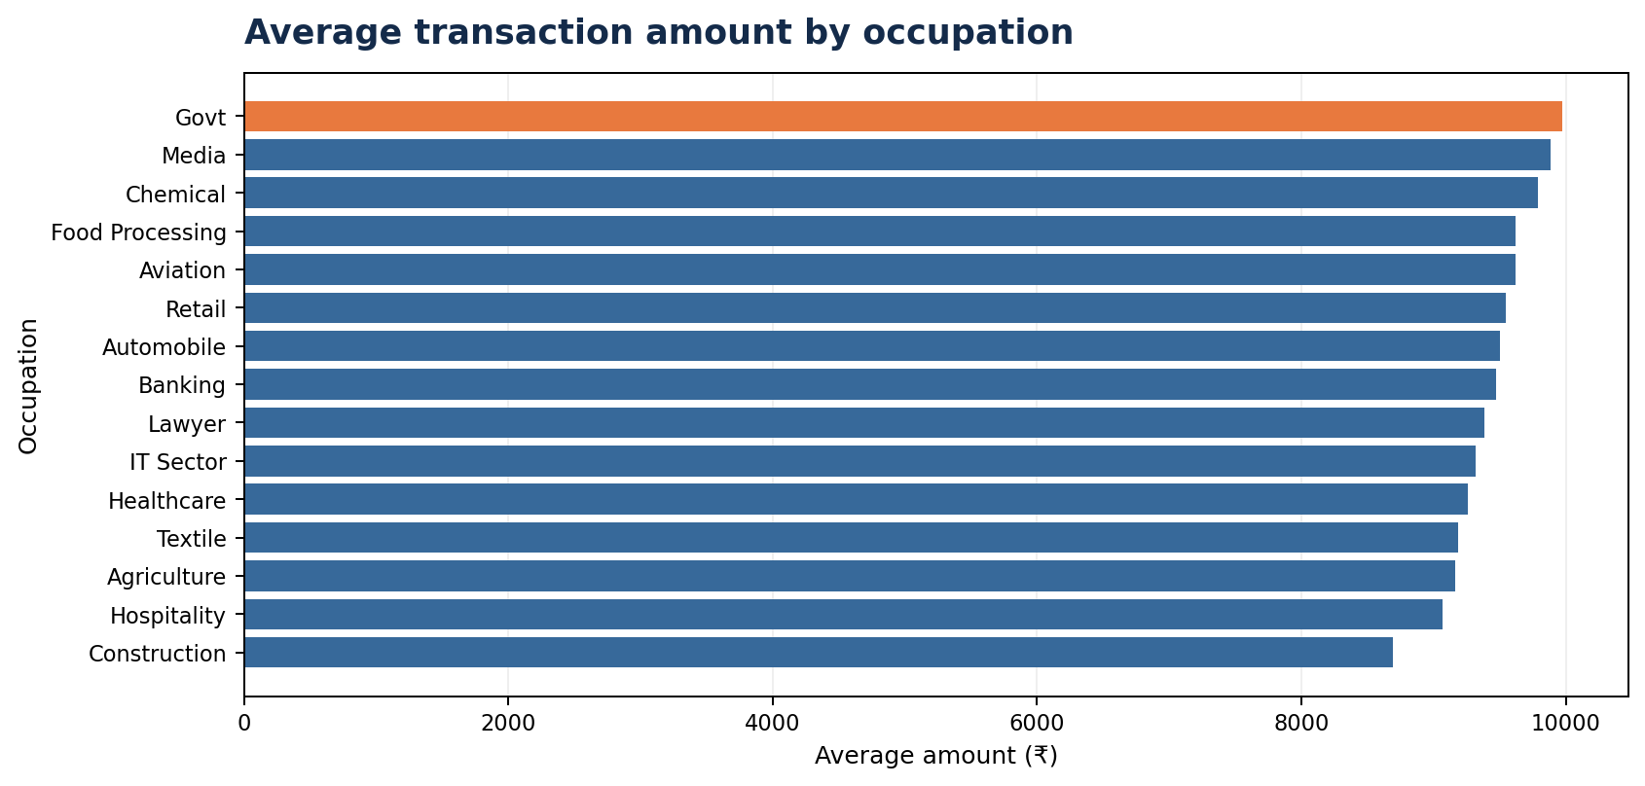
Customer profile | Occupation
IT Sector generates the highest revenue; Government records the highest average transaction amount
DIWALI SALES ANALYTICS • PYTHON / PANDAS
10

Slide 12
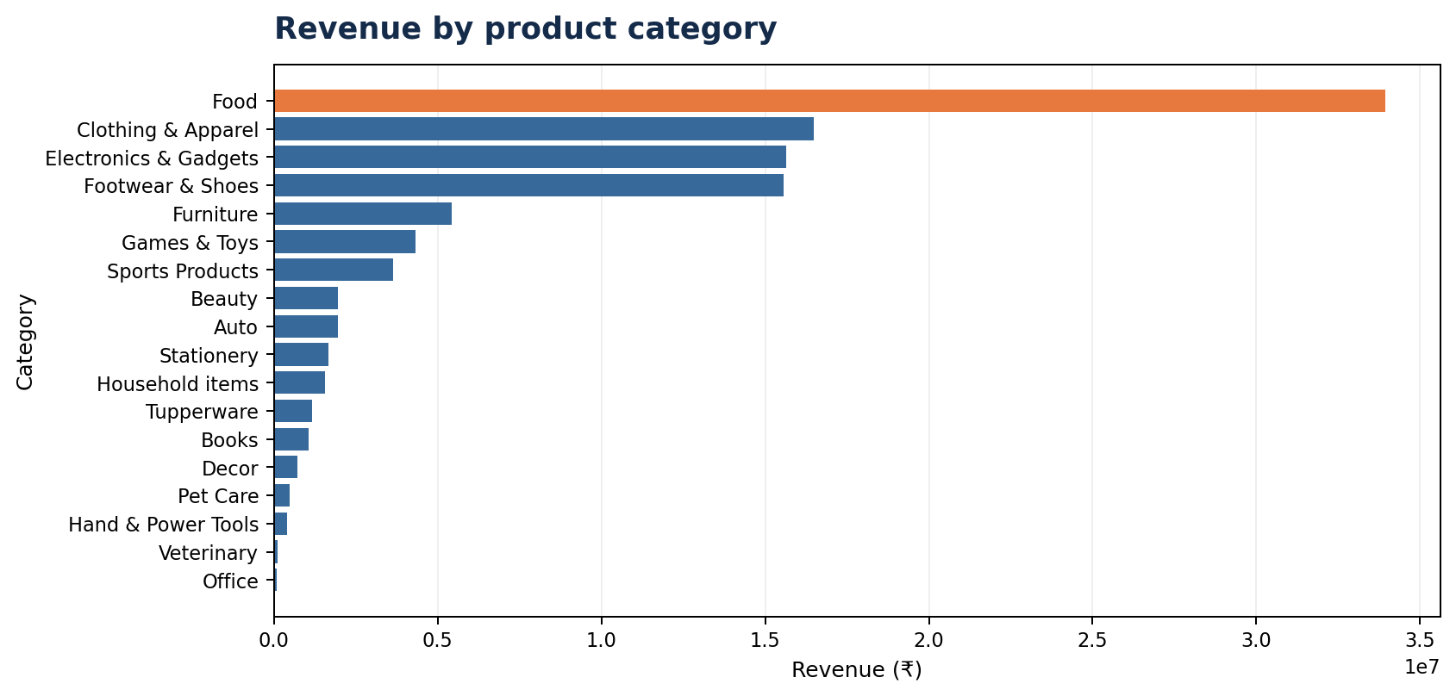
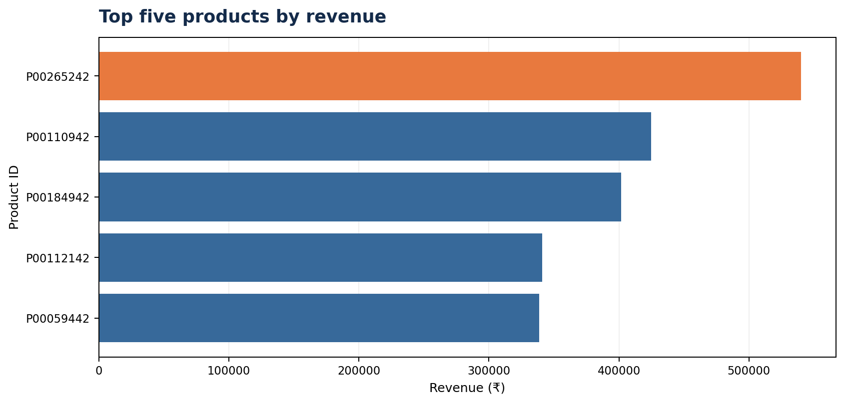
Product performance | Categories & top products
Food leads category revenue; the five listed products rank highest by individual revenue
DIWALI SALES ANALYTICS • PYTHON / PANDAS
11

Slide 13
Top five products by revenue
Ranked by total Amount across all transaction records
Rank | Product ID | Revenue | Orders
1 | P00265242 | ₹540,136 | 127
2 | P00110942 | ₹424,833 | 116
3 | P00184942 | ₹401,816 | 82
4 | P00112142 | ₹341,020 | 64
5 | P00059442 | ₹338,571 | 70
Product ranking reflects total revenue, not unit price or profit margin.
DIWALI SALES ANALYTICS • PYTHON / PANDAS
12

Slide 14
Recommendations & next steps
Translate analytical findings into measurable business actions
Prioritize campaigns for customers aged 26–35 and female customers; validate messaging through A/B testing.
Focus regional planning on Uttar Pradesh and other leading states, while accounting for marketing spend and audience reach.
Investigate high-order, lower-revenue states for basket size, discounting and product mix.
Sustain Food category performance through inventory planning and cross-selling complementary products.
Identify practices in the high-AOV Southern zone that could improve basket value elsewhere.
Enrich future analysis with profit margin, discount, channel, campaign cost and transaction date fields to assess profitability and seasonality.
DIWALI SALES ANALYTICS • PYTHON / PANDAS
13

Slide 15
THANK YOU
Key takeaway
Revenue is concentrated among female customers, the 26–35 age segment, the Central zone and the Food category.
Dataset: 11,251 records • 3,755 distinct User_IDs • 12 missing Amount values excluded from revenue totals.
Prepared using the supplied notebook and CSV dataset. Database connection credentials are not included in this report.
TURNING DATA INTO DECISIONS
A Diwali Sales Analytics Report · Shubham Kondhare

