Slide 1
Where 38% of OLA's demand slips away
July 2024 ride bookings · SQL analysis, gamified dashboard and recommendations
Shubhodip · Data analytics internship project
Notes:
Open with the headline: of every 100 rides people tried to book in July, about 38 never happened. This deck shows where they are lost, what it costs, and what to do about it. Everything comes from 103,024 bookings in OLA_DataSet.xlsx, analysed with 31 SQL queries and a Streamlit dashboard.

Slide 2
The month in four numbers
103,024
62.1%
₹35.1M
₹21.5M
bookings from 94,544 customers
completed as rides
earned from completed rides
in quoted fares lost to failed bookings
More than a third of demand never becomes a ride, and the fares at stake equal 61% of what OLA actually earned.
Notes:
Four numbers frame the story. 103,024 bookings, 62.1% completed, 35.1 million rupees earned. The last number is the one that matters: failed bookings carried 21.5 million rupees of quoted fares, which is 61% of what was earned. Revenue here means completed rides only; failed bookings are shown as fares at risk, never as revenue.

Slide 3
How the analysis was built
1
2
3
Clean
Query
Play
Excel to SQLite: 103,024 rows, 24 columns, expected blanks labelled, hour and weekday added.
31 SQL queries: KPIs, vehicles, time, zones, cancellations, payments and customers.
A gamified Streamlit app turns the findings into challenges, a what-if boss battle and a SQL lab.
Notes:
Three stages. First, clean: the Excel sheet became a SQLite database; blanks for ratings and payment on cancelled rides are expected, so they are labelled not applicable rather than dropped. Second, 31 SQL queries cover every angle. Third, the Streamlit dashboard lets a reader test the findings interactively.

Slide 4
Only 62 of every 100 bookings complete
17.9%
cancelled by drivers
10.2%
cancelled by customers
9.8%
no driver found
Notes:
Of 103,024 bookings, 63,967 completed. The rest split three ways: drivers cancelled 17.9%, customers cancelled 10.2%, and in 9.8% of cases no driver was found. Driver cancellations alone are 47% of all failures.

Slide 5
Failed bookings put ₹21.5M of fares at risk
61%
of the ₹35.08M OLA actually earned is sitting in bookings that fell through. Each +1 point of success rate is worth about 1,030 rides and ₹0.57M a month.
Notes:
Fares quoted on failed bookings add up to 21.45 million rupees: 10.2 million on driver cancellations, 5.8 on customer cancellations, 5.5 on no driver found. That is an upper bound on lost revenue, equal to 61% of realised revenue. As a rule of thumb, one extra point of success rate is about 1,030 rides, or roughly 0.57 million rupees a month.

Slide 6
Most cancellations start on the supply side
71% of customer cancellations point to the driver or the vehicle: not moving, asking to cancel, or a broken AC.
Notes:
Drivers' own top reason is personal or car-related issues at 35.5%. On the customer side the top two reasons, driver not moving towards pickup and driver asked to cancel, are driver behaviour, and a further 14.9% say the AC was not working. Together that is about 71% of customer cancellations that are supply-side rather than a change of heart. Red bars are supply-side.

Slide 7
No vehicle, hour or zone is the culprit
36.4–39.6%
failure rate in every hour of the day
3,253–3,385
bookings per day, every weekday
59.8–64.0%
success rate across all 50 zones
Notes:
This is the honest finding: almost nothing varies. The top vehicle beats the bottom by only 7%. Failure rate stays between 36 and 40 percent in every hour. Weekday volumes look uneven in raw totals only because July 2024 had five Mondays, Tuesdays and Wednesdays; per day they are level. Zones range from 59.8 to 64.0 percent success. The one outlier is Auto, with rides about 10 km against 25 km elsewhere. So the lever is system-wide driver fulfilment, not reallocating by time or place.

Slide 8
One-time riders and cash dominate
91.6%
of customers booked only once in the month
20.9%
of revenue comes from the 4.6% of rides priced at ₹2,000 or more
Notes:
Two commercial signals. Only 8.4% of customers booked more than once, so retention is the open question. And revenue is top-heavy: 2,927 rides priced at 2,000 rupees or more are 4.6% of rides but 20.9% of revenue. Payments are cash-led at 54.8%, UPI 40.5%, cards under 5%.

Slide 9
Fixing driver cancellations alone gets to 70%
−25% driver cancels
+4,609 rides · +₹2.5M a month
−50% driver cancels
+9,217 rides · +₹5.1M a month
−25% of all failures
+9,764 rides · +₹5.4M a month
Upper bound: assumes every recovered booking completes at the ₹548 average fare.
Notes:
This is the Boss Battle from the dashboard. Cutting driver cancellations by 25% wins back about 4,600 rides, adds 4.5 points of success rate and roughly 2.5 million rupees a month. Halving them takes success to 71%, past a 70% target. These are upper bounds because they assume each recovered booking completes at the average fare of 548 rupees.

Slide 10
Six moves to close the gap
1
Driver accountability
2
Vehicle readiness
3
Close the supply gap
Rewards and penalties for cancels; nudge stalled pickups.
AC, condition and capacity checks before going online.
Incentives in Vijayanagar, Langford Town and Hosur Road.
4
Cut customer friction
5
Win the second ride
6
Audit pricing
Live ETA, auto-reassign stalled drivers, confirm addresses.
Second-ride offer; UPI cashback to move cash users.
Fare is unrelated to distance; Auto earns 2.5× more per km.
Notes:
Moves one to four go straight at the failure leak: driver accountability, vehicle readiness, supply incentives in the three weakest zones, and customer-side friction. Move five tackles retention and cash. Move six is a pricing audit: in this data fare has almost no relationship to distance, and Auto earns about 2.5 times more per kilometre because its rides are shorter.

Slide 11
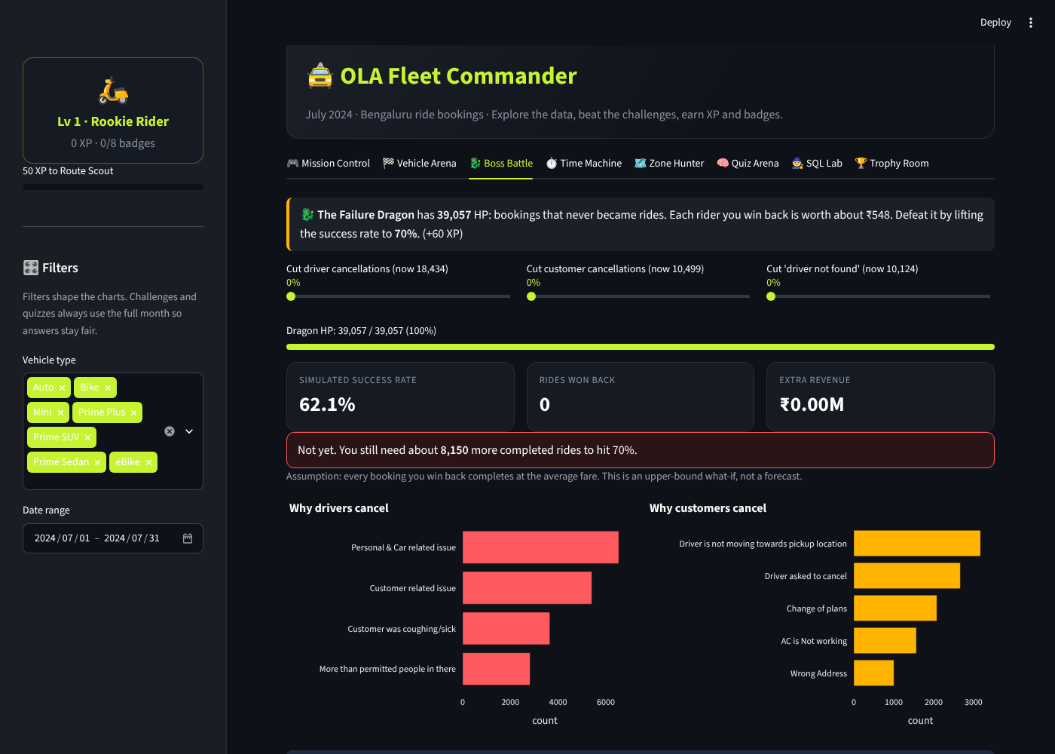
OLA Fleet Commander: the dashboard
8 tabs
KPIs, vehicles, boss battle, time, zones, quiz, SQL lab, trophies.
XP and badges
5 levels and 8 badges earned by answering and exploring.
Boss Battle
Slide cancellation cuts and watch success rate climb to 70%.
SQL Lab
Run the 31 project queries live, read-only.
Notes:
The Streamlit app turns the analysis into a game. Readers earn XP by predicting results: the top vehicle, the worst hour, the weakest zone, or by answering a five-question quiz. The Boss Battle is a what-if simulator for cancellation reductions. The SQL Lab runs the same 31 queries from the project file against the live database.

Slide 12
Caveats and next steps
Read with care
Next
One month, one city: no trend or seasonality view.
Fare and distance are almost uncorrelated (0.002); the data looks simulated, so trust direction over exact values.
No driver or vehicle IDs, so no driver-level analysis.
Add driver-level and fleet data to test accountability.
Extend to more months for trends and seasonality.
Pilot the second-ride offer and measure repeat rate.
Notes:
Close with honesty. One month of data cannot show trends, and the near-zero fare-distance correlation suggests a simulated or anonymised extract, so the direction of the findings is more reliable than exact values. Next steps: richer data, more months, and a pilot for the second-ride offer. Then take questions.

