Slide 1

Predictive Analysis _ Turtle Games
July 24, 2023
Shubhra Kapoor

Slide 2



Overview
Problem Statement
Background
Patterns and Trends
Recommendation
Q&A

Slide 3
Problem Statement

Slide 4
boost overall sales and revenue using data-driven insights

Slide 5

Approach & Background

Slide 6
Approach
Data Ingestion and Wrangling
Exploratory Data Analysis using Python & R Packages and libraries

Slide 7
Background
Technique used for Data analysis
Predictive Modeling
Means Clustering
Natural Language Processing (NLP)
Statistical Analysis

Slide 8

Patterns and Trends

Slide 9
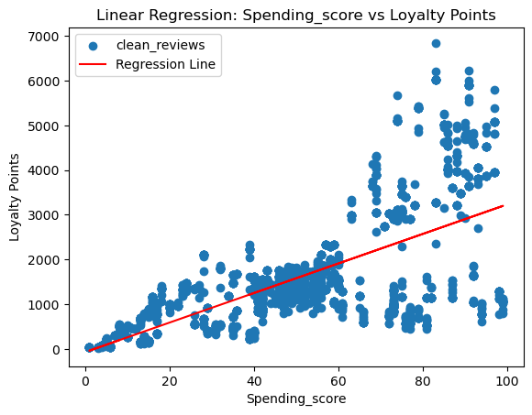
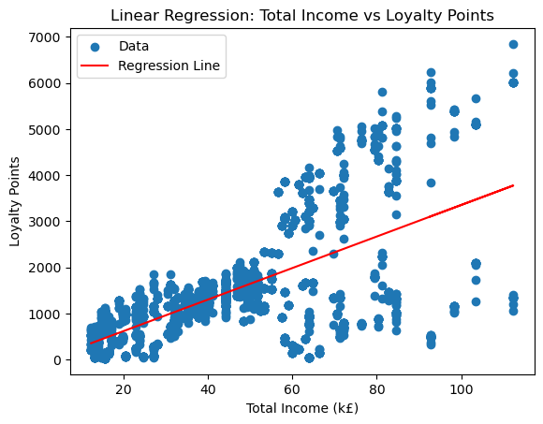
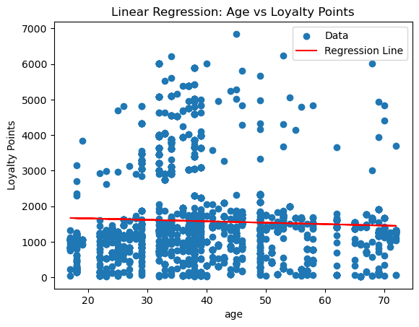
Liner Regression Model & Insights

Slide 10
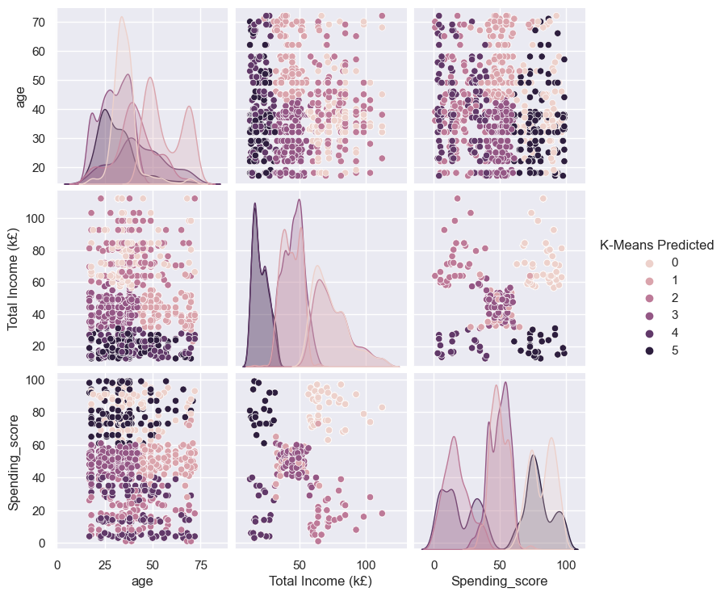
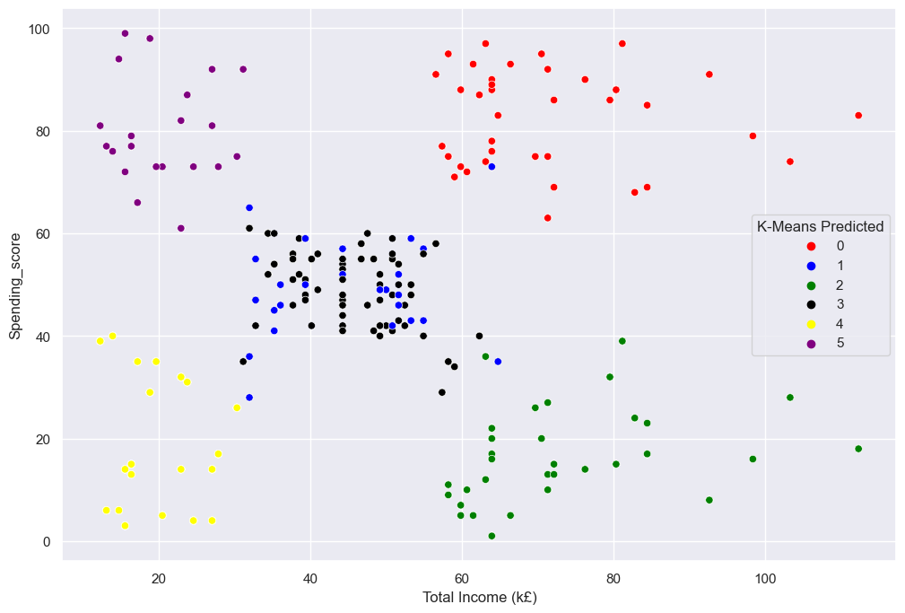
K-Means Clustering Model & Insights

Slide 11
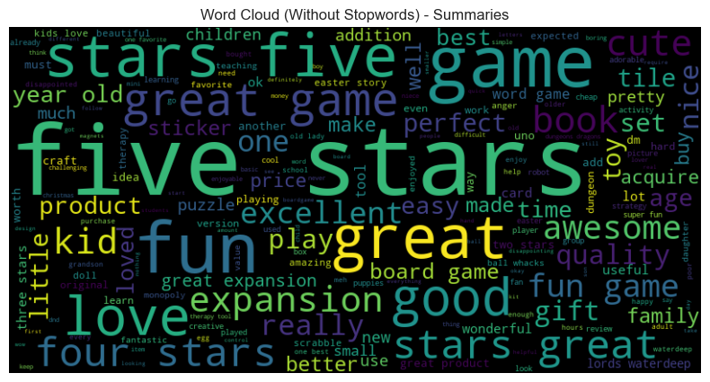
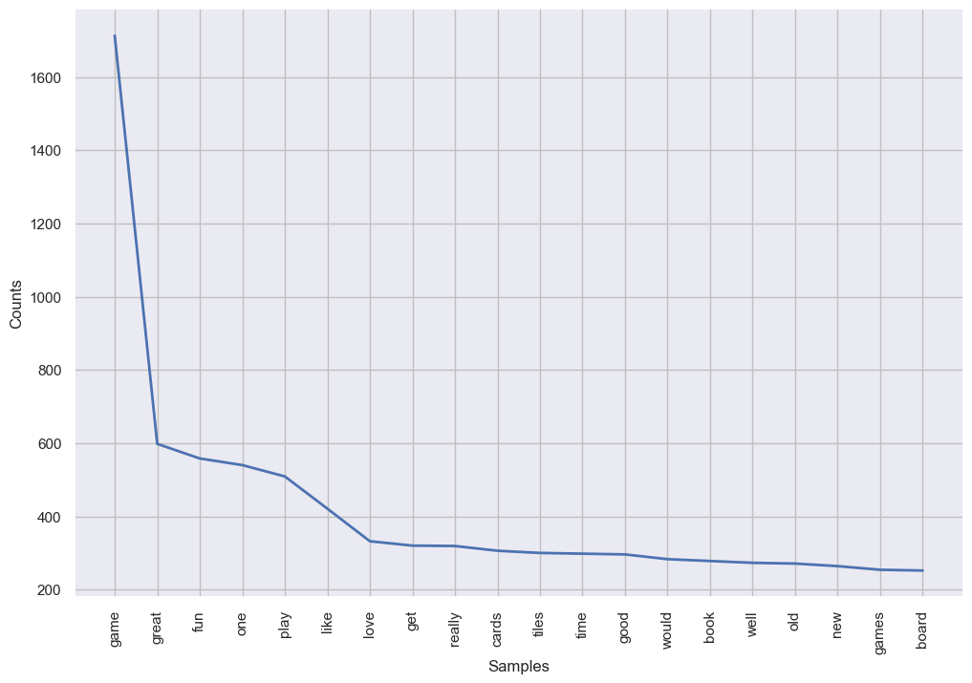
Natural Language Processing & Customer Sentiments

Slide 12
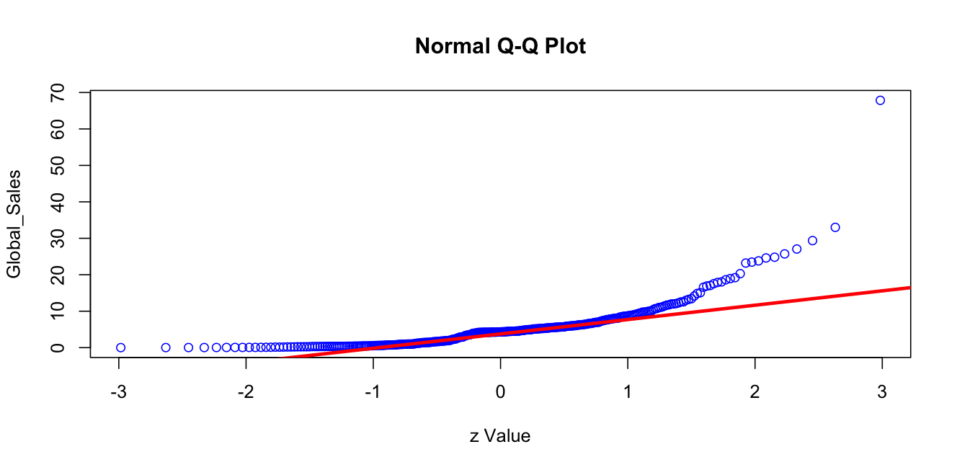
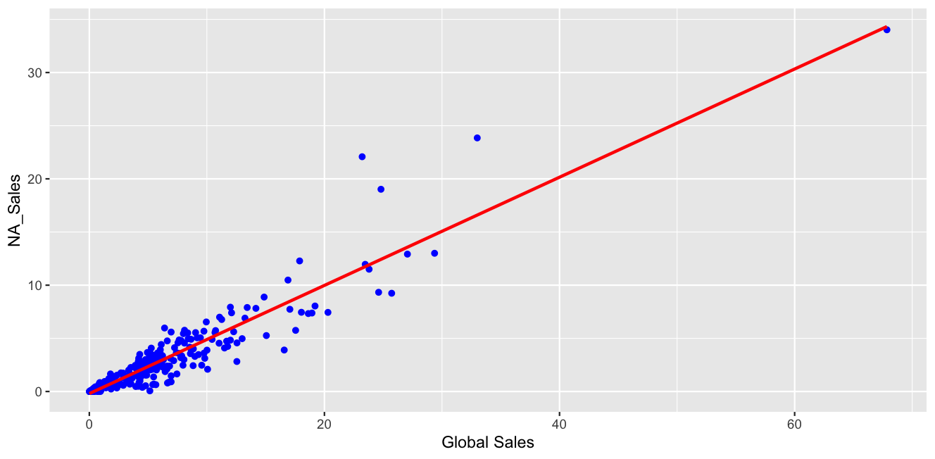
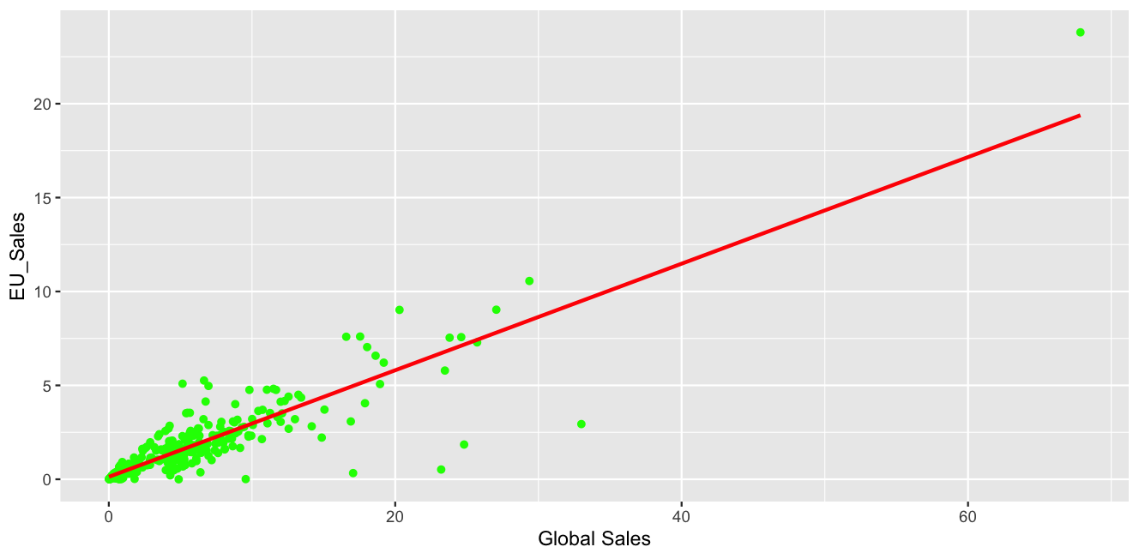
Normal Distribution, Skewness and Kurtosis Model

Slide 13
Recommendation : What Winning Looks like
Target High-Impact Regions:
Promote Top-Selling Products:
Address Underperforming Products:
Personalize Marketing and Loyalty Programs:
Leverage Customer Feedback:

Slide 14
Thank You

