Slide 1
Future institute of engineering and management
TOPIC :
HATE SPEECH DETECTION

Slide 2
PRESENTED BY :
Shubhrajit Ghosh 21CSE35 14800121107
Barsha Dutta 21CSE23 14800121061
Debjit Paul 21CSE02 14800121044
Projjal paul 21CSE60 14800121041

Slide 3
Goal :
The objective of this study is to develop a robust model for detecting hate speech in social media content using various deep learning techniques.
Models Used: LSTM (Long Short-Term Memory)
Accuracy: 74.03%
LSTM is designed to capture long-range dependencies in sequences, making it effective for understanding context in textual data.
[ bi directional LSTM accuracy 74.4%]
One-Hot Encoding:
Used as a feature representation method for text input, where each word is represented as a unique vector. This approach often lacks contextual information but serves as a baseline for comparison.
Dataset: The models were trained on a comprehensive dataset containing examples of both hate speech and non-hate speech text, ensuring a balanced representation of classes.
Results: The LSTM model achieved an accuracy of 74%, indicating its capability to detect hate speech but suggesting room for improvement. The one-hot encoding method provided a baseline for feature representation, while the transformer model was hypothesized to achieve higher accuracy due to its ability to understand context better than LSTM and one-hot encoding.

Slide 4
Literature survey
Source | Technology Used | Accuracy(%)
Automatic Hate Speech Detection on Social Media: A Brief Survey | RNN (Recurrent Neural Network) LSTM (Long Short-Term Memory) CNN (with RNN) | 78.5 82.0 83.0
Detecting Hate Speech Utilizing Deep convolutional Network and Transformer Models | CNN (Convolutional Neural Network) BiLSTM (Bidirectional LSTM) BERT (Bidirectional Encoder Representations from Transformers) RoBERTa | 84.5 87.2 82.4 80.2
Analysis Text of Hate Speech Detection Using Recurrent Neural Network | RNN (Recurrent Neural Network) LSTM (Long Short-Term Memory) BiLSTM (Bidirectional LSTM) CNN (with RNN) | 78.5 82.0 85.5 83.0

Slide 5
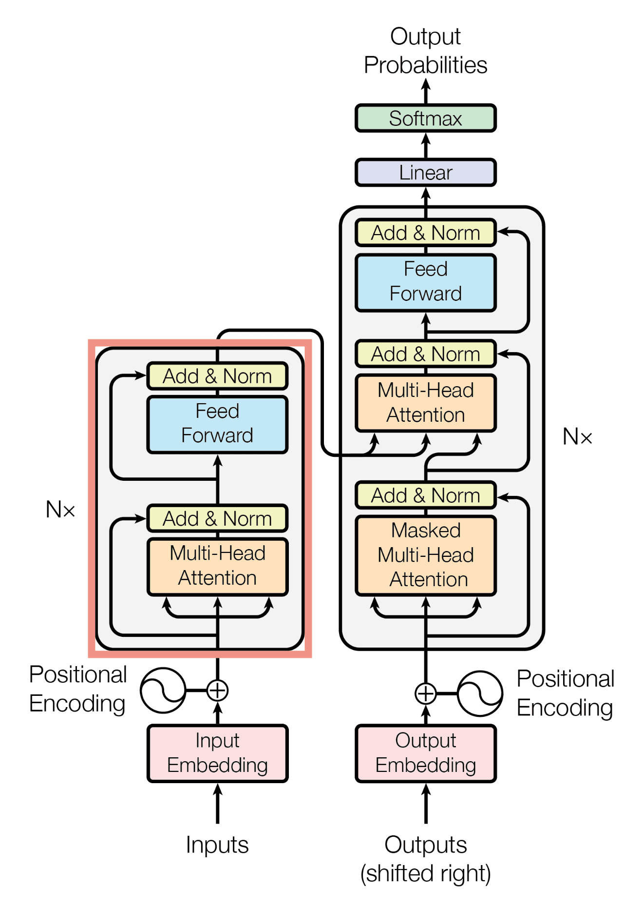
Self-Attention: Computes relationships between all words in a sequence, allowing the model to focus on relevant tokens dynamically.
Positional Encoding: Adds information about word positions in the sequence since Transformers don’t have a built-in sense of order.
Layer Normalization: Stabilizes training by normalizing inputs to each layer, improving convergence.
Residual Connections: Allows outputs of sub-layers to be added to their inputs, aiding gradient flow during training.
Multi-Head Attention: Utilizes multiple attention mechanisms in parallel to capture different types of relationships in the data.
Feed-Forward Networks: Applies independent transformations to each position’s representation after the attention layers.
Encoder-Decoder Structure: The encoder processes the input, while the decoder generates the output, using masked self-attention to ensure future tokens are not seen.
Training Techniques: Involves masked language modeling and utilizes larger batch sizes for more effective learning. These policies enable the Transformer model to excel in understanding and generating natural language.
basic Transformer model

Slide 6
Robert model
The RoBERTa model (Robustly optimized BERT approach) is an advanced variant of the BERT (Bidirectional Encoder Representations from Transformers) model in deep learning. Developed by Facebook AI, RoBERTa improves upon BERT in several key ways:
Training Data: RoBERTa is trained on a larger dataset, which includes more diverse sources, enhancing its understanding of language.
Training Method: It removes the next sentence prediction objective used in BERT and focuses solely on masked language modeling, allowing for more effective training on contextual information.
Dynamic Masking: Instead of static masking (where the same tokens are masked for each training epoch), RoBERTa employs dynamic masking, providing a different masked version of the input during each epoch. This enhances the model's ability to learn from varied contexts.
Larger Batch Sizes: RoBERTa uses larger mini-batch sizes during training, which can lead to better optimization.
Longer Training: The model is trained for more steps, allowing it to fine-tune its representations more thoroughly.
Overall, RoBERTa achieves state-of-the-art results on a variety of NLP benchmarks, showcasing its robustness and effectiveness in understanding language.

Slide 7
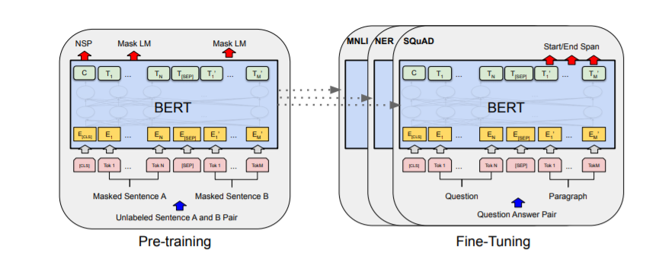
AdVANTANGE of Robert model
Masked Language Modeling: Focuses solely on masked language modeling, without next sentence prediction, enhancing contextual learning.
Dynamic Masking: Masks different tokens in each training epoch, providing varied contexts for improved learning.
Larger Training Data: Trained on a larger and more diverse dataset to boost language understanding.
Larger Batch Sizes: Uses larger mini-batches during training for better optimization.
Extended Training Duration: Trained for more steps, allowing for thorough refinement of representations.
Hyperparameter Tuning: Experiments with various hyperparameters to optimize training performance.
These policies enable RoBERTa to achieve state-of-the-art results in natural language processing tasks.

Slide 8
Thank you

