Slide 1
Hotel Management System
A comprehensive full-stack application combining Angular frontend with Spring Boot microservices for seamless hotel operations management.
By:Shubhranshu Satpathy

Slide 2
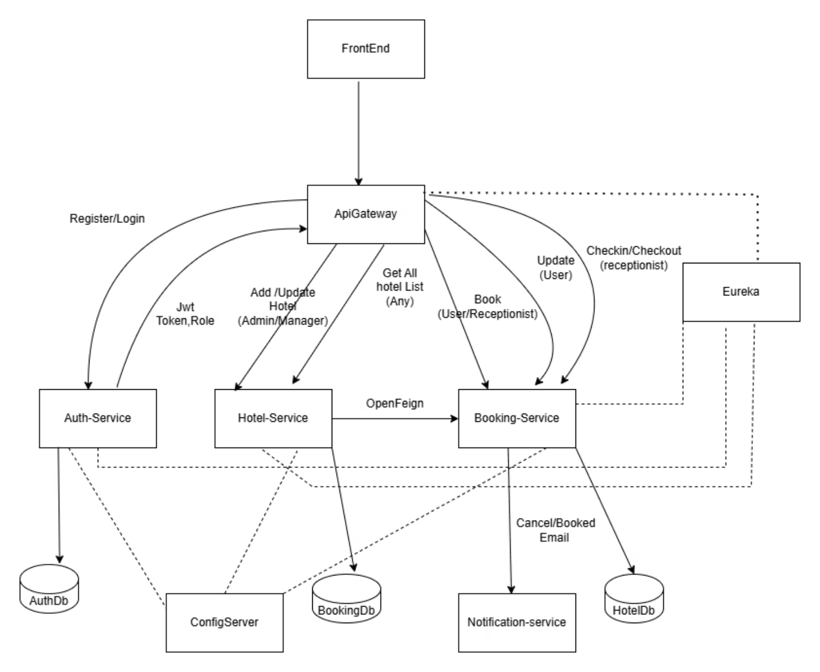
Architecture
Frontend Layer
Built with Angular 21+, delivering responsive, role-based dashboards for administrators, managers, receptionists, and guests. Clean UI optimized for all devices.
Backend Layer
Spring Boot microservices architecture with service discovery, centralized configuration, and event-driven communication via Kafka for scalable operations.It Also Include Authentication and Role Based Acces Managed by ApiGateway and Jwt Token

Slide 3

Role-Based Access
Tailored interfaces and permissions for every user type, ensuring efficient workflows and data security across the organization.
Admin Dashboard
Manager Portal
Complete oversight of hotel operations and system configuration. Register managers and monitor all activities.
Manage hotel details, room inventory, staff registration, and view booking analytics for their properties.
Reception Interface
Guest Dashboard
Handle check-ins, check-outs, guest services, and on-site bookings with streamlined workflows.
Browse hotels, make reservations, manage bookings, and update profile information with ease.

Slide 4
Core Features
01
02
Secure Authentication
Hotel Discovery
JWT-based login with password management and role assignment
Browse listings with advanced search by criteria and availability
03
04
Room Management
Booking Operations
Track inventory, availability, and detailed room specifications
Complete reservation lifecycle from booking to check-out
05
06
Profile Control
Real-time Notifications & Remainder
User data updates and account security management
Event-driven alerts via Kafka for booking confirmations

Slide 5
Backend Services Ecosystem
API Gateway
Service Discovery
Config Server
Auth Service
Centralized routing and JWT authentication on port 8008
Eureka server for dynamic service registration at port 8761
Centralized configuration management on port 8888
User registration, login, and role-based access control
Hotel Service
Booking Service
Notification Service
Hotel and room management with search capabilities
Reservation handling, cancellations, and check-in operations
Handles All produced Kafka Request and sends

Slide 6
Technology Stack
Frontend Technologies
Backend Technologies
Angular 21+ framework with TypeScript
Java 17 with Spring Boot 3.x
RxJS for reactive programming patterns
Spring Cloud (Gateway, Eureka, Config)
Vitest for comprehensive unit testing
Spring Security with JWT authentication
Prettier for consistent code formatting
Apache Kafka for message brokering
Responsive design with mobile optimization
MongoDB for NoSQL data persistence
Docker & Docker Compose orchestration

Slide 7
Development Setup
Prerequisites
Install Node.js 18+, Angular CLI 21+, Java 17, Docker, and Maven on your development machine.
Clone Repository
Clone both frontend and backend repositories to your local environment using git clone commands.
Install Dependencies
Run npm install for frontend and Maven builds for backend services to fetch all required packages.
Start Infrastructure
Launch MongoDB, Kafka, and Zookeeper using docker-compose up for backend dependencies.
Run Services
Start Config Server, Eureka, then Auth, Hotel, and Booking services in sequence, followed by API Gateway.
Launch Frontend
Execute ng serve to start the Angular development server at localhost:4200 with live reload enabled.

Slide 8
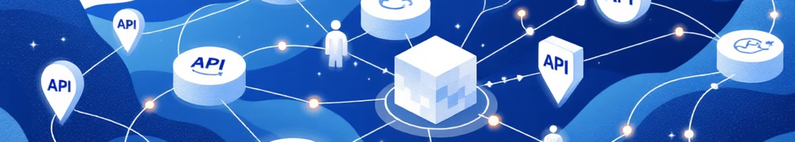
API Endpoints Overview
All endpoints route through the API Gateway at localhost:8008 with role-based authorization enforced via JWT tokens.
Auth Service
Hotel Service
Booking Service
Public registration and login, authenticated password changes, admin manager registration, manager receptionist registration
Hotel CRUD operations, room management, public search functionality, availability queries, check-in/check-out processing
Create and cancel reservations, view bookings by user or hotel, update booking details, receptionist check-in operations

Slide 9
Database Architecture
MongoDB Databases
Separate database instances ensure service independence and data isolation:
HotelAuthdb - User authentication data
Hoteldb - Hotel and room information
HotelBookingdb - Reservation records
Kafka Integration
Event-driven architecture enables asynchronous communication between services, particularly for booking notifications and real-time updates across the system.
Kafta Also handles All the notification and Remainders Generated by the Scheduler in Booking Services

Slide 10
Quality & Deployment
Security
Testing & Quality
DevOps
JWT-based authentication with secure token management
Role-based access control (GUEST,RECEPTIONIST, MANAGER, ADMIN)
CORS configuration for cross-origin requests
Spring Security integration across all services
Vitest for frontend unit testing
End-to-end test configuration
with ng e2e
SonarQube integration for
code analysis
Automated testing in CI/CD
pipelines
Production build with ng build command
Docker Compose orchestration for local development
Docker containerization for all services
Maven-based backend builds

Slide 11
Thank You

