Slide 1






PLM Intelligence Challenge
Turn PLM Data into Actionable Decisions
Explore product structures, detect risks and assess change impact

Slide 2

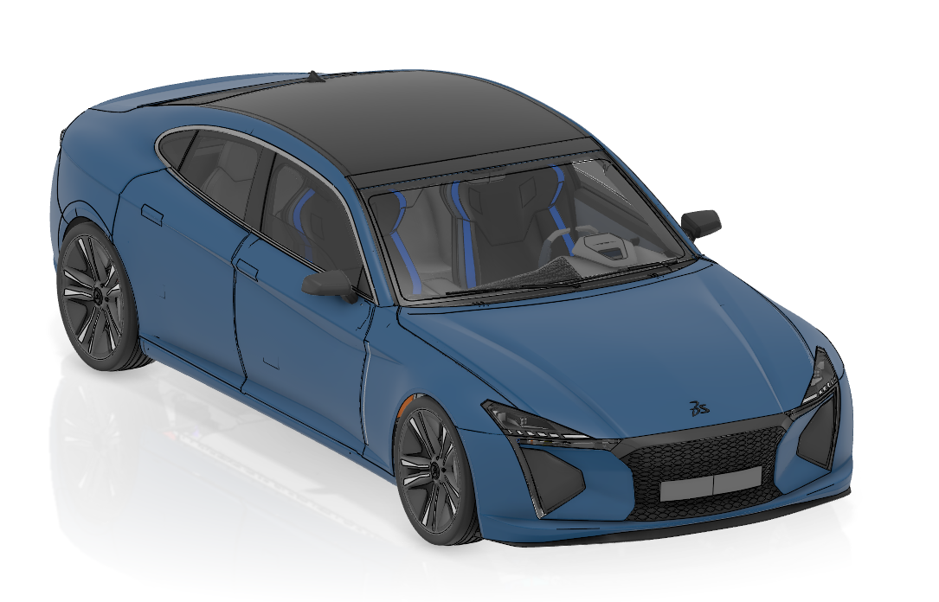
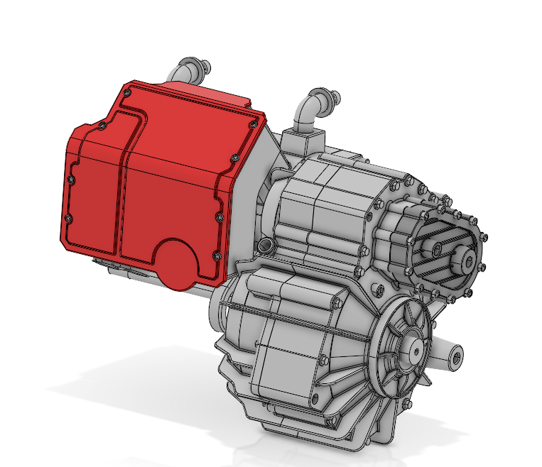
INDUSTRIAL CONTEXT
The supplier role: Powering Electric Mobility
Your are part of the engineering and digital team of an automotive electric motor supplier.
OEM ecosystem
The OEM manages its product development and PLM data with 3DEXPERIENCE
FILE/INFOS
EXCHANGE
The challenge
OEM
Supplier
Your company does not have access to the OEM’s PLM environment
The aim: Your team must work with the provided data and find ways to turn it into useful information for your business
PLM PRODUCT INTELLIGENCE / ESILV HACKATHON
01

Slide 3
INDUSTRIAL CONTEXT
The Mission: Unlocking value from raw engineering data
An electric motor supplier receives product data extracted from the OEM PLM platform
01
02
03
AUTOMOTIVE OEM
PLM DATA HANDOVER
ELECTRIC MOTOR SUPPLIER
Manages electric vehicle development on 3DEXPERIENCE.
Exports product structure and metadata into an XML package.
Needs independent tools to explore and leverage that information.
OEM / 3DEXPERIENCE
→ XML DATA PACKAGE →
SUPPLIER / SOLUTION
How can PLM data be intelligently leveraged to understand a product, identify risks, and assess the impact of a decision ?
PLM PRODUCT INTELLIGENCE / ESILV HACKATHON
02

Slide 4
THE DATA CHALLENGE
Make sense of an external PLM data package
The XML extraction contains product structure, components and lifecycle information.
PLM DATA
OEM platform
Product structure
Component information
Lifecycle/ Maturity
Engineering team
3DEXPERIENCE
supplier
SOLUTION SCOPE
PLM extraction
Search & filtering
Risk intelligence
Change impact
Business decisions
cost · risk ·
quality . sustainability
XML file
The goal: transform raw PLM data into traceable insights that support engineering decisions.
PLM PRODUCT INTELLIGENCE / ESILV HACKATHON
03

Slide 5
SOLUTION CAPABILITIES
From XML extraction to actionable product intelligence
CAPABILITY 01
CAPABILITY 02
CAPABILITY 03
Product Explorer
Product Intelligence
Change Impact Analysis
Navigate BOM and assemblies
Identify critical components
Select a proposed component change
Inspect components and properties
Highlight risks and dependencies
Find impacted products and suppliers
Compare versions and lifecycle states
Support cost and quality decisions
Explore possible cost consequences
An AI agent / chatbot could enable users to query the data in natural language, with a requirement to retrieve and display the PLM sources used to support each answer
Deliverable : Web application, dashboard or comparable interface
PLM PRODUCT INTELLIGENCE / ESILV HACKATHON
04

Slide 6
CHALLENGE QUESTIONS
Make engineering decisions with traceable evidence
Illustrative questions the product-intelligence application should help answer
01
02
03
UNDERSTAND
IDENTIFY RISKS
ASSESS A CHANGE
What are the major subassemblies of the electric motor?
Which versions and properties exist?
Which components are critical?
Where are supplier or lifecycle dependencies?
If a component is replaced, what assemblies, suppliers and costs might be affected?
PLM PRODUCT INTELLIGENCE / ESILV HACKATHON
05

Slide 7
STUDENT ADVANTAGE
Build useful software on a realistic industrial challenge
Connect mechanical engineering, PLM, data analysis, AI and user experience
WHY TAKE THIS CHALLENGE?
HOW TO GET STARTED
Learn
1
Inspect the XML product dataset
01
Work with realistic electric-motor product data.
2
Map assemblies and component attributes
02
Combine
Apply engineering, software development, data and AI.
3
Define priority exploration and analysis cases
03
Deliver
Create a solution with business value.
4
Prototype the application and cite data sources
The ambition: turn an isolated PLM extract into reliable, actionable product intelligence.
PLM PRODUCT INTELLIGENCE / ESILV HACKATHON
06
Notes:
Mise en page

Slide 9






