Slide 1

Robotics Adoption & Industry Impact (2015–2023)
Insights on Productivity, CostSavings, Workforce Impact on Robotics Technology
Notes:
AI-generated content may be incorrect. ---

Slide 2
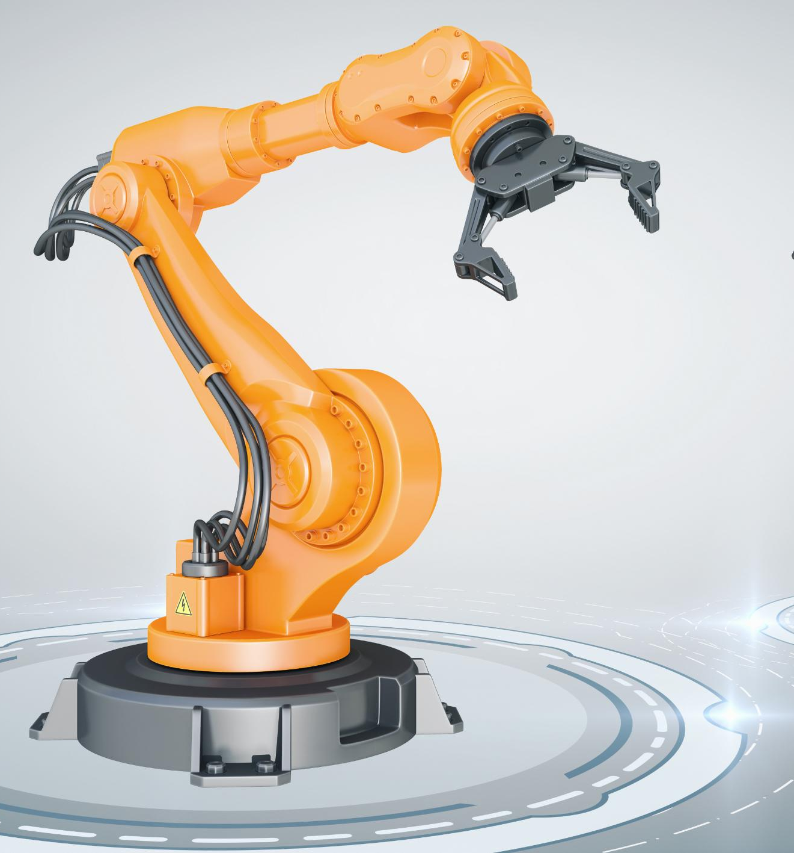
Introduction & Context
Robotics Impact Metrics
Key metrics include Robots Adopted, Productivity Gain, Cost Savings, and Jobs Displaced from robotics implementation.
Industry Transformation
Robotics enhances operational efficiency and reduces costs across manufacturing, healthcare, and logistics sectors.
Strategic Opportunities and Challenges
Understanding benefits and challenges helps identify strategic opportunities for robotics adoption in evolving industries.
Notes:
Robotics adoption is transforming industries across the globe. This analysis explores key metrics such as Robots Adopted, Productivity Gain, Cost Savings, and Jobs Displaced. Our goal is to understand the benefits, challenges, and strategic opportunities of automation. As industries evolve, robotics plays a pivotal role in enhancing operational efficiency, reducing costs, and reshaping workforce dynamics. This presentation provides a comprehensive overview of how robotics has impacted manufacturing, healthcare, and logistics sectors from 2015 to 2023.

Slide 3

Why This Analysis Matters
Robotic Adoption and Productivity
More than 8,000 robots enhance productivity by an average of 15% across industries.
Challenges of Automation
Efficiency gains come with challenges such as job displacement requiring careful strategic planning.
Strategic Planning Importance
Balancing innovation and workforce well-being needs informed decisions on investments and training.
Ensuring Sustainable Growth
Identifying trends and evaluating ROI ensures sustainable growth amid technological advances.
Notes:
Over 8,000 robots have been adopted across various industries, leading to an average productivity gain of 15%. While these improvements indicate significant efficiency enhancements, they also bring challenges such as job displacement. Strategic planning is essential to balance innovation with workforce well-being. Understanding these dynamics helps stakeholders make informed decisions about future investments, training programs, and automation strategies. This analysis is crucial for identifying trends, evaluating ROI, and ensuring sustainable growth in the face of technological advancement.

Slide 4
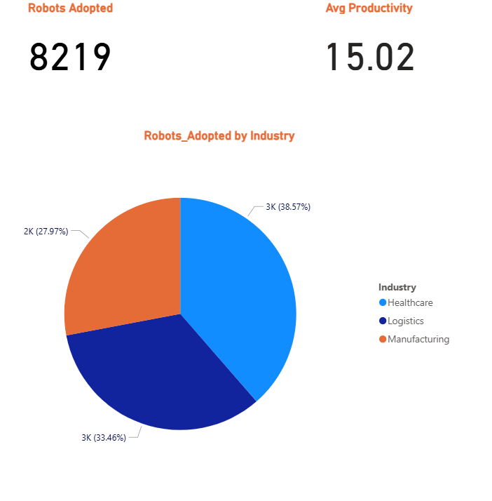
Robots Adopted by Industry
Total Robots Adopted: 8,219 robots have been integrated across key industries, reflecting rapid growth and technological advancement.
Average Productivity Gain: 15.02% improvement in operational efficiency, indicating the strong impact of robotics on workplace output.
Healthcare Robotics Leadership: Healthcare leads with 38.57% robot adoption, using automation for diagnostics and patient care improvements.
Logistics Automation: Logistics industry adopts robotics at33.46%, enhancing operational efficiency through automation.
Manufacturing Robotics Growth: Manufacturing has 27.97% adoption, indicating ongoing reliance on automation and potential expansion.
Key Takeaway: Healthcare and Logistics are at the forefront of robotics transformation, driving increased productivity and operational excellence. Manufacturing continues stable progress, strengthening quality and consistency.
Notes:
Key performance indicators reveal the scale and impact of robotics adoption. A total of 8,219 robots were deployed across industries, with an average productivity gain of 15.02%. Cost savings show a significant upward trend, while over 1,500 jobs were displaced. Training hours varied across years, indicating different levels of workforce adaptation. These KPIs provide a snapshot of how automation is reshaping industry performance and highlight areas that require strategic focus, such as workforce development and cost management.

Slide 5

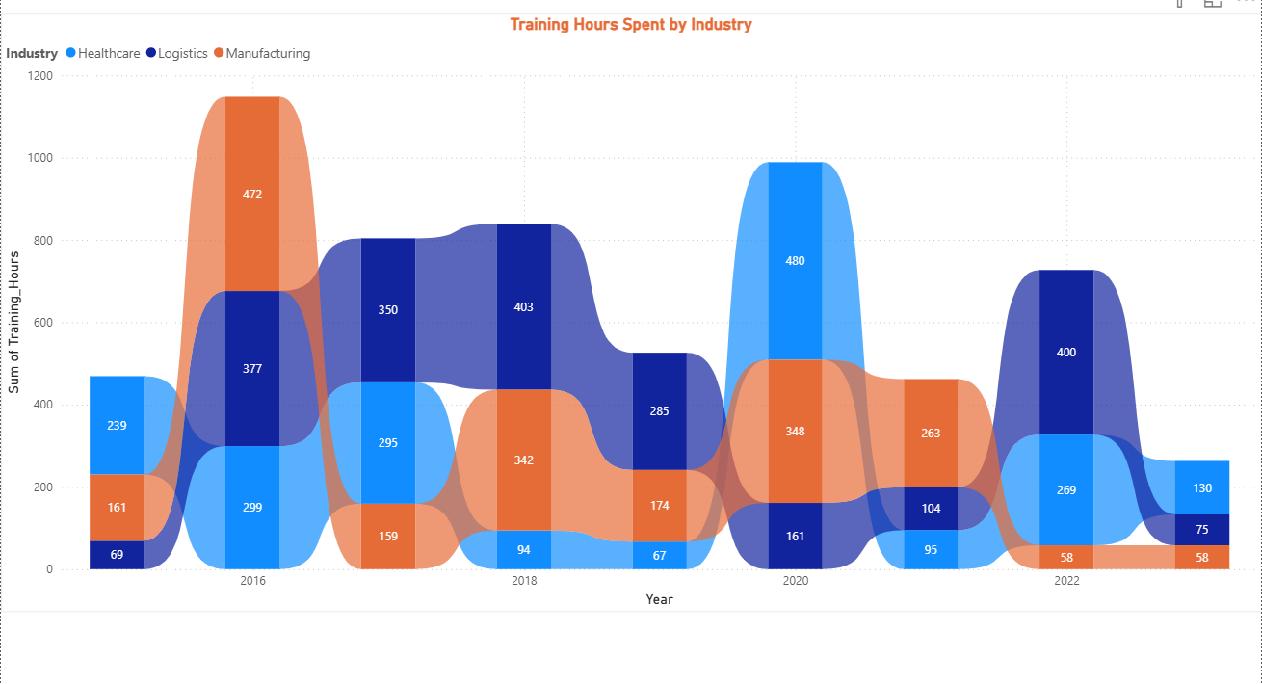
Training Hours by Industry
Training Peaks in 2016 and 2020
Training hours peaked during major robotics adoption phases in 2016 and 2020 across industries.
Healthcare's Training Investment
Healthcare recorded 480 training hours in 2020, showing a strong commitment to workforce adaptation.
Benefits of Prioritized Training
Industries prioritizing training experience smoother automation integration and workforce transition.
Continuous Learning Importance
Ongoing learning and development are vital for success in the evolving robotics age.
Notes:
Training efforts peaked in 2016 and 2020, aligning with major phases of robotics adoption. Healthcare invested heavily in training during 2020, with 480 hours recorded. This indicates a proactive approach to workforce adaptation, ensuring employees are equipped to work alongside new technologies. Industries that prioritize training tend to experience smoother transitions and better integration of automation. This metric underscores the importance of continuous learning and development in the age of robotics.

Slide 6
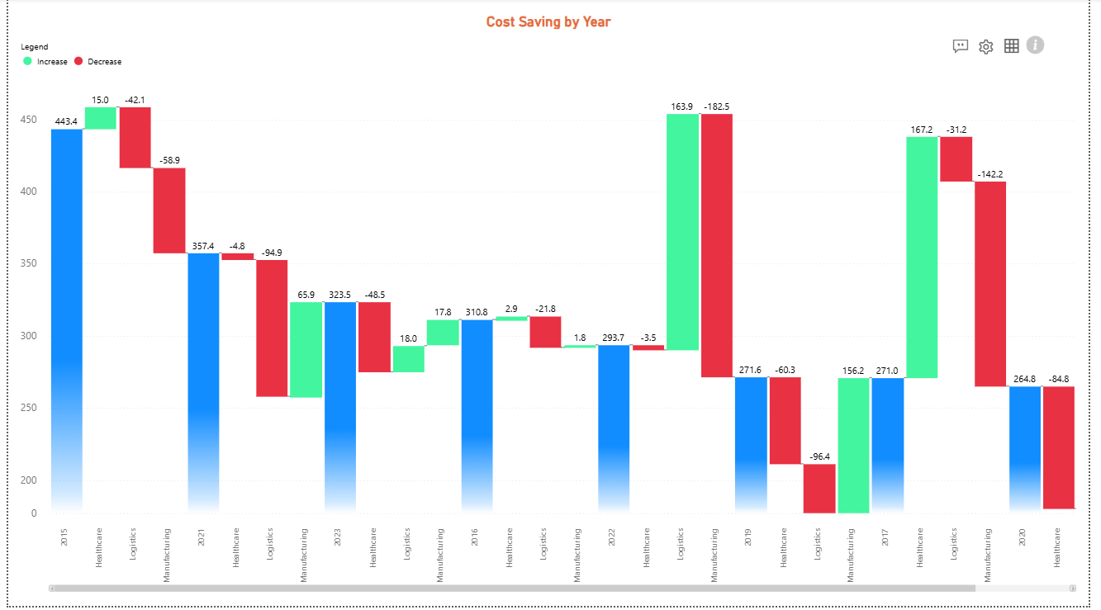
Cost Savings by Year
Spikes in Cost Savings
Notable cost savings spikes in 2019 and 2022 show successful robotics implementation impact.
Negative Savings Years
Some years showed negative savings due to high upfront automation costs and investments.
Long-term Automation Benefits
Despite early financial challenges, automation delivers substantial long-term cost reductions.
Strategic Planning Importance
Phased adoption and strategic budgeting are vital to maximize ROI and sustainable growth.
Notes:
Cost savings showed major spikes in 2019 and 2022, reflecting successful implementation of robotics. However, some years experienced negative savings due to high upfront costs. This pattern highlights the long-term benefits of automation, despite initial financial challenges. Industries must evaluate ROI over extended periods and consider phased adoption to mitigate short-term losses. Strategic planning and budgeting are essential to maximize cost efficiency and ensure sustainable growth.

Slide 7

Industry Variations in Cost Savings & Productivity Trends
Notes:
Manufacturing achieved high cost savings early in the timeline, while healthcare showed significant improvement in 2023. Productivity and cost efficiency vary by industry and year, indicating different adoption strategies and operational contexts. The scatter chart reveals how industries evolve over time, with bubble sizes representing the scale of robot deployment. This visualization helps stakeholders understand the relationship between productivity gains and financial outcomes, guiding future automation decisions.

Slide 8
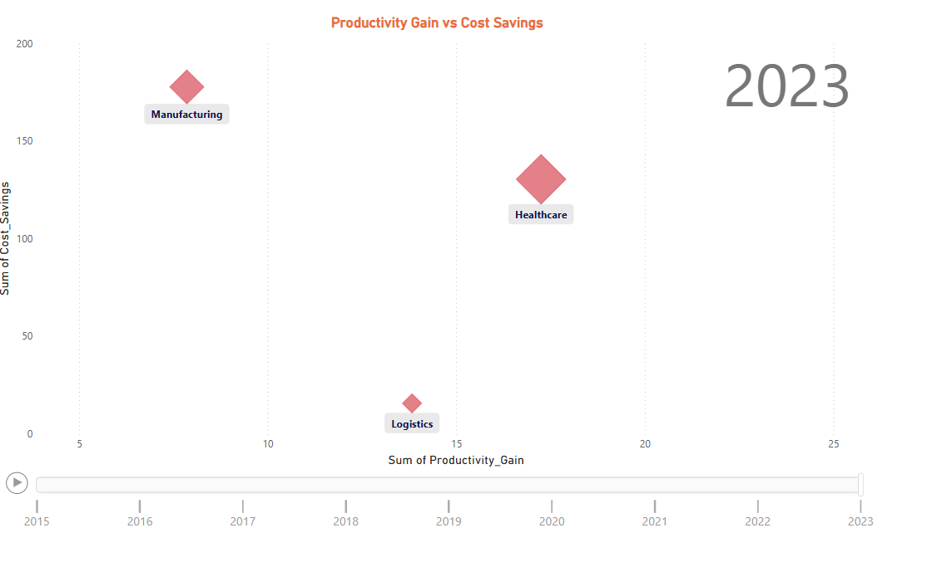
Industry Variations in Cost Savings & Productivity Trends
Key Insights from the Animation:
Manufacturing demonstrated high-cost savings in the early years of automation adoption.
Healthcare experienced significant improvements in cost savings recently, particularly in 2023, reflecting later but rapid gains from automation investment.
Productivity and cost efficiency do not rise equally across sectors or over time.
Each industry's pace of robotics adoption and operational model leads to year-by-year variation in outcomes.
Bubble size represents Jobs Displaced:
Larger bubbles indicate intense automation efforts, which correlate with:
Higher robot deployment
Greater operational changes
More workforce impact
Tracking trends year-by-year supports informed decisions about:
Where to invest in automation
Where to focus mitigation or retraining strategies
Industry automation impacts are dynamic:
Manufacturing benefited early.
Healthcare’s gains surged in 2023.
Visualizing deployment, cost, and productivity helps guide better strategic decisions for the future.

Slide 9

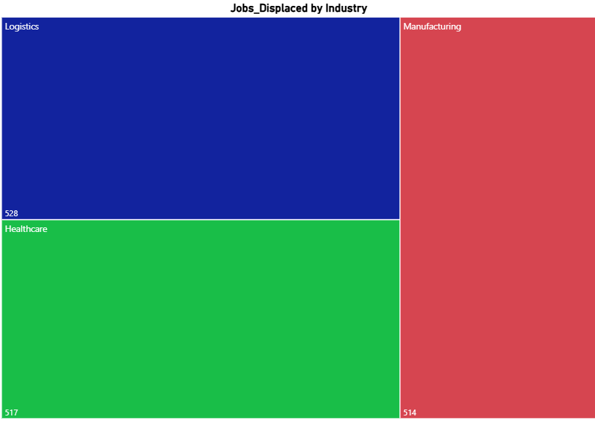
Jobs Displaced by Industry
Job Displacement Statistics
Logistics saw the highest job displacement with 528 roles, followed by healthcare and manufacturing sectors.
Impact of Automation
Automation improves efficiency but causes workforce disruptions requiring thoughtful planning and support.
Need for Reskilling
Reskilling and support programs are essential to help workers transition in evolving industries.
Human-Centric Strategies
Adopting human-centric approaches ensures technology benefits employees and maintains well-being.
Notes:
Logistics experienced the highest job displacement with 528 roles affected, followed by healthcare (517) and manufacturing (514). This data underscores the workforce impact of automation and the need for balanced planning. While robotics enhances efficiency, it also necessitates reskilling and support programs for displaced workers. Industries must adopt human-centric strategies to ensure that technological progress does not come at the expense of employee well-being.

Slide 10
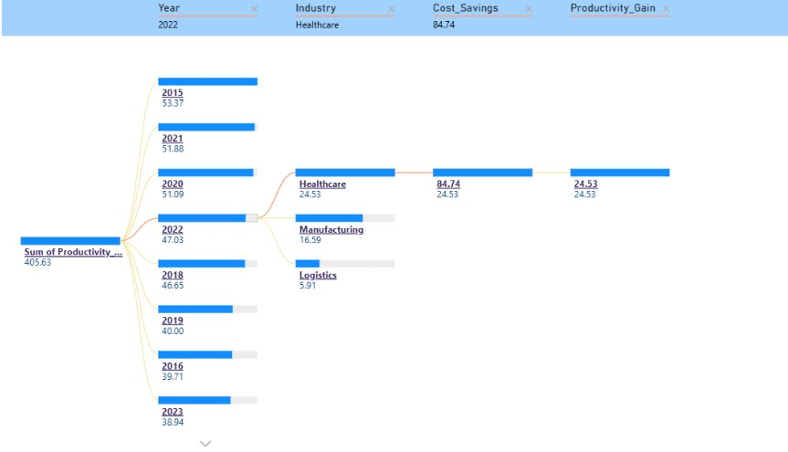
Decomposition Tree Analysis

Slide 11

Decomposition Tree Analysis
Healthcare Impact on Metrics
Healthcare generated major cost savings and productivity gains in 2022, underscoring its influence on overall performance.
Decomposition Tree Utility
Decomposition tree analysis breaks down complex metrics to reveal root causes and key contributors across dimensions.
Strategic Automation Insights
Insights from decomposition emphasize healthcare's strategic role in automation and planning for future gains.
Dimensional Metric Breakdown
Breaking down metrics by industry, year, and other dimensions helps identify successes and improvement opportunities.
Notes:
In 2022, healthcare contributed significantly to cost savings (84.74) and productivity gain (24.53). The decomposition tree helps identify root causes and key contributors to performance metrics. This analysis reveals that healthcare is a primary driver of recent improvements, emphasizing its strategic importance in automation planning. By breaking down metrics by industry, year, and other dimensions, stakeholders can pinpoint areas of success and opportunities for improvement.

Slide 12

Pros & Cons
Productivity Gains and Cost Savings
Robotics adoption leads to significant productivity improvements and long-term cost savings through efficient automation.
Workforce Training and Mitigation
Effective training investments help mitigate workforce disruption and ease transitions during robotics adoption.
Job Displacement and Costs
Initial high adoption costs and job displacement challenges impact short-term savings and workforce stability.
Uneven Adoption Challenges
Varying adoption rates across industries create inequality that requires strategic and human-centric policies.
Notes:
Pros of robotics adoption include significant productivity gains, positive cost savings trends, and effective training investments that mitigate workforce disruption. However, cons include job displacement across all industries, high initial adoption costs that reduce short-term savings, and uneven adoption rates. These insights highlight the dual nature of automation—while it drives efficiency, it also presents challenges that must be addressed through strategic planning and human-centric policies.

Slide 13
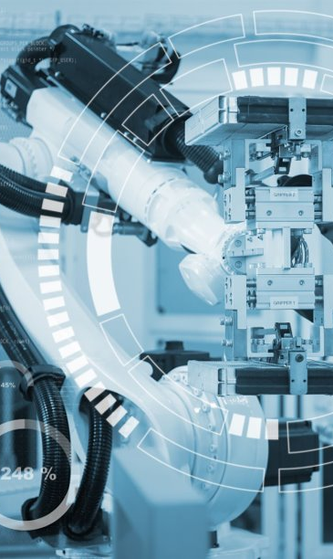
Recommendations & Action Plan
Increase Training Programs
Enhancing employee training reduces job displacement and prepares the workforce for robotics integration.
Focus on Manufacturing
Target manufacturing sectors for higher robotics adoption and improved cost efficiency in operations.
Monitor Return on Investment
Tracking ROI helps validate long-term benefits and informs strategic automation decisions.
Adopt Phased Automation
Implementing automation in phases balances technological progress with workforce stability.
Notes:
To ensure sustainable robotics adoption, industries should increase training programs to reduce job displacement, focus on manufacturing for higher adoption and cost efficiency, monitor ROI to validate long-term benefits, and adopt phased automation strategies. These recommendations aim to balance technological advancement with workforce stability, ensuring that automation enhances productivity without compromising employee well-being. Strategic investment in human capital and continuous evaluation are key to successful implementation.

