Slide 1
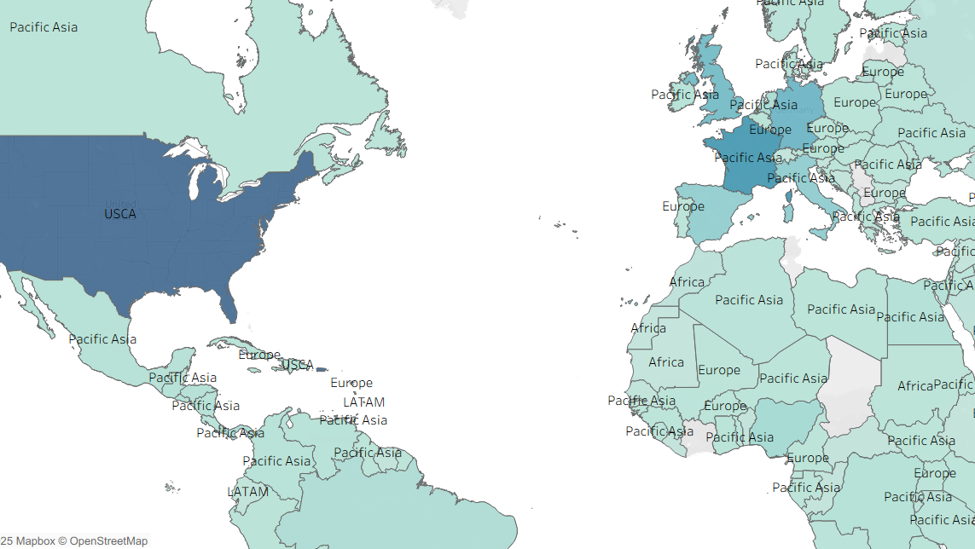
Logistics_Supply_Chain_Analysis
~ Shubham Bollu

Slide 2
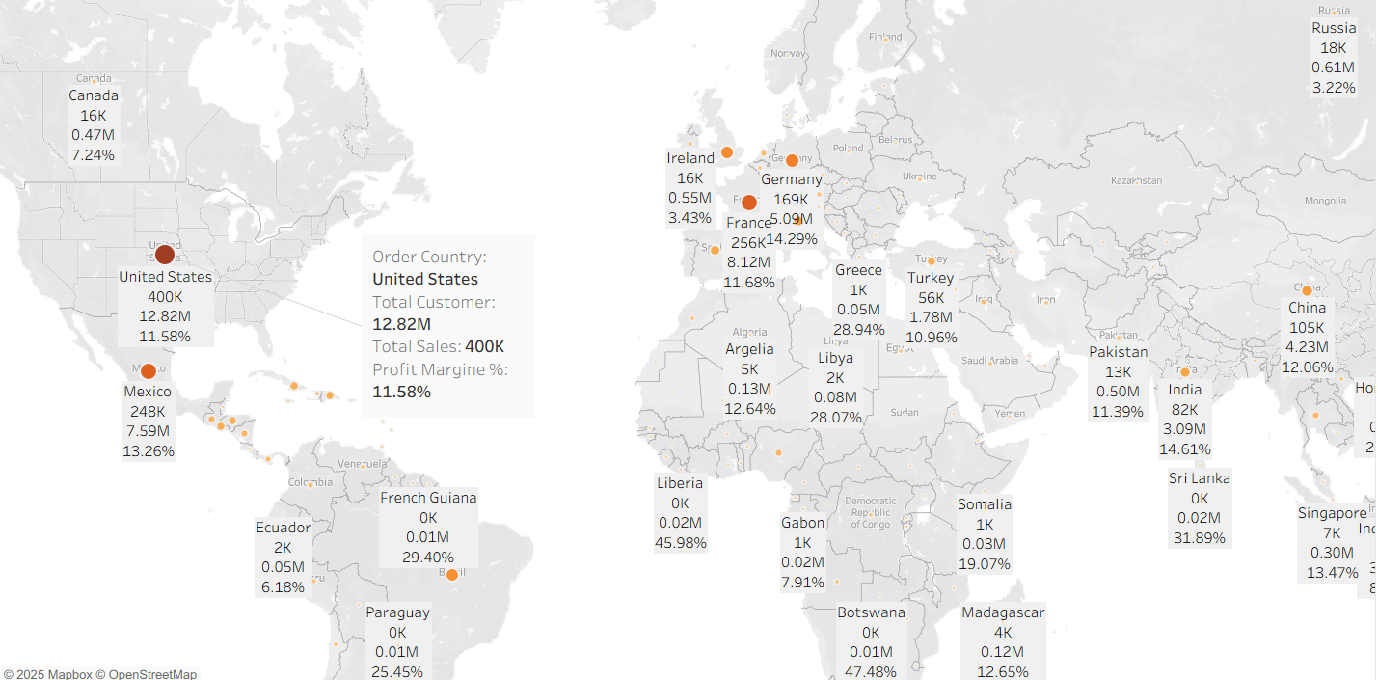
Total Analysis by Country
Key Points:
Highest sales and customer activity in the United States (€12.82M sales, 400K orders), France (€5.09M sales, 256K orders), Germany (€3.43M sales, 169K orders), and Mexico (€7.59M sales, 248K orders).
Other countries (UK, Brazil, China, India, Italy) have substantial sales but lower figures than the top performers.
Margins vary e.g., US profit margin at 11.58%, France at 14.29%, Germany at 8.12%.
Summary:
This cross-country dashboard maps sales, orders, and margin distribution. It identifies the US and France as top markets, meaning strategic focus here could yield continued growth. Margins and customer count highlight profit centers and operational strengths.

Slide 3
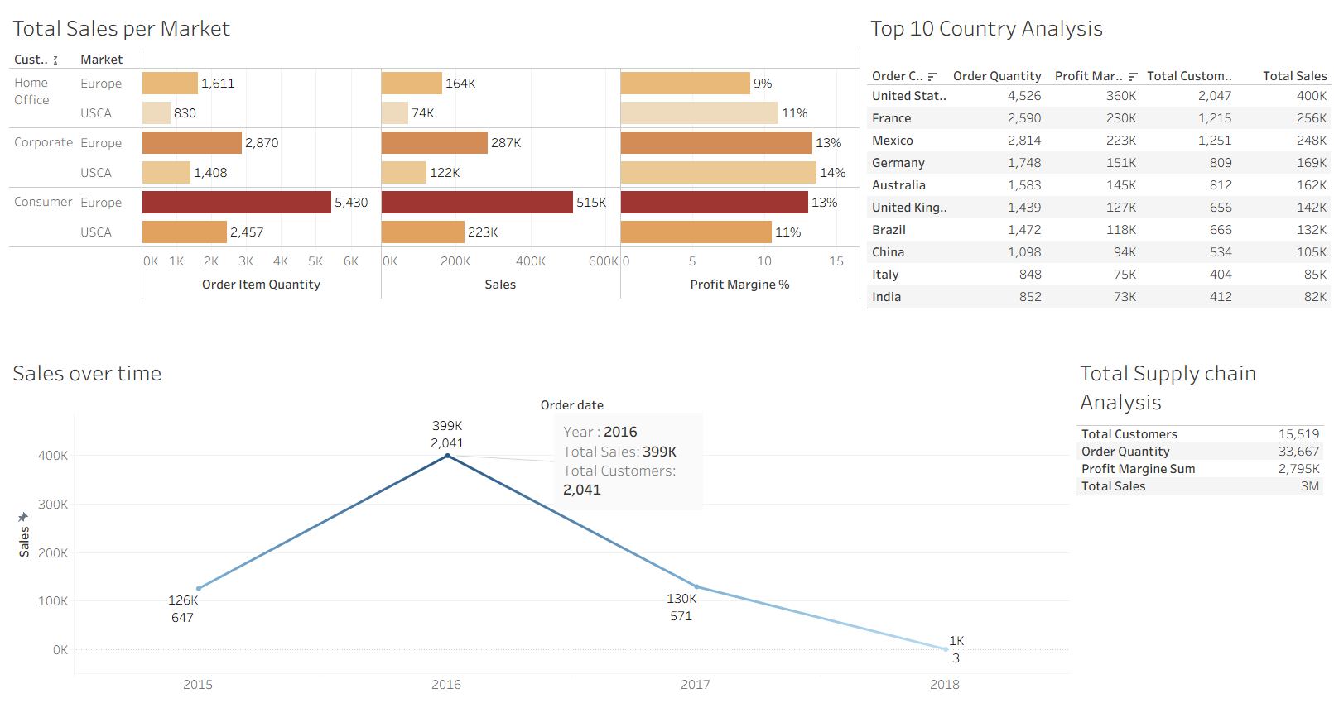
Global Sales & Profit Overview
Key Points:
Overall global sales: 3M, with a profit margin sum of €2.795M.
Sales per market: USCA (1,611), Europe (830), Office/corporate: 2,870/1,408.
Sales per year: 399K sales and 2,041 customers in 2016; a fluctuating trend shown over several years.
Summary: This overview connects yearly and market segment sales, showing where performance spikes and where growth stagnates. Variation by sector and year helps illuminate future targeting for resource allocation.

Slide 4
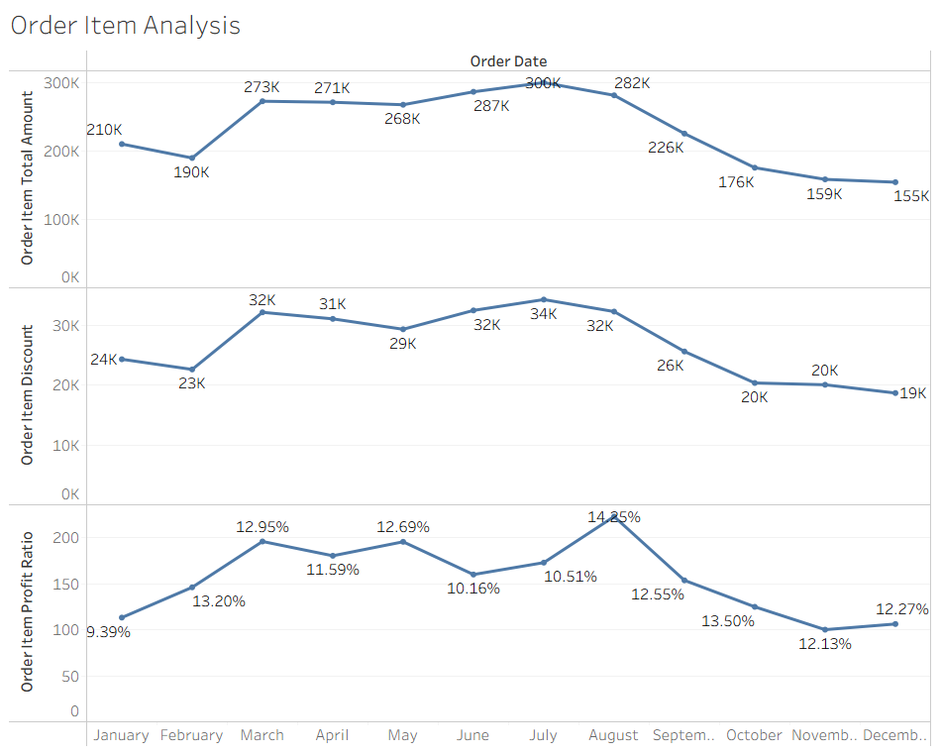
Order Item Analysis
Key Points:
Total customers: 15,519; Order quantity: 33,667.
Discount rates and average profits per order are visualized, helping track customer activity and profitability.
Order item totals range widely, illuminating what products or groups are driving volume.
Summary: By reviewing order volume, discounts, and profits, this slide lays out the link between sales incentives and business results. Watching these trends helps optimize pricing and promotional strategies.

Slide 5
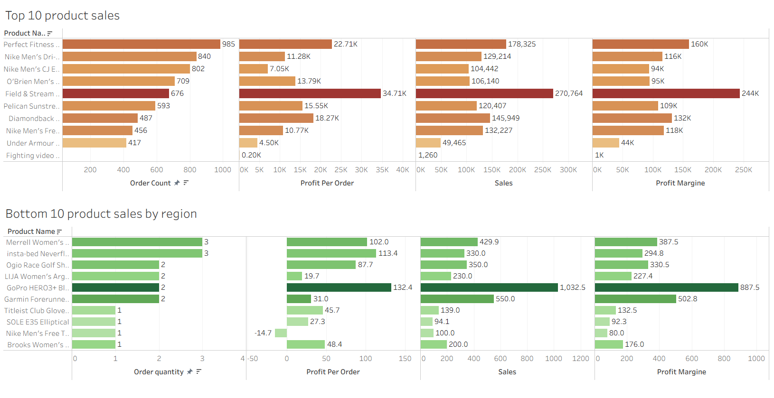
Top & Bottom Product Analysis
Key Points:
Top selling products include Perfect Fitness, Nike Mens Dri-FIT, OBrien Men's Field Stream, Pelican Sun stream, etc.
Highest order count: Perfect Fitness (985), Nike Mens Dri-FIT (840), OBrien Mens Field Stream (802), with others close behind.
Bottom products (by region): e.g., Merrell Womens (3), Ogio Race Golf (2), LIJA Womens Arg (2), GoPro HERO3 (2).
Summary: This analysis distinguishes best performers from lagging products. Investing in popular items reinforces sales, while underperformers may need review—either for relaunch, improvement, or discontinuation.

Slide 6
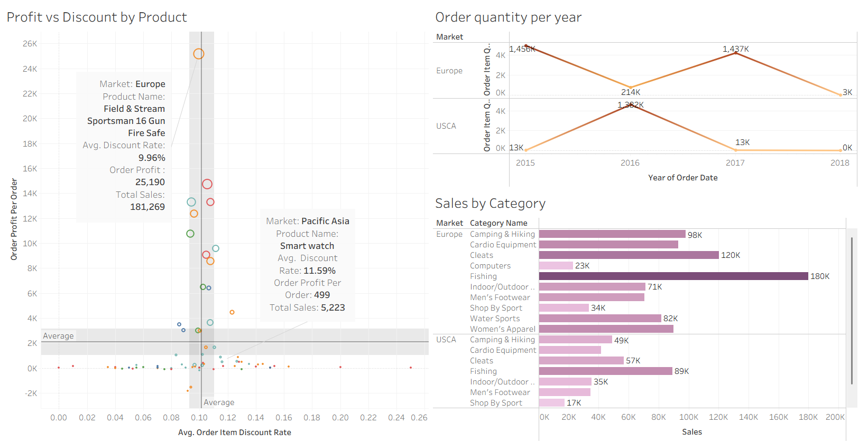
Product Analysis
Key Points:
Profit vs discount by product: data plots show how discount rates impact profit per product.
Top product (Field Stream Sportsman 16 Gun Safe): order profit 18K, avg. discount rate 9.96%.
Market and order quantity variation by year and product category.
Summary: Showing how discounting and category diversity affect profit, this slide encourages dynamic strategies for price management. Monitoring these metrics keeps product portfolios profitable and competitive.

Slide 7
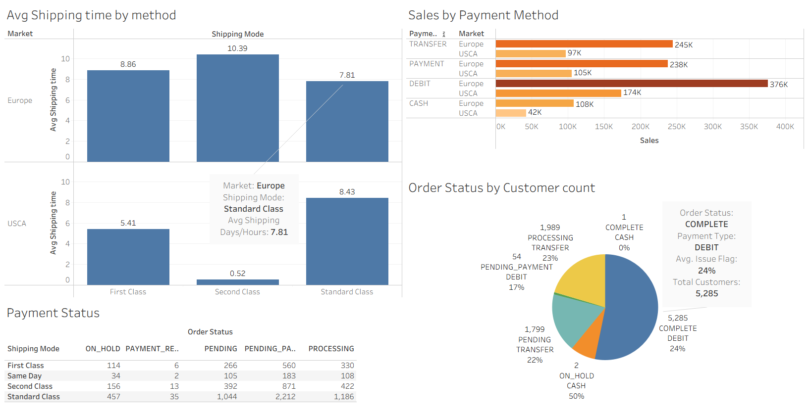
Shipping Analysis and Payment Efficiency
Key Points:
Average shipping times: Standard class (8.43 days for Europe, 10.39 USCA), first/second class faster.
Payment methods: TRANSFER, DEBIT, CASH—Europe leans on DEBIT (376K), USCA varies (174K DEBIT, 42K CASH).
Order status breakdown (COMPLETE, PROCESSING, ON HOLD, etc).
Summary: Shipping speed and payment choice directly impact customer satisfaction and business flow. Reducing shipping days and offering flexible payment options are opportunities for operational improvement.

Slide 8
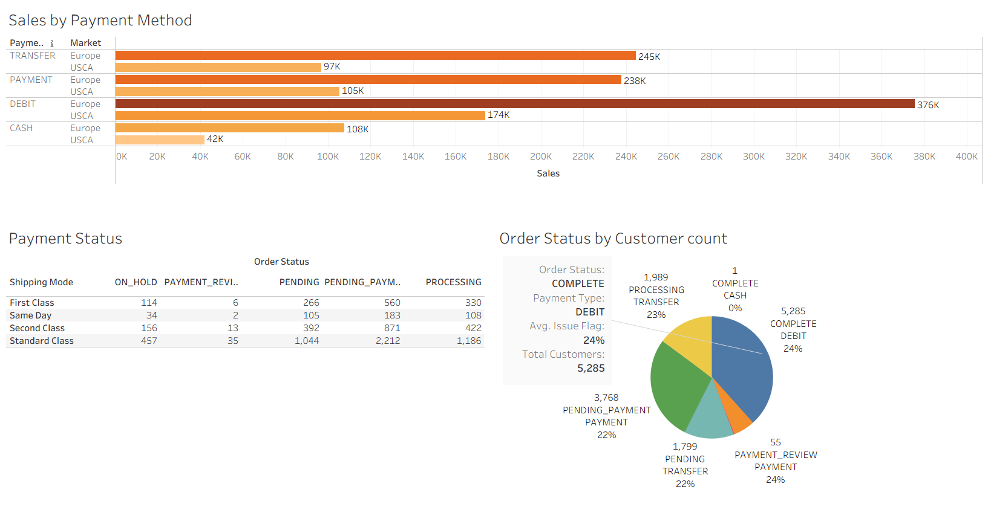
Payment Method Status Analysis
Key Points:
Sales breakdown by payment method: TRANSFER, PAYMENT, DEBIT, CASH—each showing different popularity by region.
DEBIT most popular in Europe (376K), moderate in USCA (174K).
Customer status grouped by order type and processing step; flagged issues are quantified (e.g. 24 average issues flagged).
Summary: This dashboard provides a snapshot of payment method efficiency, lighting up trends in customer choice and potential issues in the transaction process. Optimizing these methods can lead to smoother operations and happier customers.

Slide 9
Conclusion:
The supply chain is strongest in the US and France, where sales, margins, and customer engagement are highest. Key product lines deliver most of the value so focus should remain on optimizing successful products and re-evaluating underperformers. Improvements in shipping speed and adaption to regional payment preferences can further boost satisfaction. Regularly monitoring sales trends, discount strategies, and flagged workflow or payment issues will keep operations efficient and responsive. Strategic investment in primary markets and a data-driven approach to product, shipping, and payment management are essential for sustainable growth and a competitive edge.

