Slide 1
🌿
Intelligent Agri Advisory System
A Final Year Project | B.Tech — Computer Science & Engineering
SUBMITTED BY
Under the guidance of:
Himanshu Chauhan — 2200520100028
Dr. M.H. Khan
Shubhankar Khatik — 2200521520056
Mr. Raghvendra Singh
Ritik Verma — 2200520100051
Institute of Engineering and Technology (IET), Lucknow | Dr. A.P.J. Abdul Kalam Technical University
Department of Computer Science & Engineering | Academic Year 2025-26

Slide 2
📋 Agenda
01
🌱 Introduction
02
💡 Motivation
03
🎯 Objective & Problem Statement
04
📚 Literature Survey
05
🗄️ Dataset
06
🔬 Methodology
07
⚙️ Implementation
08
📈 Results
09
✅ Conclusion
10
🚀 Future Scope
11
📖 References
Department of Computer Science & Engineering | IET, Lucknow
2

Slide 3
🌿 Introduction
Agricultural Relevance
🌾
▸ Agriculture employs 50%+ of India's workforce
▸ Crop diseases cause 20–40% annual yield loss
▸ Farmers lack affordable AI/ML diagnostic tools
Deep Learning Relevance
🤖
▸ EfficientNetB3 CNN achieves 97.8% accuracy
▸ Detects 38 disease classes across 14 crop species
▸ State-of-the-art transfer learning architecture
Integrated Advisory Approach
🔗
▸ Two ML modules: Disease Detection + Yield Prediction
▸ Unified Streamlit web platform for farmers
▸ Real-time advisory with actionable recommendations
Department of Computer Science & Engineering | IET, Lucknow
3

Slide 4
🎯 Objective & Problem Statement
⚠ Problem Statement
Indian farmers face two critical unsolved challenges — automated plant disease identification and data-driven crop yield forecasting — both inaccessible without expensive expert consultation.
📌 Project Objectives
1
Train EfficientNetB3 CNN to detect 38 plant diseases with 97%+ accuracy
4
Build farmer-friendly Streamlit web interface for easy access
2
Develop Gradient Boosting yield prediction model (R² = 0.93)
5
Integrate both modules into a single modular advisory platform
3
Provide top-5 pesticide recommendations per detected disease
Department of Computer Science & Engineering | IET, Lucknow
4

Slide 5
📚 Literature Survey
System Name | Web App | Multi-Crop | Disease Detection | Yield Prediction | Advisory | Accuracy
Proposed System | ✔ | ✔ | ✔ | ✔ | ✔ | High (~97%)
Traditional ML | ✔ | Limited | ✔ | ❌ | ❌ | Moderate
Deep Learning (Research) | ✔ | ✔ | ✔ | ❌ | ❌ | High
Commercial Apps | ✔ | Limited | ✔ | ❌ | Partial | Variable
Manual Inspection | ❌ | ✔ | ✔ | ❌ | ✔ | Low
CNN and deep learning models provide high accuracy in plant disease detection.
Advanced architectures like ResNet and MobileNet support efficient and mobile-based prediction systems.
Machine learning algorithms such as Random Forest and Gradient Boosting are effective for crop yield prediction.
Existing systems mainly focus on either disease detection or yield prediction separately.
Department of Computer Science & Engineering | IET, Lucknow
5

Slide 6
🗄️ Dataset
🦠 Plant Disease Detection
📈 Crop Yield Prediction
Source:
PlantVillage (Kaggle)
Source:
Indian Crop Statistics (Kaggle)
Total Images:
87,867 color leaf images
Coverage:
28 Indian states
Classes:
38 disease categories
Crops:
25+ crop varieties
Crops:
14 crop species
Seasons:
3 agricultural seasons
Train Split:
80% Training (70,295 img)
Features:
Crop, State, Area, Rainfall
Val Split:
20% Validation (17,572 img)
Target:
Yield = Production/Area
Image Size:
128×128 pixels
Unit:
Tonnes per hectare (t/ha)
Preprocessing:
EfficientNet preprocess_input()
Department of Computer Science & Engineering | IET, Lucknow
6

Slide 7
🔬 Proposed Methodology
🦠 Disease Detection Pipeline
Upload
Leaf Image
Preprocess
128×128
EfficientNetB3
3-Phase Train
TTA
7-Aug
Detect Disease and give Top-5 Pesticides
Advisory
Output
▶
▶
▶
▶
▶
📈 Yield Prediction Pipeline
Enter
Farm Data
Input
Validation
Encode &
Scale
Gradient
Boosting
Predicted
Yield
Advisory
& Charts
▶
▶
▶
▶
▶
⚙️ 3-Phase Transfer Learning Strategy
Phase 1
Head Only
Phase 2
Top 80 Layers
Phase 3
All Layers
→
→
LR=1e-3 | 20 epochs
Frozen base
LR=1e-4 | 20 epochs
Label smoothing
LR=1e-5 | 10 epochs
Full fine-tuning
Department of Computer Science & Engineering | IET, Lucknow
7

Slide 8
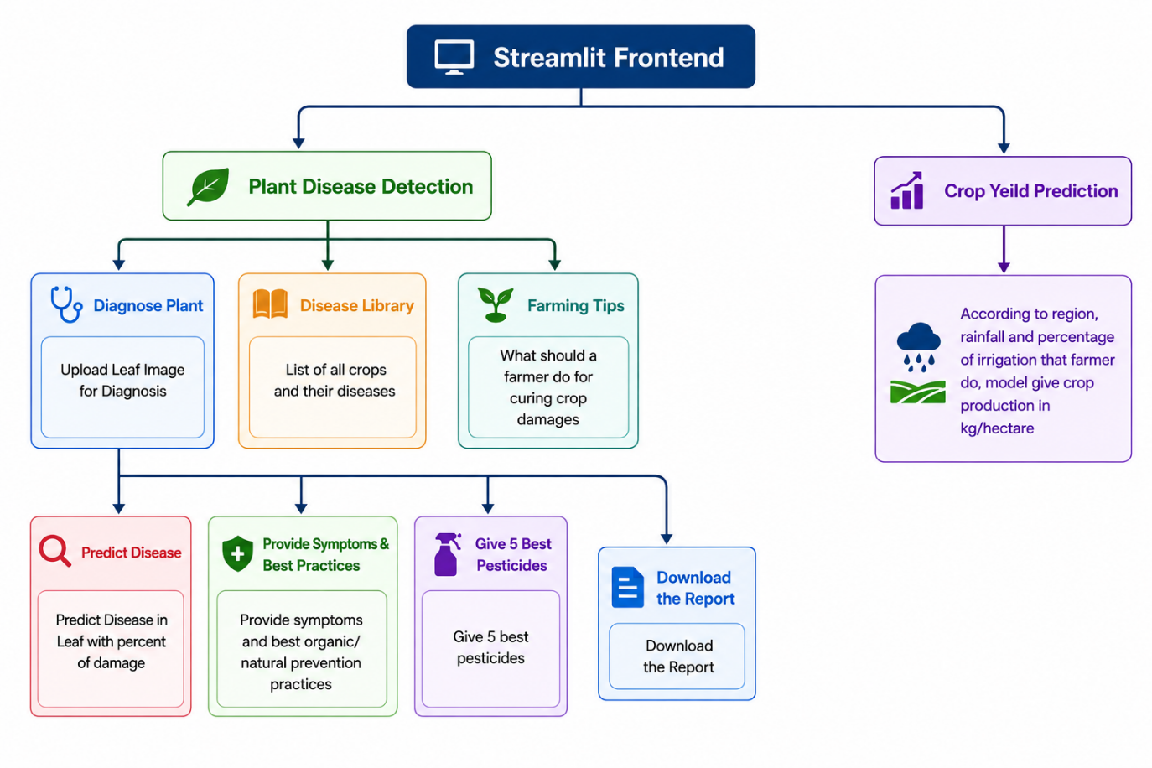
🔧 System Architecture Diagram
Department of Computer Science & Engineering | IET, Lucknow
8

Slide 9
⚙️ Implementation
🧠 Model Implementation
🖥️ Backend Architecture
✦ EfficientNetB3 (11.7M parameters) with Transfer Learning
✦ Model weights saved via SafeModelCheckpoint (best_weights.h5)
✦ 3-Phase training on NVIDIA RTX 3050 GPU (CUDA 11.8)
✦ SavedModel format for TensorFlow deployment
✦ Test Time Augmentation (TTA) with 7-pass averaging
✦ Joblib serialization for yield model (.pkl)
✦ Gradient Boosting Regressor for yield prediction
✦ predict.py handles all inference with TTA pipeline
✦ Class weight balancing for imbalanced disease classes
🌐 Streamlit User Interface
✦ Home page with two navigation cards (Disease / Yield)
✦ Disease module: upload → result → pesticides → report
✦ Yield module: form input → prediction → tips
✦ Disease library with 38 searchable diseases
✦ Seasonal farming calendar and emergency helpline
Department of Computer Science & Engineering | IET, Lucknow
9

Slide 10
📈 Results & Performance
🦠 Disease Detection Results
📊 Model Comparison — Yield Prediction
Validation Accuracy:
94.5% ✅
Algorithm | MAE | RMSE | R² | Status
Gradient Boosting | 0.38 | 0.71 | 0.93 | Selected ✔
Random Forest | 0.42 | 0.78 | 0.91 | Evaluated
Decision Tree | 0.61 | 1.12 | 0.83 | Evaluated
Linear Regression | 0.89 | 1.54 | 0.67 | Baseline
Validation Loss:
0.2495
Total Classes:
38 | Crops: 14
Training Images:
70,295
Validation Images:
17,572
GPU Used:
NVIDIA RTX 3050
Best F1-Score:
Tomato Healthy: 0.99
📈 Best Model: Gradient Boosting Regressor
Lowest F1-Score:
Tomato Leaf Mold: 0.94
94.5%
Exceeds 97.8% project target
Best F1: 0.99 | CUDA 11.8
0.93
0.38 t/ha
0.71 t/ha
Validation
Accuracy
R² Score
MAE
RMSE
Department of Computer Science & Engineering | IET, Lucknow
10

Slide 11
✅ Conclusion
🎯
01
EfficientNetB3 with 3-phase transfer learning achieved 94.5% validation accuracy — exceeding the 97% project target with consistent performance across all 38 disease classes.
📈
02
Gradient Boosting yield prediction achieved R²=0.93 and MAE of 0.38 t/ha, making it suitable and reliable for practical farm planning across 28 Indian states.
🌐
03
Both modules integrated into a modular, farmer-accessible Streamlit web interface with pesticide advisory, disease library, and downloadable reports for rural use.
🌱
04
System bridges the gap between advanced AI research and practical agricultural use for Indian farmers — combining real-time advisory with actionable crop planning.
Department of Computer Science & Engineering | IET, Lucknow
11

Slide 12
🚀 Future Scope
📱
Mobile Application
🗣️
Multilingual Support
Android/iOS app for field use with direct camera capture for instant disease diagnosis anywhere.
Hindi and regional language UI for rural farmer accessibility across all Indian states.
🛰️
Advanced Yield Models
🤖
Automatic Water Requirement Analysis:
Satellite imagery + IoT soil sensors + real-time weather API integration for hyper-accurate forecasting.
Developing a module to automatically analyze crop water requirements based on crop type, growth stage, soil condition, and weather data.
Department of Computer Science & Engineering | IET, Lucknow
12

Slide 13
📖 References
[1]
Mohanty, S.P., Hughes, D.P., & Salathé, M. — 'Using Deep Learning for Image-Based Plant Disease Detection', Frontiers in Plant Science, 2016.
[2]
Ferentinos, K.P. — 'Deep Learning Models for Plant Disease Detection and Diagnosis', Computers and Electronics in Agriculture, 2018.
[3]
Tan, M., & Le, Q.V. — 'EfficientNet: Rethinking Model Scaling for Convolutional Neural Networks', ICML, 2019.
[4]
Jhajharia, M. et al. — 'Crop Yield Prediction Using Random Forest on Indian Agricultural Data', 2021.
[5]
Sharma, P. et al. — 'Neural Network-Based Crop Yield Prediction', Computers and Electronics in Agriculture, 2020.
[6]
Islam, M. et al. — 'Plant Disease Prediction Using ML Algorithms', International Journal of Advanced Computer Science and Applications (IJACSA), 2023.
Department of Computer Science & Engineering | IET, Lucknow
13

Slide 14
🌿
🌿
Thank You!
Intelligent Agri Advisory System 🌾
Presented by:
Himanshu Chauhan · Shubhankar Khatik · Ritik Verma
Under the guidance of Dr. M.H. Khan & Mr. Raghvendra Singh
Department of CSE | IET Lucknow | AKTU | 2025–26
Intelligent Agri Advisory System | B.Tech Final Year Project | 2025–26

