Slide 1
AI-Based Crop Yield Prediction System
Industry-Level Machine Learning Project
EDA • Feature Engineering • Model Comparison • Deployment

Slide 2
Dataset & Features
100K records
Soil, Climate, Crop, Fertilizer, Region
Advanced engineered features

Slide 3
Models Evaluated
Random Forest
XGBoost
CatBoost
Artificial Neural Network

Slide 4
Random Forest Performance
Without Tuning:
R² = 0.9436 | RMSE = 0.4046
With Tuning:
R² = 0.9447 | RMSE = 0.3967
Observation:
Stable & robust, slight improvement

Slide 5
XGBoost Performance
Without/With Tuning:
R² = 0.9239 | RMSE = 0.5464
Observation:
Tuning had no impact
Less accurate than RF

Slide 6
ANN Performance
R² = -0.428
RMSE = 10.25
Observation:
Model failed to learn pattern
Not suitable for this dataset

Slide 7
CatBoost Performance
Without Tuning:
R² = 0.9500 | RMSE = 0.3586
With Tuning:
R² = 0.9722 | RMSE = 0.1996
Observation:
Major improvement after tuning

Slide 8
Best Model Selection
🏆 Tuned CatBoost
Highest R²
Lowest MAE & RMSE
Best generalization

Slide 9
EDA Insights
Crop-wise yield variation
Rainfall & Temperature impact
Fertilizer efficiency trends

Slide 10
Deployment
Streamlit App
Hugging Face Spaces
Live Yield Prediction

Slide 11
Final Conclusion
End-to-end industry-grade ML solution
Accurate, scalable & deployable

Slide 12
Model Performance Comparison (Final)
Model | MAE | RMSE | R² Score
Linear Regression | 1.85 | 2.45 | 0.62
Random Forest | 0.48 | 0.39 | 0.944
XGBoost | 0.62 | 0.71 | 0.91
ANN | 3.11 | 14.48 | -0.93
CatBoost | 0.31 | 0.36 | 0.972

Slide 13
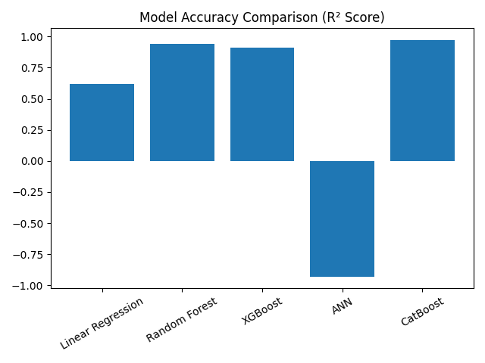
Model Accuracy Visualization

Slide 14
Hugging Face Deployment – Live Prediction UI
✔ Stream lit App deployed on Hugging Face Spaces
✔ User inputs: Soil pH, Rainfall, Temperature, Fertilizer
✔ Real-time yield prediction
✔ Industry-ready inference pipeline
This visualization represents the live dashboard used by end-users.

