Slide 1
Online Auction System using Spring Boot & React.js
A Full-Stack Web Application for Online Bidding
Presented by: Subrat girijaprasad setha

Slide 2
Introduction
Online auctions provide a platform for users to bid on products remotely. This project implements an online auction system using Java Spring Boot and React.js. It enables users to create auctions, place bids, and manage their accounts.

Slide 3
Problem Statement
Traditional auctions require physical presence, making them inaccessible to many users. Many online auction systems lack real-time features, leading to delayed bid updates. This project aims to build an efficient auction platform with modern web technologies.

Slide 4
Objectives
• Develop a web-based auction system using Java Spring Boot and React.js
• Implement secure user authentication for auction participation
• Enable users to create and manage auction listings
• Allow bidding on auction items
• Explore real-time bidding features for future improvements

Slide 5
Technology Stack
• Frontend: React.js
• Backend: Spring Boot (Java)
• Database: MySQL/PostgreSQL
• Authentication:JSON Web Token (JWT)
• Deployment: Heroku
• Future Scope: WebSockets for real-time updates

Slide 6
System Architecture
The system follows a client-server model where the React.js frontend interacts with the Spring Boot backend through RESTful APIs. The backend handles business logic and database operations, while the frontend presents auction data to users.

Slide 7
Implementation Details
•User Authentication: Secure login and registration using JWT tokens
• Auction Management: Users can create auctions with item details and base prices
• Bidding Process: Users can place bids, but real-time updates are not yet implemented
• Database Management: Stores user information, auctions, and bid history

Slide 8
Results & Discussion
The system successfully enables users to create auctions, place bids, and manage accounts. While real-time updates are yet to be implemented, the foundation for future improvements has been established. The UI is responsive and user-friendly.

Slide 9
Challenges Faced
• Implementing real-time bidding was complex due to WebSocket integration challenges
• Managing concurrent bids required careful database transaction handling
• Deploying the full-stack application required proper configuration for frontend-backend communication

Slide 10
Future Scope
• **Real-Time Bidding:** Implement WebSockets for instant bid updates
• **Email Notifications:** Notify users about bid status and auction results
• **Auction Reports:** Provide insights and analytics for users
• **Payment Integration:** Allow direct transactions for winning bids

Slide 11
Conclusion
The online auction system successfully integrates Spring Boot and React.js to provide a functional platform for online bidding. While the current system lacks real-time updates, it establishes a strong foundation for future enhancements.

Slide 12
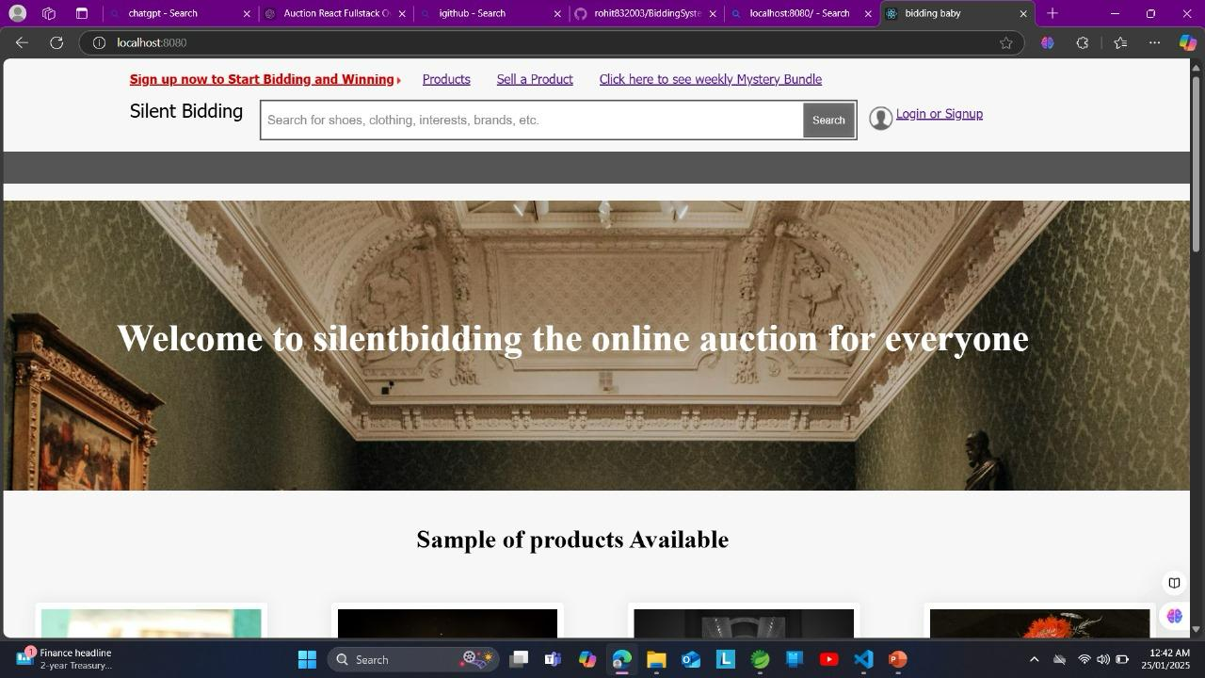

Slide 13
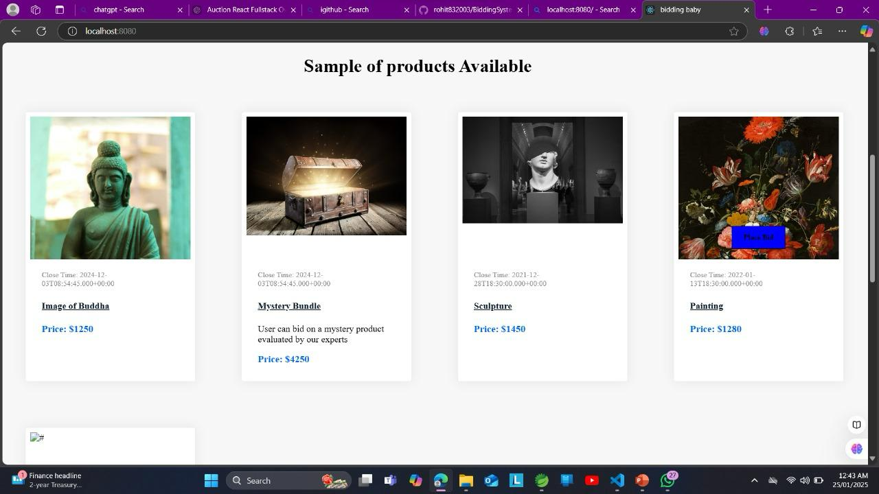

Slide 14
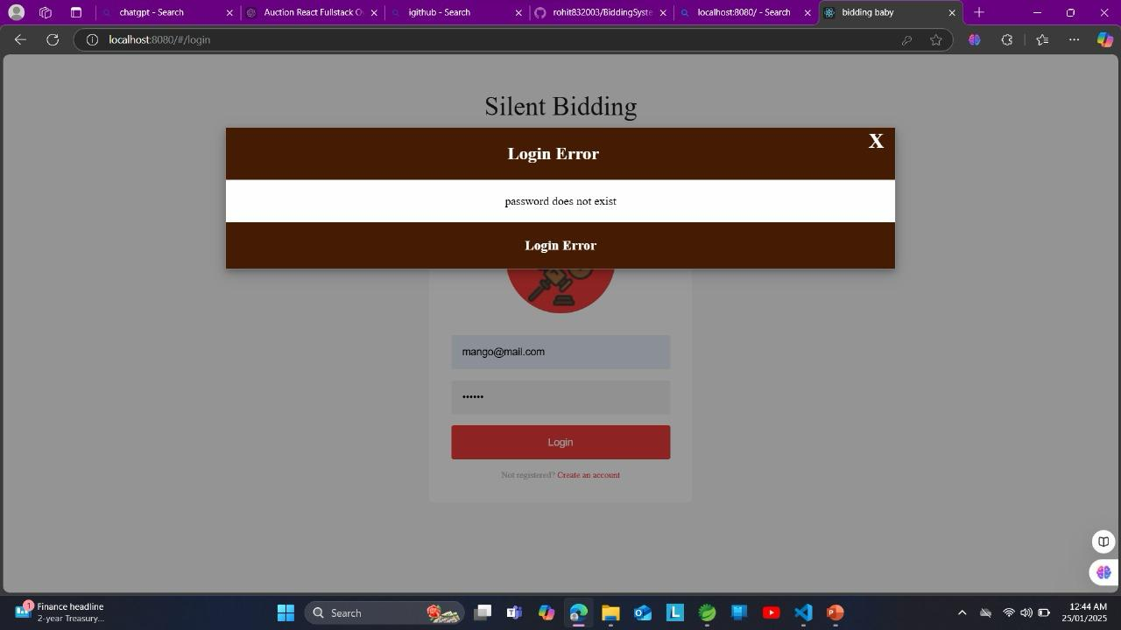

Slide 15
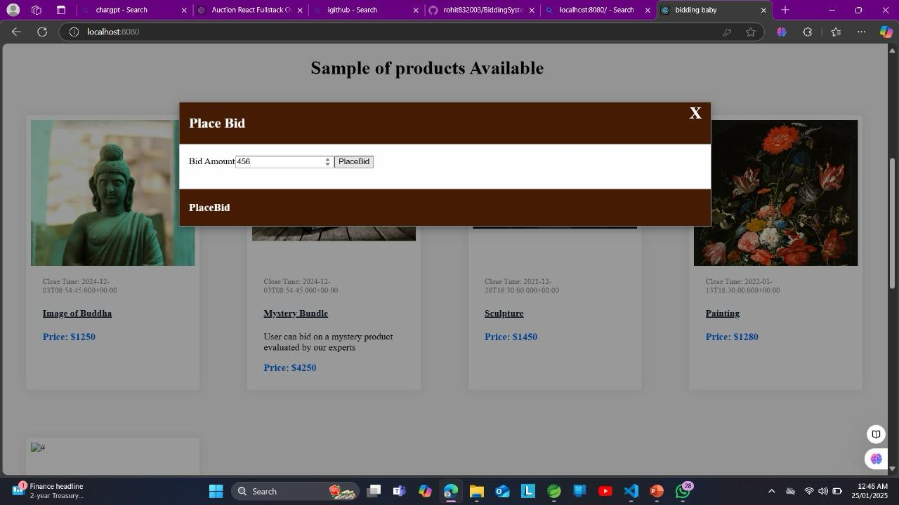

Slide 16
References
1. Spring Boot Official Documentation - https://spring.io/projects/spring-boot
2. React.js Official Guide - https://reactjs.org/docs/getting-started.html
3. WebSockets Overview - https://developer.mozilla.org/en-US/docs/Web/API/WebSockets_API
4. JSON Web Tokens (JWT) - https://jwt.io/introduction/

